Slide 1
Lesson 2 Starter: Subordinate clauses & conjunctions
Let’s answer the following questions as a class

Slide 2
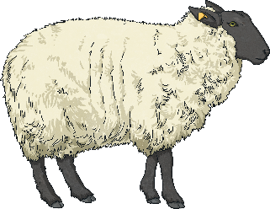
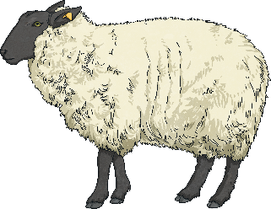
Lesson 2 Starter: Subordinate clauses & conjunctions
Let’s answer the following questions as a class
after
although
while
until
before
just as
when
which

Slide 3
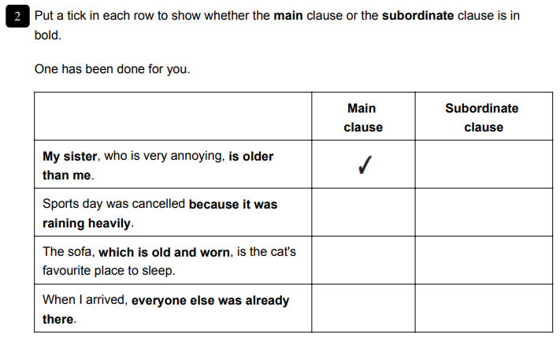
Lesson 2 Starter: Subordinate clauses & conjunctions
Let’s answer the following questions as a class
after
although
while
until
before
just as
when
which

Slide 4
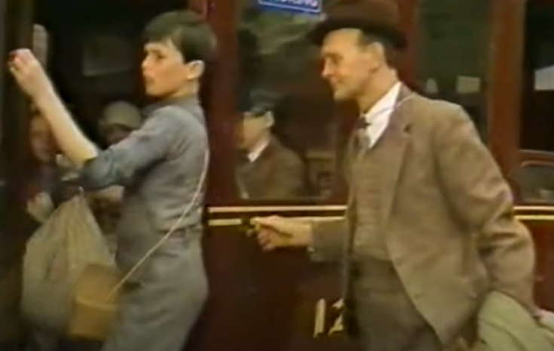
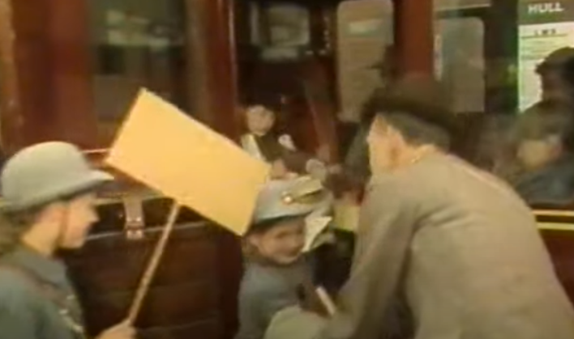
Lesson 2: Descriptive Writing
Where did you start your narrative yesterday?
Look at the images, where are they now? How do you know?
Let’s watch the next part of the short film. https://www.youtube.com/watch?v=rj5kiH5XZxw

Slide 5
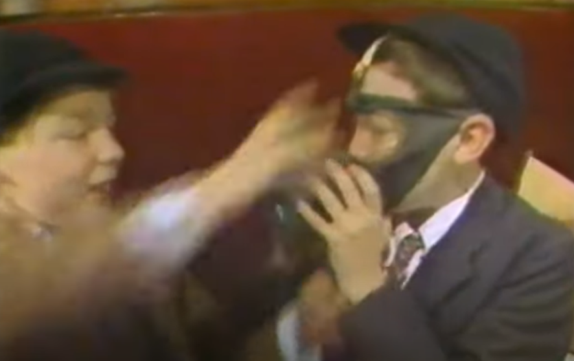
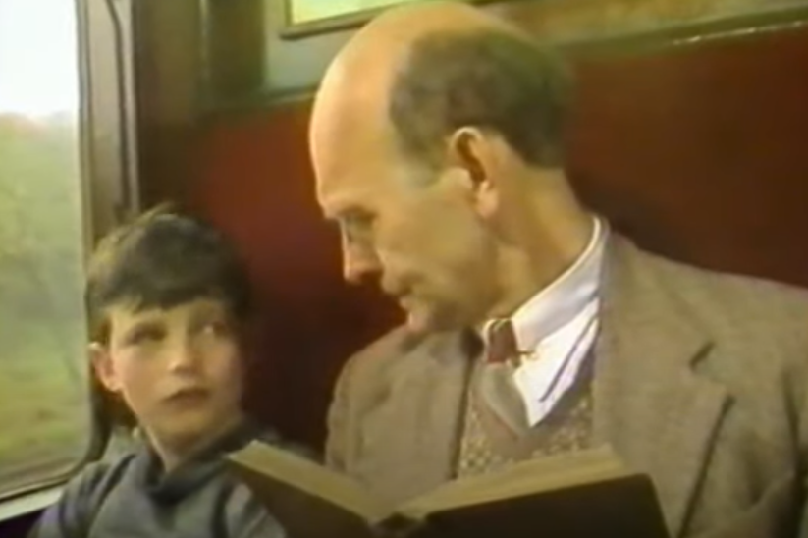
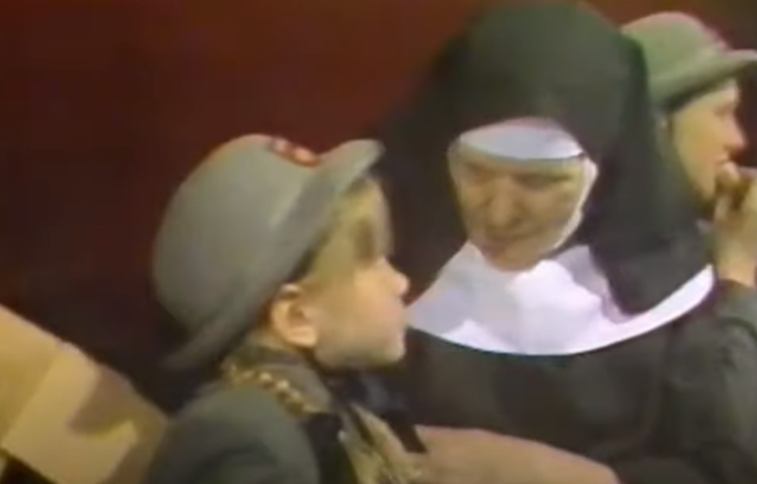
Lesson 2: Descriptive Writing
What were the people doing on the train?

Slide 6
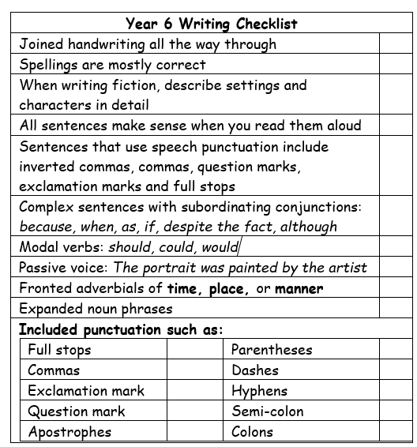
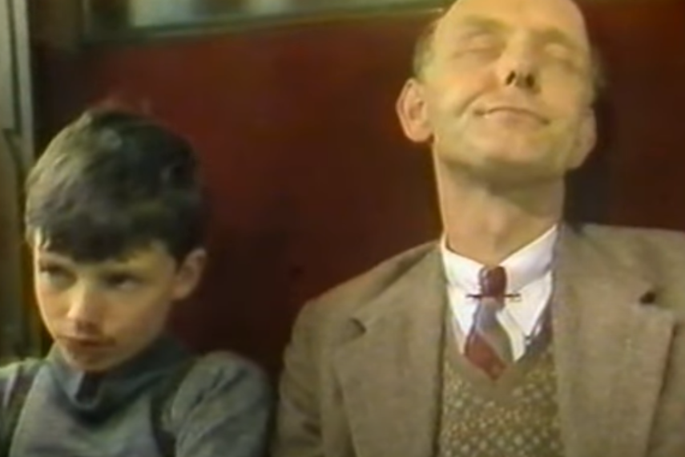
Lesson 2: Descriptive Writing
Activity: Today, you will continue writing your narrative piece on the journey of evacuee children during WW2.
Let’s create a wordbank for the scene on the train.

Slide 7
Modelled Example
Hurriedly entering the crowded train station, the group of anxious children followed their teacher to the platform. On the platform sat an enormous crimson train. It had windows running along its sides where unhappy faces peered out from within. The school children watched as their teacher stood by the door with a reassuring smile on his face. With a hand, he ushered the children on board. They hurried up onto the train and quickly found their seats until one boy turned around in a panic.
“What is it?” the teacher growled.
“I’ve lost my gasmask!” the young boy exclaimed as he turned again, searching his body for it. With a tired groan, the teacher lifted the gasmask from behind the boy who then stared in a mixture of amazement and embarrassment.
“It’s here.” the teacher stated, his voice bored and weary of the boy’s antics.

