Slide 1
Lesson 1 Starter: Subordinate clauses & conjunctions
What is a main clause?
What is a subordinate clause?
Which one is independent?
A subordinate clause supports the independent clause. The opening words of subordinate clauses show that they are dependent on the independent clause.
For example:
after the storm cleared
because he didn’t like chocolate
The independent clause makes sense on its own because it is a complete thought.
For example:
I went to town.
It was red.
Write down an example of each on your whiteboards

Slide 2
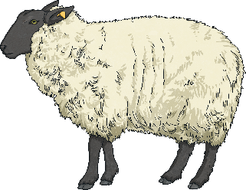
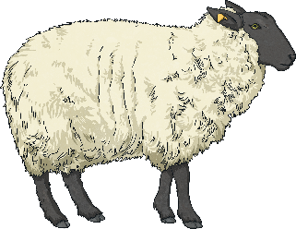
Lesson 1 Starter: Subordinate clauses & conjunctions
What are conjunctions?
Conjunctions are used to start subordinate clauses.
What conjunctions do you remember?
which
while
when
until
although
after
before
so that
just as

Slide 3
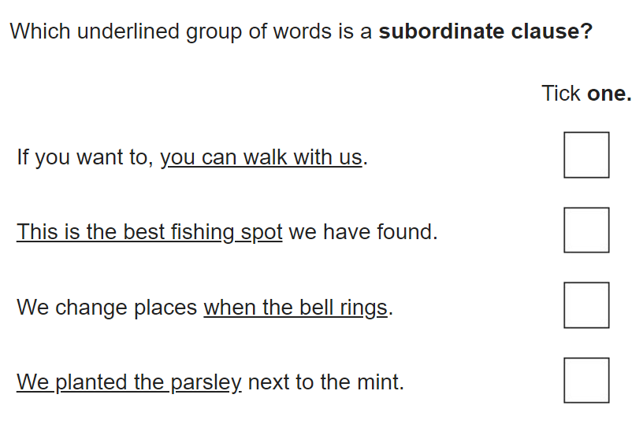
Lesson 1 Starter: Subordinate clauses & conjunctions
Let’s answer the following questions as a class

Slide 4
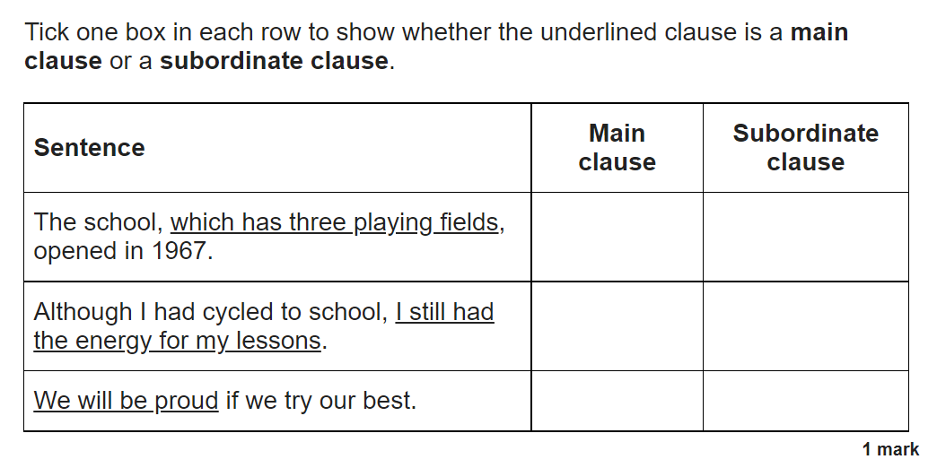
Lesson 1 Starter: Subordinate clauses & conjunctions
Let’s answer the following questions as a class

Slide 5
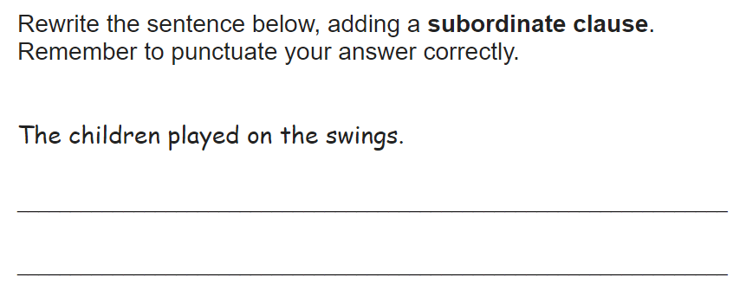
Lesson 1 Starter: Subordinate clauses & conjunctions
Let’s answer the following questions as a class

Slide 6
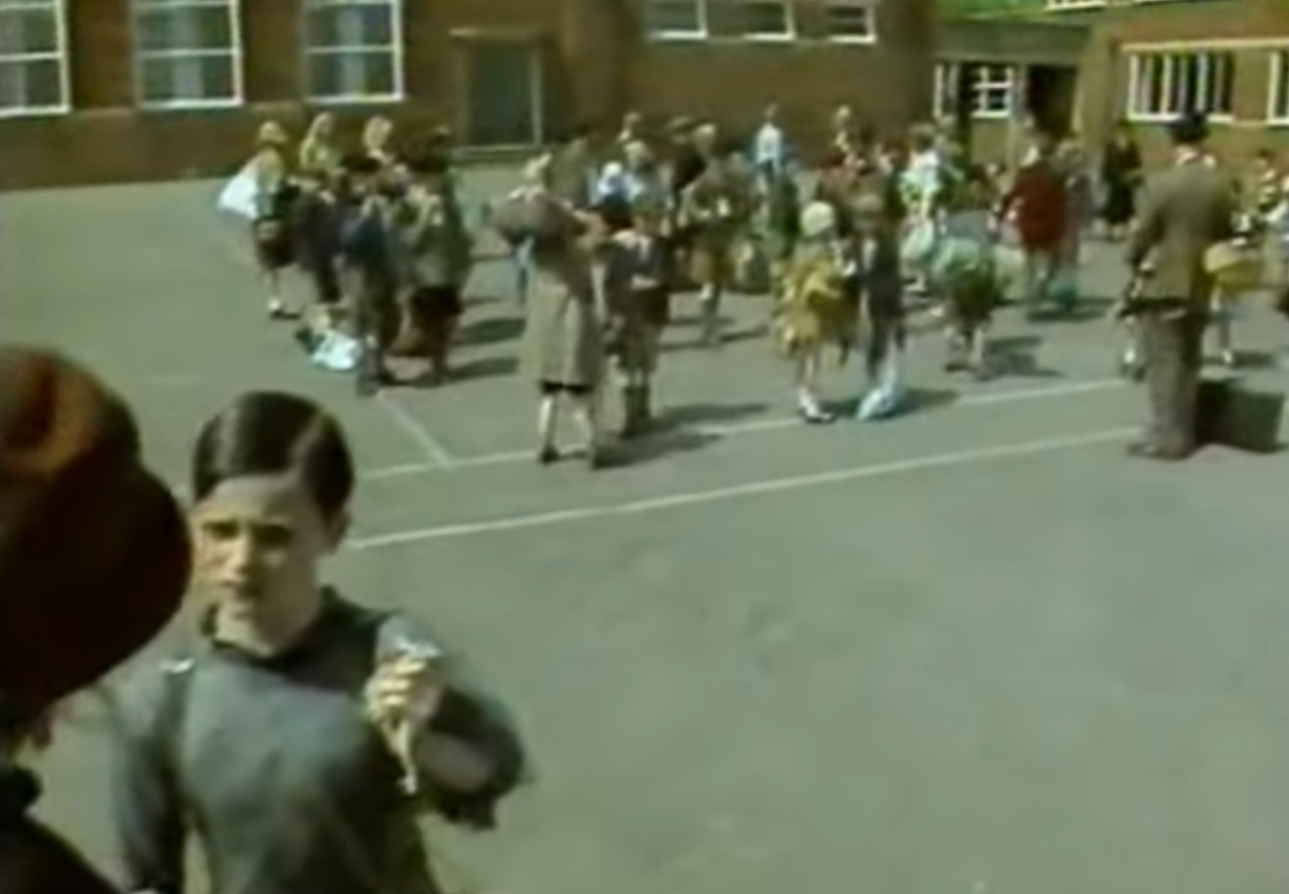
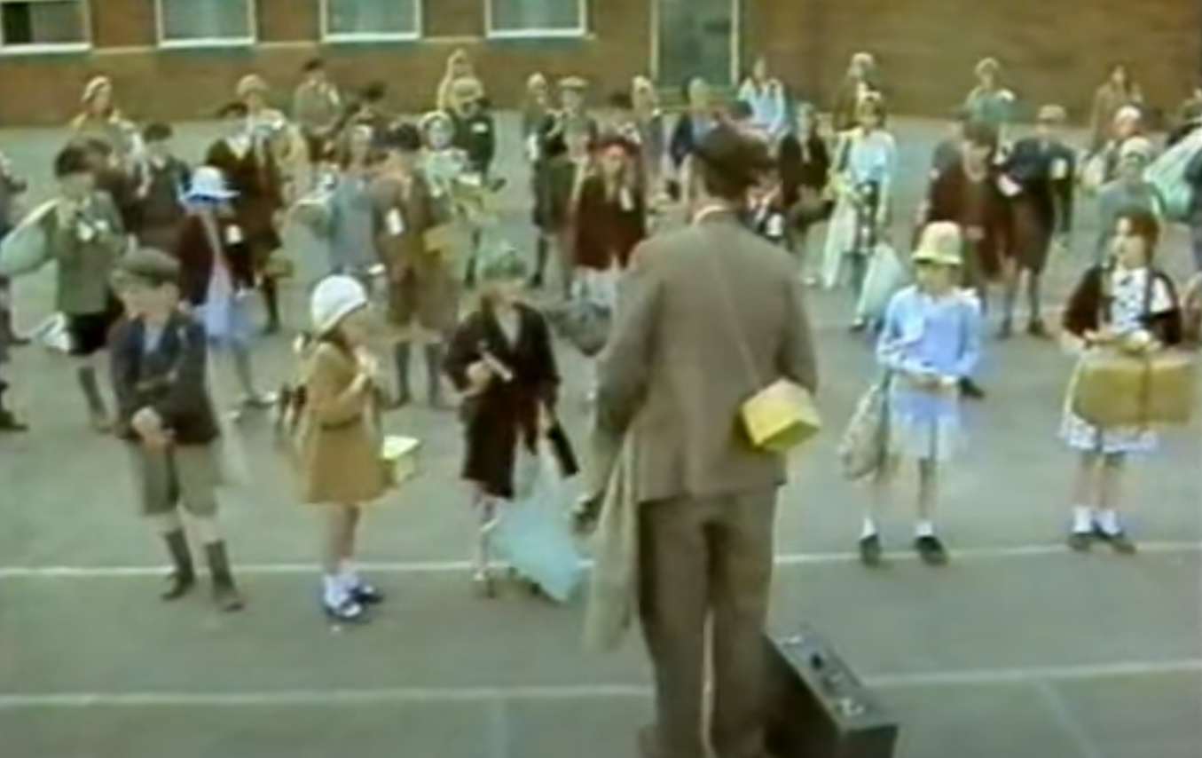
Lesson 1: Descriptive Writing
Look at the images.
What is happening?
Where are they?
Do you think this is set in modern day? Why?
How do you know?

Slide 7
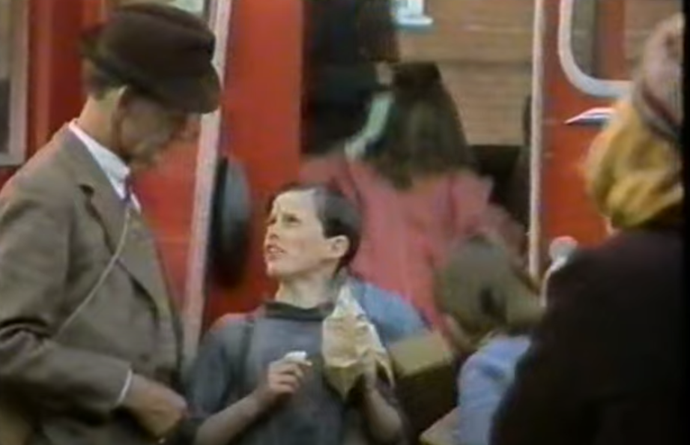
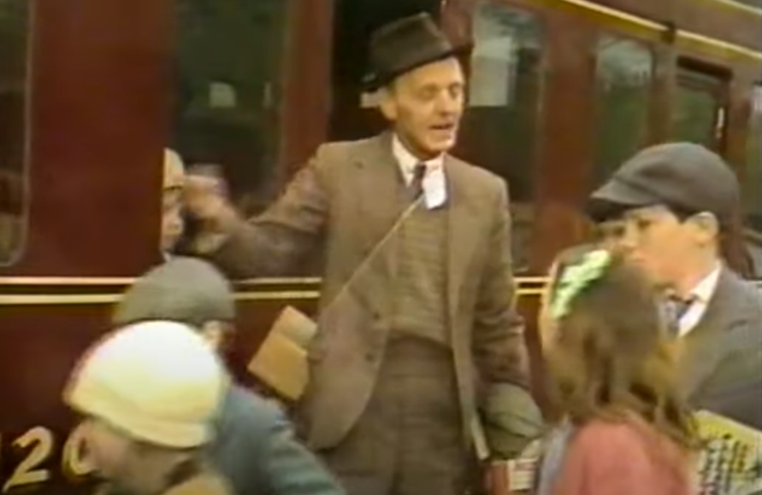
Lesson 1: Descriptive Writing
What’s happening now?
Where are they?
Who are the people?

Slide 8
Lesson 1: Descriptive Writing
The images are from a short film about the evacuation of children during WW2.
Is this a primary or secondary source?
How might the children be feeling?
Let’s watch part of the short film where the pictures have been taken from
https://www.youtube.com/watch?v=rj5kiH5XZxw
Remember:
Primary Source
This is a source directly from the time like a helmet.
Secondary Source
Something that is a copy of a primary source, like a replica, or a history book

Slide 9
Lesson 1: Descriptive Writing
What happened in the video?
What was the first location?
Let’s describe it as a class – remember to look at your own playground to generate more ideas.

Slide 10
Lesson 1: Descriptive Writing
Activity: Today you will be writing a short narrative to describe the children’s journey whilst being evacuated.
You will start your narrative in the school’s playground.
Remember there are children, teachers and the mothers who are dropping their children off at the school.
Think about what the setting looks like as well as the people.

Slide 11
Modelled Example
Hushed whispers and sorrowful goodbyes filled the chilly morning air within the school’s playground. Children from all around were gathered in neat rows; they anxiously clutched their small suitcases to their chests and watched as their mothers waved them goodbye. Tears were wiped away by dainty handkerchiefs and shaking hands as the mothers offered their beloved children a brave smile.
A young boy, his hair as dark as the night sky and as sleek as silk, trotted away from his mother and hurried over to the teacher who stood alone amongst the children. He was like a beacon, calling the children over and keeping them safe. He was a tall man, clad in a neat brown suit, and wore a faint smile. He placed his whistle between his thin lips and blew hard. The children quickly stood tall and whipped their heads round to watch in anticipation; they grew uneasy, unsure of what he was about to announce.
“Alright, children!” he called. “Now, pay attention.”

