Slide 1
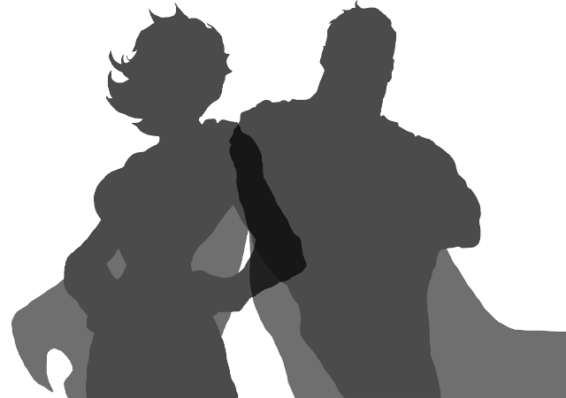
Lesson 2: Villains
Let’s share some of our superheroes with the class.
What do we find interesting about them?
What is their superpower? Why did you choose that?

Slide 2
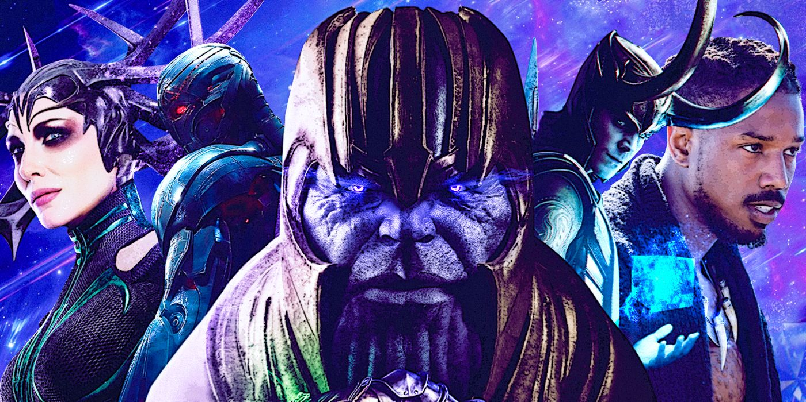
Lesson 2: Villains
What are villains that we know of?
What powers do they have?
What makes them good villains? Why?

Slide 3
Lesson 2 Activity:
Today you will be designing and creating your own villains who will fight your superhero you created yesterday.
Remember to think of an interesting name, super power and back story for them!

