Slide 2
Aim
to use relative clauses to add information to a noun.
Success Criteria
I know that a complex sentence has at least two clauses.
I use the relative pronouns who, which, where, when and whose to begin a subordinate clause.
I know that what is not a relative pronoun.
I know that the relative pronoun comes after the main noun.

Slide 3
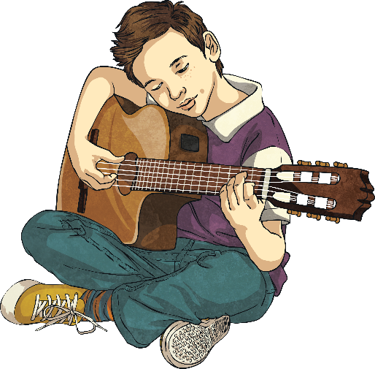
Let’s start with a simple sentence.
Matthew was playing the guitar.
Not very interesting, is it?
Why don’t we add some extra information?
Matthew was playing the guitar. He was in his bedroom.
Ok, but still rather simple. How could we improve this?

Slide 4
Let’s make it a complex sentence.
Matthew was playing the guitar. He was in his bedroom.
The second sentence adds a bit of non-vital information to the first one, so we can drop it in as a relative clause, like this…
Matthew, was playing the guitar.
who was in his bedroom,

Slide 5
We’ve dropped in a relative clause!
Matthew, who was in his bedroom, was playing the guitar.
main clause
subordinate clause
The main clause could be a sentence by itself and still make sense:
Matthew was playing the guitar.
However, the second sentence is now a subordinate clause, which doesn’t make any sense by itself: Who was in his bedroom.
The subordinate clause has to be stapled into the sentence with commas.

Slide 6
So it’s all relative, then?
We’ve replaced the pronoun in the second sentence with a relative pronoun. Can you spot it?
Matthew was playing the guitar. He was in his bedroom.
Matthew, who was in his bedroom, was playing the guitar.
Who is the relative pronoun we use to replace ‘people’ nouns/pronouns.

Slide 7
Other Relative Pronouns
Which is the relative pronoun we use to replace ‘objects’ nouns/pronouns.
Apples grow on trees. They are very healthy.
Apples, which are very healthy, grow on trees.

Slide 8
Other Relative Pronouns
Whose is the relative pronoun we use to replace possessive pronouns.
Victoria became Queen in 1837. Before Elizabeth II, her reign was the longest in British history.
My dog is called Frizz. His fur is very curly.
My dog, whose fur is very curly, is called Frizz.
Victoria, whose reign was the longest in British history before Elizabeth II, became Queen in 1837.

Slide 9
Other Relative Pronouns
Where is the relative pronoun we use to replace ‘place’ nouns/pronouns.
Mallorca is a Spanish island. We go there on holiday.
Mallorca, where we go on holiday, is a Spanish island.
The relative pronoun always goes straight after the main noun, so sometimes we have to re-order the clause slightly.

Slide 10
Other Relative Pronouns
When is the relative pronoun we use to replace ‘time’ noun phrases/pronouns.
In 2008, I was two years old. My brother was born in 2008.
In 2008, when my brother was born, I was two years old.
The relative pronoun 'that' is used for relative clauses where the added information is vital to the meaning of a sentence. When using 'that', we tend not to use commas around the relative clause. For example:
The old house that is next to our school is up for sale.

Slide 11
Instead of, not as well as…
Relative pronouns are used in relative clauses. Can you spot what’s wrong with these new sentences?
My mum is a doctor. Her name is Safira.
My mum, whose her name is Safira, is a doctor.
The writer has left the pronoun in the new subordinate clause, as well as adding a relative pronoun.

Slide 12
Where in a sentence?
Look at this sentence. Where is the relative clause now? How do you know?
The children all did well in the spelling test,
which made their teacher smile.
The children all did well in the spelling test,
which made their teacher smile.
Which is the relative pronoun so this time the relative clause is after the main clause. We still need a comma before the relative clause as this is also extra, non-essential (non-restrictive) information.

Slide 13
Punctuation
Relative clauses containing non-vital information have to be separated from the main clause. Typically, we use commas to mark the relative clauses, although dashes or brackets can also be used.
George was passed by a fire engine, which had its blue lights on.
Hospitals (where doctors and nurses work) are very busy places.
Grandma – whose eyes are sensitive – has to wear dark glasses.

Slide 14
Activity:
List the relative pronouns in your books.
Write 5 – 7 examples of sentences which have relative clauses in them.
When finished, write a short paragraph about your MAD Friday last week using relative clauses.

Slide 15
Plenary
What have we learned?
We can combine two simple sentences into a complex sentence using a relative pronoun.
Relative pronouns look like question words, but they’re actually replacing a noun.
One of the sentences becomes a subordinate clause which we place after the noun.

