Slide 1
Physical Geographical: Rivers
Lesson 10 : What Living Things might we find in British rivers?

Slide 2
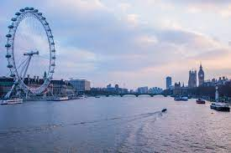
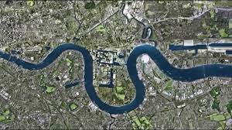
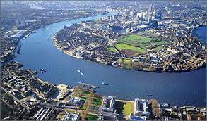
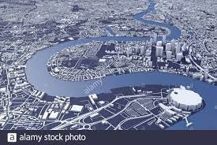
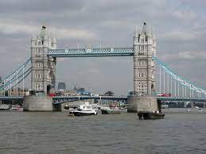
Identifying British rivers
All of these images are of the same river.
Can you recognise it?
Your task.
In your group, how many UK rivers can you name?

Slide 3
Task 1: Identifying British rivers.
Your task.
You will be given a sheet that is similar to this one.
Using atlases and internet research, you must find the names of the rivers that have been identified using numbers.
You will also need to know where their mouth ends.

Slide 4
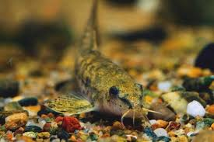
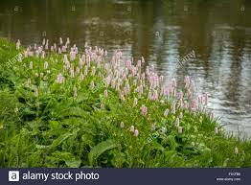
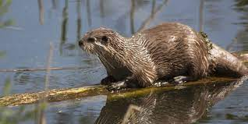
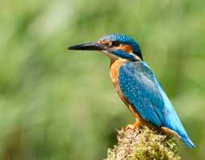
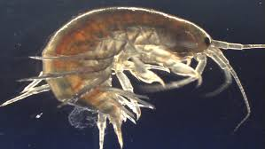
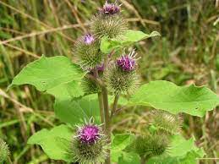
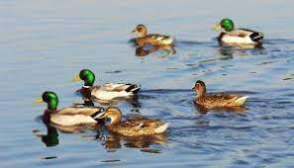
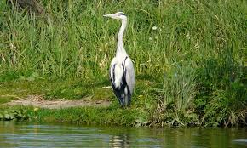
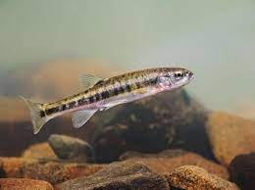
Task 2: Living things in British Rivers
In your group, you are to produce a non-chronological report to look at the different types of living thing that might have a river as part of its habitat.
You can include:
Minibeasts that live in the water;
Types of fish;
Animals that live near water or use the water;
Plant life.
Research materials can include:
any resources provided;
books from the library;
Internet research.
See next slide for more ideas.

