Slide 1
What are formal and informal speech? Formal language does not use colloquialisms, contractions or first person pronouns such as 'I' or 'We'. Informal language is more casual and spontaneous. It is used when communicating with friends or family either in writing or in conversation.

Slide 2
What are formal and informal speech? Formal language does not use colloquialisms, contractions or first person pronouns such as 'I' or 'We'. Informal language is more casual and spontaneous. It is used when communicating with friends or family either in writing or in conversation.

Slide 3
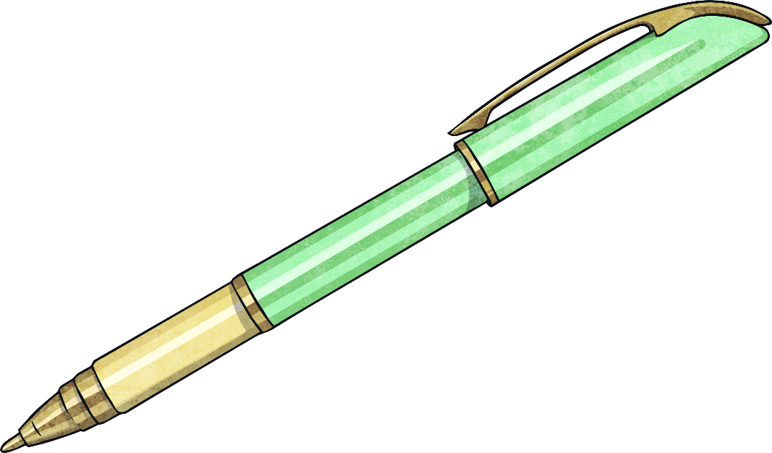
What Is a Formal Letter?
A formal letter is a letter that we send to people we don’t know or who we are not very familiar with.
Types of formal letters can be:
Complaint letters
Protest letters
Invitations
Letters to schedule an appointment

Slide 4
What are the features of a letter?
A Company
123 Business Street
London
W1 2AB
Phone: 020 123 4567
Your address
Polly Pearson
5 Hilly Street
Sheffield
S1 3YZV
Recipient’s address
7th January 2016
Date
Dear Ms Pearson
Xxxxxx xx xxxxx xxxxxx xxxxxxx xxxxx. Xxxxxx xxx x xxxx xx xxx x xxxxxxxxxxx. X xxx xxxxxx xxxxxxxx x xx xxx xxx xx xxxx. Xxxxx xx xxxx x xxxxx xxxx x xxxx x xxxxxx. X xxx xxxxxx xxxxxxxx x xx xxx xxx xx xxxx. Xxxxx xx xxxx x xxxxx xxxx x xxxxx x xxxxxx.
Xxxx xxxx x xx xx xx xxx xxxx x xxx xxx.
Your sincerely
John Smith
Manager
Greeting
Main body
Closing farewell

Slide 5
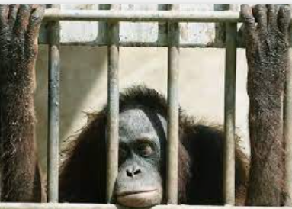
How to Write a Formal Letter (Complaint) Zoo
Imagine you have paid to visit a zoo with mostly good reviews.
What could go wrong?

Slide 6
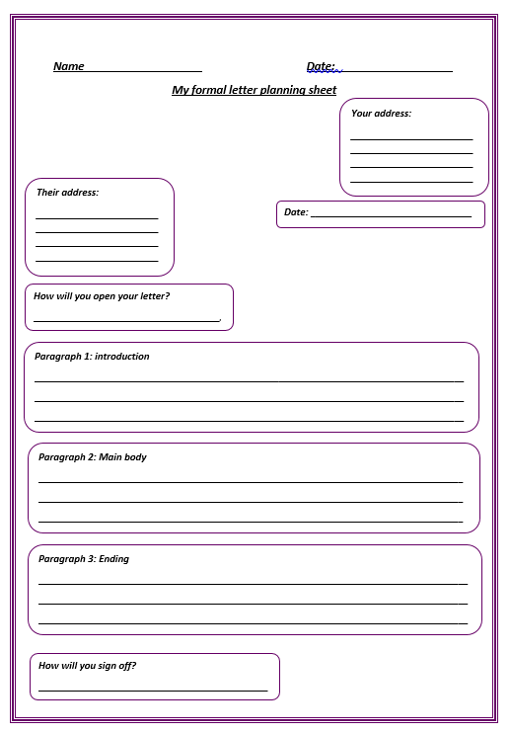
Planning – stick into books
In your introduction, make sure you introduce who you are and why you are writing to them

Slide 7
Planning
In your main body, include what went wrong – make at least 3 different points of complaint. Make sure to add detail and how it made you feel
In your ending paragraph, state what compensation you would like (refund? Free tickets for a return trip when they have changed that which upset you?)

Slide 8
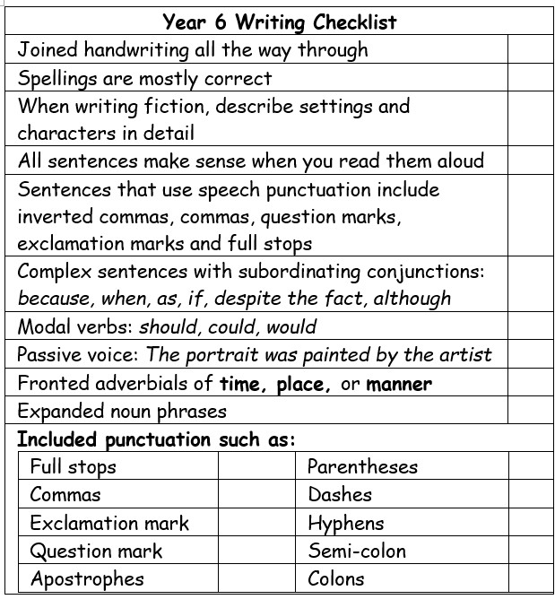
Begin writing your letter. When finished, edit your letter with a partner. Refer to the year 6 writing checklist.

