Slide 1
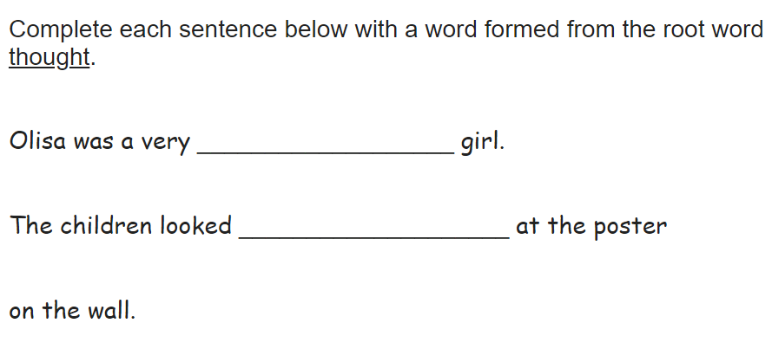

Slide 2
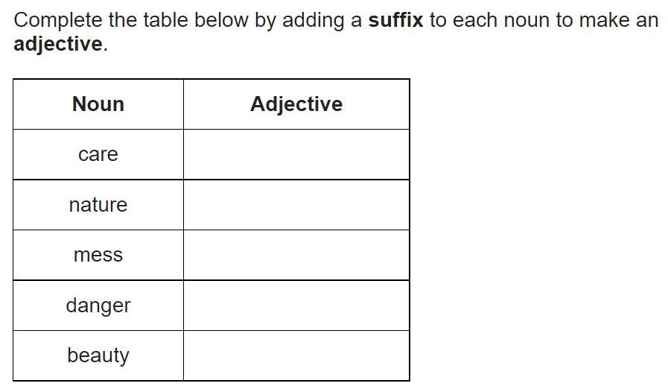
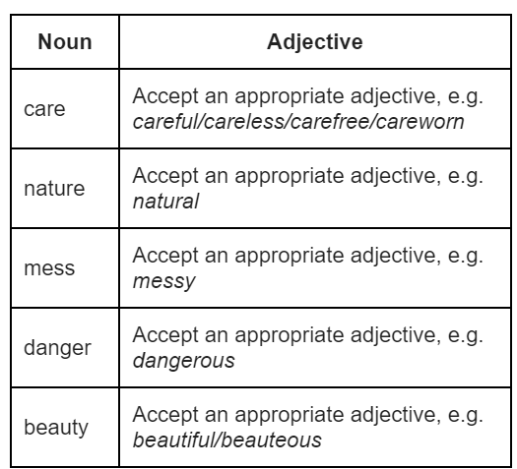

Slide 3
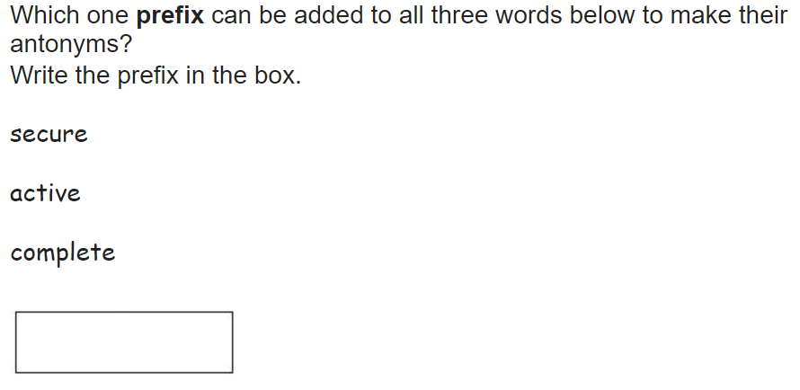
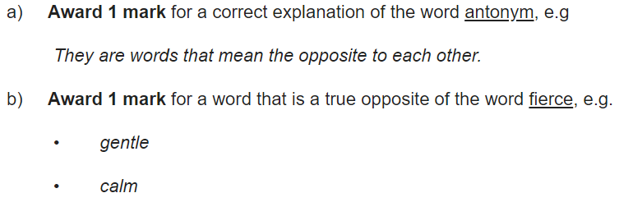
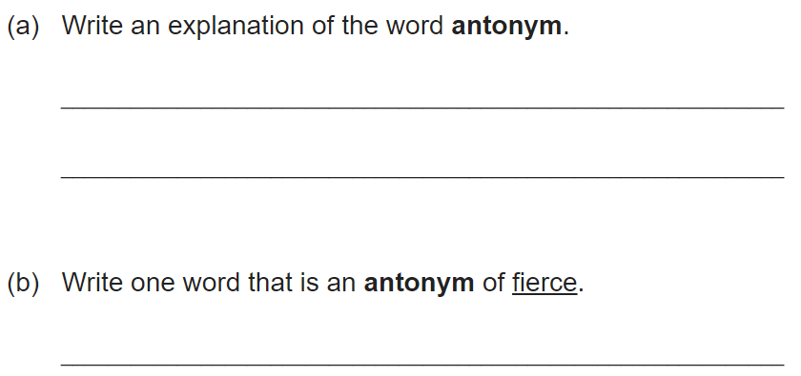

Slide 4
Let’s recap: What Is a Narrative Poem?
A narrative poem is a type of poem that tells a story.
Narrative poems tend to be quite long. They tell a story like in a novel and also use rhythm and rhyme, like in a poem.
What is a stanza?
In poetry, a stanza is a group of lines within a poem, usually set off from others by a blank line or indentation.
What is a syllable?
A syllable is a single, unbroken sound of a spoken (or written) word.
What is a rhyme scheme?
A rhyme scheme is the pattern of rhymes at the end of each line of a poem or song. It is usually referred to by using letters to indicate which lines rhyme
What rhyme scheme did we use yesterday?

Slide 5
Writing a Narrative Poem
Yesterday, we turned Jack and the Beanstalk into a narrative poem.
Let’s share your poems to the class.
Jack and the Beanstalk
Once upon a time, there was a boy named Jack who lived with his mother on a small farm. They were very poor, and Jack’s mother decided to sell their only cow so that they could afford to plant more crops. She told Jack to take the cow to the market and sell it.

Slide 6
Writing a Narrative Poem
Here is an example of how you may want to start your narrative poems.
This week, you are going to be turning your quest narratives into a narrative poem. You know what happens in your own narratives, so you will know what to include in your narrative poems.
You will be following the same rhyme scheme as yesterday (abcb). You will also need to follow the same syllable scheme (7, 6, 8, 6).
The Ballard of Beowulf
On a hill in the village,
Sat King Hrothgar’s mead-hall,
Everyone was amazed by it,
He’d say come one come all.
How might we continue it?

Slide 7
Writing a Narrative Poem
You’re ready to write! Begin writing your own quest narratives in your workbooks. Take your time and remember the rhyming (abcb) and syllable scheme (7, 6, 8, 6).
Here are some things to remember:
Use a title which summarises the story of the poem
Use carefully chosen vocabulary
Tell a story from beginning to end
Follow the pattern of syllables
Write in stanzas
Follow the rhyming pattern
Start each line with a capital letter

