Slide 1
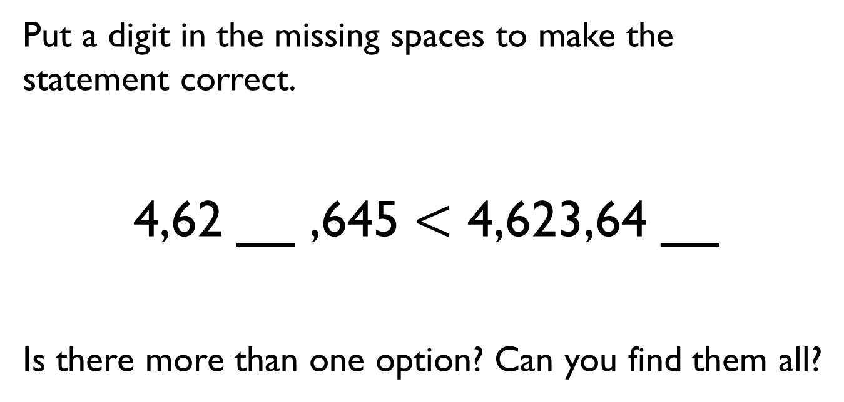
Put a digit in the missing spaces to make the statement correct.
4,62 __ ,645 $<$ 4,623,64 __
Is there more than one option? Can you find them all?
M | HTh | TTh | Th | H | T | O

Slide 2
Dora has the number 824,650
She subtracts forty thousand from her number.
She thinks her new number is 820,650
Is she correct?
Explain how you know.

Slide 3
Use the digit cards and statements to work out my number.
The ten thousands and hundreds have the same digit.
The hundred thousand digit is double the tens digit.
It is a six-digit number.
It is less than six hundred and fifty-five thousand.
Is this the only possible solution?
0
3
3
5
5
6
7

Slide 4
Eva has ordered eight 6-digit numbers.
The smallest number is 345,900
The greatest number is 347,000
All the other numbers have a digit total of 20 and have no repeating digits.
What are the other six numbers?
Can you place all eight numbers in ascending order?

Slide 5
Jack draws bar model A.
His teacher asks him to draw another where the total is 30,000
A
B
Explain how you know bar B is inaccurate.
50,000
10,000
30,000

