Slide 1
English writing skills week 2
Outcome for the week.
To write descriptive paragraphs about a famous painting.

Slide 2
Word classes
Every sentence you read is made up of different groups of words.
How many of these groups can you remember from previous years?
When you think you have named as many as you can, click the return key to see what the main groups of words are. We call these word classes
verbs
nouns
adjectives
prepositions
pronouns
adverbs
You will be learning about all of these over this term.
conjunctions
determiners

Slide 3
Lesson one- part One Word class: nouns
Find out what the function (job) of a noun is in a sentence.
What is the difference between common and proper nouns?
Look around where you are. Give examples of common and proper nouns.
How can you tell the difference between a common a proper noun?
Answers
The function of a noun is to identify things by their name.
A common noun refers to general things, such as table, cat, chair, girl.
A proper noun refers to a specific place or name, such as London, Upminster, Thomas, Charlie and the Chocolate Factory.
A proper noun must have a capital letter.

Slide 4
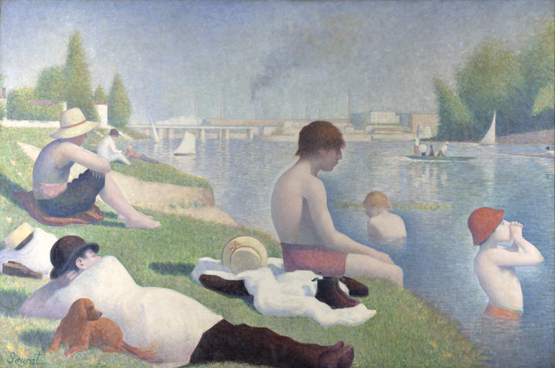
lesson one -part two The Bathers at Asnieres
By George Seurat. Look at his painting and then answer the questions on the next slide.

Slide 5
What does the painting show?
What are the different characters doing?
What time of year is it?

Slide 6
4. What time period do you think this might be? What evidence shows this?
5. What or who are they looking at?
6. What might they be thinking and saying?

Slide 7
Lesson one-part three Writing activity
Identify at least 5 different nouns in the painting.
What makes a simple sentence? Try to explain this to someone.
Then click return to see an explanation for what a simple sentence is.
A simple sentence must contain a subject (noun) and a verb.
The subject is what the sentence is about
The verb tells you what the subject is doing.
A simple sentence must contain just one idea and make sense on its own.
A simple sentence is known as a main clause.
Using a noun you identified, tell someone a simple sentence about it.
Example. The boy stood in the water.
Now write 5 simple (main clause) sentences about the painting.
Then show them to someone and identify what parts make it a simple sentence, by showing the subject and verb.

Slide 8
Lesson 2 part 1 word class: noun
Identify the nouns. Are these all simple sentences?
A young boy.
Paris is a beautiful city.
The opal-green grass waved at the people in the boat.
Answers are below.
A young boy. Not a simple sentence as there is no verb.
Paris is a beautiful city. Simple sentence as it has a subject (Paris) and a verb (is)
The opal-green grass waved at the people in the boat. Simple sentence. The subject is the grass, which is waving.
What other types of words can you see being used?

Slide 9
Lesson two- part two. Simple sentences
Look at the painting again. Look for simple sentences about different characters or objects that we could pair up.
For example, 1a The dog laid on the grass. 1bThe boy shouted across the river. How many different things could you pair up?

Slide 10
Lesson 2-part 3 Compound sentences
What can you recall from Year Five, about what makes a compound sentence different from a simple one? Answer below
To join the main clauses (simple sentences) together there is a special group of words to help. These are FANBOYS
.
Look at the next slides and try to work out how the FANBOY is used to join the simple sentences.
Never join two main clauses with a comma unless you have a FANBOY after it.
A compound sentence is made up by joining two simple sentences together.
This means a compound sentence is made up of two main clauses and both of these clauses (simple sentences) must make sense.
.

Slide 11
Lesson 2-part 3 Compound sentences
Compound sentences are two simple sentences joined using a FANBOY.
What are the FANBOYS? Click below for answer.
FANBOYS For And Nor But Or Yet So
FANBOYS: examples using for
He didn’t wear his coat, for it was already getting warm by the river.
The lady wore a sunhat, for she didn’t want to get sunburnt.
Harry was cold, for he was swimming in the river early in the morning.
Frankie, the puppy, sat next to his owner, for he wanted to keep cool in his shade.
What do you notice about the main clauses either side of the ‘for’?
Use ‘for’ if the second main clauses explains the first main clause.

Slide 12
Lesson 2-part 3 Compound sentences
What do you notice about the main clauses either side of the ‘and’ and ‘nor’?
FANBOYS; examples using ’and’
The boy was waist deep in the cool fast-flowing river, and he was cold.
The boy sat on the soft grass bank, and his toes were dipped in the cool water.
The sun was warm, and the water was cold.
Andrea let her children go into the water, and she smiled as she observed them playing.
FANBOYS: examples using ‘nor’
The girl declared that she would not cannonball into the river, nor would she dive into the cold water.
The man decided not to sit in the sun, nor did he swim in cool water.
Nick did not go into the river, nor did his beautiful, young wife.
Ollie didn’t want the ice-cream cone he had been given, nor did he want a cold drink.
Use ‘and’ if both clauses are about similar information and the second is adding more details.
Use ‘nor’ if both clauses offer reasons for something the subject does not do.

Slide 13
Lesson 2-part 3 Compound sentences
What do you notice about the main clauses either side of the ‘but’ and ‘or’?
FANBOYS: examples using ‘but’
The boy loved swimming in the lake, but he didn’t get to go in today.
The river was very cold, but the boys didn’t care.
The man enjoyed putting his feet in the water, but he did not want to go for a swim.
Bob was shouting in anger, but his brother stayed calm.
FANBOYS: examples using ‘or’
The boy didn’t know if he should wear his swimming hat, or he could just get his hair wet.
Megan, who was in the middle of the water, got cramp and realised she needed help, or she might drown.
The lady could go for a swim, or she could sit on the warm grass for a while first.
Use ‘or’ if both clauses give alternative actions that the subject might do.
Use ‘but’ if the second main clause makes a contrast to the first.

Slide 14
Lesson 2-part 3 Compound sentences
What do you notice about the main clauses either side of the ‘yet’ and ‘so’?
FANBOYS: examples using ‘yet’
The boy loved swimming, yet, he rarely swam.
The man had lots of people sitting beside him, yet he was lonely.
The lady had been feeling annoyed all morning, yet she was nice towards the boys when they splashed her.
The youngest boy screamed for help when some seaweed floated by, yet he was fine.
The boy was too hot laying in the sunshine, so he went for a swim in the river to cool down.
The boy shouted to his friends on the riverboat, so they were able to hear him over their talking.
The boy found a diamond ring on the bottom of the river, so he put it in his pocket to keep it safe.
The lady sat under the shade of the trees, so she would not feel too hot.
Use ‘yet’ when the second clause is the case despite the first clause.
Use so when the second clause happens because of the first clause.

Slide 15
Lesson 2-part 3 Compound sentences
Now it is your turn.
Write some examples of compound sentences using the simple sentences you previously made and link them using FANBOYS.
You can create extra simple sentences if you need to.
Challenge yourself to use each FANBOY at least once.

Slide 16
Lesson three- part one word class: nouns
A sentence can be improved by adding more detail to the noun.
When extra information is added to a noun, it becomes a noun phrase .
What types of extra information could be added to a noun?
How to make a noun phrase
A noun phrase is made up by using a determiner (an, a, the) a noun and an adjective.
When using an adjective to describe things, does it get placed before or after the noun?
Your task.
Use some nouns that are around the room to write examples of noun phrases.

Slide 17
Lesson three part two- FANBOYs
Tell someone what FANBOYS stands for
We call them FANBOYS, but they are also called co-ordinating conjunctions.
What do FANBOYS join together?
What must the sentences do on both sides of the FANBOYS?
If at school, look at the examples from other children and decide if the sentence is successful.

Slide 18
Lesson three-part three drafting your work
Task: Writing a description based on a famous painting
Audience: who is your writing aimed at?
Purpose: to be able to describe things, which engages the reader.
What you should be doing.
Produce two paragraphs that describe the things seen on a trip to the river. The paragraphs should cover different areas within the picture.
You could write it in third person and describe what you see. Alternatively, you could write it from the point of view of one of the characters and describe what is seen by them.
Things you might think about.
The focus of your work is to produce good quality descriptive work. Think back to what skills you have previously been taught to help make something descriptive.
Apply the skills taught about nouns and compound sentences during your work.
Remember the non-negotiables such as basic punctuation.

Slide 19
Lesson four-part one Checking a piece of work
Read through this example to identify and correct the ten mistakes. Once you think you have found them, the answers are on the next slide.
On a warm sunday afternoon, the small, brown dog on the river bank a Green, uneven patch of land) silently stares. A young boy in a striking red hat shouted loudly, so that people on the far side of the Seine hear him. Another boy – an older, more thoughtfull individual - checks for the reaction from the other group, as he dangles he’s feet in the cooling water. A short distance away sailing boats, which resemble graceful swans, glided effortlessly across the glassy, polished surface of the Water.
Notes:
;

Slide 20
On a warm Sunday afternoon, the small, brown dog on the river bank (a green, uneven patch of land) silently stares. A young boy in a striking, red hat shouts loudly, so that people on the far side of the Seine hear him. Another boy – an older, more thoughtful individual - checks for the reaction from the other group, as he dangles his feet in the cooling water. A short distance away, sailing boats, which resemble graceful swans, glide effortlessly across the glassy, polished surface of the water.
Notes:
;

Slide 21
Lesson four-part one word class: noun
To make writing more interesting for reading, it is useful to use precise nouns when identifying things
This means instead of writing, the brown dog laid behind the man, the word dog would be replaced by a breed of dog
Write or tell someone three more precise nouns that could be used instead of: dog, boat, tree, flower
When you are editing your draft, look to see if nouns can be changed

Slide 22
Lesson 4 parts 2&3- completing task
If in school, read through your work with a partner.
If at home read your work out loud, to help hear when there are errors.
Read your work once to check you have cohesion (flows easily) in your work.
Read it again to see if you have missed any basic skills.
Read a third time to check you have achieved the task set and this is a descriptive piece of work.
Part 3 – Presentation piece.
Write up the description into best.

