Slide 1
Inverted Commas
“ ”

Slide 2
Inverted Commas
“ ”

Slide 3
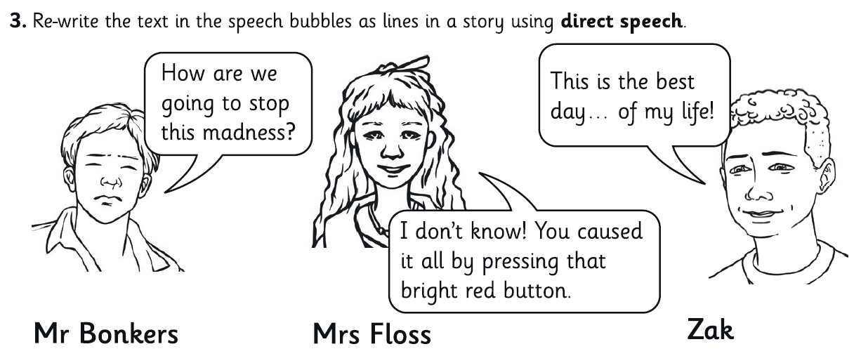
Inverted Commas
“ ”

Slide 4
Editing and Publishing
Today, you will be editing and improving your work.
Let’s practise. Read through the following sentences and edit them so that they are spelt correctly and make sense.

Slide 5
Editing and Publishing
Read through your work alone and make sure it makes sense.
Think about ways you could improve your work.
Could you use more interesting verbs?
Could you add in an expanded noun-phrase?
Have you used a semi colon and a hyphen?
Have you used inverted commas correctly?
When you have read through your own work, ask your partner to look through it too.

Slide 6
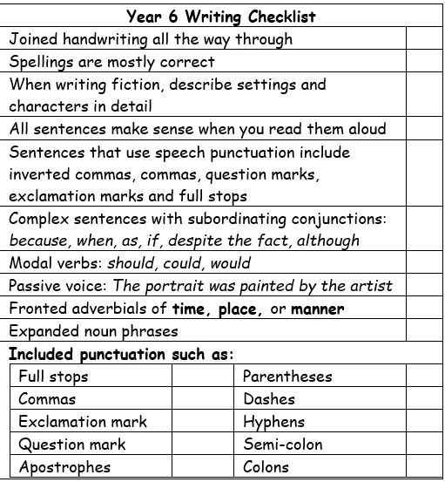
Editing and Publishing
If you have been given your checklists, make sure they are stuck in and ticked off.
Once you are completely satisfied with your work, you may begin publishing it into your top copy books.
You must write in your best handwriting.

