Slide 1
Different Names
Inverted commas can also be called:
Speech marks
Quotation marks
“ ”

Slide 2
Beginning and End
Keep your speech marks at the beginning and the end of the words being spoken.
“Lower please!” I said.
“ ”

Slide 3
New Speaker, New Line
Start a new line whenever someone new speaks.
“How are you doing today?” asked Henry.
“I’m great!” said Ashton.
“ ”

Slide 4
Capital Letters
Begin the direct speech with a capital letter.
“What an amazing day!” he announced.
“ ”

Slide 5
Punctuation
Make sure your speech is correctly punctuated. This includes a piece of punctuation before closing the inverted commas.
“There are times, I feel, that you are a little cold,” I said.
“ ”

Slide 6
Reporting Clause
Include in your sentences information about who is speaking and even how they are speaking. This is called the reporting clause.
“There are times, I feel, that you are a little cold,” I said.
“ ”

Slide 7
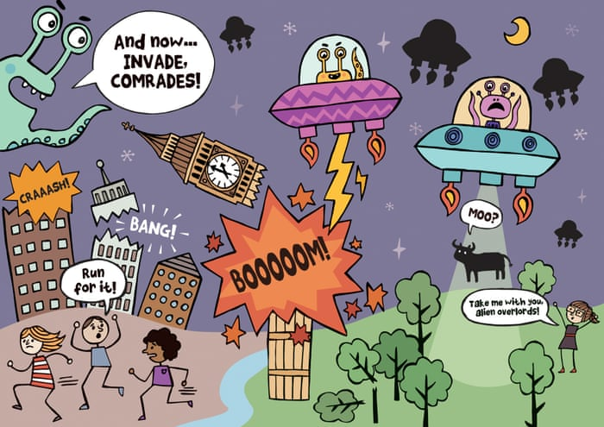
Have a go at using direct speech. Use the picture below to help you think of ideas.
“ ”

Slide 8
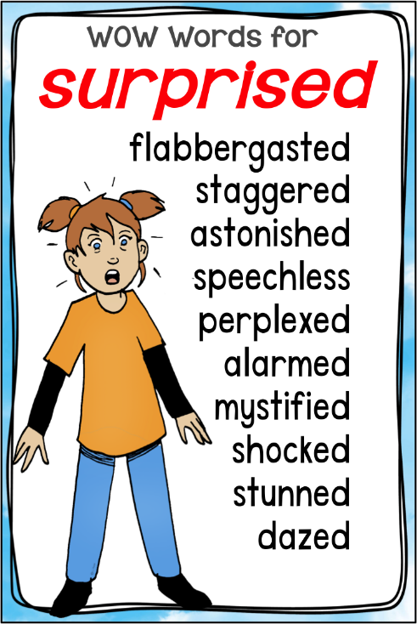
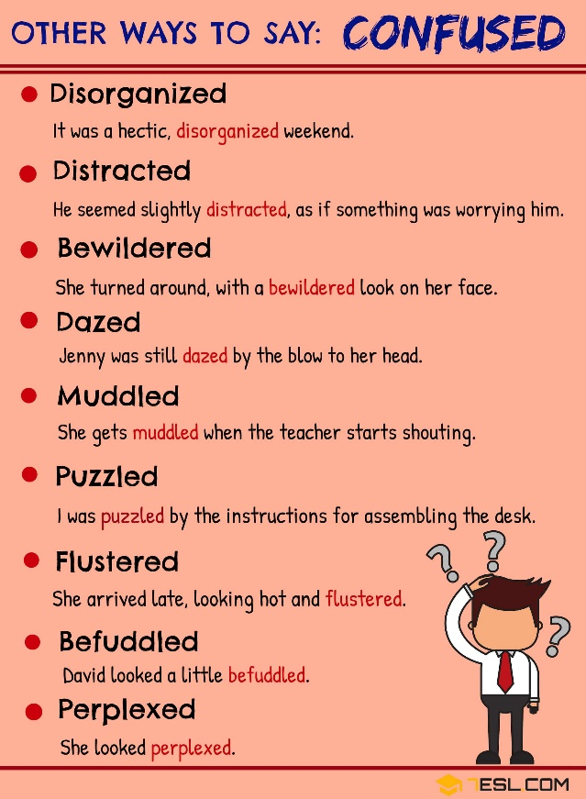
Remember to uplevel your words
sadness
confused
surprised

Slide 9
Today, you will be continuing your writing.
Remember to refer back to your plans when writing – all of your ideas are already there.
When writing, make sure you refer back to the resources to uplevel and improve your work – we do not want boring words such as sad, happy and said.
If you are stuck for ideas, ask your partner for their thoughts too. Don’t forget, you can read other children’s work to help inspire more ideas.

Slide 10
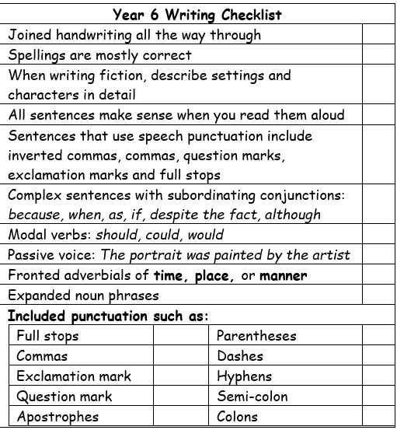
Spend up to 15 minutes editing each other’s work.
Leave a star and a wish:
You have used good fronted adverbials.
You could use modal verbs.
PM: _____ 29/11/21
When you are happy with your editing, continue writing your narratives.
Refer back to:
Your writing checklists;
The example we read through;
Your word mats.

