Slide 1
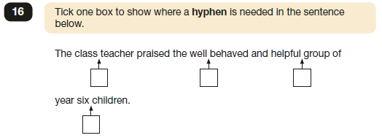
Hyphens

Slide 2
Hyphens

Slide 3
Time Slip Narrative
Let’s share some of your narrative ideas with the class.
Who is your protagonist?
What item sends them back in time?
Briefly, what do they need to do in order to return to their own time?

Slide 4
Time Slip Narrative
Remember, these are examples of abstract nouns!
How might your character be feeling after they time travel?
Write them down onto your plans

Slide 5
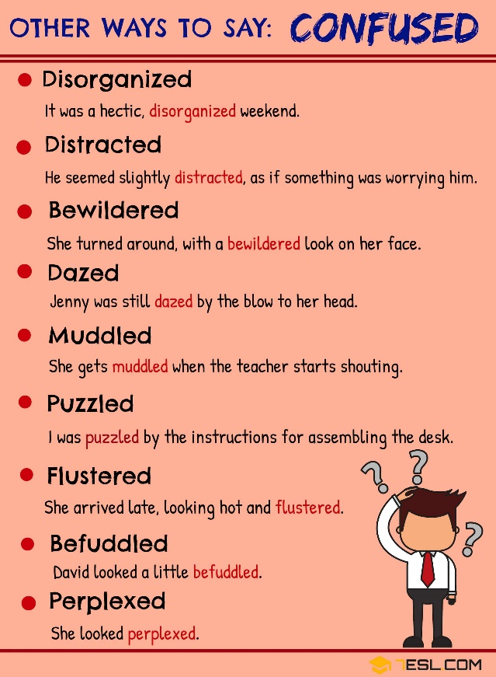
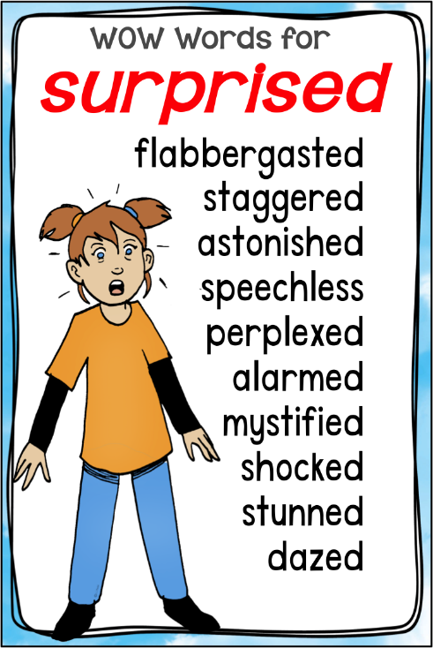
What are better words than…
sadness
confused
surprised

Slide 6
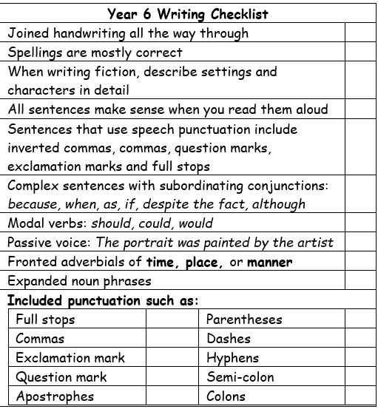
Time Slip Narrative
If you have not finished your plans, use the next 20 minutes to do so. Think your narrative through thoroughly. Make sure to think about what each setting looks like and ways to describe them. Think about what object will trigger the time travel. Think about what your character needs to do in order to get back home.
When you are happy with your plans, begin writing your narratives.
Refer back to:
Your writing checklists;
The example we read through;
Your word mats.

Slide 7
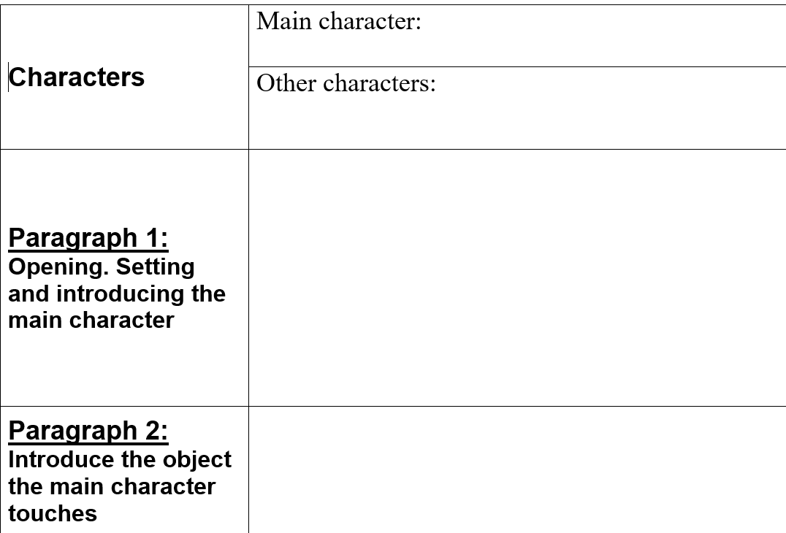
Time Slip Narrative Planning Sheet
Think of a main character (protagonist) that is of a similar age to you. Make them interesting. Think about what they look like too.

Slide 8
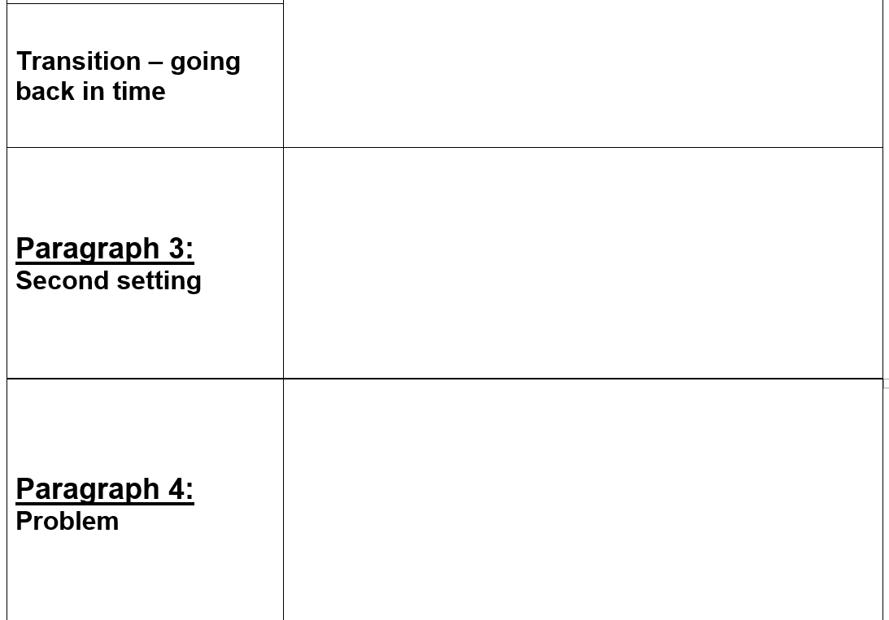
Time Slip Narrative Planning Sheet
Think of an object that your protagonist could touch that sends them back in time during WW2.

Slide 9
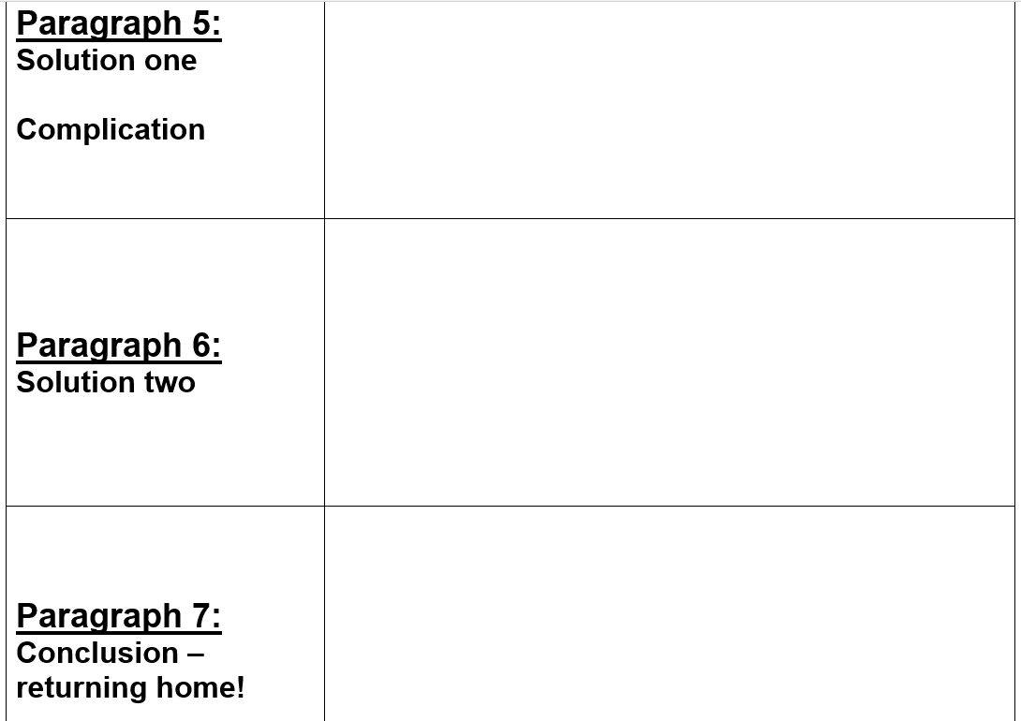
Time Slip Narrative Planning Sheet
Remember to think of ways to describe how character react to the problem. What could go wrong?

