Slide 1
Hyphens

Slide 2
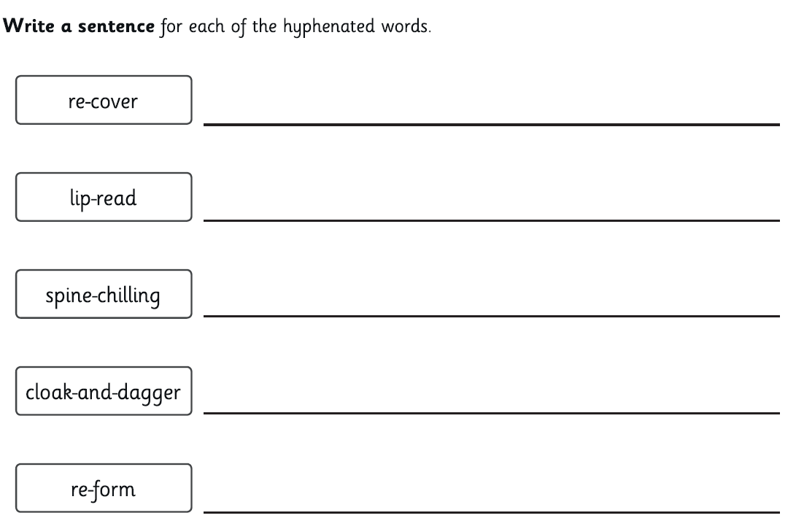
Hyphens

Slide 3
Time Slip Narrative
What happened in the video we watched yesterday?
What did the house look like? What did the garden look like?
What happened to the main character? How did he feel?
How do you know he felt this way?

Slide 4
Time Slip Narrative
Over the next two weeks, you will be producing a time slip narrative. This is when your character travels back in time.
Your time period will be during 1940s, England (during WW2)
As a class, we are going to read through an example piece to help you generate ideas.
Make sure to have your plans out and ready for you to begin jotting down your ideas. You can magpie ideas too.
Teachers, please open the document found in this week’s folder.

Slide 5
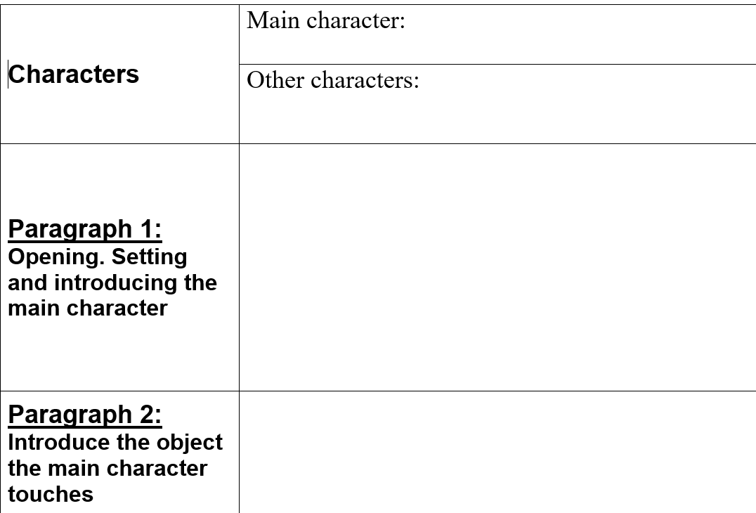
Time Slip Narrative Planning Sheet
Think of a main character (protagonist) that is of a similar age to you. Make them interesting. Think about what they look like too.

Slide 6
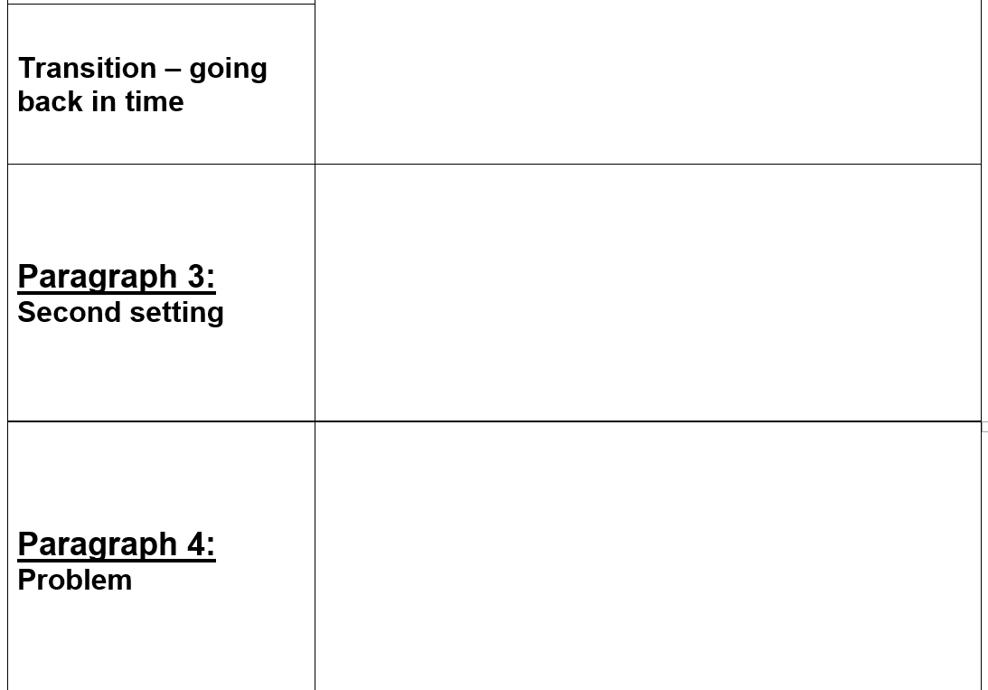
Time Slip Narrative Planning Sheet
Think of an object that your protagonist could touch that sends them back in time during WW2.

Slide 7
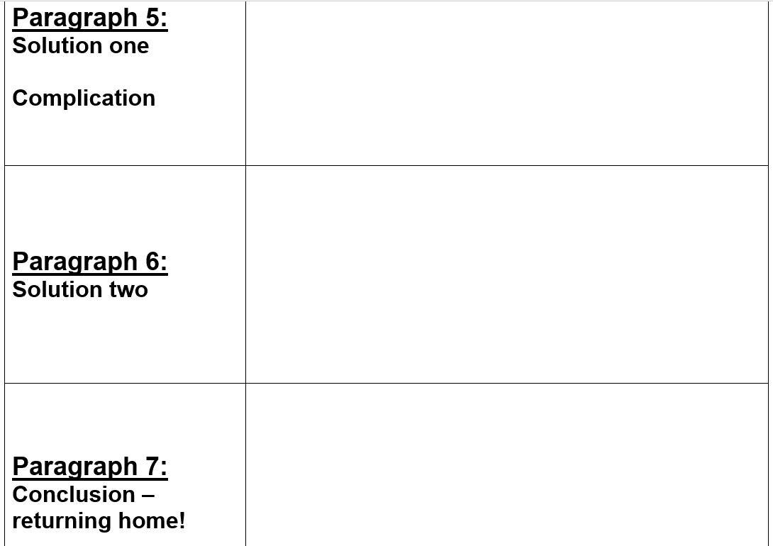
Time Slip Narrative Planning Sheet
Remember to think of ways to describe how character react to the problem. What could go wrong?

