Slide 1
Hyphens
What do you know about hyphens? Tell your partner.
are shorter than dashes
can be used in compound adjectives
can be used after prefixes
can be used in some numbers 20 to 99
-
can be used in compound nouns
are used to avoid ambiguity
are used to show that a word continues on the next line
have no gap between words
Do you and your partner agree?

Slide 2
Words Continuing on the Next Line
Read the following extract, identifying the hyphen:
We were lucky to go on the most amazing safari trip while we were on holiday in Africa. We saw elephants, lions and rhino-ceroses.
We were lucky to go on the most amazing safari trip while we were on holiday in Africa. We saw elephants, lions and rhino-ceroses.
We use hyphens to show that a word is continuing on the following line.

Slide 3
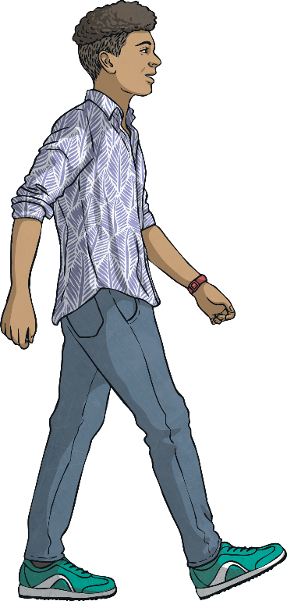
Numbers 20 to 99
Read the following sentences, identifying the hyphens:
“Ninety-eight, ninety-nine, one hundred. Coming ready or not!”
“Ninety-eight, ninety-nine, one hundred. Coming ready or not!”
Joseph, my eldest brother, turned twenty-one last week.
Joseph, my eldest brother, turned twenty-one last week.
We use hyphens in the numbers from twenty to ninety-nine where two numbers are put together to make another.

Slide 4
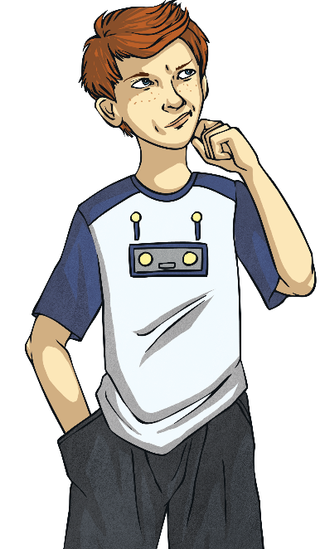
Informal Phrases
Read the following sentences, identifying the hyphens:
I don’t like those wishy-washy colours on you.
I don’t like those wishy-washy colours on you.
I can’t stand her lah-di-dah attitude.
I can’t stand her lah-di-dah attitude.
We use hyphens in informal phrases with words that are not usually used singly.

Slide 5
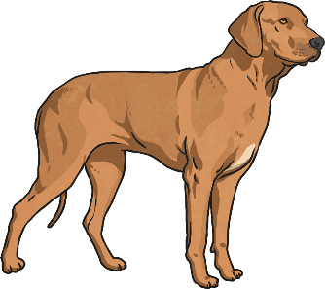
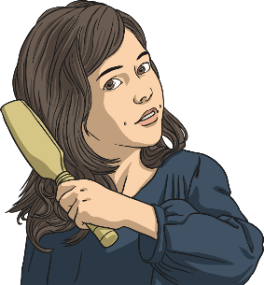
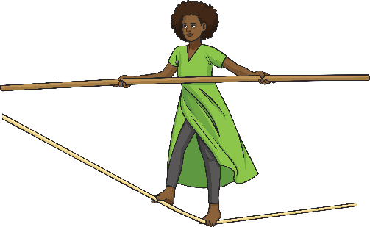
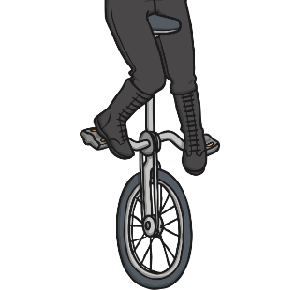
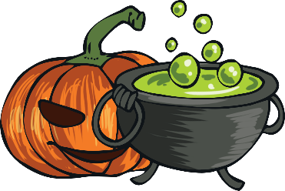
Your Turn: Numbers and Informal Phrases
Choose a mystery box, then write a description of it including a number from twenty to ninety-nine or an informal phrase:
?
?
?
?
?
?

Slide 6
Compound Nouns
Read the following sentences and identify which one has been written correctly.
I saw a young passer by staring in through the window.
I saw a young passer by staring in through the window.
I saw a young passer-by staring in through the window.
I saw a young passer-by staring in through the window.
We use a hyphen to create a compound noun where if we didn’t, it might get confusing.

Slide 7
Compound Adjectives
Read the following sentences and identify which one has been written correctly.
The tired looking teacher slumped at his desk.
The tired looking teacher slumped at his desk.
The tired-looking teacher slumped at his desk.
The tired-looking teacher slumped at his desk.
We use a hyphen to create a compound adjective before a noun.

Slide 8
Compound Noun or Compound Adjective?
Sort the following words (by clicking on each one) depending on whether they are a compound noun or a compound adjective:
Compound Nouns
Compound Adjectives
passer-by
take-off
two-year-old
six-page
five-star
short-sleeved
bad-tempered
mother-in-law
dry-cleaning
check-out
second-hand

Slide 9
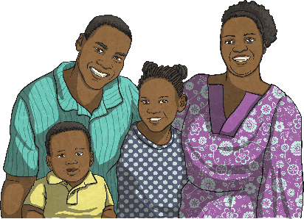
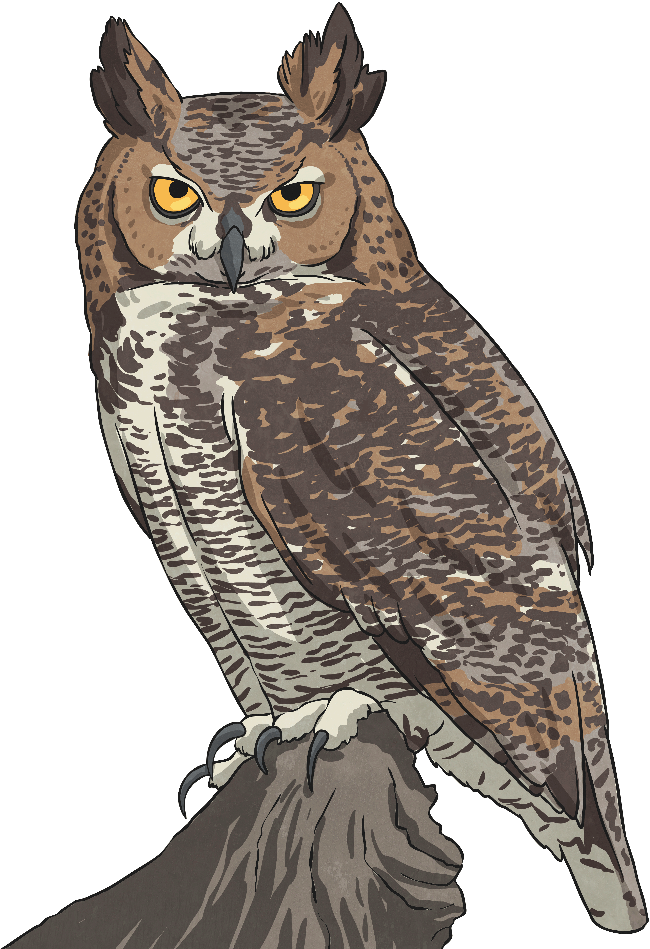
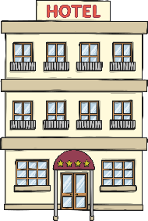
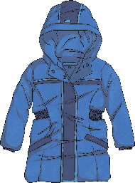
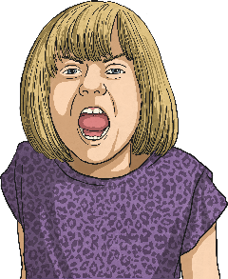
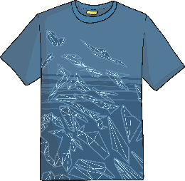
Your Turn: Compound Nouns and Compound Adjectives
Choose a mystery box, then write a description of it including a compound noun or compound adjective.
?
?
?
?
?
?

Slide 10
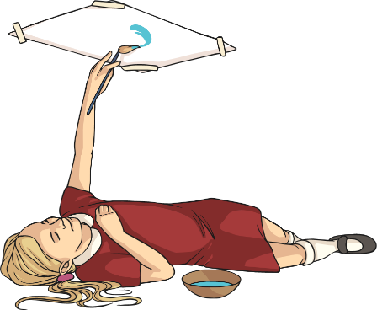
Hyphens after Prefixes
Read the following sentences and identify where hyphens have been used and why.
The all-knowing genie granted my three wishes.
The all-knowing genie granted my three wishes.
We painted self-portraits in our art lesson this afternoon. ✓
We painted self-portraits in our art lesson this afternoon. ✓
We usually use a hyphen after the prefixes all- and self-, as they make compound adjectives and nouns.

Slide 11
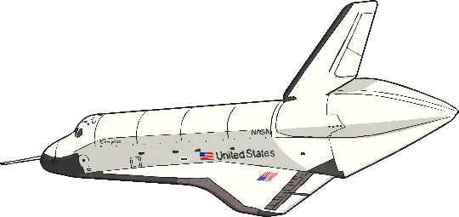
Hyphens after Prefixes
Read the following sentences and identify where hyphens have been used and why.
We will re-enter the Earth’s atmosphere soon.
We will re-enter the Earth’s atmosphere soon.
We will reenter the Earth’s atmosphere soon.
We will reenter the Earth’s atmosphere soon.
We sometimes need to use a hyphen with a word that has a prefix, to avoid doubling up a vowel and changing the pronunciation.

Slide 12
Hyphens after Prefixes to Avoid Ambiguity
Read the following sentences and identify where hyphens have been used and why.
I had to re-cover my book when the cover got damaged.
I had to re-cover my book when the cover got damaged.
I had to recover my book when the cover got damaged.
I had to recover my book when the cover got damaged.
We sometimes need to use a hyphen within a word that has a prefix to avoid ambiguity (recover means something very different to re-cover).

Slide 13
Hyphens after Prefixes to Avoid Ambiguity
Choose the appropriate word to complete these sentences.
Our teacher asked me to research / re-search my drawer to find my missing homework.
Our teacher asked me to research / re-search my drawer to find my missing homework.
It is important to recycle / re-cycle as much as possible.
It is important to recycle / re-cycle as much as possible.
Mrs Cook said that she was going to remark / re-mark the tests because the scores all seemed quite low.
Mrs Cook said that she was going to remark / re-mark the tests because the scores all seemed quite low.
Marek is an excellent goalkeeper because he has quick reflexes / re-flexes.
Marek is an excellent goalkeeper because he has quick reflexes / re-flexes.

Slide 14
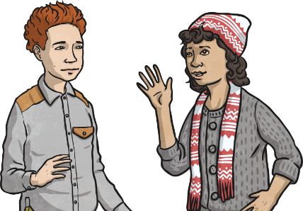
Hyphens Quick Quiz 1
Put hyphens into these sentences.
I’ve got a four-year-old brother and a six-year-old sister.
I’ve got a four year old brother and a six year old sister.
Our teacher always talks in a sing-song voice.
Our teacher always talks in a sing song voice.
It is important to co-operate when playing a team game.
It is important to cooperate when playing a team game.
My mum said she had re-sent the message to my auntie when she didn’t get a reply.
My mum said she had resent the message to my auntie
when she didn’t get a reply.
Why have the hyphens been used? Discuss with your partner.

Slide 15
Hyphens Quick Quiz 2
Do these sentences have the correct punctuation? If not, correct them.
I woke up at six-twenty-five this morning!
I woke up at six twenty-five this morning!
My dog has bluey grey eyes.
My dog has bluey-grey eyes.
Casey’s self esteem was improving as she got to know more people.
Casey’s self-esteem was improving as she got to know more people.
Why have the hyphens been used? Discuss with your partner.

Slide 16
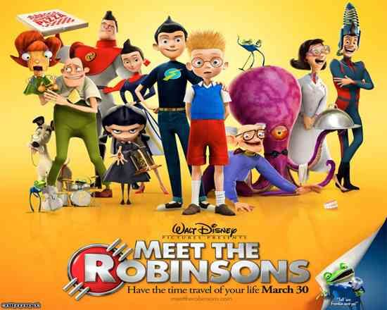
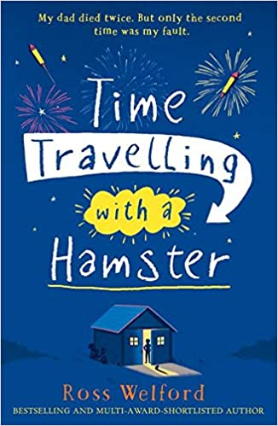
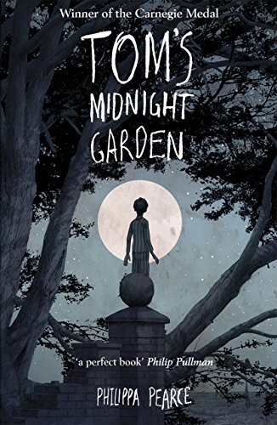
Time Slip Narrative
Have you watched anything that has had time travel in it?
Have you read any books with time travel?
What’s your opinion on time travel in stories?

Slide 17
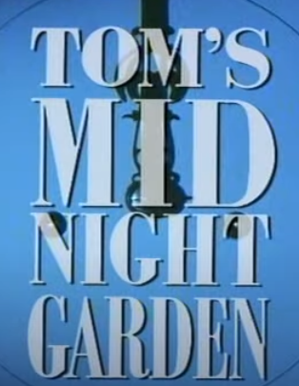
Time Slip Narrative
We are going to watch the following video. (Episode 1)
https://www.youtube.com/watch?v=gmJQDhxL9mY&t=1321s
(Episode 2) https://www.youtube.com/watch?v=wSUSbWeExbY&t=262s
You need to have your purple books out to record down notes as you watch.
Think about:
What is the time period?
Who are the characters?
What do the characters look like?
what does the house look like?
What does the boy look like?
How is he feeling?
What does he do?

Slide 18
Time Slip Narrative
Let’s share our notes:
What is the time period?
Who are the characters?
What do the characters look like?
what does the house look like?
What does the boy look like?
How is he feeling?
What does he do?
Activity: write a summary of what happens in the video.
Tom’s Midnight Garden starts with …
After that, …
Tom then …

