Slide 2
What Do Sikhs Believe?
Sikhs believe that:
There is only one God and Sikhs only worship and pray to this one God;
God cannot be described as either male nor female;
God is both sargun and nirgun;
God created the world for people to enjoy;
God created people to know the difference between right and wrong;
Images of God are forbidden, as is worshipping them;
All people are equal.
sargun – The belief that God is everywhere and within everything.
nirgun – The belief that God is above and beyond the range of human experience.

Slide 3
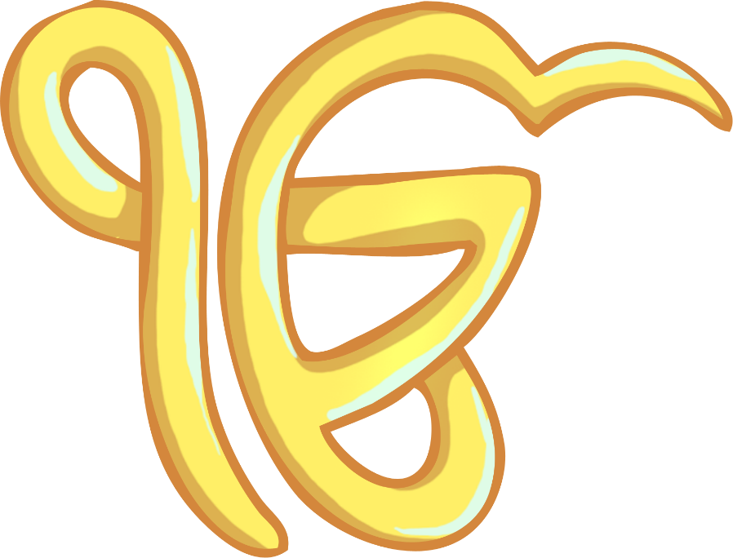
Sikh Symbols and Their Meanings: Ik Onkar
Ik means one. Onkar means supreme reality or being.
Translated into English it is equivalent to: There is only one God.
It is the first line of the Mool Mantar Prayer.

Slide 4
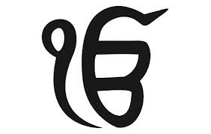
Ik onkar
There is only one true God

Slide 5
Independent task:
Draw a pathway that illustrates the Sikh belief that all pathways lead to the same God.

Slide 6
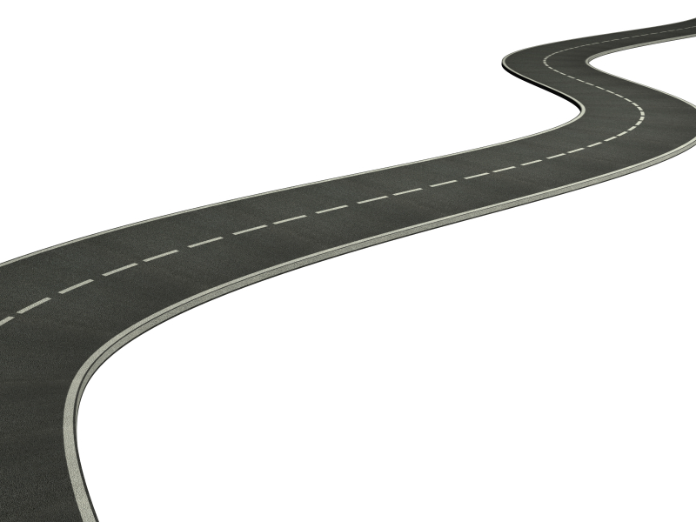
There is only one true God

