Slide 1
Sikhism
The Teachings of Guru Nanak

Slide 2
What makes a good teacher?
Discuss with a partner what you think makes a good teacher and a good learner.
List the qualities that you think a good teacher needs to have or needs to be
What are the differences between the qualities of a good teacher and the qualities of a good learner?

Slide 3
What is a Guru?
The word guru is sometimes used to describe someone who is an expert at something.
Guru is from the Sanksrit language. It literally means ‘dispeller (remover) of darkness’. This shows that a teacher or leader can help people achieve knowledge, which then makes their life happier, lighter and easier.
In the Sikh religion, the title of Guru was given to the ten most important leaders and teachers of the faith.
Sanskrit - an ancient language from south Asia. Many languages from the region have origins in Sanskrit.

Slide 4
Guru Nanak
What can you remember about the life of Guru Nanak ?
Meaning of the word Guru
…a teacher who teaches people about God and how to live their lives.
The term Sikh means disciple or learner.
Sikh’s never make pictures of God as it is considered disrespectful; however, they do have images of their Gurus. On the next slide there are images of Guru Nanak.
What do they have in common?
Why might they be different?

Slide 5
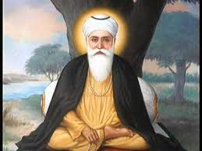
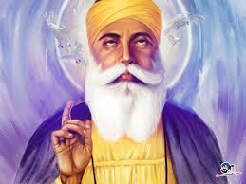
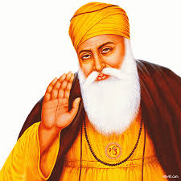

Slide 6
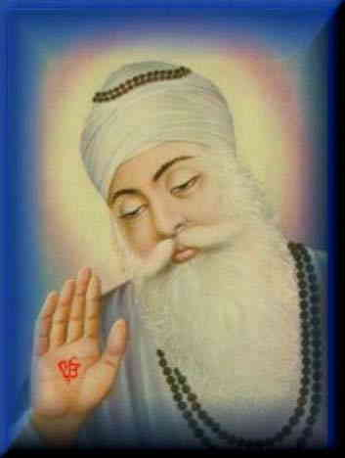
What does the image tell you about Guru Nanak?
Why has the artist painted him in this way?
What do you think he was trying to show?

Slide 7
light around Guru Nanak
raised hand
Ik Onkar (One God) on his hand
kind expression
lowered eyes
These symbols could infer that Guru Nanak is reflecting on God.

Slide 8
GURU NANAK’S TEACHINGS
There is only one God.
We should worship and pray to the one God and no-one else.
Work hard and help others.
Be honest.
Everyone is equal in the eyes of God - there is no rich, poor, male, female, black or white.
The only difference between people is in their actions.

Slide 9
GURU NANAK’S TEACHINGS 2
Be kind to all - birds, animals and people.
Fear nothing, pray for the good of all.
Be simple and honest in your daily life.
Your tasks.
Which of these teachings would you consider most important. Explain why you think this.
Guru Nanak used a lot of poetry to tell people about the meaning of God. Use his teachings to write an acrostic style poem using GURU NANAK as your line starters.

Slide 10
God is one, not many.
Understand this.
Remember to worship the one God.
Understand this.
Never be work-shy.
Always know this.
Never be dishonest.
Always know this.
Kindness is supreme.

Slide 11
God is one, not many.
Understand the teachings.
Remember to worship the one God.
Unite as one.
Never be work-shy.
Always treat others with respect.
Never be dishonest.
Acknowledge and help others.
Kindness is supreme.

