Slide 1
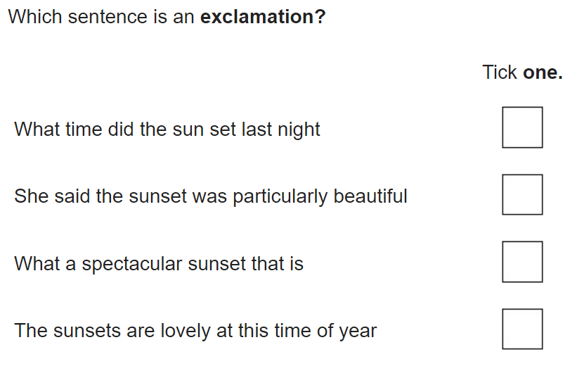
Grammar Starter

Slide 2
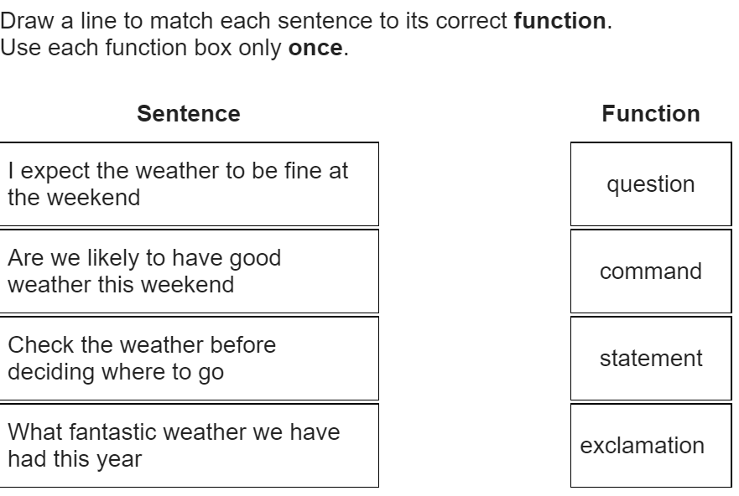
Grammar Starter

Slide 3
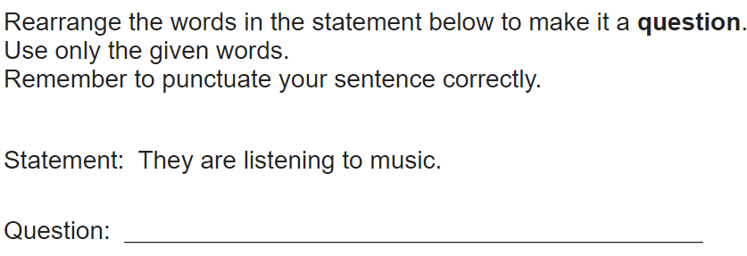
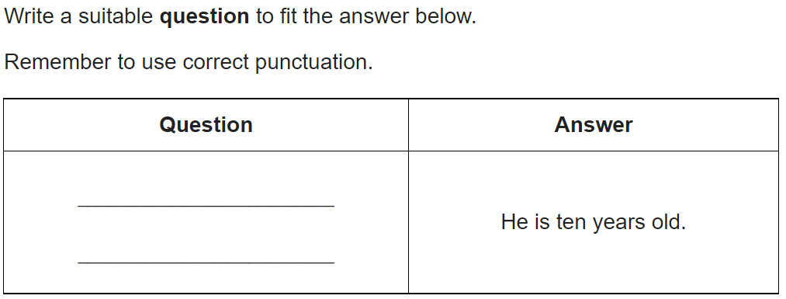
Grammar Starter

Slide 4
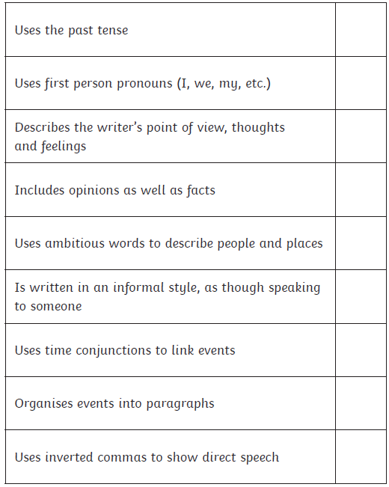
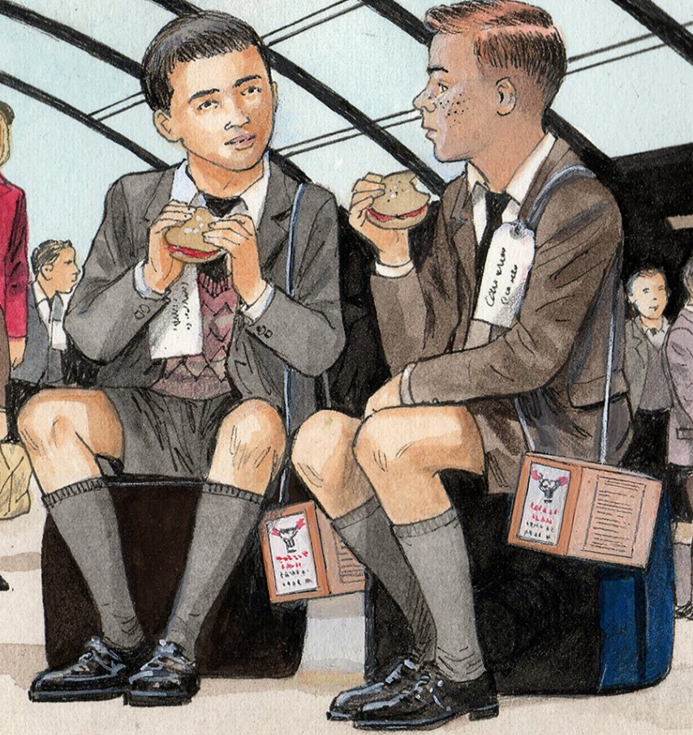
Diary Entry #1
Today, you will be writing your first paragraph of the diary entry.
Remember, you are either Tucky or David. You may refer to the book whilst you write.

Slide 5
Diary Entry #1 Sentence Starters
Dear Diary,
Today was… because….
I never thought that ….
I feel like … because …
I wish that …
Even though …, I wish that I could …
My teacher, ____, was telling us…
It made me feel …
I’m glad that ___ was there with me. He makes me feel ….
I wonder what will happen when ….

Slide 6
Diary Entry #1 Example
Dear Diary,
The day that I prayed would NEVER come had arrived. Mother woke me up but I pretended to be asleep so she would leave me – she didn’t. She woke me up and handed me my apple that I have every morning. It was pitch black in the cellar but I knew what it was the moment I felt the cold saucer touch my hands. To be honest, it made me feel sick just looking at it as I knew it would be my last. I was overcome with dread at the thought. She soon got upset that I didn’t want to eat it so to please her, I did. It didn’t taste the same as it usually did but that’s because all I could think about was the fact that I was being shipped off to who knows where!
Mother was very stone faced even though I could tell she was upset too. When we walked to the station, Mother reminded me that men mustn’t cry even when I tried to hide my tears with my sleeve.

