Slide 2
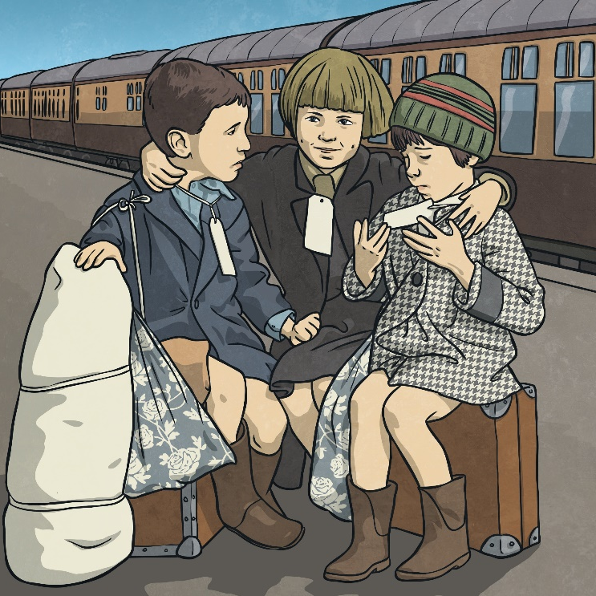
Today we are going to be taking down notes about children in WW2.
Make sure you have your rough work books out and a pencil/pen ready to take down notes that will help you with your writing this week.
This week you will be writing a diary entry from the perspective of David or Tucky from Friend or Foe as they are evacuated during WW2.
What do you already know about children during WW2?
What do we already know about David and Tucky?

Slide 3
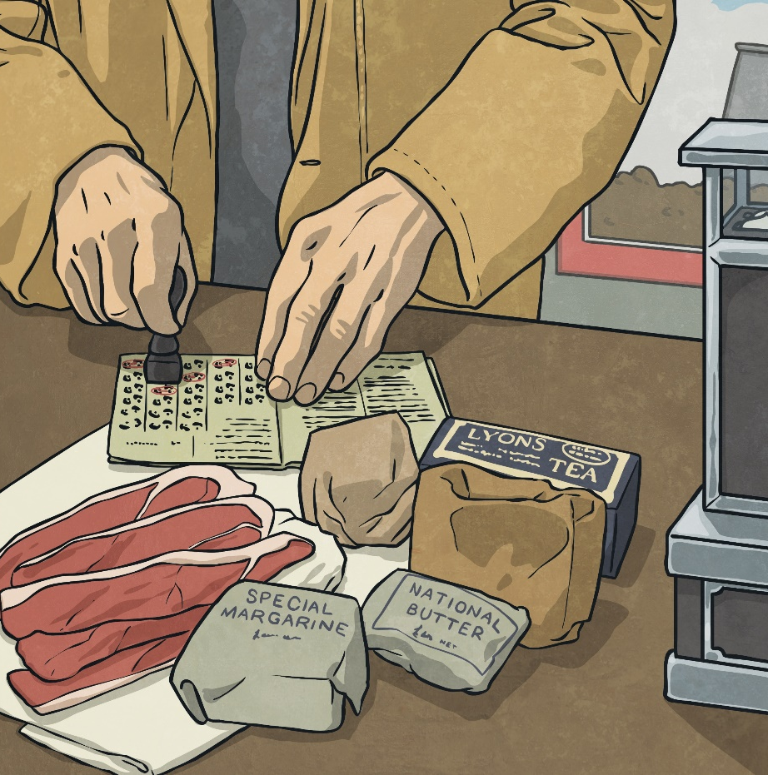
Rationing
Rationing was where things such as food, clothing and petrol were limited to a certain amount per person. This was to make sure that food was shared out fairly and that everyone had what they needed. Goods became scarce because German submarines started attacking ships that brought things to Britain. The country had to become self-sufficient and a way of doing this was to ration things. Rationing began in January 1940 and gradually most food was rationed.

Slide 4
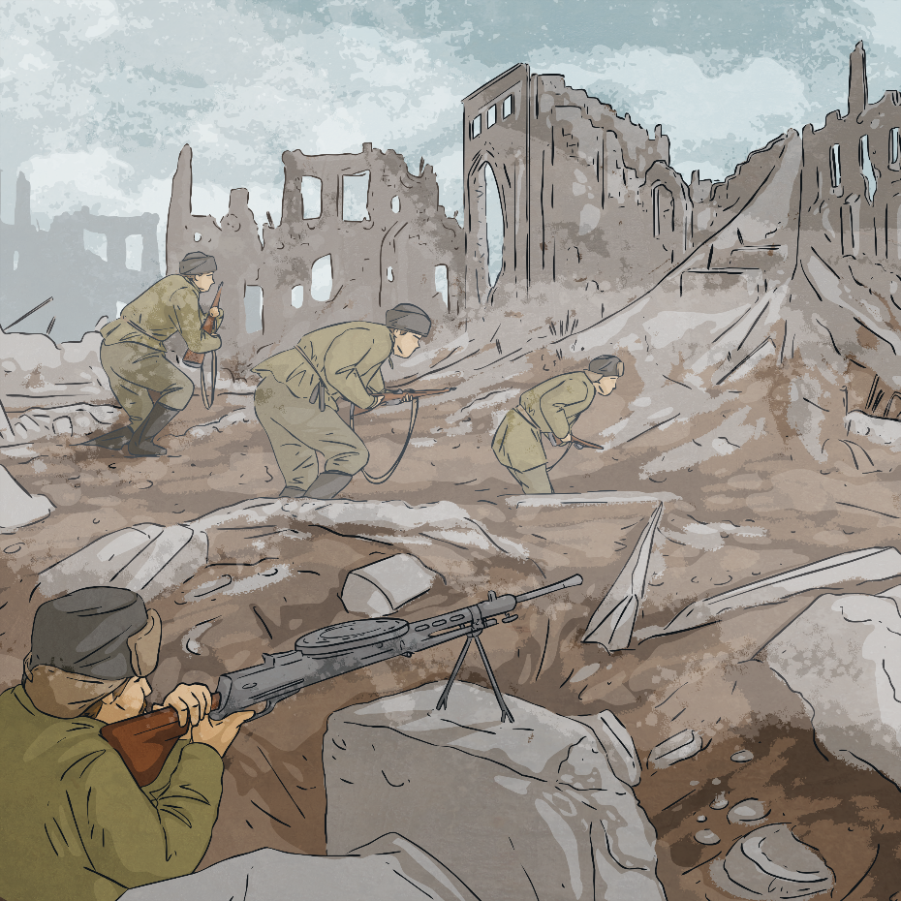
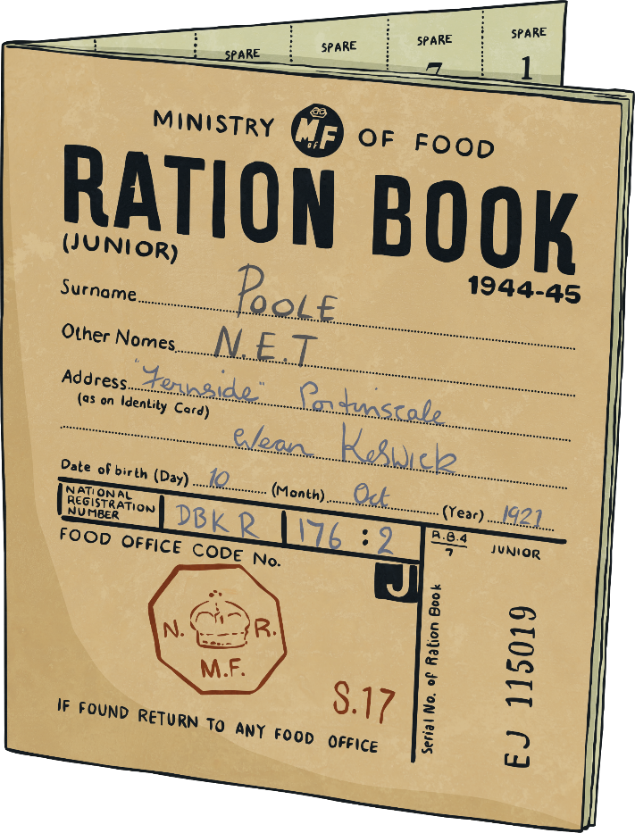
Rationing
People were given ration books which had food coupons in them. Every time they bought food, the shopkeeper took a token. This made sure people only bought the food they were allowed to have. Have a look at this Ration Book Families were encouraged to turn their gardens into allotments, in order to grow their own fruit and vegetables.

Slide 5
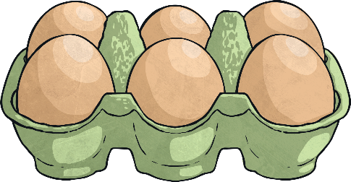
Rationing
A weekly ration for one person was usually:
50g butter, 225g sugar, 50g cheese, 100g bacon or ham, 1 egg, 100g margarine, 1.8 litre of milk, 50g of tea.
A simple thing like making a birthday cake became a maths challenge for the cook! The whole family’s ration of sugar, butter and eggs would have to be used.
People were inventive during the time of rationing. A substitute called powdered egg was used (it tastes about as nice as it sounds!). Popular recipes included:
Eggless Cake
Rabbit Stew
Vegetable and Oatmeal Casserole
Mock Fish Cakes
Eggless Mayonnaise

Slide 6
Rationing
Rationing of some food continued until 1954, nine years after the end of the war! It was an exciting time, although a bit confusing for some children. Children hadn’t seen bananas for so many years that some didn’t know how to eat them and tried to eat them with the skin on!

Slide 7
Soldiers
Family life was greatly affected by the Second World War. Britain didn’t have enough soldiers to fight a war so introduced conscription. This meant that all men aged between 18 and 41 were required to register for service, unless they were doing certain jobs, such as mining or farming. This meant that most children’s dads had to leave and fight.
Children would hear from their dads in postcards and letters. However, these were censored to ensure that if a German spy got hold of them, the spy wouldn’t know any details about what soldiers were doing.

Slide 8
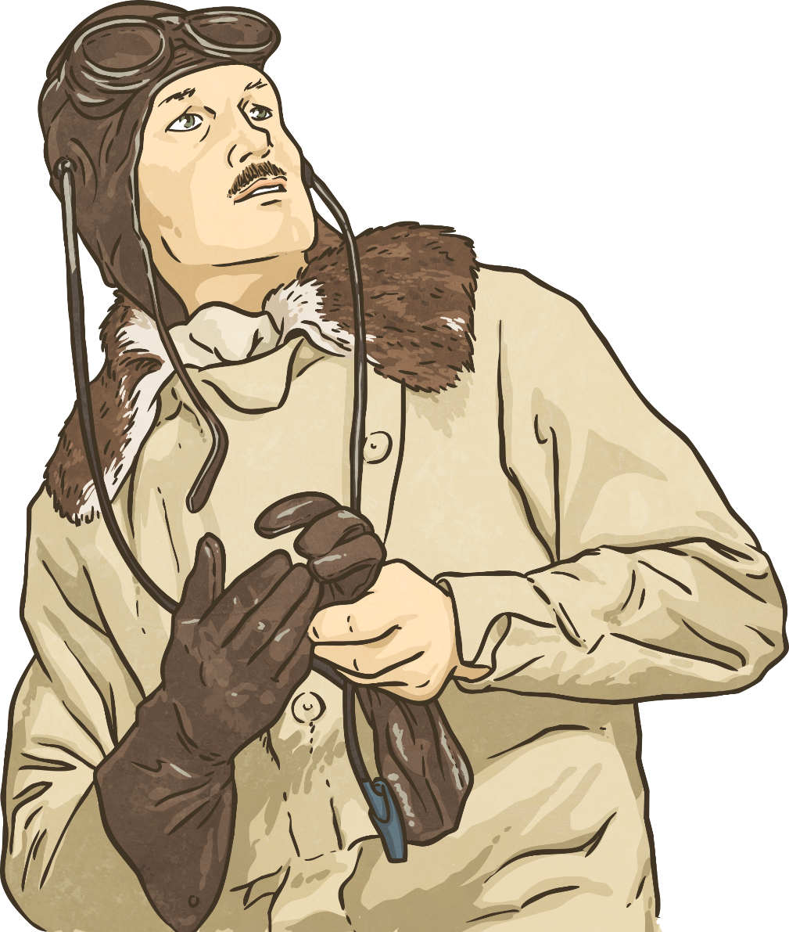
Soldiers
Soldiers were only allowed a few days leave each year. If they were fighting thousands of miles away, they couldn’t travel home. This meant that many children didn’t see their dads for the entire length of the war.
It is estimated that between 300,000 and 500,000 children lost their fathers in the war.

Slide 9
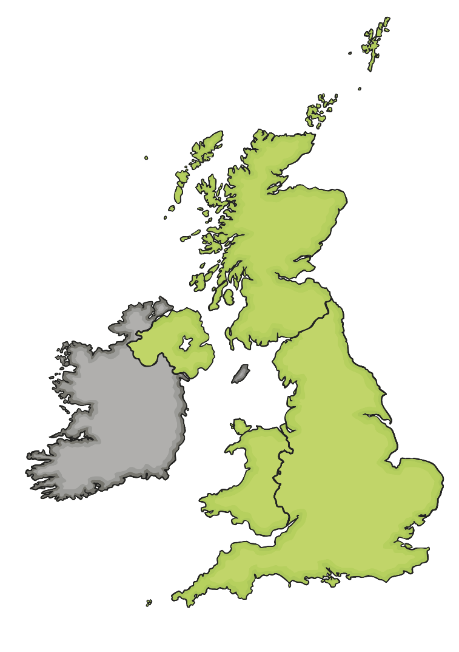
Bombing
As the war progressed, Germany targeted British cities as part of their bombing campaign.
Belfast docks and shipyards were targeted. 1,000 people were killed and 100,000 people were left homeless.
Clydebank was an important shipbuilding town and was badly bombed. Over half of the city was made homeless after the bombing raids.
The majority of Plymouth city centre was totally destroyed during bombing raids. 900 died and 40,000 people were left homeless.
From 7th September 1940, London was bombed every night (and sometimes during the daytime) for 57 days in a row. 17,500 people lost their lives.
Coventry was bombed on 14th – 15th November 1940. Coventry Cathedral was destroyed and one third of all the city’s houses were damaged. 568 people were killed.
Birmingham was the third most bombed city. It was bombed over several months.
Liverpool was the second most bombed city after London. 1,900 people were killed and 70,000 people were made homeless due to the damage done to their houses.
Cardiff docks were important for bringing supplies in to the country. 355 people were killed during the bombing.

Slide 10
Evacuation
At the start of the war, the government realised that cities would be targeted. They decided to encourage parents to allow their children to be evacuated to safer, rural locations.
Parents were given a list of things to pack for their children. The children had labels attached to them with their name, age and home address on them.
Children were taken on trains or buses to their new locations. A person called a billeting officer would collect the children and take them to a village hall. People who had volunteered to take in the evacuees would then walk amongst them and choose the children they liked the look of.

Slide 11
Evacuation
For some children, evacuation was a positive experience. For others it was not. Talk about the positives and negatives of being evacuated.
Positive Points of Evacuation | Negative Points of Evacuation
Children were kept safe from bombs. | Children missed their parents.
Children got to live in the peaceful, beautiful countryside. | Sometimes brothers and sisters were kept in separate places.
Many children stayed with caring people. | Some children stayed with people who weren’t very nice to them.

Slide 12
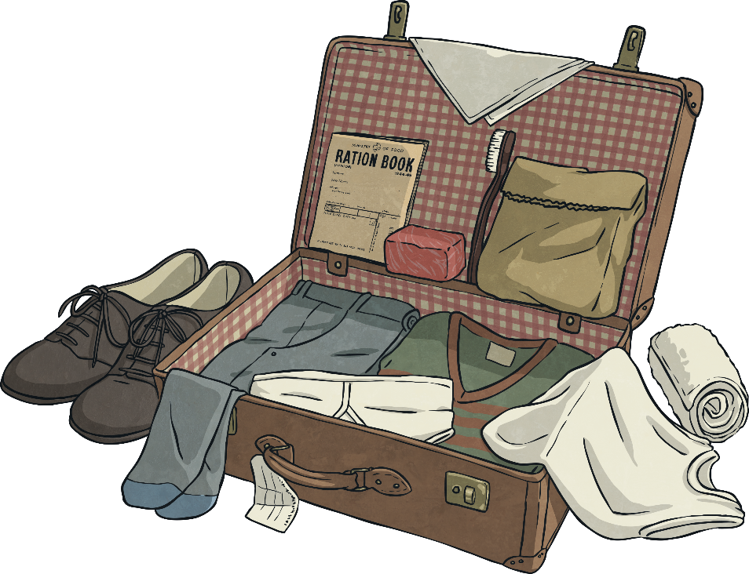
Evacuation
Parents were given a list of things to pack for their children which included a gas mask, underwear, pyjamas or a nightie, plimsolls, toothbrush, comb, a towel, soap, a flannel, handkerchiefs and a warm coat.
This list doesn’t sound like very much, but some families struggled to even get these items. A lot of children who were being evacuated came from very poor families.
Some children took a toy with them but it would have been something small. They had to be able to carry all their possessions themselves in one small suitcase.

Slide 13
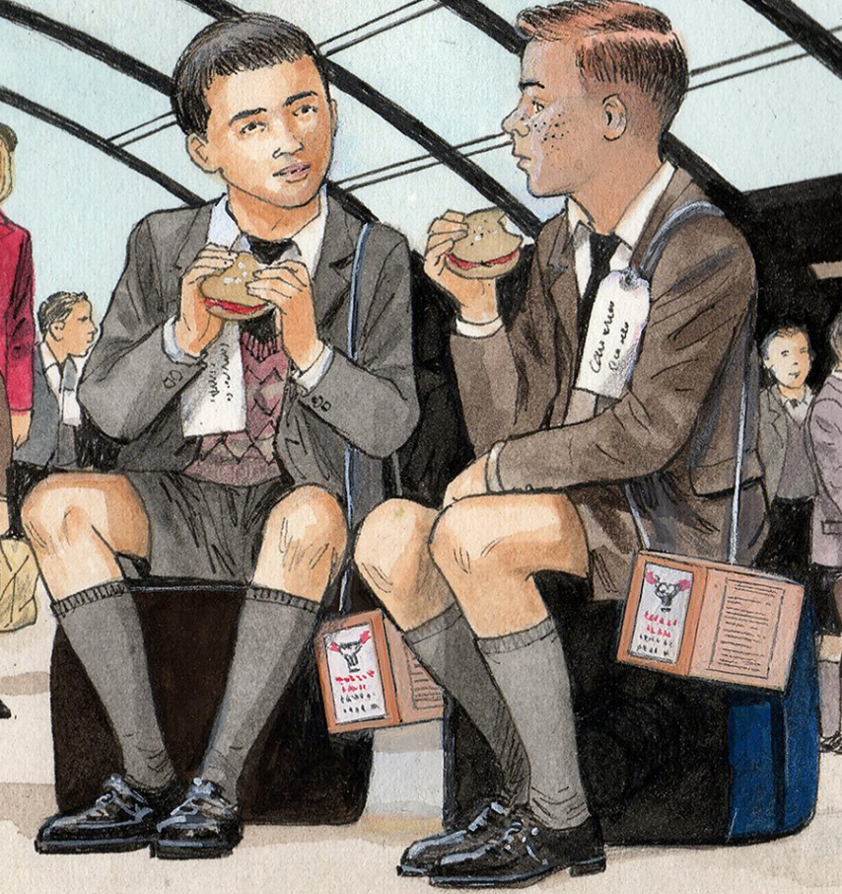
Friend or Foe
Summarise what has happened so far in Friend or Foe.
List the key moments in the book so far.
How does David feel about being evacuated? List the emotions we have seen in the book so far.
What helps David and Tucky feel better whilst being evacuated?

Slide 14
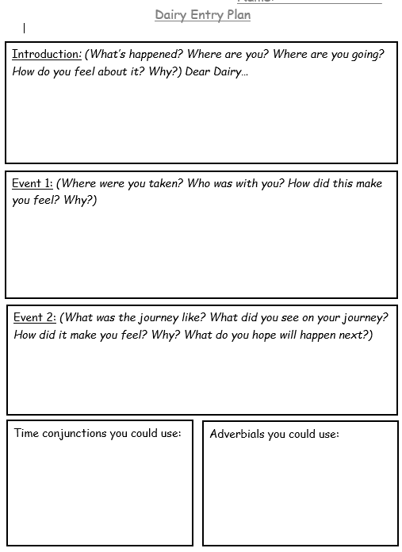
Activity:
Your task is to imagine you are David or Tucky. You are being evacuated and you are recording your experience in your diary.
This diary entry will be about the journey – you have not met Mr Reynolds yet.
Use the planning sheet to help you plan your first diary entry. Stick this into your books.
Look at the questions to help you think of ideas.
Also remember to use all of the information that we learned today in the lesson.

Slide 15
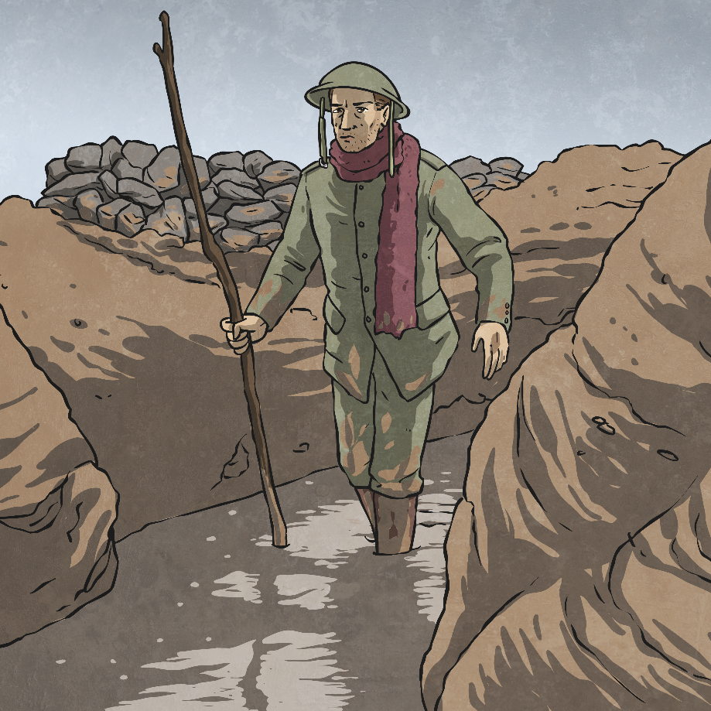
Glossary
censored – To have parts taken out.
conscription – Where it is the law that people join one of the armed forces.
evacuated – To be taken to a place of safety.
self-sufficient – To be able to produce everything needed without getting things from somewhere else.

