Slide 3
1)
2)
3) What percentage of the circle is shaded?
4) What percentage of the circle
is not shaded?
How many degrees are in a right angle?
What do angles on a straight line add up to?
?

Slide 4
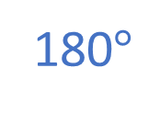
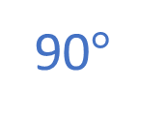
1)
2)
3) What percentage of the circle is shaded?
4) What percentage of the circle
is not shaded?
How many degrees are in a right angle?
90$°$
What do angles on a straight line add up to?
?
180$°$
60%
40%

Slide 6
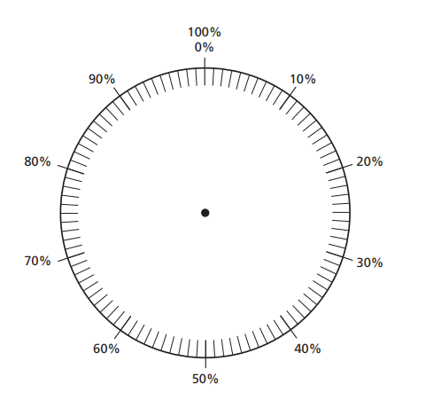
Children were asked to vote for their favourite colour.
Blue
Green
Yellow
Red
0%
10%
20%
30%
40%
50%
60%
70%
80%
90%
100%
Complete the pie chart to
represent the data.
Red
Blue
Yellow
Green

Slide 7
Have a go at question 1 on the worksheet

Slide 8
Quarter turn
90$°$

Slide 9
Quarter turn
90$°$
90$°$
Half turn

Slide 10
Quarter turn
90$°$
90$°$
90$°$
Three-quarter turn
Half turn

Slide 11
Full turn
Quarter turn
90$°$
90$°$
90$°$
90$°$
Three-quarter turn
Half turn

Slide 12
A full turn is equal to 360$°$
360$°$ represents 100% of the data within a pie chart.

Slide 13
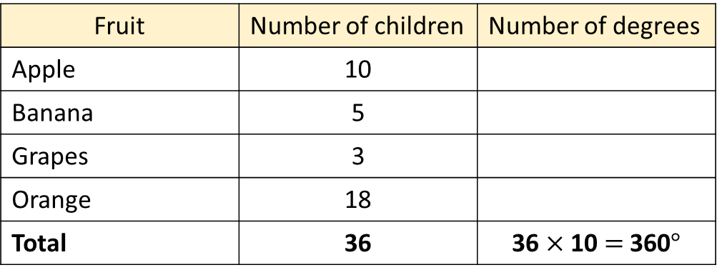
Children were asked their favourite fruit.
The table shows the results.
Fruit | Number of children | Number of degrees
Apple | 10
Banana | 5
Grapes | 3
Orange | 18
Total | 36 | 36 $×$ 10 $=$ 360$°$
10 $×$ 10 $=$ 100$°$
5 $×$ 10 $=$ 50$°$
3 $×$ 10 $=$ 30$°$
18 $×$ 10 $=$ 180$°$
Complete the table to show the number of degrees in each sector of a pie chart.

Slide 14
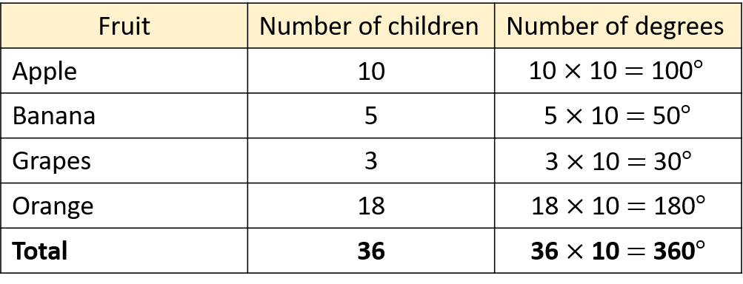
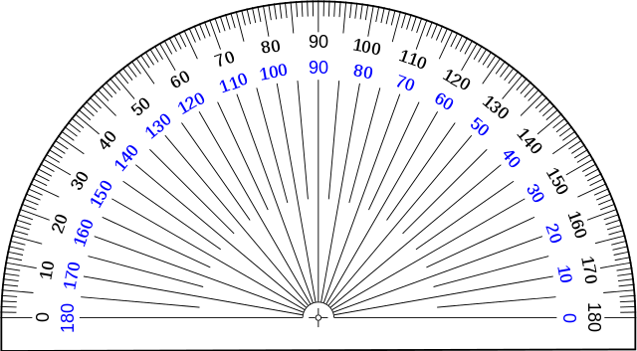
Draw a pie chart to represent the data.
Outer scale
Apple

Slide 15
Draw a pie chart to represent the data.
Apple
Banana

Slide 16
Draw a pie chart to represent the data.
Apple
Banana
Grapes

Slide 17
Draw a pie chart to represent the data.
Apple
Orange
Banana
Grapes

Slide 18
Children were asked their favourite fruit.
The table shows the results.
Fruit | Number of children | Number of degrees
Apple | 10
Banana | 9
Grapes | 8
Orange | 18
Total | 45
10 $×$ 8 $=$ 80$°$
9 $×$ 8 $=$ 72$°$
8 $×$ 8 $=$ 64$°$
18 $×$ 8 $=$ 144$°$
45 $×$ 8 $=$ 360$°$
Complete the table to show the number of degrees in each sector of a pie chart.
Have a think

Slide 19
Have a go at the rest of the questions on the worksheet

