Slide 3
1)
2)
3) What fraction of the circle is shaded?
4) What percentage of the circle
is shaded?
10% of 280 $=$
280
30% of 280 $=$

Slide 4
1)
2)
3) What fraction of the circle is shaded?
4) What percentage of the circle
is shaded?
10% of 280 $=$
28
280
30% of 280 $=$
84
$\frac{\text{2}}{\text{5}}$
40%
100% $÷$ 5 $=$ 20%

Slide 6
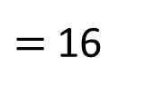
80 children were asked to choose their favourite sport from six options.
Football
Tennis
25%
30%
Rugby
5%
10%
20%
Hockey
10%
Swimming
16
Dance
Work out the number of children who chose each sport.
How many children chose swimming?
80
20% of 80
$=$ 16
Have a think
10% of 80 $=$ 8

Slide 7
80 children were asked to choose their favourite sport from six options.
Football
Tennis
24
20
25%
25%
30%
30%
5%
Rugby
5%
4
10%
10%
20%
Hockey
10%
20%
Swimming
8
10%
16
Dance
8
Work out the number of children who chose each sport.
20% of 80
$=$ 16
30% of 80 $=$ 24
25% of 80 $=$ 20
10% of 80 $=$ 8
5% of 80 $=$ 4

Slide 8
Have a go at questions 1 - 2 on the worksheet

Slide 9
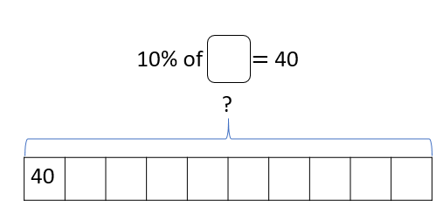
The pie chart shows children’s favourite ice cream flavours.
Vanilla
Strawberry
16%
15%
Chocolate
Lemon
30%
29%
10%
Mint chocolate
10% of ___ $=$ 40
40 children chose mint chocolate.
How many children took part in the survey?
400

Slide 10
400 children were asked to vote for their favourite ice cream flavours.
Vanilla
Strawberry
16%
15%
Chocolate
Lemon
30%
29%
10%
Flavour | Frequency
Vanilla
Chocolate
Mint Choc | 40
Lemon
Strawberry
60
Mint chocolate
120
10% of 400 $=$ 40
30% of 400 $=$ 120
Have a think
5% of 400 $=$ 20
15% of 400 $=$ 60

Slide 11
400 children were asked to vote for their favourite ice cream flavours.
Vanilla
Strawberry
16%
15%
Chocolate
Lemon
30%
29%
10%
Flavour | Frequency
Vanilla
Chocolate
Mint Choc | 40
Lemon
Strawberry
60
Mint chocolate
120
10% of 400 $=$ 40
1% of 400 $=$ 4
30% of 400 $=$ 120
116
5% of 400 $=$ 20
64
15% of 400 $=$ 60

Slide 12
Have a go at the rest of the questions on the worksheet

