Slide 3
If the radius of a circle is 11 mm.
What is the diameter?
If the diameter of a circle is 29 km.
What is the radius?
What fraction of the circle is
shaded?
What fraction is not shaded?

Slide 4
If the radius of a circle is 11 mm.
What is the diameter?
If the diameter of a circle is 29 km.
What is the radius?
What fraction of the circle is
shaded?
What fraction is not shaded?
22 mm
14.5 km
$\frac{\text{2}}{\text{5}}$
$\frac{\text{3}}{\text{5}}$

Slide 6
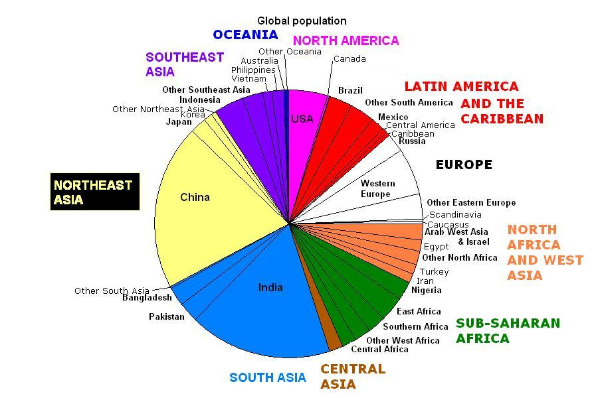
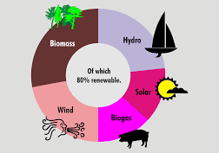
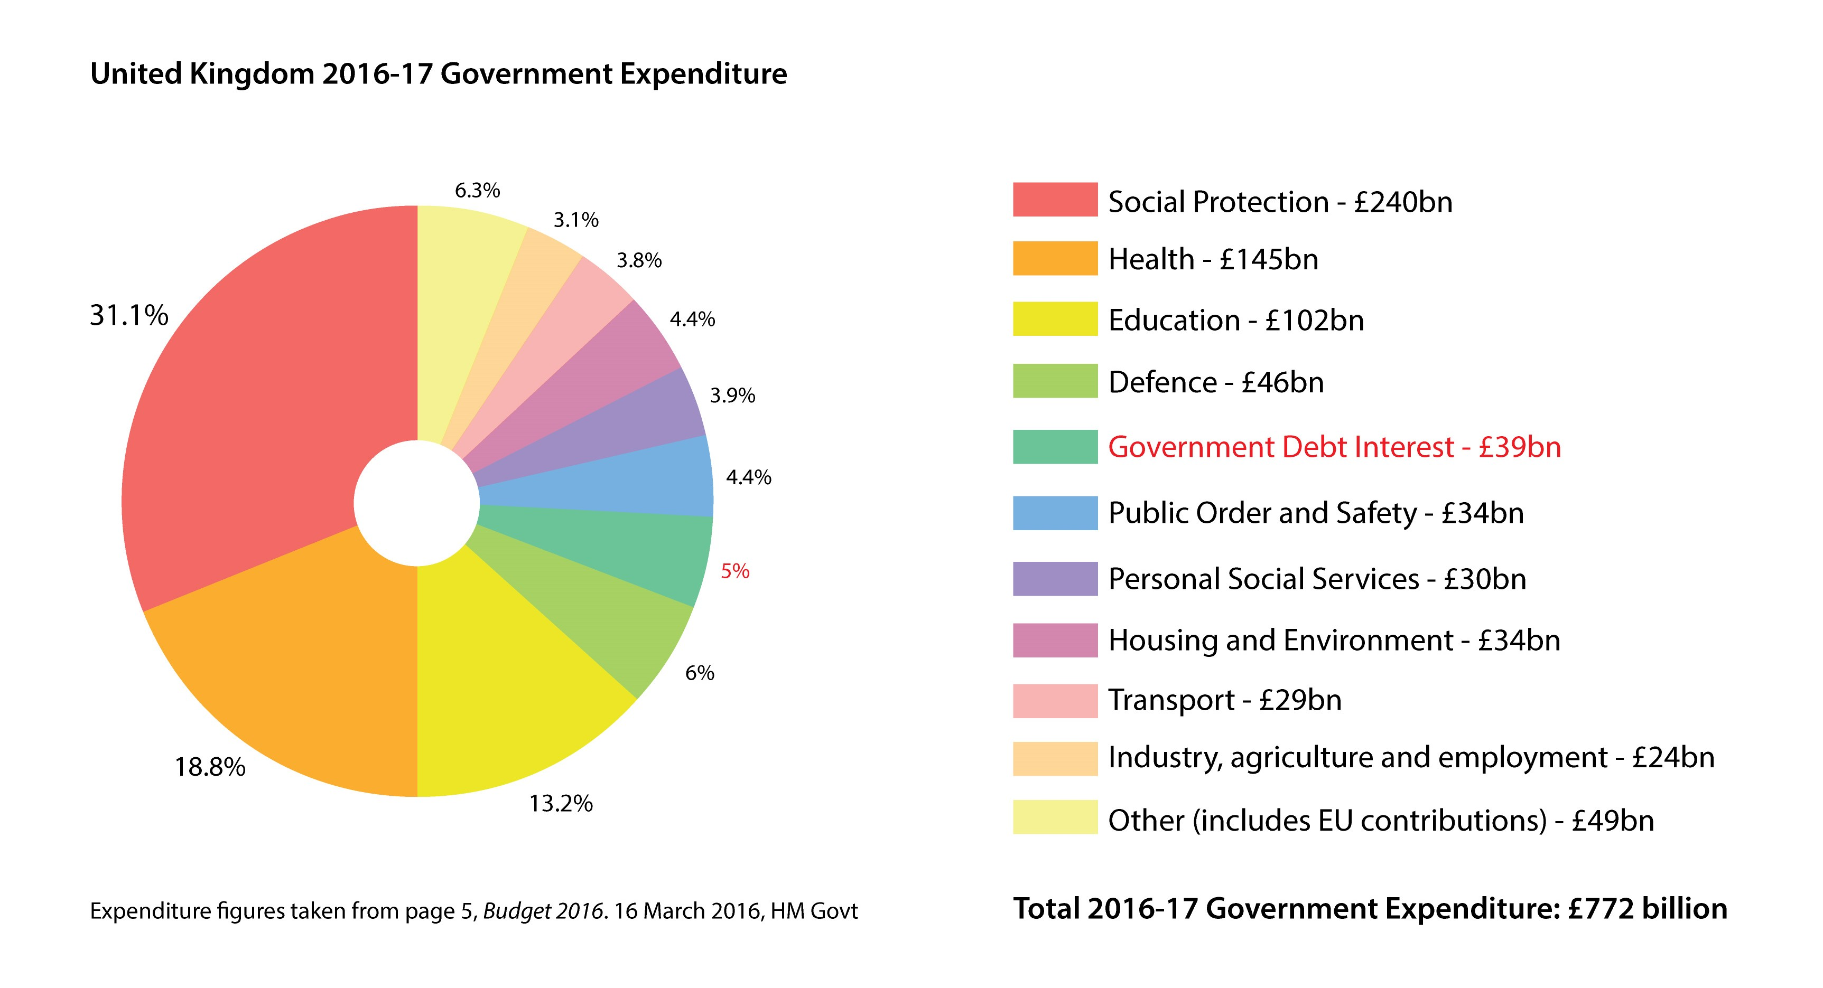

Slide 7
Mrs White is ordering some Leavers hoodies for her class.
The pie chart shows the favourite colours of the children.
If she can only order one colour, what colour hoodies should she order?
Blue
Green
Yellow
If she can order different colours, should she order more yellow or blue hoodies?
Yellow
Green

Slide 8
Favourite colours
$$\frac{\text{1}}{\text{4}}$$
What fraction is red?
Blue
Red
$$\frac{\text{1}}{\text{4}}$$
What fraction is green?
$$\frac{\text{2}}{\text{4}}$$
or $\frac{\text{1}}{\text{2}}$
Blue
Green
What fraction is blue?
Have a think
times as many prefer blue compared to red.
Two
Half
as many prefer green as they do blue.

Slide 9
Have a think
B
R
Red | Green | Blue
$$\frac{\text{1}}{\text{5}}$$
$$\frac{\text{1}}{\text{5}}$$
$$\frac{\text{3}}{\text{5}}$$
B
G
B
Three
times as many prefer blue compared to green.

Slide 10
B
R
Red | Green | Blue
$$\frac{\text{1}}{\text{5}}$$
$$\frac{\text{1}}{\text{5}}$$
$$\frac{\text{3}}{\text{5}}$$
B
G
How many children prefer blue?
B
If there were 30 children?
$\frac{\text{3}}{\text{5}}$ of 30
$=$ 18
Have a think
$\frac{\text{3}}{\text{5}}$ of 60
If there were 60 children?
$=$ 36
$\frac{\text{3}}{\text{5}}$ of 100
If there were 100 children?
$=$ 60

Slide 11
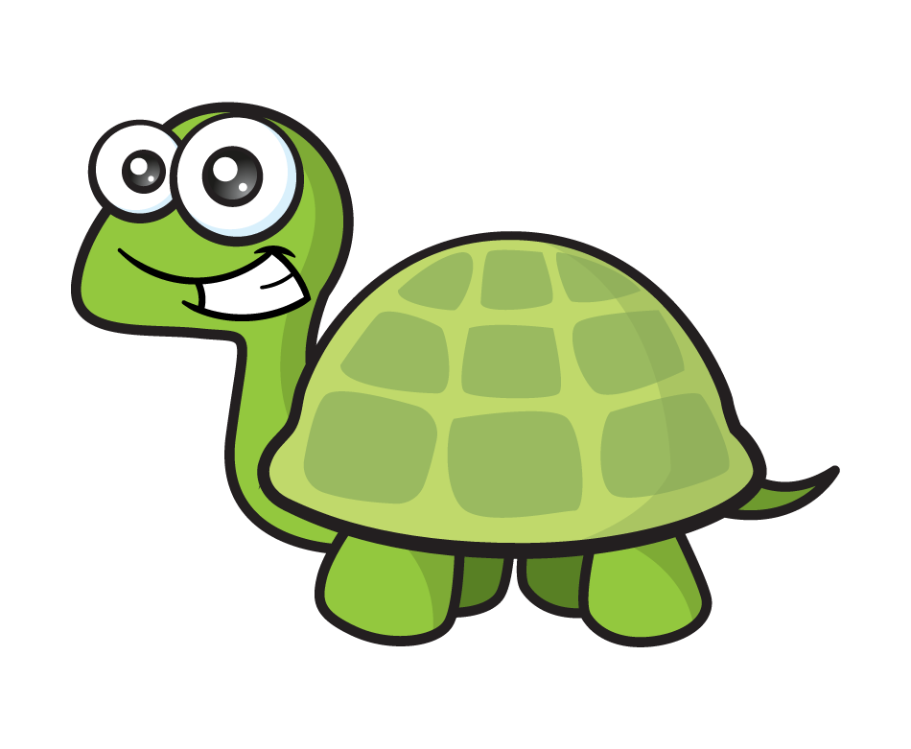
56 children are attending Tiny’s birthday party.
The children were asked what flavour crisps they wanted.
Salt and Vinegar
Cheese and Onion
Roast chicken
Ready Salted
Is there another way?
How many children wanted salt and vinegar and roast chicken flavour crisps?
Salt and Vinegar: $\frac{\text{2}}{\text{8}}$ of 56
$=$ 14
$\frac{\text{1}}{\text{2}}$ of 56 $=$ 28
Roast chicken: $\frac{\text{1}}{\text{4}}$ of 56
$=$ 14
It’s my birthday today!
14 $+$ 14 $=$ 28

Slide 12
56 children are attending Tiny’s birthday party.
The children were asked what flavour crisps they wanted.
Salt and Vinegar
Cheese and Onion
Roast chicken
Ready Salted
Have a think
What fraction did not want Ready Salted flavour?
$\frac{\text{1}}{\text{8}}$ did want Ready Salted.
It’s my birthday today!
$\frac{\text{7}}{\text{8}}$ did not want Ready Salted.

Slide 13
Have a go at questions 1 - 2 on the worksheet

Slide 14
Types of trees in a field
5
5
Oak
Willow
5
5
Birch
5
5
There are 5 birch trees in the field.
How many trees are there altogether?
5 $×$ 6 $=$ 30 trees altogether

Slide 15
Types of trees in a field
3
Oak
Willow
3
3
6
Birch
3
3
There are 6 willow trees in the field.
How many oak trees are there?
6 $÷$ 2 $=$ 3
Have a think
3 $×$ 3 $=$ 9 oak trees

Slide 16
At school A, 64 children were asked what sports team they would like to join.
At school B, 96 children were asked what sports team they would like to join.
A
B
Football
Dance
Hockey
Swimming
True or False?
Have a think
More children want to join football at School A than School B

Slide 17
At school A, 64 children were asked what sports team they would like to join.
At school B, 96 children were asked what sports team they would like to join.
A
B
Football
Dance
Hockey
Swimming
24 children
$\frac{\text{3}}{\text{8}}$ of 64
$\frac{\text{2}}{\text{8}}$ of 96
True or False?
More children want to join football at School A than School B
False

Slide 18
Have a go at the rest of the questions on the worksheet

