Slide 1
Week 33
Monday English
Using drama to explore Lord and Lady Macbeth’s relationship.

Slide 3
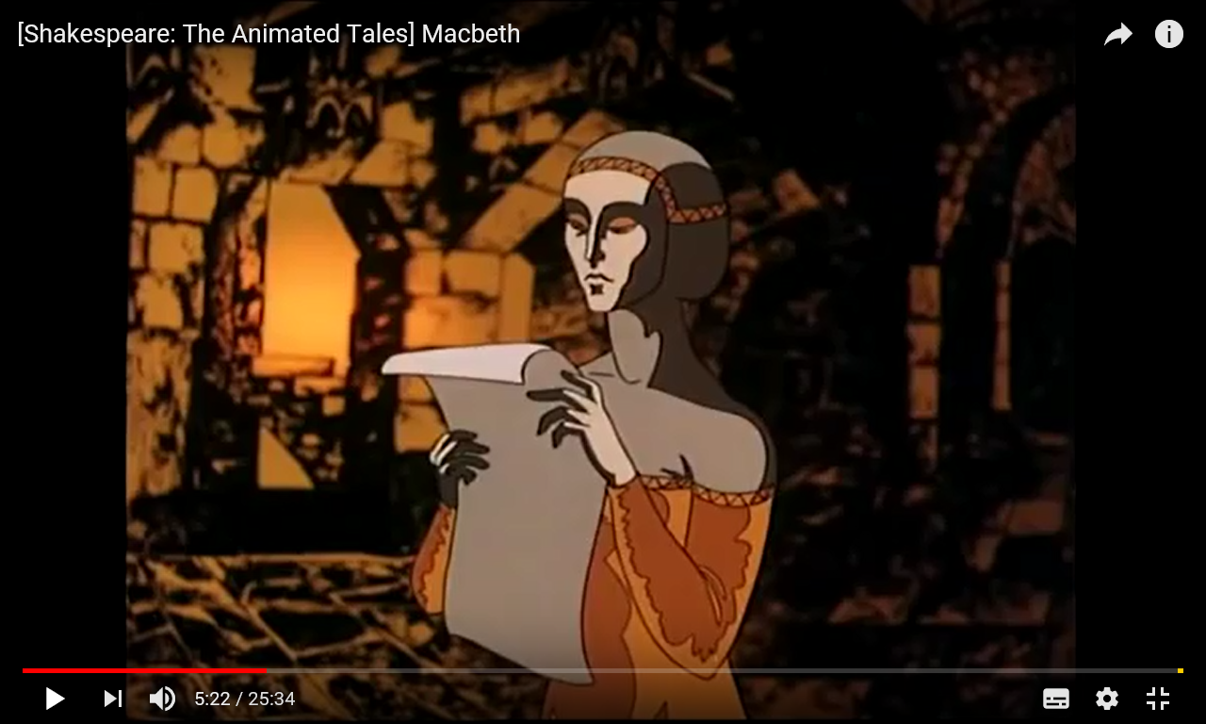

Slide 4
LADY MACBETH
Great Glamis, worthy Cawdor,
Greater than both, by the all-hail hereafter,
MACBETH
My dearest love,
Duncan comes here tonight.
LADY MACBETH
And when goes hence?
MACBETH
Tomorrow, as he purposes.
LADY MACBETH
O, never
Shall sun that morrow see!
Look like the innocent flower,
But be the serpent under it.
Only look up clear.
Leave all the rest to me.
The raven himself is hoarse
That croaks the fatal entrance of Duncan
Under my battlements.

Slide 5
What happens next?

Slide 6
Week 33
Tuesday English
Exploring Lady Macbeth’s true feelings.

Slide 7
V n
A e
H e
R d
L g

Slide 8
It’s the morning after King Duncan’s murder.
Write a first person diary entry as Lady Macbeth, describing her feelings about the King’s murder.
Try to hint at what might happen in the future, too.

Slide 9
What am I writing?
A diary entry
Who am I writing it for?
Other Year Six children
Why am I writing it?
To entertain
What do I want the reader to do?
To understand how greedy and
ambitious Lady Macbeth really is

Slide 10
3 x wow words
achieve, hindrance, interfere

Slide 11
What is Lady Macbeth thinking?
What adjectives could we use to describe her?
How does she talk, move, look?
How does she compare with her husband?

Slide 12
Monday
My dear diary, I am so desperate. Desperate as a hungry animal. When will I achieve my long-standing need for power? How rich could I become? Can I trust my husband to carry through my desired deed? Oh diary… I am so terribly desperate!
Tuesday
Joy! I am desperate no more! This morning, as the damp, dawn mist swirled around the castle battlements, the King was found dead in his bed. Murdered! Why should I sound so surprised? Ha! Ha! We both know, my dearest, oldest friend, that it is I who arranged this heinous, devilish act. Unfortunately, my wretched husband worries too much; he must not become a hindrance or else…

Slide 13
Let’s showcase some of your writing…

Slide 14
Week 33
Wednesday English
Exploring Lady Macbeth’s motivations.

Slide 16
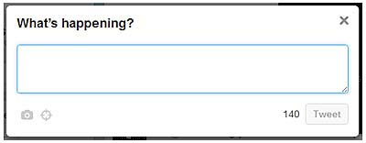
Write a tweet, giving your opinion of Lady Macbeth and why you think this.

Slide 17
What are Lady Macbeth’s motivations for having Duncan killed?
POWER AND WEALTH!!!

Slide 18
Wednesday
If I were the last person on earth, I could not be happier. Imagine this! I can buy anything I desire – golden trinkets, rooms full of silver, a legion of dutiful servants. Hold on! An army…I need a stronger, more powerful army to rout Banquo and his treacherous family. After that… Queen of England! Queen of Europe! Queen of the World! Nobody can interfere with my plans!

Slide 19
What does Lady Macbeth’s think about her husband?

Slide 20
Thursday
Hmmm…. my husband will of course have to be persuaded of my plans. Not that I am concerned whatsoever by that. After all, I easily convinced this poor, weak man of the need to murder Duncan. Wicked, ghostly witches may talk in the new King of Scotland’s head; his heart is gripped tightly by my cold, strong hands. Macbeth is a mere puppet on a string, ready to dance to my tune.

Slide 21
Look like the innocent flower,
But be the serpent under it.
Only look up clear.
Leave all the rest to me.

Slide 22
Week 33
Thursday English
Using repetition for effect in the final diary entry.

Slide 23
B g
U d
R n
S t
A e

Slide 24
The Power of the Simile…
Power is like …
Can you also try a metaphor?
Wealth is …

Slide 25
I was desperate. Desperate as a hungry animal. Not any longer. However, I must go now, dear diary. I hear some soldiers, milling around outside my chamber like excitable mice. Power, wealth, influence – which of these is my favourite feeling? I cannot decide! The King is dead! Long live the Queen!

Slide 26
repetition
short sentence
I was desperate. Desperate as a hungry animal. Not any longer. However, I must go now, dear diary. I hear some soldiers, milling around outside my chamber like excitable mice. Power, wealth, influence – which of these is my favourite feeling? I cannot decide! The King is dead! Long live the Queen!
preposition
simile
three dash sentence
exuberant ending

Slide 27
Monday
My dear diary, I am so desperate. Desperate as a hungry animal. When will I achieve my long-standing need for power? How rich could I become? Can I trust my husband to carry through my desired deed? Oh diary… I am so terribly desperate!
Tuesday
Joy! I am desperate no more! This morning, as the damp, dawn mist swirled around the castle battlements, the King was found dead in his bed. Murdered! Why should I sound so surprised? Ha! Ha! We both know, my dearest, oldest friend, that it is I who arranged this heinous, devilish act. Unfortunately, my wretched husband worries too much; he must not become a hindrance or else…
Wednesday
If I were the last person on earth, I could not be happier. Imagine this! I can buy anything I desire – golden trinkets, rooms full of silver, a legion of dutiful servants. Hold on! An army…I need a stronger, more powerful army to rout Banquo and his treacherous family. After that… Queen of England! Queen of Europe! Queen of the World! Nobody can interfere with my plans!

Slide 28
Thursday
Hmmm…. my husband will of course have to be persuaded of my plans. Not that I am concerned whatsoever by that. After all, I easily convinced this poor, weak man of the need to murder Duncan. Wicked, ghostly witches may talk in the new King of Scotland’s head; his heart is gripped tightly by my cold, strong hands. Macbeth is a mere puppet on a string, ready to dance to my tune.
Friday
I was desperate. Desperate as a hungry animal. Not any longer. However, I must go now, dear diary. I hear some soldiers, milling around outside my chamber like excitable mice. Power, wealth, influence – which of these is my favourite feeling? I cannot decide! The King is dead! Long live the Queen!

Slide 29
Let’s have a look at some of your writing, so far…

