Slide 3
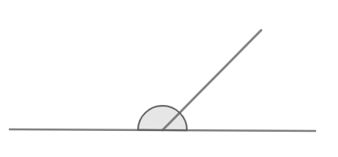
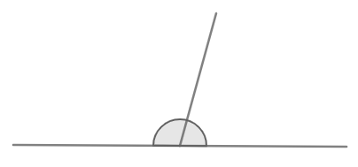
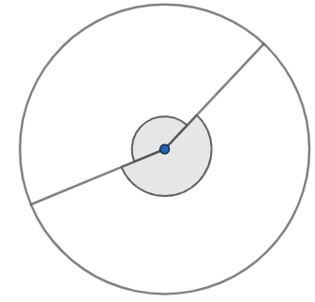
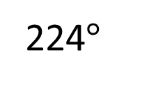
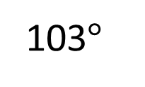
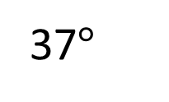
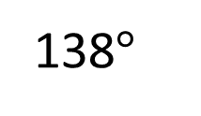
Work out the unknown angles.
103$°$
$$a°$$
$$b°$$
37$°$
138$°$
$$c°$$
224$°$
$$d°$$

Slide 4




Work out the unknown angles.
77$°$
143$°$
103$°$
$$a°$$
$$b°$$
37$°$
136$°$
138$°$
$$c°$$
224$°$
$$d°$$
222$°$

Slide 6
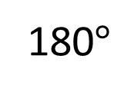
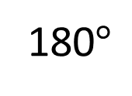
180$°$
$$x$$
$$y$$
180$°$
What are the sizes of angles $x$ and $y$?

Slide 7
Have a think
$$w$$
$$x$$
$$z$$
$$y$$
What do you predict about the sizes of angles $w, x, y$and $z$?

Slide 8
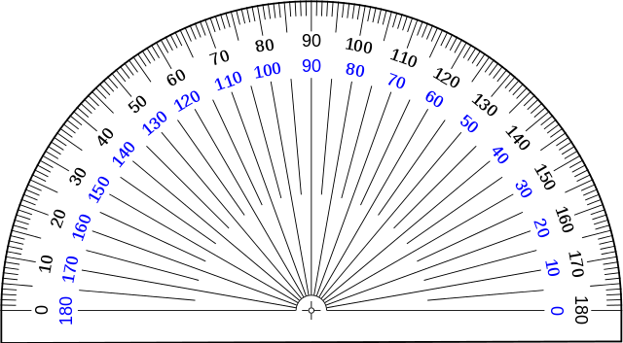
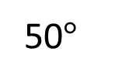
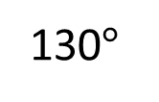
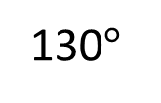
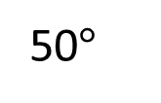
What do you predict about the sizes of angles $w, x, y$and $z$?
$$w$$
$$x$$
130$°$
50$°$
50$°$
$$z$$
$$y$$
130$°$

Slide 9
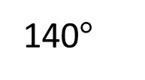
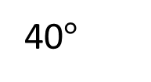
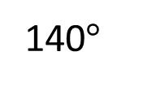
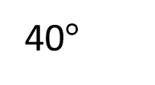
What do you predict now?
Which angles will have increased? Which angles will have decreased?
140$°$
40$°$
40$°$
140$°$
Have a think

Slide 10
Have a think
140$°$
40$°$
40$°$
140$°$
What do you predict now?

Slide 11
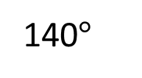
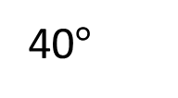
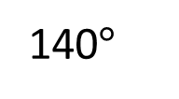
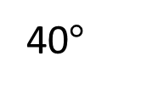
140$°$
40$°$
40$°$
140$°$

Slide 12
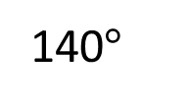
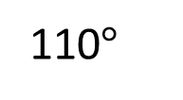
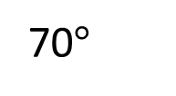
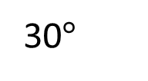
Have a think
140$°$
40$°$
70$°$
30$°$
40$°$
140$°$
110$°$
What do you predict now?

Slide 13
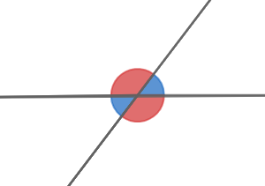
These are called vertically opposite angles.
Vertically opposite angles are equal in size.

Slide 14
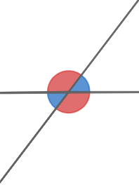
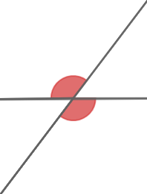
How many pairs of vertically opposite angles can you find?
2 pairs
1 pair

Slide 15
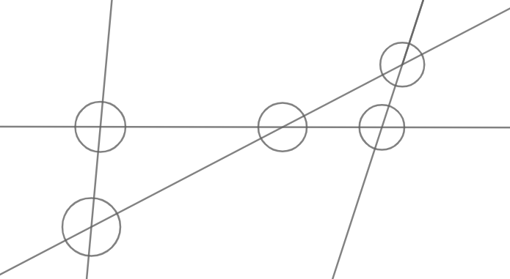
How many pairs of vertically opposite angles can you find?
Have a think
2 pairs
5 $×$ 2 $=$ 10 pairs

Slide 16
Have a go at questions 1 - 4 on the worksheet

Slide 17
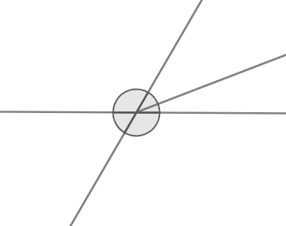
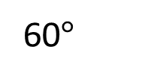
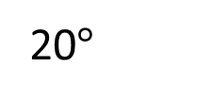
What is the size of angle $x$?
$$x$$
20$°$
60$°$
Have a think

Slide 18
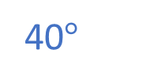
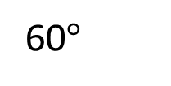
What is the size of angle $x$?
What is the size of angle $x$?
40$°$
$$x$$
20$°$
60$°$
$x+$ 20$°=$ 60$°$
$x$ $=$ 40$°$

Slide 19
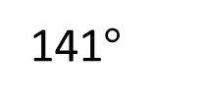
Angle $b$ is twice the size of angle $a$.
$$a°$$
$$b°$$
141$°$
Work out the size of angles $a$ and $b$.
Have a think

Slide 20
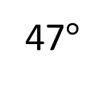
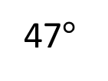
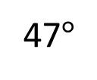

Angle $b$ is twice the size of angle $a$.
$$a°$$
$$b°$$
141$°$
$a+b=$ 141$°$
$$a$$
47$°$
141$°$ $÷$ 3
$=$ 47$°$
Work out the size of angles $a$ and $b$
141$°$
$a=$ 47$°$
$b=$ 94$°$
$$b$$
47$°$
47$°$

Slide 21
Have a go at the rest of the questions on the worksheet

