Slide 3

Complete the bar models.
2) The arrow is turned 90$°$ anti-clockwise.
Which way is the arrow now facing?
180
67
180
82 | 85
360
89
360
78 | 92

Slide 4
Complete the bar models.
2) The arrow is turned 90$°$ anti-clockwise.
Which way is the arrow now facing?
180
67
180
82 | 85
113
13
360
89
360
78 | 92
271
190

Slide 6
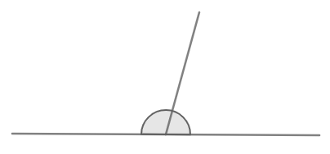
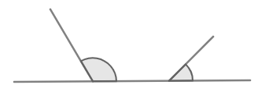
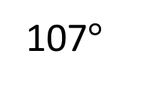
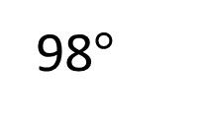
Adjacent angles on a straight line sum to 180$°$
$$b°$$
98$°$
$$a°$$
107$°$
Can you calculate the missing angles?
Have a think

Slide 7
Adjacent angles on a straight line sum to 180$°$
$$b°$$
98$°$
$$a°$$
107$°$
$a°$ $+$ 98$°$ $=$ 180$°$
$a°$ $=$ 82$°$

Slide 8
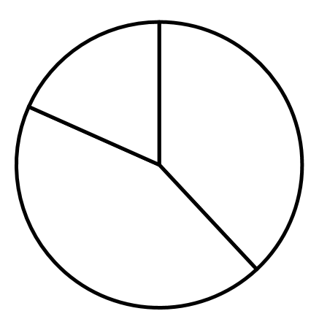
Angles around a point sum to 360$°$
Calculate the missing angles
51°
90°
113°
$$a$$
72°
$$b$$
162°
Have a think

Slide 9
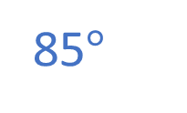
Angles around a point sum to 360$°$
Calculate the missing angles.
51°
90°
85$°$
113°
$$a$$
72°
$$b$$
162°
90$°+$ 51$°+$72$°=$ 213$°$
360$°$
162$°$ | 113$°$ | $$a$$
360$°$
275$°$ | $$a$$
275$°$ | 85$°$
275$°$ | $$a$$
213$°+$ $b°=$ 360$°$
$b°=$ 147$°$
162$°+$ 113$°=$ 275$°$
275$°+$ $a°=$ 360$°$

Slide 10
Have a go at questions 1 - 6 on the worksheet

Slide 11
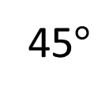
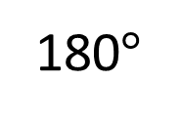
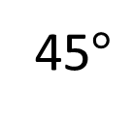
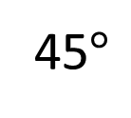
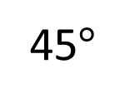
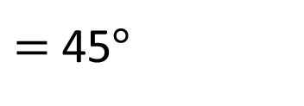
Angle $a$ is 3 times the size of angle $b$
Work out the size of the unknown angles.
$$a$$
$$b$$
$a+b=$ 180$°$
$$a$$
45$°$
45$°$
45$°$
180$°$ $÷$ 4
$=$ 45$°$
180$°$
$$b$$
45$°$
Have a think
$a=$ 135$°$
$b=$ 45$°$

Slide 12
A number of children voted for their favourite colour.
A third of the children said blue was their favourite colour.
Four times as many children voted for green as those who voted for yellow.
Work out the size of the angle for each sector in the pie chart.
Have a think

Slide 13
A number of children voted for their favourite colour.
A third of the children said blue was their favourite colour.
Four times as many children voted for green as those who voted for yellow.
120$°$
360$°$ $÷$ 3
$=$ 120$°$
360$°$ $−$ 120$°$ $=$ 240$°$

Slide 14
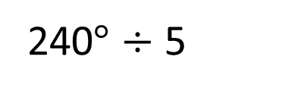
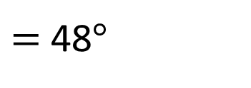

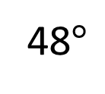
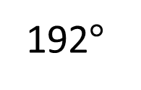
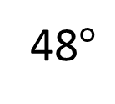
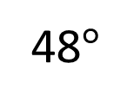
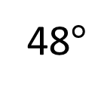
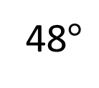
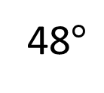
A number of children voted for their favourite colour.
A third of the children said blue was their favourite colour.
Four times as many children voted for green as those who voted for yellow.
48$°$
G
48$°$
48$°$
48$°$
48$°$
120$°$
240$°$
192$°$
Y
48$°$
240$°$ $÷$ 5
$=$ 48$°$

Slide 15
Have a go at the rest of the questions on the worksheet

