Slide 3
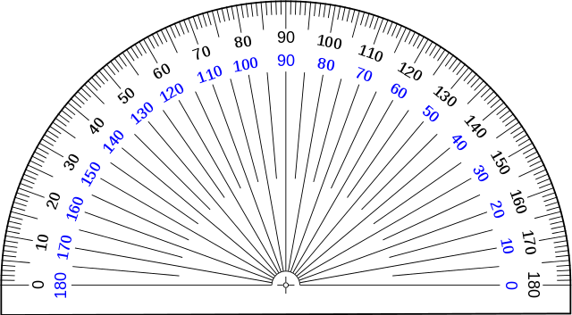
1) Complete the sentences.
There is _____ right angle in a quarter turn.
A quarter turn is _____ degrees.
There are _____ right angles in a three-quarter turn.
A three-quarter turn is ____ degrees.
2) Draw an angle of 80$°$

Slide 4
1) Complete the sentences.
There is _____ right angle in a quarter turn.
A quarter turn is _____ degrees.
There are _____ right angles in a three-quarter turn.
A three-quarter turn is ____ degrees.
2) Draw an angle of 80$°$
1
90
3
270

Slide 6
Where have you seen a full turn like this before in your life?

Slide 7
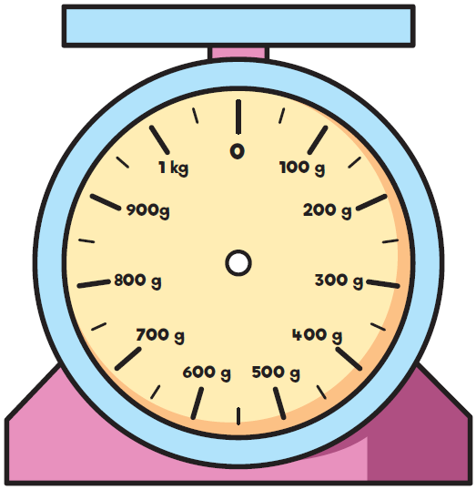
Both the clock and scale turn around a point

Slide 8
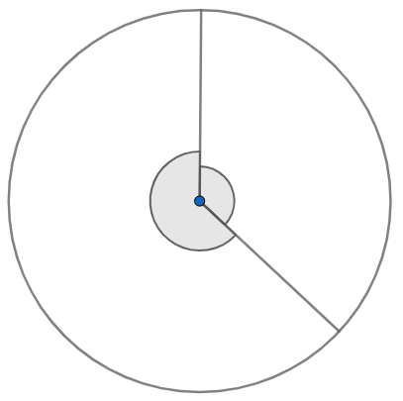
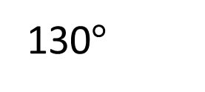
A full turn is equal to 360$°$
Have a think
130$°$
$$x$$
What is the size of angle $x$?

Slide 9
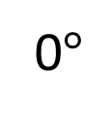
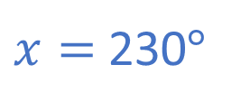

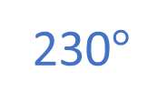
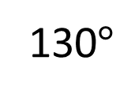
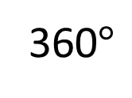
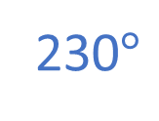
230$°$
130$°$
$$x$$
$$x$$
230$°$
0$°$
130$°$
360$°$
130$°$ $+$ $x=$ 360$°$
$x=$ 230$°$

Slide 10
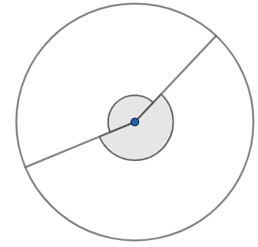
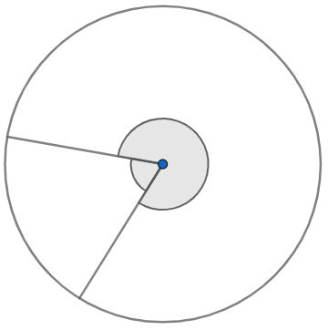
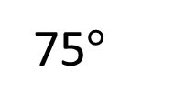
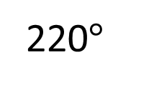
Have a think
Calculate the missing angles.
$$x$$
$$y$$
75$°$
220$°$

Slide 11
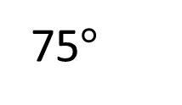
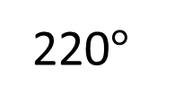
360$°$
$$x$$ | 220$°$
$$x$$
220$°$
360$°−$ 220$°=$ $x$
140$°=$ $x$
360$°$
75$°$ | $$y$$
$$y$$
75$°$
360$°−$ 75$°=$ $y$
285$°=$ $y$

Slide 12
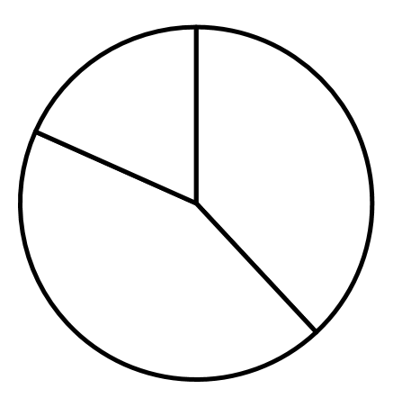
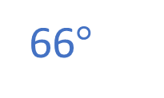
Calculate the missing angle
66$°$
137°
$$a$$
157°
360$°$
137$°$ | 157$°$ | $$a$$
360$°$
294$°$ | $$a$$
294$°$ | 66$°$
294$°$ | $$a$$
137$°+$ 157$°=$ 294$°$
294$°+$ $a°=$ 360$°$

Slide 13
Have a go at questions 1 - 4 on the worksheet

Slide 14
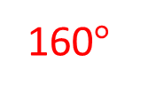
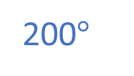
Use a protractor to draw an angle of 200$°$
That’s not possible! A protractor only goes up to 180$°$
160$°$
200$°$
160
200$°+$ ___$°=$ 360$°$
Have a think

Slide 15
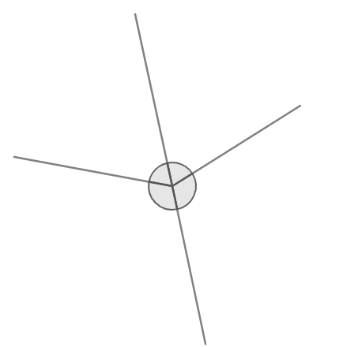
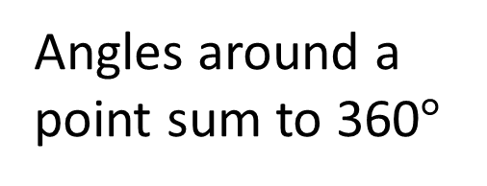
What will the sum of angles $w, x, y$ and $z$ be?
$$w$$
$$x$$
$$z$$
$$y$$
Angles around a point sum to 360$°$

Slide 16
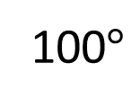
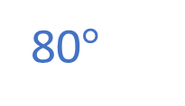
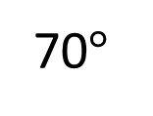
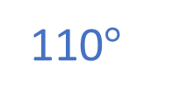
100$°$ $+$ 80$°+$ 110$°$ $+$ 70$°$ $=$
360$°$
$$w$$
80$°$
70$°$
100$°$
$$y$$
110$°$
Adjacent angles on a straight line sum to 180$°$

Slide 17
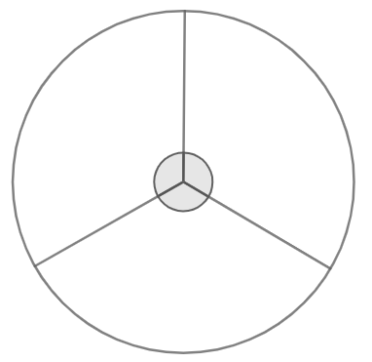
Have a think
$$x$$
$$x$$
$$x$$
Calculate the size of angle $x$

Slide 18
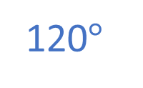
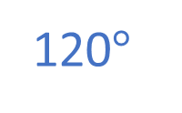
120$°$
120$°$
$$x$$
$$x$$
$$x$$
120$°$
Full turn $=$ 360$°$
360$°÷$ 3 $=$ $x$

Slide 19
Have a go at the rest of the questions on the worksheet

