Slide 3
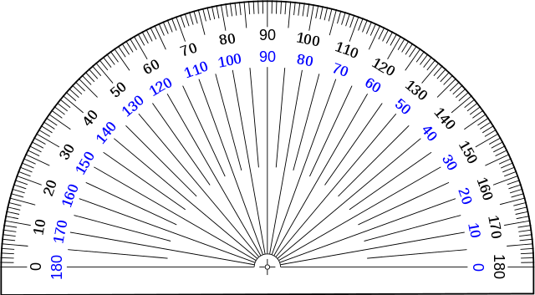
1) Complete the sentences.
There are _____ right angles in a half turn.
A half turn is _____ degrees.
There are _____ right angles in a full turn.
A full turn is ____ degrees.
2) Draw an angle of 180$°$

Slide 4
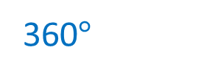
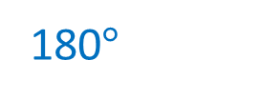
1) Complete the sentences.
There are _____ right angles in a half turn.
A half turn is _____ degrees.
There are _____ right angles in a full turn.
A full turn is ____ degrees.
2) Draw an angle of 180$°$
2
180$°$
4
360$°$

Slide 6
How many degrees are in a straight angle?
There are 180$°$ in a straight angle.

Slide 7
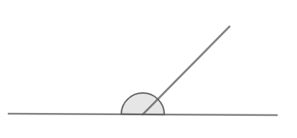
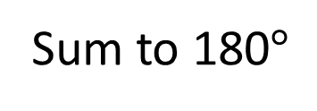
$$x °$$
$$y °$$
$x °=$ 135$°$
Sum to 180$°$
$y °=$ 45$°$

Slide 8
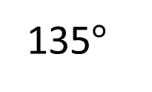
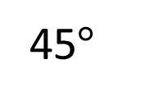
135$°$
45$°$
Adjacent angles on a straight line sum to 180$°$
Angles that share a common line and common vertex

Slide 9
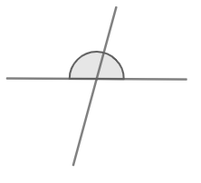
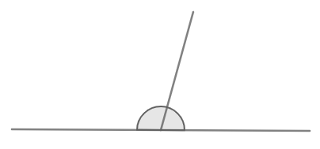
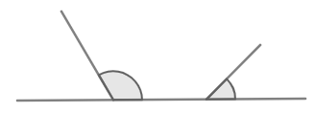
Have a think
Are the angles adjacent on a straight line?

Slide 10
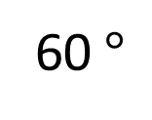
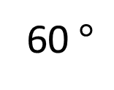
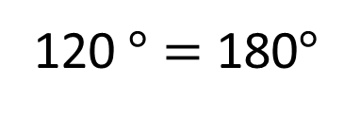
120$°$
60$°$
60$°$
$$+$$
120$°$ $=$ 180$°$
60$°$
180$°$ $−$ 120$°$ $=$

Slide 11
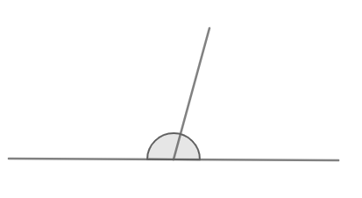
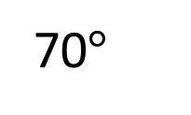
Have a think
$$x °$$
70$°$
What is the value of $x$?
$x$ $+$ 70$°$ $=$ 180$°$
$x$ $=$ 110$°$

Slide 12
Have a go at questions 1 - 3 on the worksheet

Slide 13
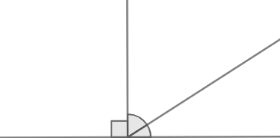
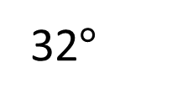
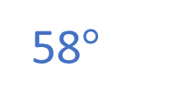
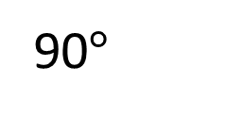
Have a think
58$°$
$$x °$$
90$°$
32$°$
What is the value of $x$?
180$°$
90$°$ | $$x °$$ | 32$°$
122$°$ | 58$°$
122$°$ | $$x °$$
180$°$
90$°$ | 32$°$ | $$x °$$
180$°$
122$°$ | $$x °$$
90$°+$ 32$°=$ 122$°$
122$°+$ $x °=$ 180$°$

Slide 14
Have a think
$$x$$
$$x$$
$$x$$
$$x$$
$$x$$
Calculate the size of angle $x$

Slide 15
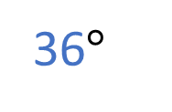

$$x$$
$$x$$
$$x$$
$$x$$
$$x$$
36$°$
$5x$ $=$ 180$°$
$x$ $=$ 180$°$ $÷$ 5
$x=$ 36$°$

Slide 16
Have a go at the rest of the questions on the worksheet

