Slide 1
PSHE and Citizenship
Living in the Wider World | Aiming High
PSHE and Citizenship | UKS2 | Living in the Wider World | Aiming High | The World of Work | Lesson 5

Slide 3
Aim
I can understand there are a variety of routes into different jobs which may match my skills and interests.
Success Criteria
I can state positive things that I have achieved in my life so far.
I can select areas of work that interest me.
I understand and can explain the different routes into careers.
This resource is fully in line with the Learning Outcomes and Core Themes outlined in the PSHE Association’s Programme of Study.

Slide 4
The Big Questions

Slide 5
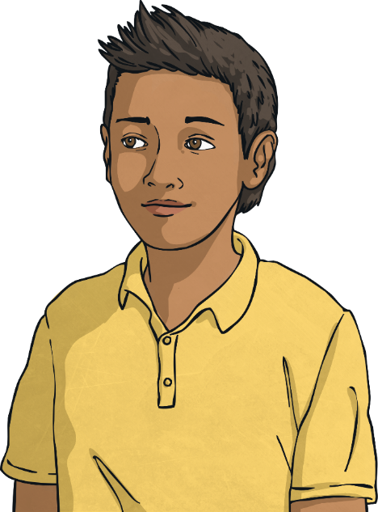
What skills might we need in the world of work?
What are the different routes into careers?

Slide 6
Reconnecting

Slide 7
My Achievements
What does ‘achievement’ mean?
Can you think of a variety of things you have achieved in your life so far?
Working with your partner, think about what you feel an ‘achievement’ is.
See if you can think of some examples from at school, within friendships, outside of school and at home.
These achievements can be from many years ago or very recent.

Slide 8
Exploring

Slide 9
Which Skill?
Innovation and enterprise within work mean coming up with new ideas through inventive and resourceful ways. They encompass many important traits needed for the world of work.
These can be grouped into seven core skills:
positivity
making decisions
teamwork
listening to others
presenting ideas
creativity
problem-solving
These skills are ones that we can practise right now.
Let’s think a bit more about these skills and look at examples of each one.

Slide 10
Which Skill?
positivity
making decisions
These seven skills are all skills that you will have achieved or will be working on achieving at the moment.
teamwork
listening to others
Spend some time with your group considering why each skill would be important to an employer and why they are necessary for the world of work.
presenting ideas
creativity
problem-solving

Slide 11
Areas of Work
There are many ways to group different jobs. Here we have different jobs grouped in 24 ways.
21. Science and Pharmaceuticals
16. Property and Construction
11. Law
6. Engineering and Manufacturing
1. Accountancy, Banking and Finance
Do you know a definition or explanation for each area of work?
22. Social Care
17. Public Services and Administration
12. Law Enforcement and Security
2. Business, Consulting and Management
7. Environment and Agriculture
23. Teaching and Education
13. Leisure, Sport and Tourism
8. Healthcare
If not, could you research the area of work and then try and explain what it is and what people in those roles do?
18. Recruitment and HR
3. Charity and Voluntary Work
24. Transport and Logistics
9. Hospitality and Events Management
14. Marketing, Advertising and PR
19. Retail
4. Creative Arts and Design
15. Media and Internet
20. Sales
5. Energy and Utilities
10. Information Technology

Slide 12
Routes into Careers
As well as knowing about different careers that exist, it is important to understand the routes you can take to get there.
Different routes that exist within our country are:
college
starting your own business
work experience
employment
university
apprenticeships

Slide 13
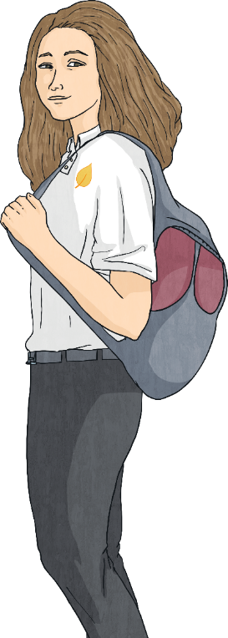
Routes into Careers
College
This involves spending more time learning key information and skills.
At college you will choose a specific course which interests you.
This might lead directly into a line of work and will give you a qualification at the end.

Slide 14
Routes into Careers
Work Experience
This involves starting to work in a role that interests you in order to gain some experience and understanding about the job. This will help you decide if it is right for you but it will also ensure you already have some of the basic skills needed for the job. This might also include spending some time volunteering in the role.

Slide 15
Routes into Careers
University
This also involves more learning and studying. Studying at university is mixed between taught learning and independent learning. You will gain a qualification at the end of the course.

Slide 16
Routes into Careers
Starting Your Own Business
Starting your own business means you work for yourself and manage your own work.
This may involve having a financial loan at first to help you build your business.

Slide 17
Routes into Careers
Employment
This is where you work for someone else or for a business owned and run by someone else.
You will be paid a set amount and may progress
to having more
responsibility and being
paid more the longer you have been there and the
more skills you have developed.

Slide 18
Routes into Careers
Apprenticeships
This route involves working, learning and earning money all at the same time.
This route may pay you a reduced amount of money to match the learning and development you are getting
from being in the role.
You will then end the apprenticeship with a qualification in the role.

Slide 19
The Big Questions

Slide 20
What skills might we need in the world of work?
What are the different routes into careers?
What have you learnt today?
How will it help you in your daily life?

Slide 21
Aim
I can understand there are a variety of routes into different jobs which may match my skills and interests.
Success Criteria
I can state positive things that I have achieved in my life so far.
I can select areas of work that interest me.
I understand and can explain the different routes into careers.
This resource is fully in line with the Learning Outcomes and Core Themes outlined in the PSHE Association’s Programme of Study.

