Slide 1
Week 30
Monday English
Macbeth narrative –paragraphs 2 and 3: description and dialogue

Slide 2
S t
N d
G s
R e
E y

Slide 3
What am I writing?
A narrative about Macbeth
Who am I writing it for?
Children aged 9 - 12
Why am I writing it?
To entertain my readers.
What do I want the reader to do?
Understand the dilemma, faced by Macbeth

Slide 4
3 x wow words
although, rough, thorough

Slide 5
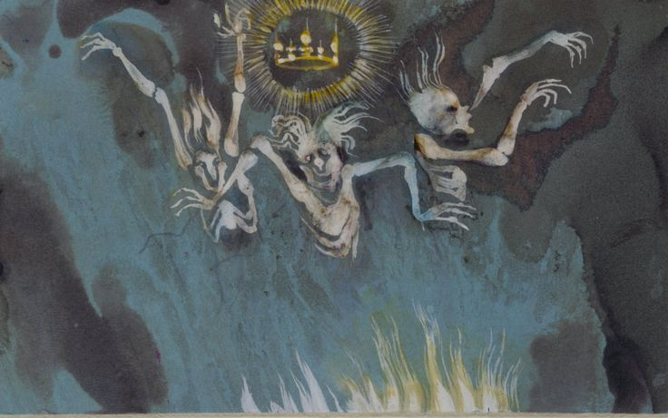

Slide 6
What were the three predictions made by the witches?
Macbeth will become Thane of Cawdor.
Macbeth will become the King of Scotland.
Banquo will never rule in Scotland. However, future generations of hs family will…

Slide 7
How do the witches look, move, speak?
How does the atmosphere change, when the witches appear (the weather, the heath)?
How do Macbeth and Banquo feel when they see the apparition?
Use a simile, a metaphor and personification

Slide 8
Very soon, Macbeth and Banquo had embarked on their long trek across the heath and back to King Duncan’s castle, on High Dunsinane Hill. As they approached the mid-point in their travels, the sky changed from a blazing red to a bruising blue and black; clouds gathered, suggesting impending doom. Within seconds, the men were choking and spluttering in a thick, soupy mist. Their steeds reared up awkwardly on their back legs, neighing frantically - three bizarre spectres swiftly rose from the marshy ground, hooting and guffawing, speaking in tongues to Macbeth and Banquo and wrapping themselves around their legs like deadly vipers.

Slide 9
Write your next paragraph, describing the scene when the witches appear.
Vocabulary for precision (expanded noun phrases, adverbials).
Figurative language (convey the gloomy atmosphere…the sense of impending doom).
Write a line, miss a line

Slide 10
Write a short paragraph of dialogue, describing how Macbeth and Banquo both feel, when the witches appear.
After a few seconds, the frail ghouls melted back into the earth. The two warriors continued on their journey.
“Those old hags claimed I am to be the Thane of Cawdor…then…the King of all Scotland! How foolish they were!” Macbeth laughed loudly.
“True, my friend. But remember that they also predicted that my son will be the King, one of these days…” responded Banquo, thoughtfully.
“Hmmm… yes, they did mention that possibility.” Macbeth whispered, not laughing any more.
Write a line, miss a line

Slide 11
Let’s have a look at some of your work, so far.
Vocabulary for precision (expanded noun phrases, adverbials).
Figurative language (conveying the gloomy atmosphere…the sense of impending doom).
Accurate speech that conveys how the characters are feeling.
3 x WOW words

Slide 12
Week 30
Monday Spellings
adverbials of time

Slide 13
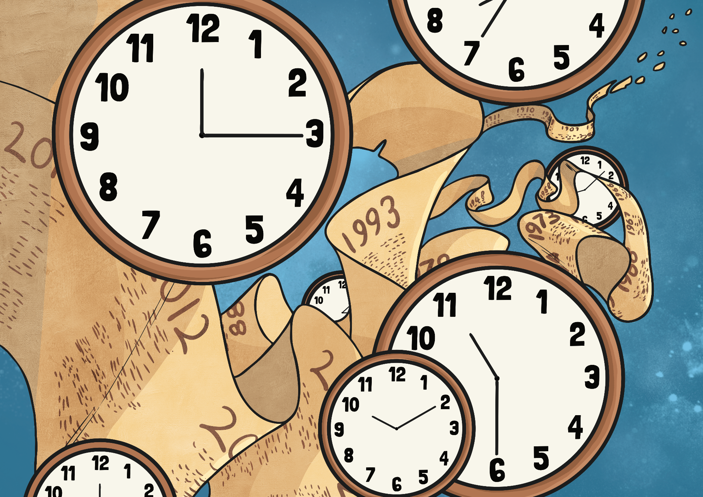
This week, we are going to practise spelling a collection of words that are all adverbials of time. Adverbials of time describe the timing of the action in a sentence.

Slide 14
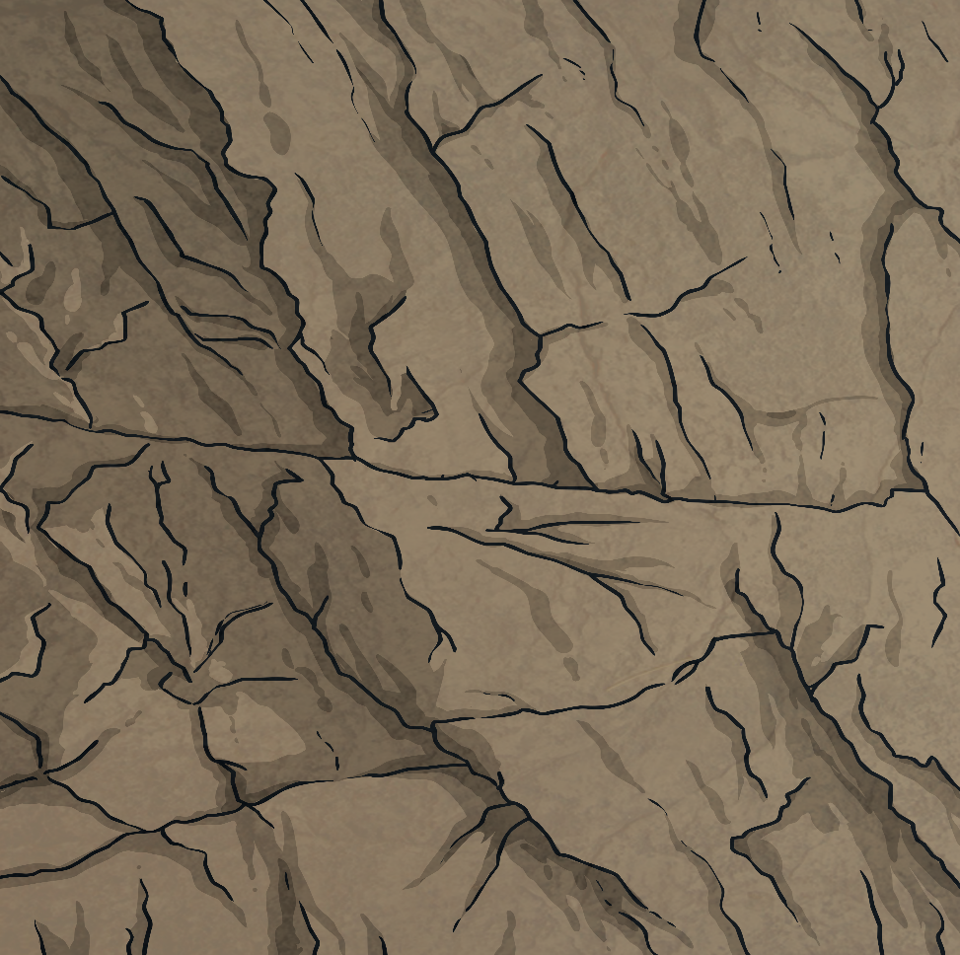
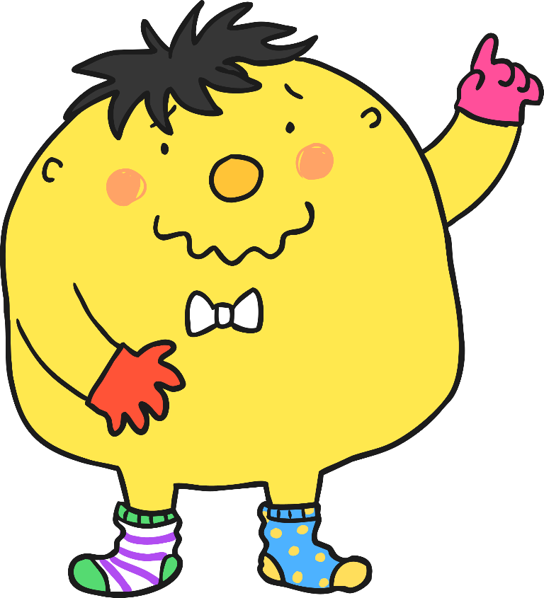
Can you identify the real time adverbial words within the grid to break Mr Whoops out of jail? Use a dictionary if you need to.
Notes:
Click on Mr Whoops when he gets out of prison and he’ll jump out and thank you.

Slide 15
Click the correct spelling words on the screen to lift the bars from the jail that Mr Whoops is held in.
imediattely
latly
earlier
previusly
previously
later
yesterday
earlyer
evenshually
resently
lately
finaly
finally
tommorow
yesturday
immediately
tomorrow
recently
eventualy
eventually

Slide 16
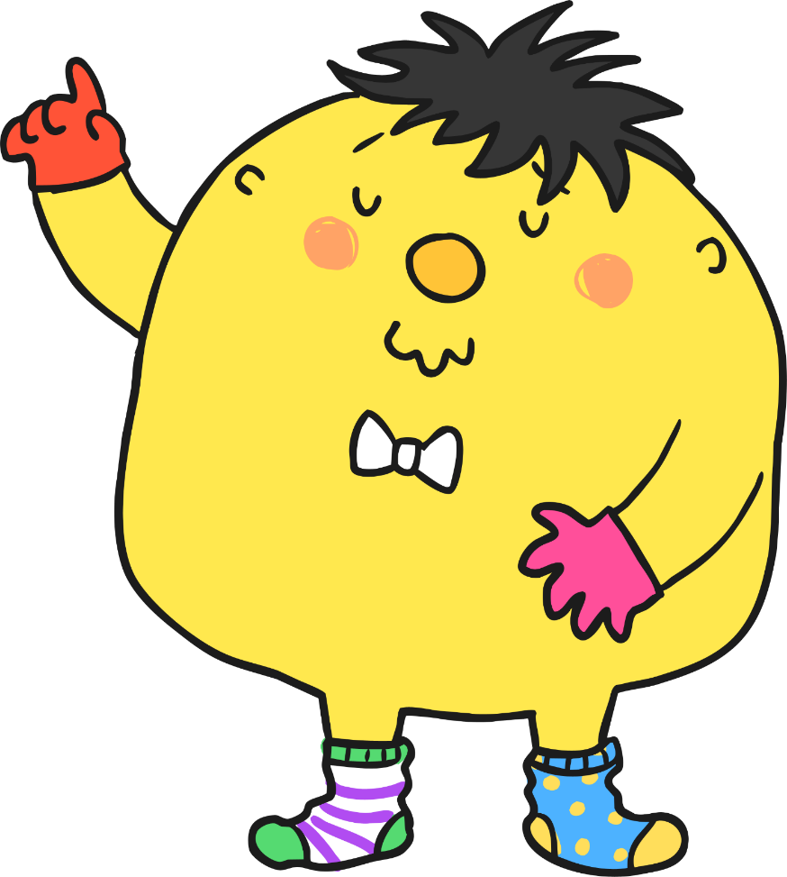
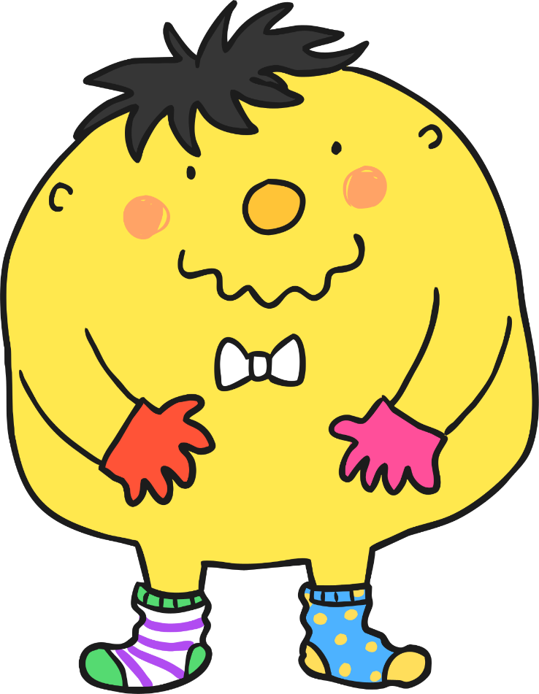
Thanks, just a few more to get!
Thanks for helping me escape! Your spelling knowledge time adverbial words really helped out there.
Notes:
Click the lock to make it disappear and to lift the bar. Once all the bars have been removed, click on Mr Whoops to make him jump out and thank the children for playing.

Slide 17
Here are your first ten spelling words for this week.
Could you speed-write the trickiest words?

Slide 18
Week 30
Tuesday English
Final paragraph – the first prediction comes true.

Slide 19
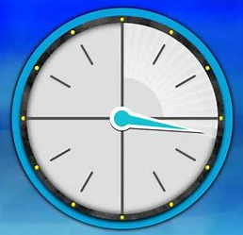

Slide 20
What am I writing?
A narrative about Macbeth
Who am I writing it for?
Children aged 9 - 12
Why am I writing it?
To entertain my readers.
What do I want the reader to do?
Understand the dilemma, faced by Macbeth

Slide 21
The witches disappear…what happens next?
A messenger arrives with the news that King Duncan has made Macbeth the Thane of Cawdor. Macbeth and Banquo can’t believe it: the first prophecy has come true.

Slide 23
Pros
Cons

Slide 24
The men rode on, putting all thoughts of ghostly visions to the back of their minds. After a few hours more on horseback, they were met on the heath by the King’s messenger. The courtier, dressed in fine silks and riding a fine, white stallion, spoke.
“Lord Macbeth, Thane of Glamis, the King has bestowed the title of Thane of Cawdor upon you. Hail, Thane of Cawdor!” the messenger stated, in a reverent tone.
Macbeth remained silent, his mind flooding with a sudden rush of questions. Could those three witches really predict the future? Would the opportunity to become King befall him? Could he still trust Banquo?

Slide 25
Week 30
Tuesday Spellings
adverbials of place

Slide 26
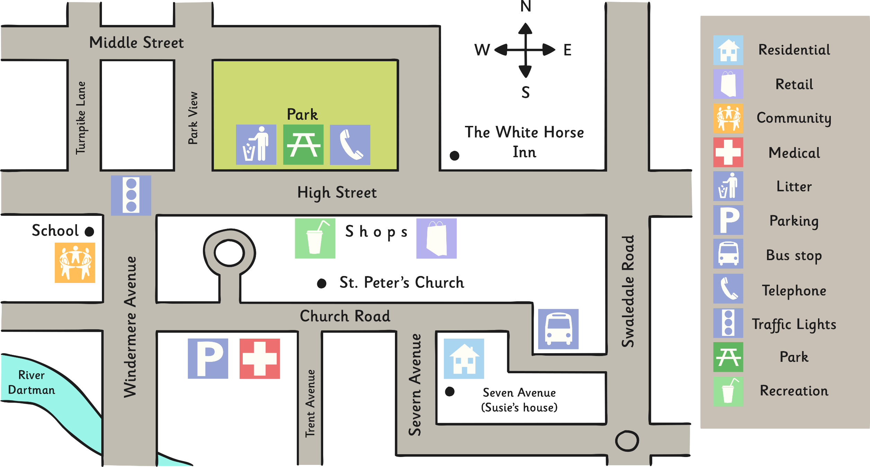
Today, we are going to practise spelling a collection of words that are all adverbials of place. Adverbials of place describe the position or placement of the action in a sentence.

Slide 27
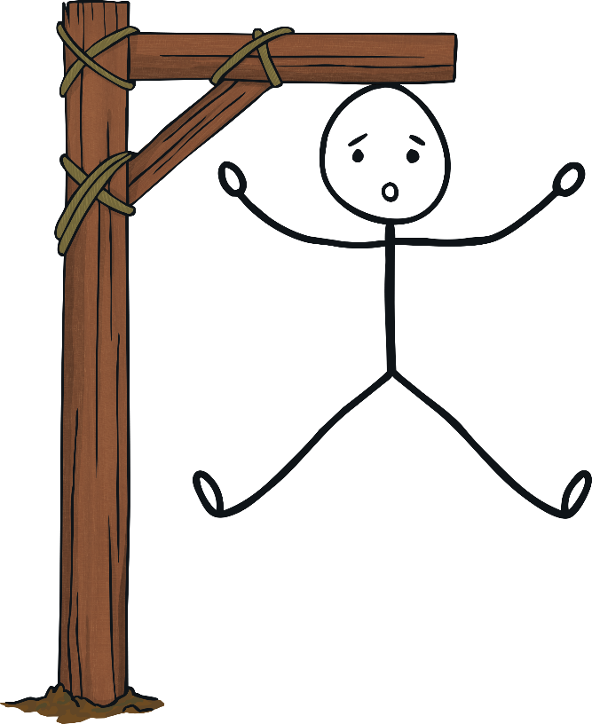
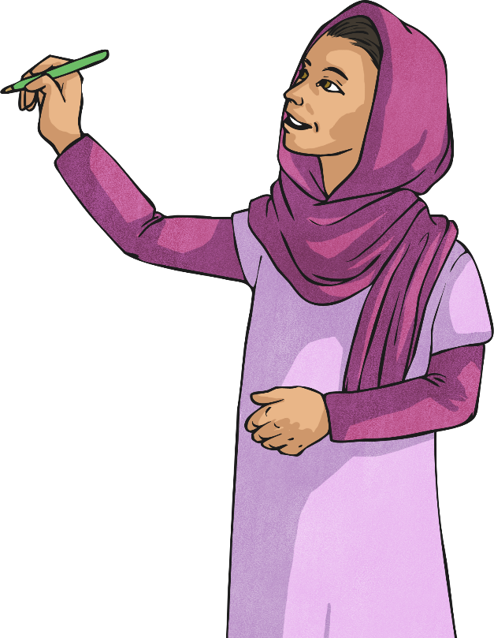
We are going to play Prefix Hangman – can you and your partner guess the letters within the adverbials of place before it’s too late?
_ _ _ _ a _
When an incorrect letter is chosen, press the ‘Oh no!’ button to add a part to the Hangman illustration.
Oh no!

Slide 28
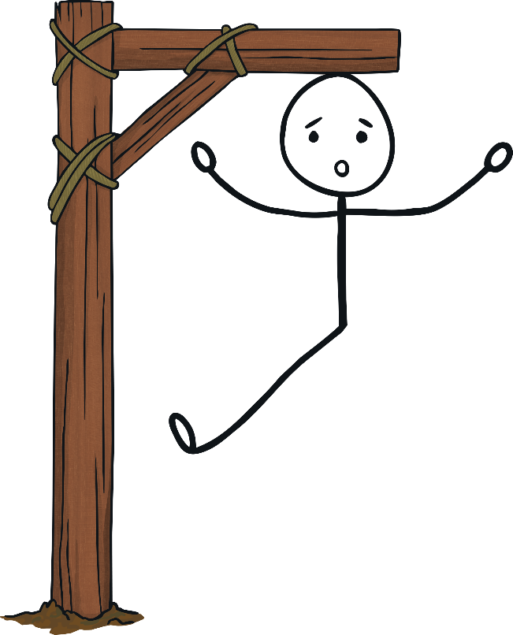
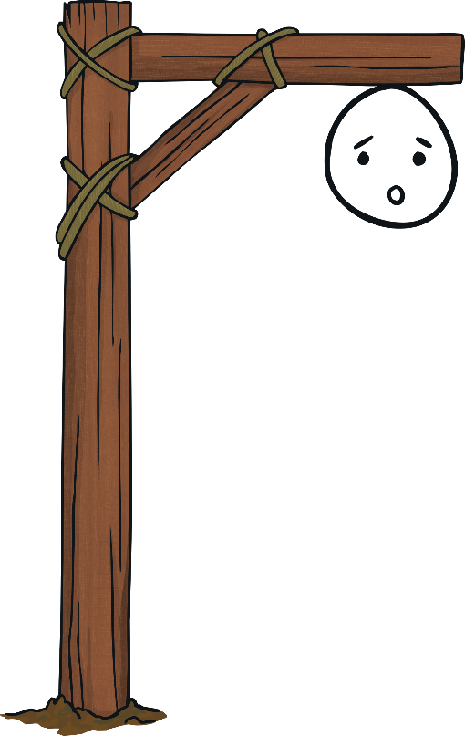
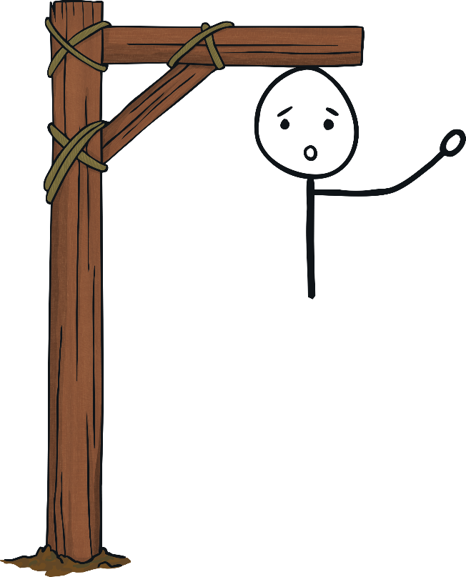
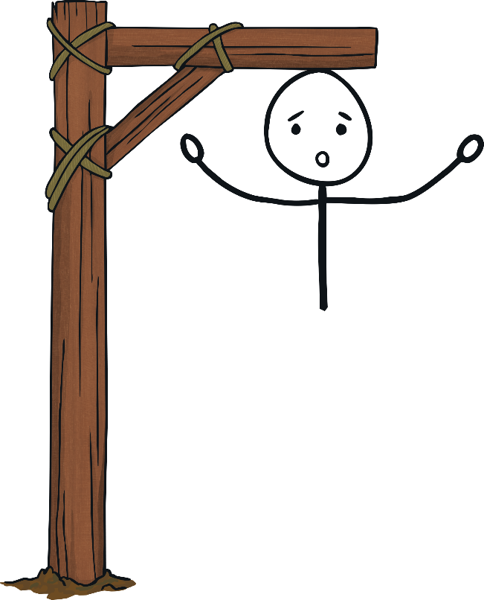
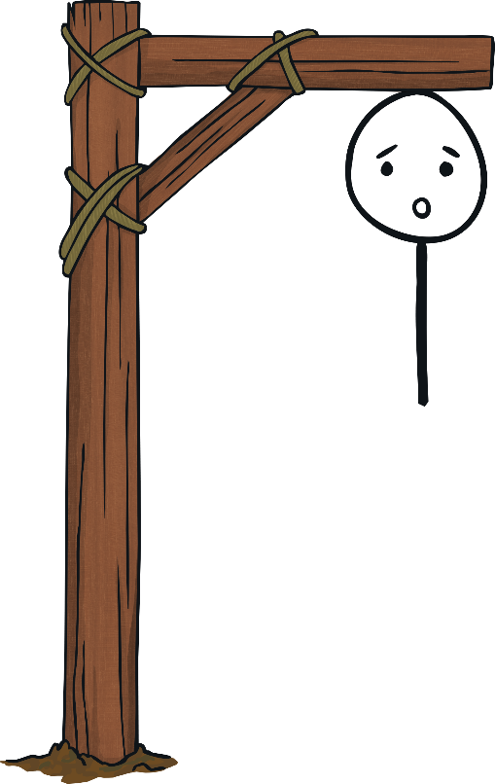
Click here for a clue!
Clue: Not far away!
______
Oh no!
a
b
c
d
e
f
g
h
i
j
k
l
m
n
o
p
q
r
s
t
u
v
w
x
y
z

Slide 29
Click here for a clue!
Clue: All over the place!
__________
Oh no!
e
a
b
c
d
e
e
e
f
g
h
i
j
k
l
m
n
o
p
q
r
r
s
t
u
v
w
x
y
z

Slide 30
Click here for a clue!
Clue: Not in any place!
_______
Oh no!
e
a
b
c
d
e
f
g
h
i
j
k
l
m
n
o
p
q
r
s
t
u
v
w
x
y
z

Slide 31
Click here for a clue!
Clue: Within the interior.
______
Oh no!
a
b
c
d
e
f
g
h
i
i
j
k
l
m
n
o
p
q
r
s
t
u
v
w
x
y
z

Slide 32
Click here for a clue!
Clue: Situated on the lower level.
__________
Oh no!
a
b
c
d
e
f
g
h
i
j
k
l
m
n
o
p
q
r
s
s
t
u
v
w
x
y
z

Slide 33
Click here for a clue!
Clue: On the exterior.
_______
Oh no!
a
b
c
d
e
f
g
h
i
j
k
l
m
n
o
p
q
r
s
t
u
v
w
x
y
z

Slide 34
Click here for a clue!
Clue: On the upper level.
________
Oh no!
a
b
c
d
e
f
g
h
i
j
k
l
m
n
o
p
q
r
s
s
t
u
v
w
x
y
z

Slide 35
Click here for a clue!
Clue: Directly below.
__________
Oh no!
a
b
c
d
e
e
f
g
h
i
n
j
k
l
m
n
o
p
q
r
s
t
u
v
w
x
y
z

Slide 36
Click here for a clue!
Clue: At the far side of something.
______
Oh no!
a
b
c
d
e
f
g
h
i
j
k
l
m
n
o
p
q
r
s
t
u
v
w
x
y
z

Slide 37
Click here for a clue!
Clue: In some place.
_________
Oh no!
a
b
c
d
e
e
e
f
g
h
i
j
k
l
m
n
o
p
q
r
s
t
u
v
w
x
y
z

Slide 38
Here are your second lot of ten spelling words for this week.
Work hard to practise these adverbials of place.

Slide 39
Week 30
Wednesday English
Proof-reading and editing your Macbeth narrative

Slide 40
What am I writing?
A narrative about Macbeth
Who am I writing it for?
Children aged 9 - 12
Why am I writing it?
To entertain my readers.
What do I want the reader to do?
Understand the dilemma, faced by Macbeth

Slide 41
What’s the difference between the proof-reading and editing?
Proof reading means correcting mistakes.
Editing means improving our writing to make it more engaging for our audience.

Slide 42
The conquest of the enemy was complete. As the great warrior, Macbeth, firmly planted the King’s flag into the marshy earth, his friend, banquo, played a sombre victory beat on a loan drum. Aggressive crows swirled around their heads and squawked, the burned out shells of trees swayed in the harsh wind and the early afternoon sky was lit up by what remained of the purpel glow of fire from the - now deserted - battleground. The two fine soldiers were burdened by the weight of guilt. Victory had been achieved but at what cost to their souls?
Very soon, Macbeth and Banquo had embarked on their long trek across the heath and back to King Duncan’s castle, on High Dunsinane Hill. As they approached the mid-point in their travels, the sky changed from a blazing red to a bruising blue and black, clouds gathered, suggesting impending doom. Within seconds, the men were choking and spluttering in a thick, soupy mist. Their steeds reared up awkwardly on their back legs, neighing frantically - three bizarre spectres swiftly rose from the marshy ground, hooting and guffawing, speaking in tongues to Macbeth and Banquo and wrapping themselves around there legs like deadly vipers.

Slide 43
The conquest of the enemy was complete. As the great warrior, Macbeth, firmly planted the King’s flag into the marshy earth, his friend, Banquo, played a sombre victory beat on a lone drum. Aggressive crows swirled around their heads and squawked, the burned out shells of trees swayed in the harsh wind and the early afternoon sky was lit up by what remained of the purple glow of fire from the - now deserted - battleground. The two fine soldiers were burdened by the weight of guilt. Victory had been achieved but at what cost to their souls?
Very soon, Macbeth and Banquo had embarked on their long trek across the heath and back to King Duncan’s castle, on High Dunsinane Hill. As they approached the mid-point in their travels, the sky changed from a blazing red to a bruising blue and black. Clouds gathered, suggesting impending doom. Within seconds, the men were choking and spluttering in a thick, soupy mist. Their steeds reared up awkwardly on their back legs, neighing frantically - three bizarre spectres swiftly rose from the marshy ground, hooting and guffawing, speaking in tongues to Macbeth and Banquo and wrapping themselves around their legs like deadly vipers.

Slide 44
After a few seconds, the frail ghouls melted back into the earth. The two warriors continued on the journey.
“those old hags claimed I am to be the Thane of Cawdor…then…the King of all Scotland! How foolish they were!” Macbeth laughed loudly.
“True, my friend. But remember that they also predicted that my son will be the King, one of these days…” responded Banquo, thoughtfully.
“Hmmm… yes, they did mention that possibility”. Macbeth whispered, not laughing any more.
The men rode on, putting all thoughts of ghostly visions to the back of their minds. After a few hours more on horseback, they were met on the heath by the King’s messenger. The courtier, dressed in fine silks and riding a fine, white Stallion, spoke.
“Lord Macbeth, Thane of Glamis, the King has bestowed the title of Thane of Cawdor upon you. Hail, Thane of Cawdor?” the messenger stated, in a reverent tone.
Macbeth is remaining silent, his mind flooding with a sudden rush of questions. Could those three witches really predict the future? Would the opportunity to become King befall him? Could he still trust Banquo?

Slide 45
After a few seconds, the frail ghouls melted back into the earth. The two warriors continued on the journey.
“Those old hags claimed I am to be the Thane of Cawdor… then… the King of all Scotland! How foolish they were!” Macbeth laughed loudly.
“True, my friend. But remember that they also predicted that my son will be the King, one of these days…” responded Banquo, thoughtfully.
“Hmmm… yes, they did mention that possibility.” Macbeth whispered, not laughing any more.
The men rode on, putting all thoughts of ghostly visions to the back of their minds. After a few hours more on horseback, they were met on the heath by the King’s messenger. The courtier, dressed in fine silks and riding a fine, white stallion, spoke.
“Lord Macbeth, Thane of Glamis, the King has bestowed the title of Thane of Cawdor upon you. Hail, Thane of Cawdor!” the messenger stated, in a reverent tone.
Macbeth remained silent, his mind flooding with a sudden rush of questions. Could those three witches really predict the future? Would the opportunity to become King befall him? Could he still trust Banquo?

Slide 46
Check that these eight features are being used correctly in your narrative…
spellings: try to find five spellings that you’re unsure about and check them in a dictionary
common mistakes: its and it’s (it is), your and you’re (you are), their (belongs to someone), there (place) and they’re (they are)
tense (this story is written in the past tense)
verb forms (was/were)
capital letters
full stops
commas to separate words in a list
commas for clarity (to separate subordinate and main clauses, after adverbial openers, for use as parenthesis)

Slide 47
“Those old hags claimed I am to be the Thane of Cawdor… then… the King of all Scotland! How foolish they were!” Macbeth laughed loudly.
All of the spoken words must be put inside speech marks “ ”
The first spoken word has a capital letter
The punctuation at the end of the speech goes BEFORE the ”
The first word of the reporting clause does NOT have a capital letter.
Use an adverb or adverbial with the reporting clause.
Miss a line for a new speaker.

Slide 48
Proof read your own work.
Use a dictionary to check spelling that you’re unsure about.

Slide 49
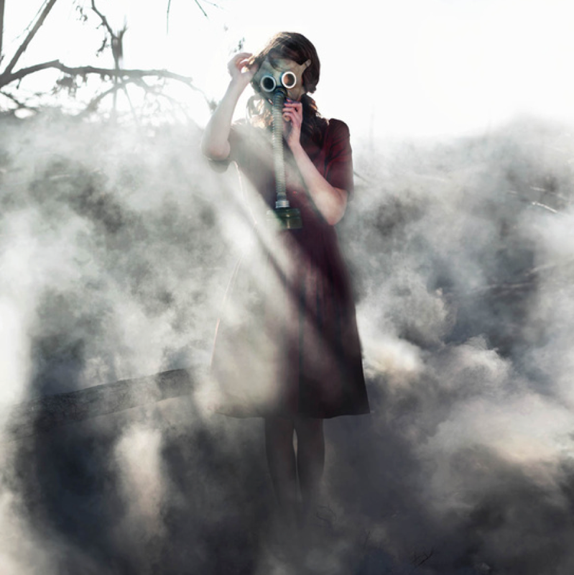
These sentences are boring and need your help to get better!
The heath was smoky. Marie stood in the trench. She held the mask to her face.

Slide 50
Edit your own work.
Vocabulary for precision (expanded noun phrases, adverbials).
Figurative language (conveying the gloomy atmosphere…the sense of impending doom).
Accurate speech that conveys how the characters are feeling.
3 x WOW words (although, rough, thorough)

Slide 51
Let’s look at a few examples.

Slide 52
Complete your redrafts!

Slide 53
Week 30
Friday Spellings
adverbials of time and place

Slide 54
Let’s remind ourselves of this week’s spellings…
adverbials of time
adverbials of place

Slide 55
Complete the look, say, cover, write and check activity for your twenty words.

