Slide 1
Week 29
Tuesday English
Macbeth narrative

Slide 2
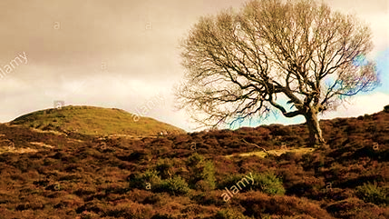
Great Birnam Wood
The
Heath
High Dunsinane Hill
Who lives in the castle on High Dunsinane Hill?

Slide 3
The story starts on the heath. What’s a heath?
Open, uncultivated land with acidic, sandy soil and gorse, heather and rough grass.
What might be found there?

Slide 4
It’s a cold, wet and windy day on the heath.

Slide 5
The Heath
I can see…
I can hear…
I can smell…
I can feel…
Use a simile, a metaphor and personification

Slide 6
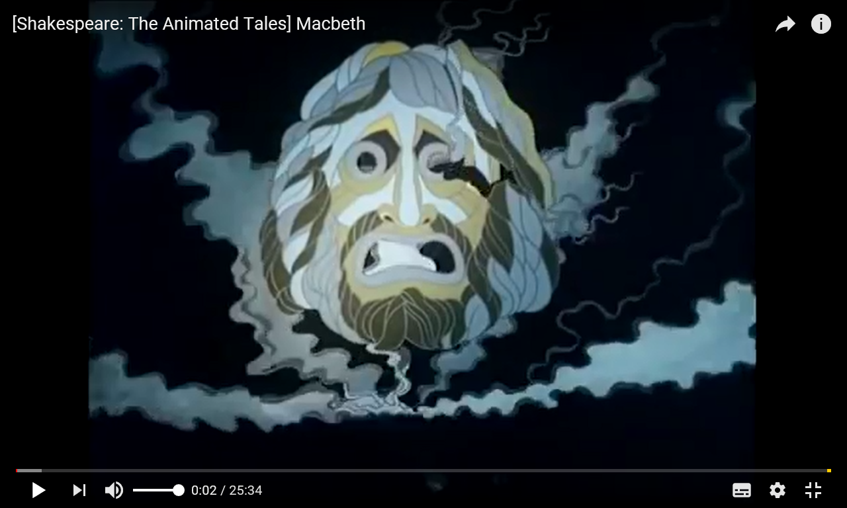

Slide 7
Week 29
Tuesday Spellings
-ough words #1

Slide 8
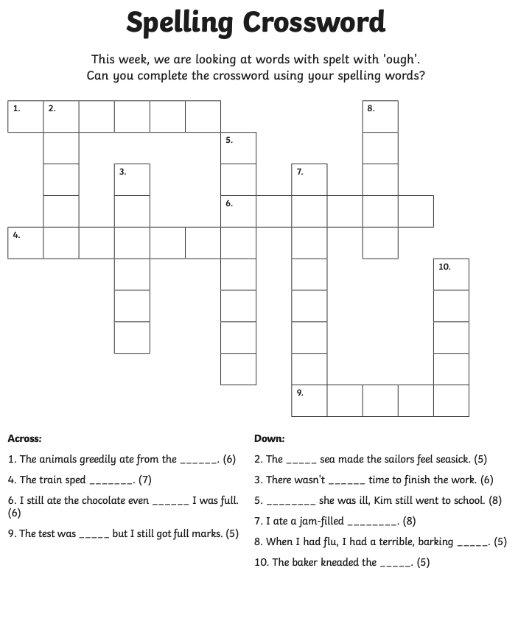

Slide 9
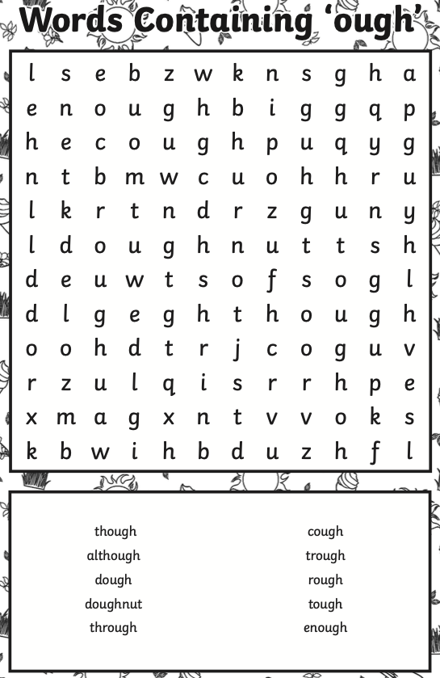

Slide 10
Week 29
Wednesday English
Macbeth narrative – opening paragraph

Slide 11
B g
L t
Y d
N y
A e

Slide 12
What am I writing?
A narrative about Macbeth
Who am I writing it for?
Children aged 9 - 12
Why am I writing it?
To entertain my readers.
What do I want the reader to do?
Understand the dilemma, faced by Macbeth

Slide 13
3 x wow words
although, rough, thorough

Slide 14
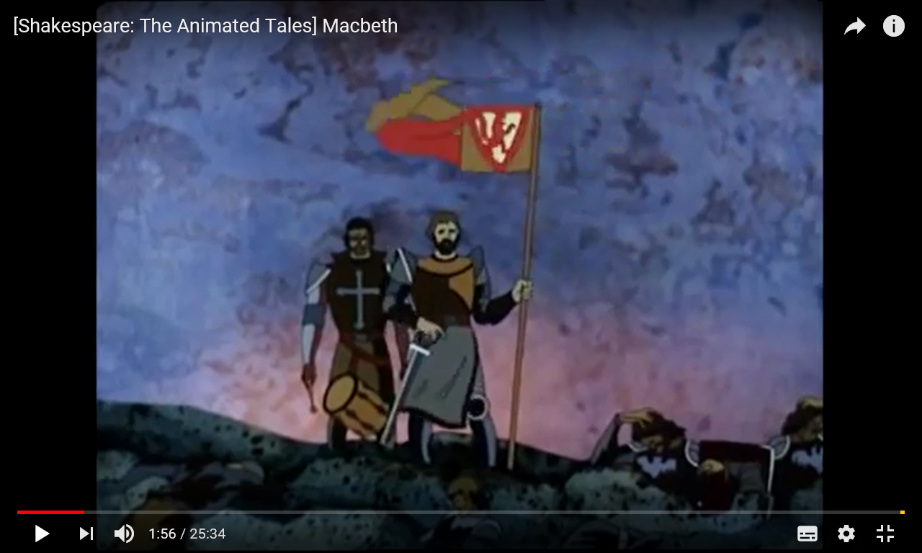

Slide 15
The conquest of the enemy was complete. As the great warrior, Macbeth, firmly planted the King’s flag into the marshy earth, his friend, Banquo, played a sombre victory beat on a lone drum. Aggressive crows swirled around their heads and squawked, the burned out shells of trees swayed in the harsh wind and the early afternoon sky was lit up by what remained of the purple glow of fire from the - now deserted - battleground. The two fine soldiers were burdened by the weight of guilt. Victory had been achieved but at what cost to their souls?

Slide 16
Write your opening paragraph, describing the scene after the battle.
Write a line, miss a line

Slide 17
Week 29
Wednesday Spellings
-ough words #2

Slide 18
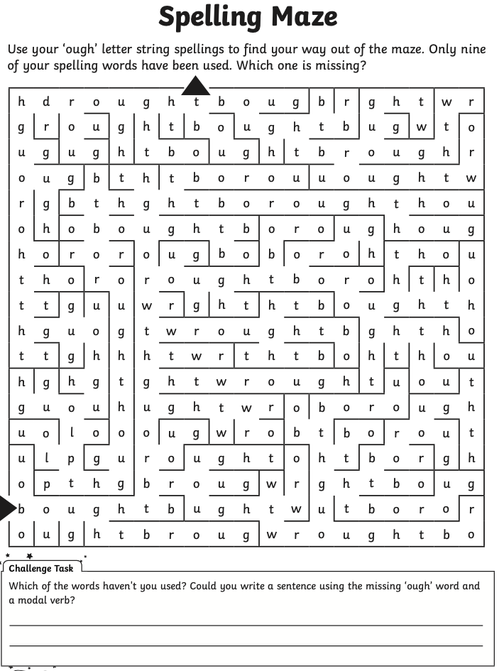

Slide 20
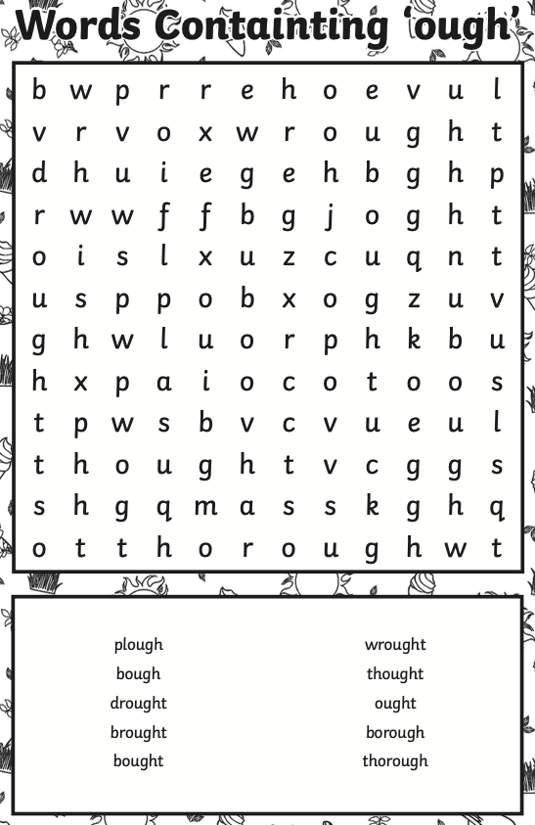

Slide 21
Week 29
Thursday English
Macbeth narrative – the witches’ predictions

Slide 22
Let’s remind ourselves about the heath…

Slide 23
There are some other creatures on this heath, some special creatures. What creatures are they?
They are witches!
The witches gather in the mist and rain on the heath and are talking…

Slide 24
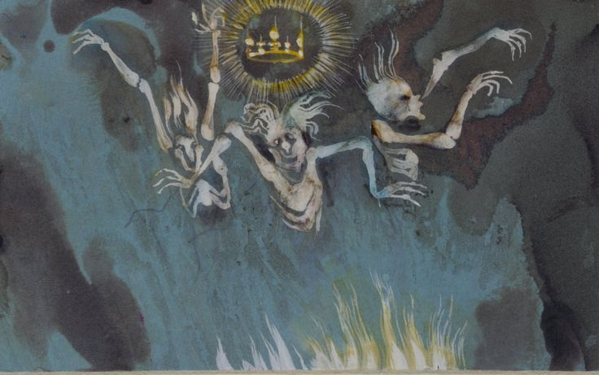
Today, I want you to create an effective piece of poetry.
You’ll be composing your own witches’ spells, based on Macbeth.
Write down something you’ve heard about witches.

Slide 25
The Witches
In Shakespeare’s time, people believed that witches:
could control the weather | could sink ships
had the power of flight | had the ability to make people go mad
could vanish into thin air | would become your enemy if you refused them food
were able to change their physical form | usually ‘worked’ at night
could see into the future | had contact with the devil and their familiars (animals)
could bring disease and illnesses to crops, animals or people | were able to cast spells (for ‘good’ and ‘bad’) by chanting and making potions

Slide 26
Today, I want you to create an effective piece of poetry.
You’ll be composing your own witches’ spells, based on Macbeth.

Slide 27
FIRST WITCH (to Macbeth) All hail, Macbeth! Hail to thee, Thane of Glamis!
SECOND WITCH All hail, Macbeth! Hail to thee, Thane of Cawdor!
THIRD WITCH All hail, Macbeth, that shalt be King hereafter!
FIRST WITCH Hail!
SECOND WITCH Hail!
THIRD WITCH Hail!
FIRST WITCH (to Banquo) Lesser than Macbeth and greater.
SECOND WITCH Not so happy, yet much happier.
THIRD WITCH Thou shalt get kings, though thou be none. So all hail, Macbeth!

Slide 28
The witches are back from doing their thing: killing pigs, placing curses on a sailor whose wife angered them.
They encounter Macbeth and Banquo on the heath as the two soldiers return from battle. The witches, a.k.a. the Weird Sisters, make three prophecies:
Macbeth will become Thane of Cawdor.
Then Macbeth will become the King of Scotland.
Banquo will never rule in Scotland, but his children and their children and their children will…

Slide 29
It’s time to rehearse your lines…

Slide 30
The witches disappear…what happens next?

Slide 31
Week 29
Friday Spellings
-ough words

Slide 32
Let’s remind ourselves of this week’s spellings…
1. The first way to pronounce -ough is with an "oh" sound, like in the word "go."
2. The second way to pronounce -ough is with an "ooh" sound, like in the word "too."
3. The third way to pronounce -ough is with an "off“ sound, like in the word “cough”.
4. The fourth way to pronounce -ough is with an "aw" sound, like in the word “thought”.
5. The fifth way to pronounce -ough is with an "ow" sound, like in the word “bough”.
6. The sixth way to pronounce -ough is with an "uff" sound, like in the word “enough“.

Slide 33
Now it’s time to test yourself on the –ough spellings…
Good luck!

