Slide 1
Week 28
Monday English
Proof-reading your Jabberwocky narrative.

Slide 2
While the courageous yet fragile child rested against the Tumtum Tree, ….
Complete the sentence below:

Slide 3
Our TAPE grid…
What am I writing?
A narrative story.
Who am I writing it for?
Other Year 6 children.
Why am I writing it?
To entertain my audience.
What am I trying to do?
To create suspense and scare my readers.

Slide 4
Remember that we can improve our writing by carefully and thoroughly:
Proof-reading it to correct spelling, punctuation and grammar mistakes.
Editing it to make it more engaging for our readers.
Today, you’ll proof-read your writing.

Slide 5
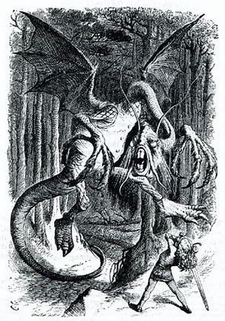
How to identify errors…

Slide 6
Here’s a section of dialogue between the boys and his father. There are ten errors. See if you can spot them all…
“Please, please take great care, my son”! the boys father wispered in his ear.
“but father… What is their to worry about!” the boy replied, curious that his father should be telling him this.
“The … the … the monstras J-J-Jabberwocky!” His father replied, choking on his words.
The boy did’nt reply. He quietly signalled goodbye and made his way towards the forest.

Slide 7
“Please, please take great care, my son!” the boy’s father whispered in his ear.
“But father… what is there to worry about?” the boy replied, curious that his father should be telling him this.
“The … the … the monstrous J-J-Jabberwocky!” his father replied, choking on his words.
The boy didn’t reply. He quietly signalled goodbye and made his way towards the forest.

Slide 8
Check that these eight features are being used correctly in your narrative…
spellings: try to find five spellings that you’re unsure about and check them in a dictionary
common mistakes: its and it’s (it is), your and you’re (you are), their (belongs to someone), there (place) and they’re (they are)
tense (this story is written in the past tense)
verb forms (was/were)
capital letters
full stops
commas to separate words in a list
commas for clarity (to separate subordinate and main clauses, after adverbial openers, for use as parenthesis)

Slide 9
“The … the … the monstrous J-J-Jabberwocky!” his father replied, very hesitantly.
All of the spoken words must be put inside speech marks “ ”
The first spoken word has a capital letter
The punctuation at the end of the speech goes BEFORE the ”
The first word of the reporting clause does NOT have a capital letter.
Use an adverb or adverbial with the reporting clause.
Miss a line for a new speaker.

Slide 10
Write a weather personification sentence to create a mood for your narrative.
For example:
The wind whipped at the boy’s face and pulled his hair, trying with all of its might to keep him out of the forest.

Slide 11
Week 28
Monday Spellings
-ough words #1

Slide 12
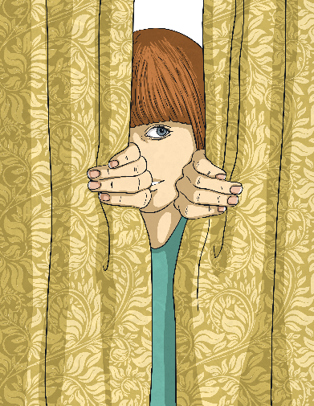
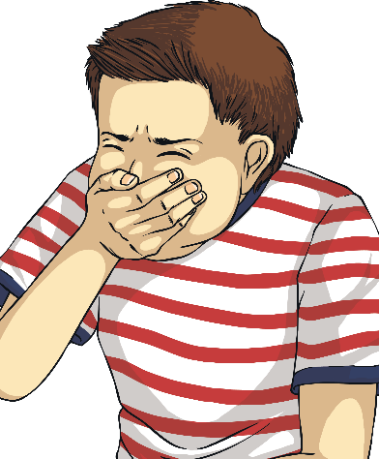
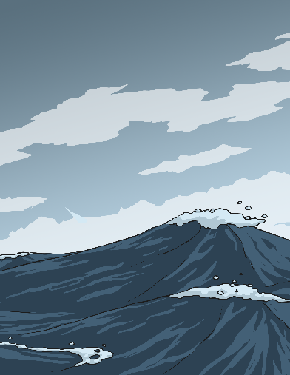
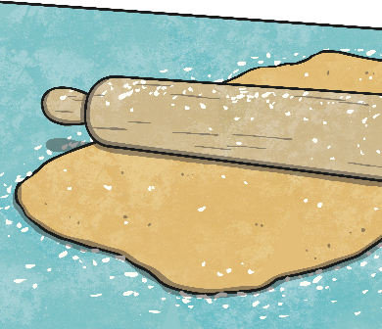
Today, we are starting to look at a particular letter string that can make different sounds within different words.
‘ough’
Sometimes ‘ough’ can make a...
an ‘oo’ sound as in through
or
‘long o’ sound as in dough
or
an ‘off’ sound as in cough
or
an ‘uff’ sound as in rough
Can you think of any other words where the ‘ough’ letter string makes these particular sounds?

Slide 13
Did You Think Of...?
an ‘oo’ sound as in through
or
‘long o’ sound as in dough
or
an ‘off’ sound as in cough
or
an ‘uff’ sound as in rough
through
dough
though
although
doughnut
cough
trough
rough
tough
enough

Slide 14
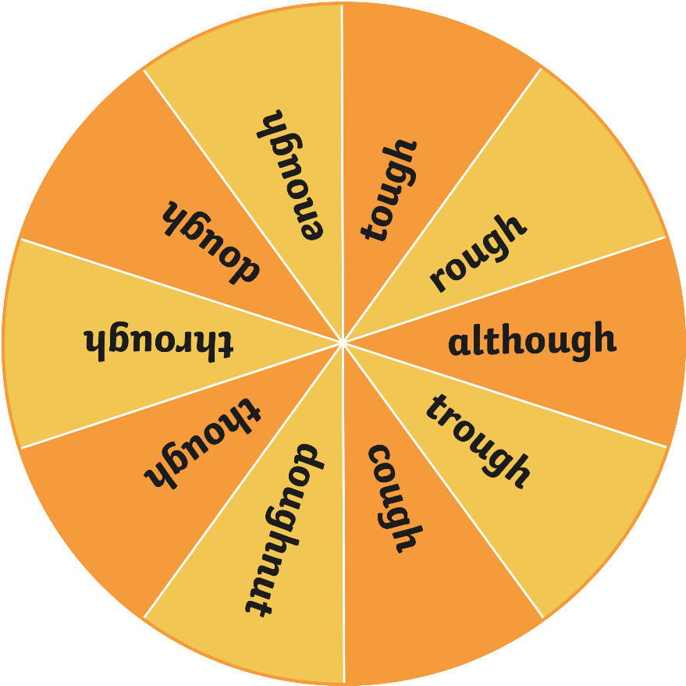
Let’s spin the spinner!
Now, work with your partner to write a sentence that contains the ‘ough’ letter string word on your whiteboards.
Could your sentence begin with a fronted adverbial?
Spin

Slide 15
Let’s spin the spinner!
Now, work with your partner to write a sentence that contains the ‘ough’ letter string word on your whiteboards.
Could your sentence have an embedded relative clause?
Spin

Slide 16
Let’s spin the spinner!
Now, work with your partner to write a sentence that contains the ‘ough’ letter string word on your whiteboards.
Could your sentence include some direct speech?
Spin

Slide 17
Let’s spin the spinner!
Now, work with your partner to write a sentence that contains the ‘ough’ letter string word on your whiteboards.
Could your sentence include a subordinate clause?
Spin

Slide 18
Let’s spin the spinner!
Now, work with your partner to write a sentence that contains the ‘ough’ letter string word on your whiteboards.
Could your sentence include an expanded noun phrase?
Spin

Slide 19
Here are the first ten spelling words for this week.
Practise these ‘ough’ words carefully.

Slide 20
Week 28 Tuesday English
Editing your Jabberwocky narrative

Slide 21
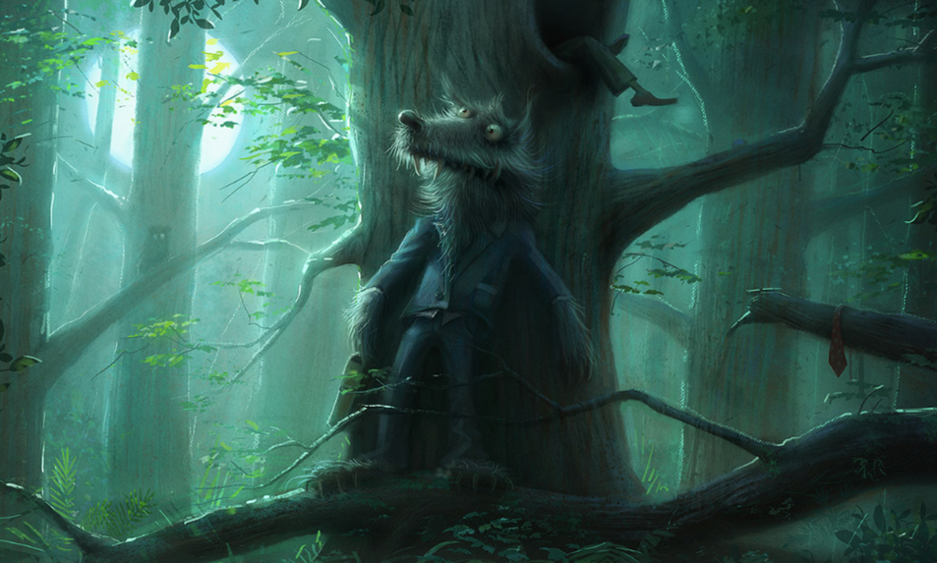
The Tumtum Tree…
Can you identify the prepositions in the sentences below?
The anxious wolf was tired of searching through the dense woodland. So, he rested against the Tumtum Tree, noticing the intense light of the Moon above the forest canopy.

Slide 22
Our TAPE grid…
What am I writing?
A narrative story.
Who am I writing it for?
Other Year 6 children.
Why am I writing it?
To entertain my audience.
What am I trying to do?
To create suspense and scare my readers.

Slide 23
In a sentence, the main verb shows the tense.
Simple present:
- something which is happening now
He walks to school.
Simple past:
- something that’s already happened
He walked to school.

Slide 27
Perfect and progressive tenses

Slide 28
The present perfect tense:
He has finished his work.
They have finished their work.
The past perfect tense:
She had finished her work.
Perfect = to have verb.

Slide 29
The present progressive tense:
He is finishing his work.
They are finishing their work.
I am finishing my work.
The past progressive tense:
She was finishing her work.
They were finishing their work.
Progressive = to be verb.

Slide 30
To have perfection is to be progressive.

Slide 32
Yesterday, you proof-read your writing for mistakes. Today, you’ll edit your writing to make it more engaging for your readers.

Slide 33
The Tumtum Tree…
These sentences are very boring and need to be edited so that they’re more engaging. Can you help?
The wolf had big eyes and big teeth. He had fur and wore a suit.

Slide 34
Remember: we’ve looked at these features. Try to use them as they will improve your story…
Direct speech.
Prepositions.
Fronted adverbials.
Short sentences.
Subordinate clauses.
Rhetorical questions.
Past perfect (had) and past progressive (was, were) tense.
Exciting sentences - for example, personification of the weather.
Last week, you were asked to write a list of ten different features used in the time slip story example. Read that list now to remind yourself of the features and use them in your story.

Slide 35
Now, edit your story from last week.

Slide 36
Long word:
N g
V d
G l
E s
T y

Slide 37
Week 28
Tuesday Spellings
-ough words #2

Slide 38
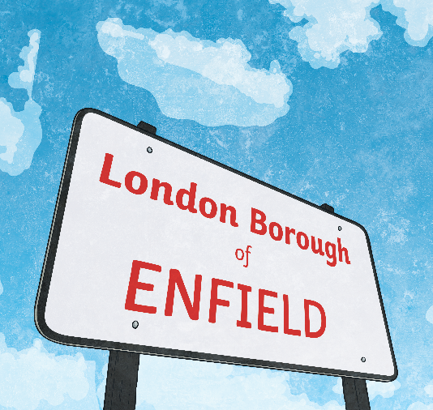
Today, we are again looking at the ‘ough’ letter string and how it can make different sounds in different words.
‘ough’
Sometimes ‘ough’ can make a...
an /ow/ sound as in plough
or
an /aw/ sound as in bought
or
an /uh/ sound as in borough
Can you think of any other words where the ‘ough’ letter string makes these particular sounds?

Slide 39
Did You Think Of...?
an /ow/ sound as in plough
or
an /aw/ sound as in bought
or
an /uh/ sound as in borough
plough
bough
drought
bought
brought
wrought
thought
ought
borough
thorough

Slide 40
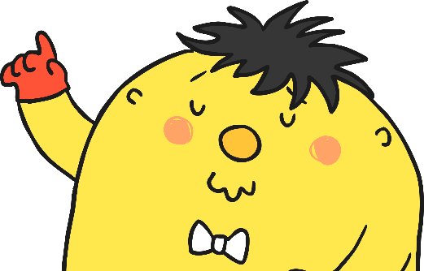
Mr Whoops has got in a terrible muddle with his relative clause sentences. Can you help him put the correct ‘ough’ word into each one?
Keisha, who works for the Red Cross charity, is in East Africa helping to build wells so that those people affected by _________ have a clean, fresh water supply.
drought

Slide 41
Mr Whoops has got in a terrible muddle with his relative clause sentences. Can you help him put the correct ‘ough’ word into each one?
George, who is extremely untidy, really _________ to clean his bedroom.
ought

Slide 42
Mr Whoops has got in a terrible muddle with his relative clause sentences. Can you help him put the correct ‘ough’ word into each one?
bought
Mr Fletcher _________ his wife a bunch of flowers from the local flower shop, which made her smile.

Slide 43
Mr Whoops has got in a terrible muddle with his relative clause sentences. Can you help him put the correct ‘ough’ word into each one?
The children sat happily on the _________ of the tree, which groaned under their weight.
bough

Slide 44
Mr Whoops has got in a terrible muddle with his relative clause sentences. Can you help him put the correct ‘ough’ word into each one?
With a creak, the _________ iron gates began to swing open, which made their nerves jangle.
wrought

Slide 45
Mr Whoops has got in a terrible muddle with his relative clause sentences. Can you help him put the correct ‘ough’ word into each one?
Farmer Harold, who had lived on the farm for more than 50 years, used a horse-drawn _________ to cultivate his fields.
plough

Slide 46
Mr Whoops has got in a terrible muddle with his relative clause sentences. Can you help him put the correct ‘ough’ word into each one?
The whole of the _________ council were against the proposed building plans that would cause outrage in the town.
borough

Slide 47
Mr Whoops has got in a terrible muddle with his relative clause sentences. Can you help him put the correct ‘ough’ word into each one?
The girl, whose birthday was next month, _________ about who she would invite to her party.
thought

Slide 48
Mr Whoops has got in a terrible muddle with his relative clause sentences. Can you help him put the correct ‘ough’ word into each one?
The teacher _________ gifts for all his pupils at the end of term, which was an extremely generous thought.
brought

Slide 49
Mr Whoops has got in a terrible muddle with his relative clause sentences. Can you help him put the correct ‘ough’ word into each one?
The police officers, who needed to quickly solve the case, conducted a _________ search of the crime scene.
thorough

Slide 50
Here are the rest of your spelling words for this week.
Practise these ‘ough’ words carefully.

Slide 51
Week 28
Wednesday English
Writing the final version of your Jabberwocky narrative.

Slide 52
Rewrite the sentence, without using an ‘e’
“Please, please take great care, my son!” the boy’s father whispered in his ear.

Slide 53
Our TAPE grid…
What am I writing?
A narrative story.
Who am I writing it for?
Other Year 6 children.
Why am I writing it?
To entertain my audience.
What am I trying to do?
To create suspense and scare my readers.

Slide 54
You’ve proof-read and edited your writing. Now write your final version of your Jabberwocky narrative.
Prepositions.
Fronted adverbials.
Short sentences.
Subordinate clauses.
Rhetorical questions.
Past perfect (had) and past progressive (was, were) tenses.
Exciting sentences - for example, personification of the weather.
Also, don’t forget that you’ll be using one example of direct speech – be accurate in your use of the direct speech rules!

Slide 55
Finally…
Read your Jabberwocky narrative out loud to your table partner. Make sure to use intonation for dramatic effect.

Slide 56
Week 28
Friday Spellings
-ough words

Slide 57
Let’s remind ourselves of this week’s spellings…
1. The first way to pronounce -ough is with an "oh" sound, like in the word "go."
2. The second way to pronounce -ough is with an "ooh" sound, like in the word "too."
3. The third way to pronounce -ough is with an "off“ sound, like in the word “cough”.
4. The fourth way to pronounce -ough is with an "aw" sound, like in the word “thought”.
5. The fifth way to pronounce -ough is with an "ow" sound, like in the word “bough”.
6. The sixth way to pronounce -ough is with an "uff" sound, like in the word “enough“.

Slide 58
Sort the twenty words, according to their sounds.
sound | words
-ough with an "oh" sound
-ough with an "ooh" sound
-ough with an "off“ sound
-ough with an "aw" sound
-ough with an "ow" sound
-ough with an "uff" sound

Slide 59
Complete the look, say, cover, write and check activity for your twenty words.

