Slide 1
Week 27 English
Monday – features of narrative writing

Slide 2
The Jabberwocky – Lewis Carroll
‘Twas brillig, and the slithy toves
Did gyre and gimble in the wabe;
All mimsy were the borogroves,
And the mome raths outgrabe.
‘Beware the Jabberwock, my son!
The jaws that bite, the claws that catch!
Beware the Jubjub bird, and shun
The frumious Bandersnatch!’
He took his vorpal sword in hand:
Long time the manxome foe he sought –
So rested he by the Tumtum tree,
And stood awhile in thought.
And as in uffish thought he stood,
The Jabberwock, with eyes of flame,
Came whiffling through the tulgey wood,
And burbled as it came!
One, two! One, two! And through and through
The vorpal blade went snicker-snack!
He left it dead, and with its head
He went galumphing back.
‘And hast thou slain the Jabberwock?
Come to my arms, my beamish boy!
O frabjous day! Callooh! Callay!’
He chortled in his joy.
‘Twas brillig, and the slithy toves
Did gyre and gimble in the wabe;
All mimsy were the borogroves,
And the mome raths outgrabe.
Sausage, mash and bacon

Slide 3
Who are the key characters?
What actions take place?
Where does it take place?
What’s the outcome?

Slide 4
What’s a narrative?

Slide 5
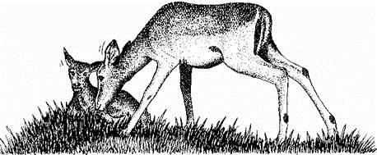
Let’s have another look at an extract from the baby impala text.
This is an example of a narrative.
In your pairs, identify five features of narrative writing.

Slide 6
Terror filled the air. The impala doe, eyes bulging with fear, leaped awkwardly across the dry stream bed. She hesitated. She was not quite sure whether to leap up the steep bank and so go on to safety. The fawn watched her from the bank. His anxious cries were constantly drowned by the roar and crackle of the fire.
Before long, his mother came back to him in one beautiful bound. Above her, smoke and burning grass swept over the edge of the bank, like a curtain shutting out the sky. The impala doe suddenly lay down, partly covering her baby.
The fire quickly leaped across the dry river bed. It flared up. In a few moments, the air was almost too hot to breathe. Soon, the flames had gone; only smoke and ash remained. A welcome breath of air swept softly down the dried river bed. The smoke swirled and eddied, before beginning to lift upwards. For the impala and her baby, the danger had passed. Relief filled the air.

Slide 8
Some short sentences
Designed to entertain the audience
Figurative language
Written in time order
Adverbials of time and place
Narrative features
Paragraphs
Adverbs
Third person
Past tense
Repetition
Abstract nouns

Slide 9
Our TAPE grid…
What am I writing?
A narrative story.
Who am I writing it for?
Other Year 6 children.
Why am I writing it?
To entertain my audience.
What am I trying to do?
To create suspense and scare my readers.

Slide 10
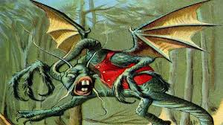
the
creeps
towards
prey
unfortunate
through
lurches
forest

Slide 11
the
creeps
towards
prey
through
unfortunate
lurches
forest

Slide 13
Week 27
Monday Spellings
hyphenated prefix words

Slide 14
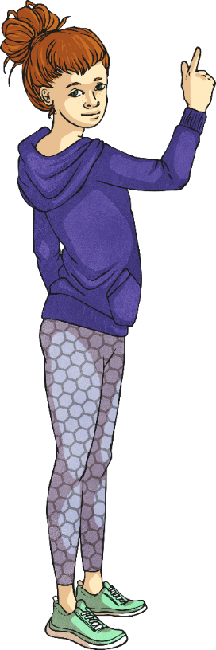
Some words with prefixes need to have a hyphen added to separate the prefix and the root word. For example…
co-ordinate
re-educate
co-own
Working with a partner, can you discuss why these words might need hyphens?
Do the examples have anything in common?

Slide 15
All of these words have a prefix that ends in a vowel and a root word that begins in a vowel.
co-ordinate
re-educate
co-own
This usually means that the prefix and root word are separated by a hyphen.

Slide 16
Jake and Rowena have been juggling with some of your spelling words.
Can you figure out what they might be?
(Don’t forget that they are all hyphenated prefix words.)
t
o
p
a
o
Clue:
When people
get along to complete a task.
e
r
e
c
-

Slide 17
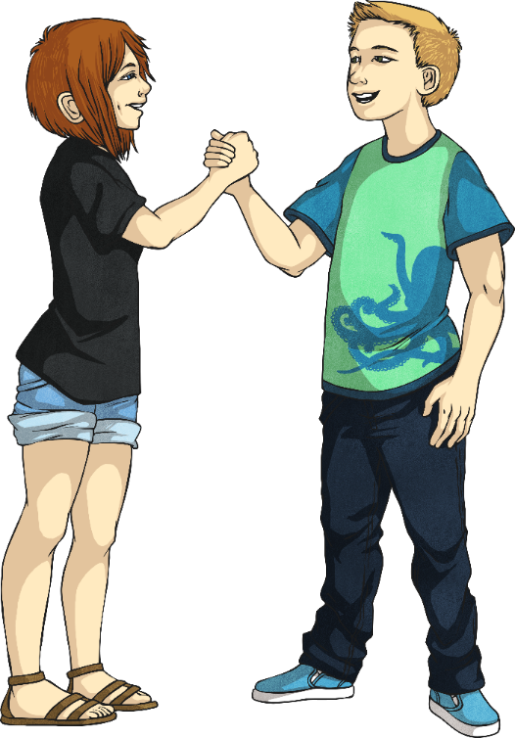
c
o
-
o
p
e
r
a
t
e

Slide 18
Jake and Rowena have been juggling with some of your spelling words.
Can you work with a partner to figure out what they might be?
(Don’t forget that they are all hyphenated prefix words.)
t
e
l
e
Clue:
To vote for a prime minister for another
term in office.
r
e
-
c

Slide 19
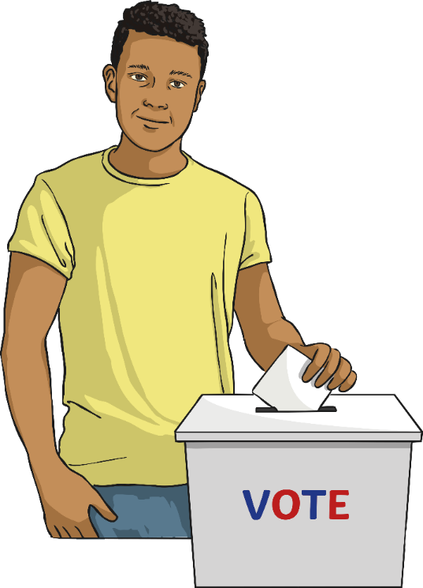
r
e
-
e
l
e
c
t

Slide 20
Jake and Rowena have been juggling with some of your spelling words.
Can you work with a partner to figure out what they might be?
(Don’t forget that they are all hyphenated prefix words.)
e
e
r
t
Clue:
To go back
into the same building.
r
e
-
n

Slide 21
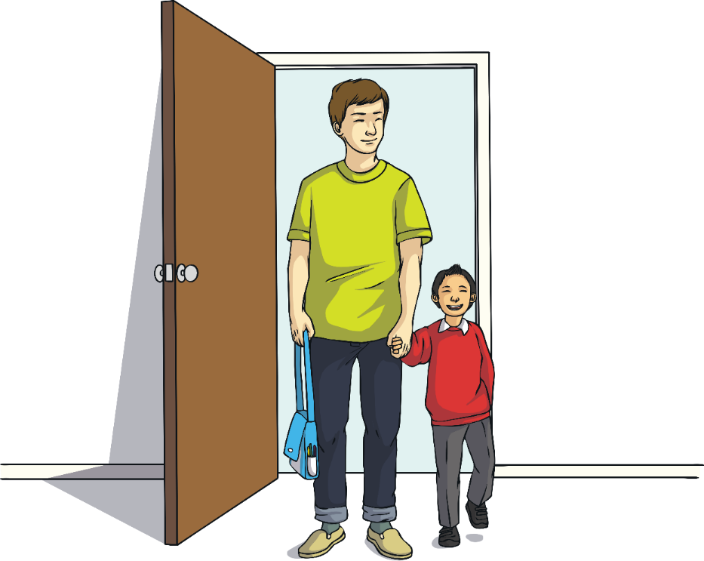
r
e
-
e
n
t
e
r

Slide 22
Jake and Rowena have been juggling with some of your spelling words.
Can you work with a partner to figure out what they might be?
(Don’t forget that they are all hyphenated prefix words.)
h
o
r
t
Clue:
What you are
if you write a book with someone else.
u
c
-
o
a

Slide 23
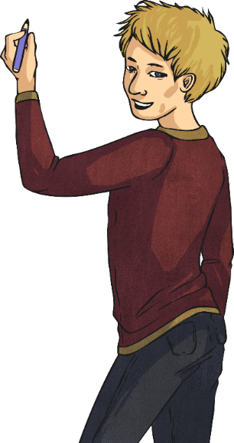
c
o
-
a
u
t
h
o
r

Slide 24
Here are your hyphenated prefix spellings words for this week.

Slide 27
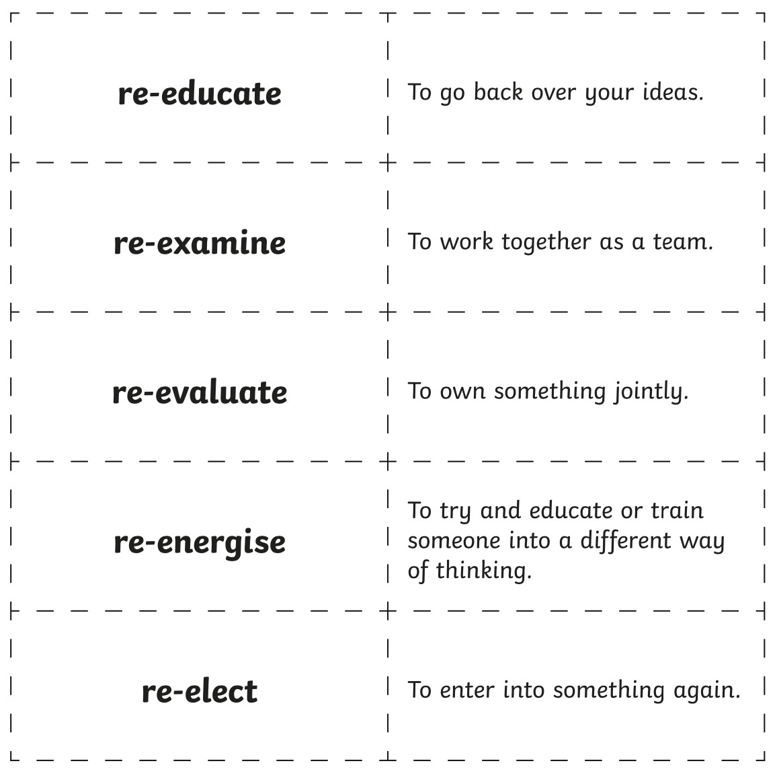

Slide 28
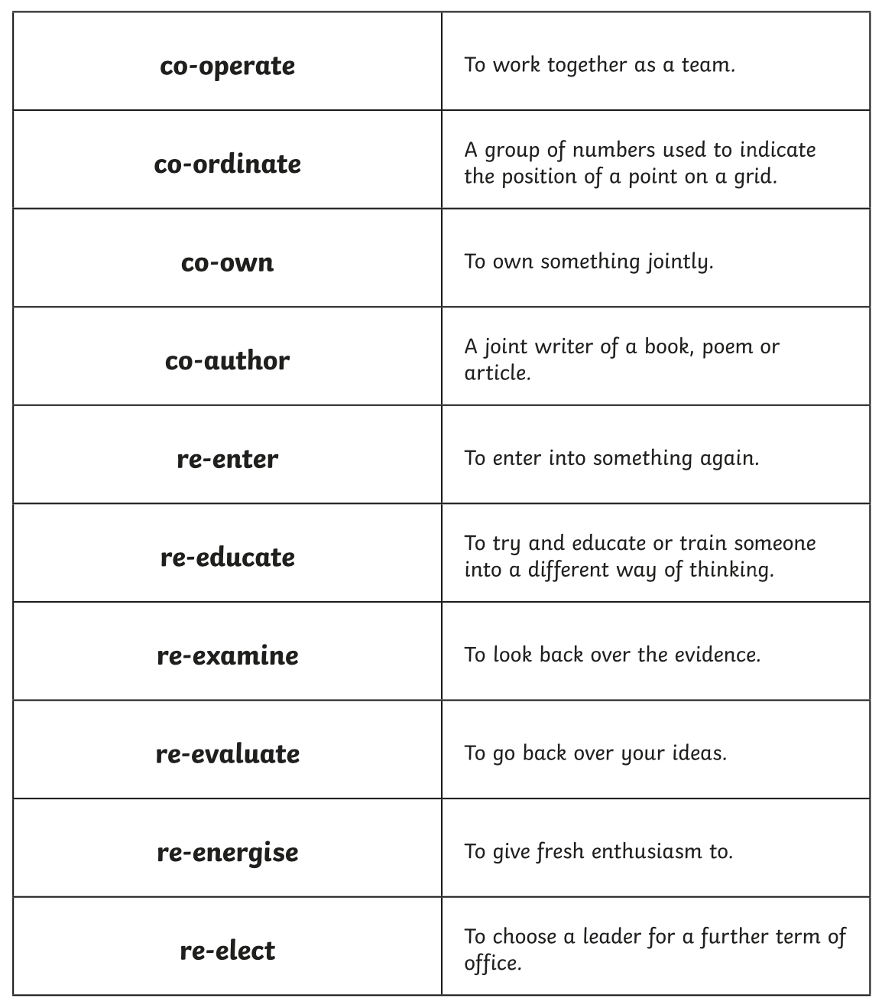

Slide 29
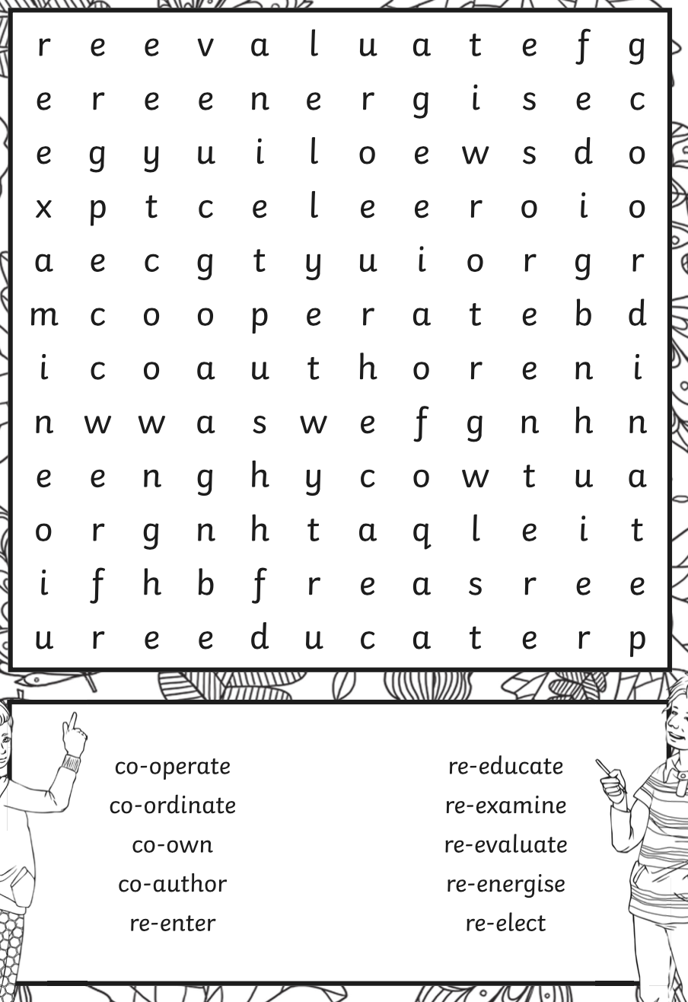

Slide 30
Week 27 English
Tuesday
– using prepositions to write our first paragraphs

Slide 31
The anxious yet relieved boy found his trusty vorpal sword under his bed.

Slide 32
Prepositions
where or when something is in relation to something else
prepositions are followed by nouns
The children celebrated after the SATS tests.
The children slept after celebrating.

Slide 33
Preposition Alphabet!
A = at
B = by
C = close to
Let’s see how far we get…

Slide 34
Our TAPE grid…
What am I writing?
A narrative story.
Who am I writing it for?
Other Year 6 children.
Why am I writing it?
To entertain my audience.
What am I trying to do?
To create suspense and scare my readers.

Slide 35
Para 1: preparing to go on the quest
Para 2: discussing the quest with father
Para 3: going into battle with the Jabberwocky
Para 4: returning home triumphantly

Slide 36
Think…
How is the boy/girl feeling about setting off on this quest?

Slide 37
With a heavy heart, the boy collected together some essentials for his life or death quest, placing them carefully into his small rucksack. Trepidation flooded through him. Before long, the boy was standing outside his house, silently studying its features – the yellowing yet sturdy thatched roof, the heavy oak door, the fresh roses, which stood smartly beyond the tiled pathway. Would he ever feel the warmth of home again? Could he dare imagine the danger he was soon to face? As the boy nervously stepped past the garden gate, he heard a familiar voice behind him.
-prepositions

Slide 38
Prepositions
Fronted adverbials
Short sentence
Subordinate clause
RQs x 2 together
Segue

Slide 39
With a heavy heart, the boy collected together some essentials for his life or death quest, placing them carefully into his small rucksack. Trepidation flooded through him.
Fronted adverbial
Short sentence

Slide 40
Before long, the boy was standing outside his house, silently studying its features – the yellowing yet sturdy thatched roof, the heavy oak door, the fresh roses, which stood smartly beyond the tiled pathway.
Fronted adverbial
Subordinate clause

Slide 41
Would he ever feel the warmth of home again? Could he dare imagine the danger he was soon to face? As the boy nervously stepped past the garden gate, he heard a familiar voice behind him…
Rhetorical questions x 2
Segue

Slide 42
Time to showcase some work.

Slide 43
Week 27 English
Wednesday –using direct speech in our narrative writing

Slide 44
Our TAPE grid…
What am I writing?
A narrative story.
Who am I writing it for?
Other Year 6 children.
Why am I writing it?
To entertain my audience.
What am I trying to do?
To create suspense and scare my readers.

Slide 45
Direct Speech
“Please take care, my son!” cried the boy’s father, loudly.

Slide 46
“Please take care, my son!” cried the boy’s father, loudly.
All of the spoken words must be put inside speech marks “ ”
The first spoken word has a capital letter
The punctuation at the end of the speech goes BEFORE the ”
The first word of the reporting clause does NOT have a capital letter.
Use an adverb with the reporting clause.
Miss a line for a new speaker.

Slide 47
“Please take care, my son!” cried the boy’s father, loudly.
“What should I worry about?” the boy asked, anxiously.
“The … the … the monstrous J-J-Jabberwocky!” his father replied, choking on his words.
Listening carefully, the boy hugged his father tightly. Then, he took a fearful step forward into the unknown…

Slide 48
“What should I worry about?” the boy asked, anxiously.
All of the spoken words must be put inside speech marks “ ”
The first spoken word has a capital letter
The punctuation at the end of the speech goes BEFORE the ”
The first word of the reporting clause does NOT have a capital letter.
Use an adverb with the reporting clause.
Miss a line for a new speaker.

Slide 49
“What should I worry about?” the boy asked, anxiously.

Slide 50
Time to showcase some direct speech.

Slide 51
Week 27
Wednesday Spellings
hyphenated compound adjectives

Slide 52
RECAP!
Here are your hyphenated prefix spellings words for this week.

Slide 53
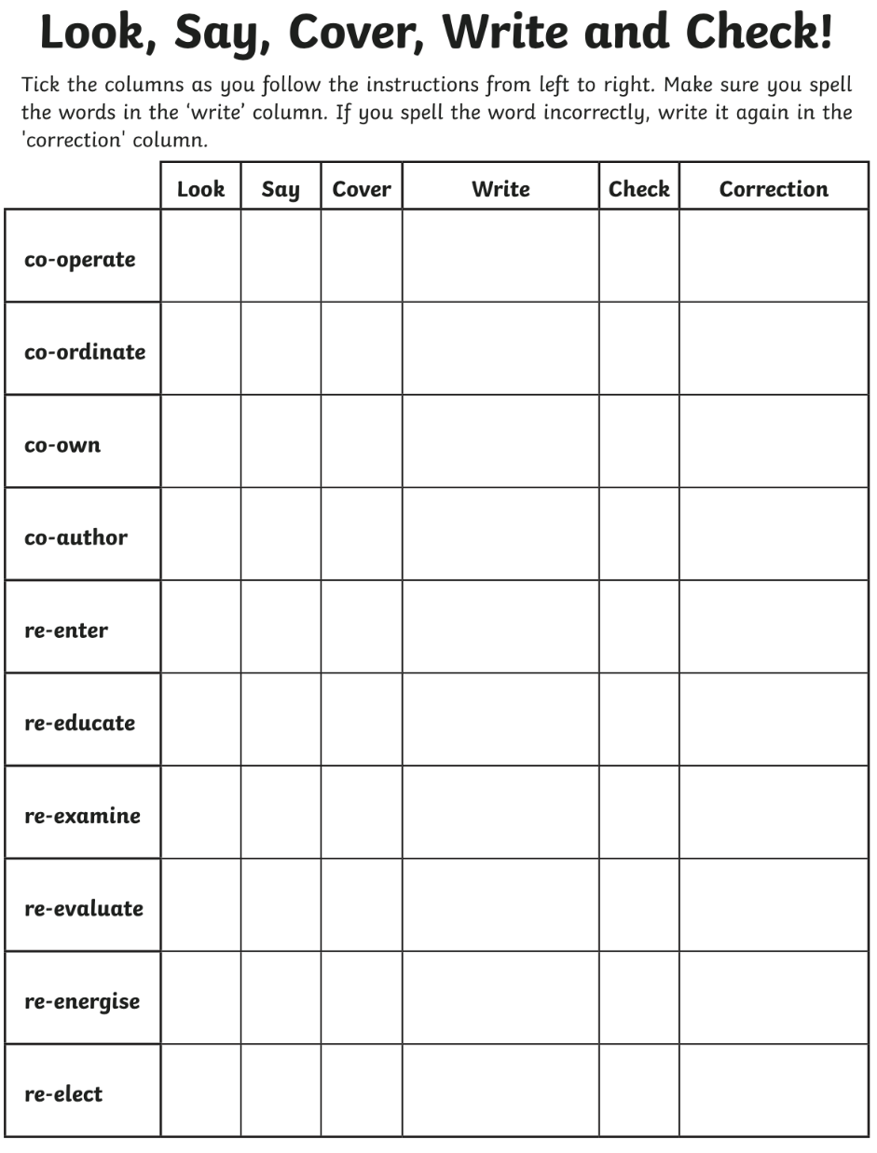

Slide 54
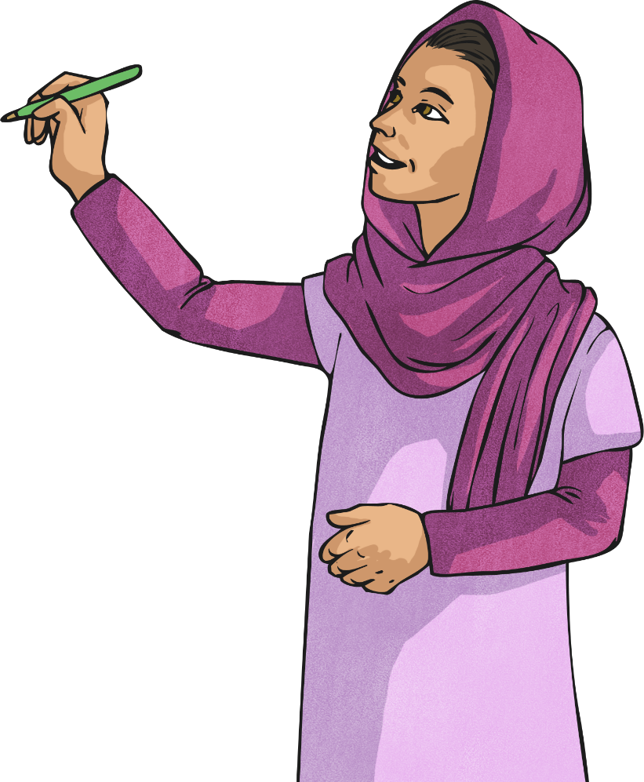
A compound adjective is an adjective that
comprises of more than one word.
Can you spot the compound adjective in this sentence?
The stingy man walked straight past the volunteers holding the charity collection buckets - he was such a cold-hearted individual.
Usually, a hyphen (or sometimes more than one hyphen) is used to link the words together to show that it is one adjective and to avoid any ambiguity.

Slide 55
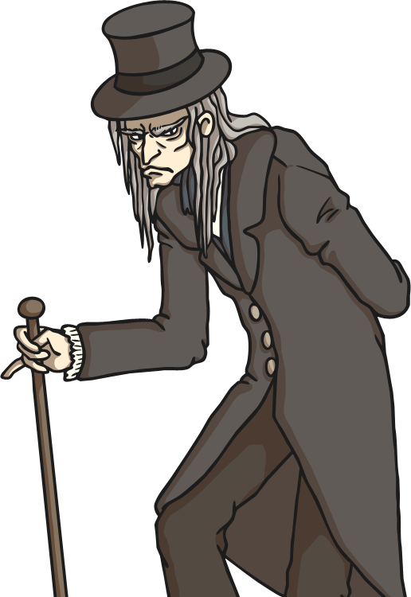
On the following slides, clues will be given to other hyphenated compound adjectives that have been used to describe nouns.
Ebenezer Scrooge was much detested in his town for being a miserly and
individual.
tight-fisted

Slide 56
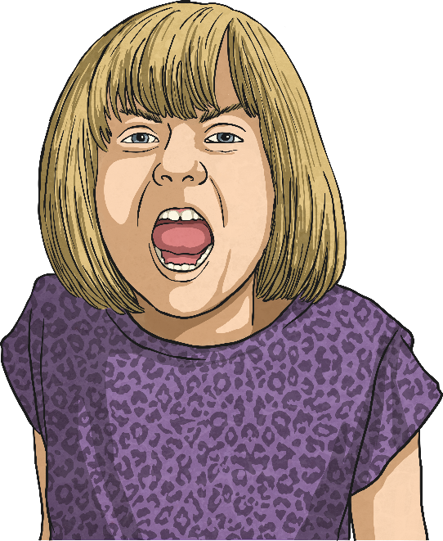
Can you figure out this hyphenated compound
adjective and spell it on a whiteboard?
My little sister, Nancy, is so stubborn when it comes to what she wants to do. She definitely is a little lady.
pig-headed

Slide 57
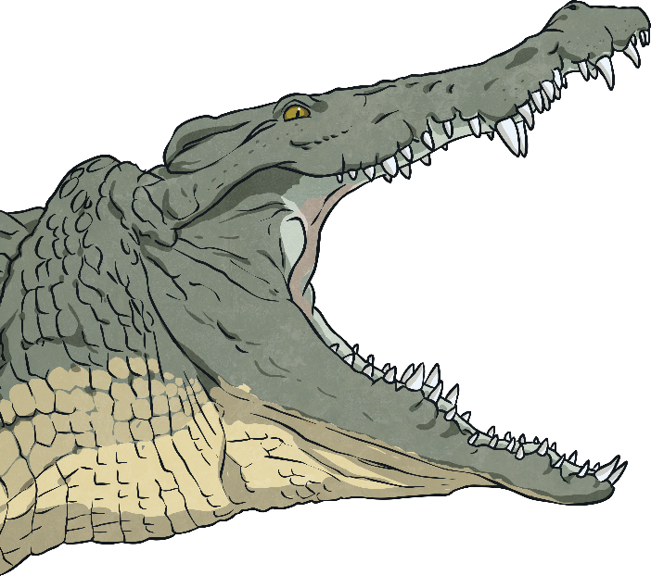
Can you figure out this hyphenated compound
adjective and spell it on a whiteboard?
Fearing for his life, Frederick rocketed away from the crocodile. He didn’t want to be the creature’s next meal!
man-eating

Slide 58
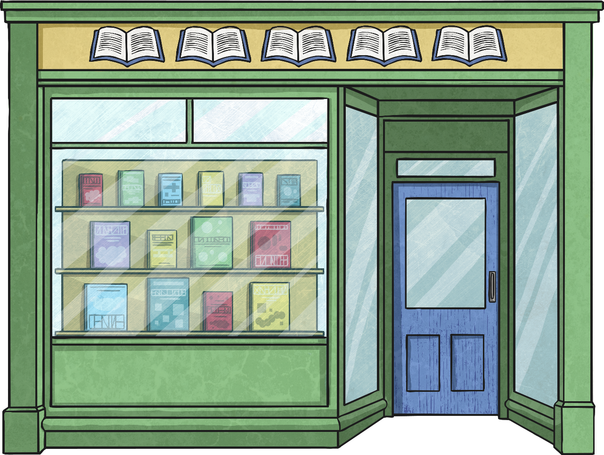
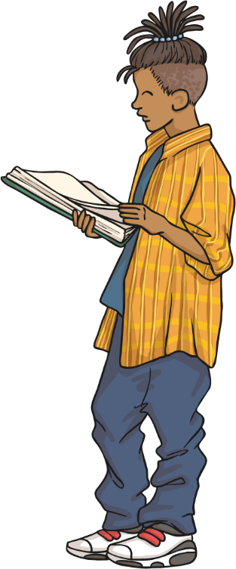
CLOSED
little-used
Sadly, the council had decided to close down the
library. Barely anyone ever visited it to borrow books these days.

Slide 60
Week 27 English
Thursday
– using shorter sentences to write our third and fourth paragraphs.

Slide 61
Our TAPE grid…
What am I writing?
A narrative story.
Who am I writing it for?
Other Year 6 children.
Why am I writing it?
To entertain my audience.
What am I trying to do?
To create suspense and scare my readers.

Slide 62
Firstly, the monster pounced forwards. Then, it swung its scaly tail around. Then, it knocked the boy off his feet. Then, the boy cried loudly.
The monster pounced. Its scaly whip crackled. The boy stumbled. He whimpered agonisingly.

Slide 63
After that, the boy grabbed his deadly vorpal sword. Then, he swung it around. Then, he hit the ferocious monster. Soon, the deadly beast died.
He seized his vorpal sword. He struck the monster. The creature collapsed, lifeless.
Your go – 13 words or less.

Slide 64
The monster pounced. Its scaly whip crackled. The boy stumbled. He whimpered agonisingly. He seized his vorpal sword. He struck the monster. The creature collapsed, lifeless.

Slide 65
Time to showcase some work.

Slide 66
Think…
How is the boy/girl feeling, on the way back home?

Slide 67
With a spring in his step, the boy swiftly gathered up the creature’s head, positioning it firmly in his rucksack (so it didn’t roll around). Joy, relief, exhaustion – different emotions crashed around inside him.
Fronted adverbial
Brackets
Abstract nouns

Slide 68
After a short while, the boy could hear the faint sound of cheering. As he got closer to his village, the cheering became louder. Very soon, he was at the village border. Look-outs trumpeted. A victorious fanfare of fireworks lit the night sky like fiery flowers. A figure rushed forward…it was the boy’s father.
Fronted adverbial
Subordinate clause
Short sentence
Simile

Slide 69
With a spring in his step, the boy swiftly gathered up the creature’s head, positioning it firmly in his rucksack (so it didn’t roll around). Joy, relief, exhaustion – different emotions crashed around inside him. After a short while, the boy could hear the faint sound of cheering. As he got closer to his village, the cheering became louder. Very soon, he was at the village border. Look-outs trumpeted. A victorious fanfare of fireworks lit the night sky like fiery flowers. A figure rushed forward…it was the boy’s father.

Slide 70
Now it’s time to test yourself on this week’s spellings…
Good luck!

