Slide 1
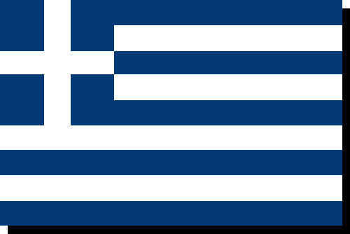
Greece
Over 8 million tourists visit Greece every year to see the history
and to visit the warm coastal areas
Greece's Facts
Area: 50,961 sq mi. Capital City: Athens Population: 10.9 million Main Language: Greek Currency: Euro. It was the Drachma Agriculture—products: wheat, corn, barley,
sugar beets, olives, tomatoes, wine

Slide 2
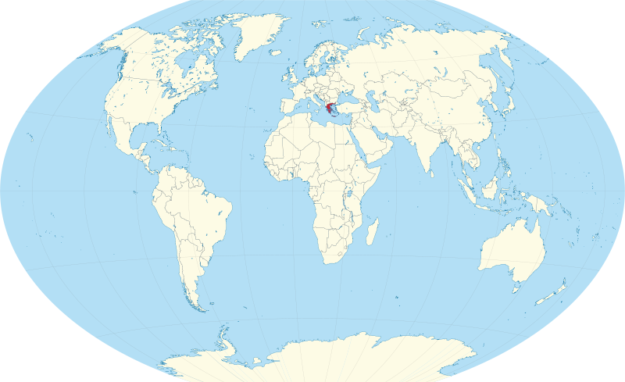
Location of Greece on a world map

Slide 3
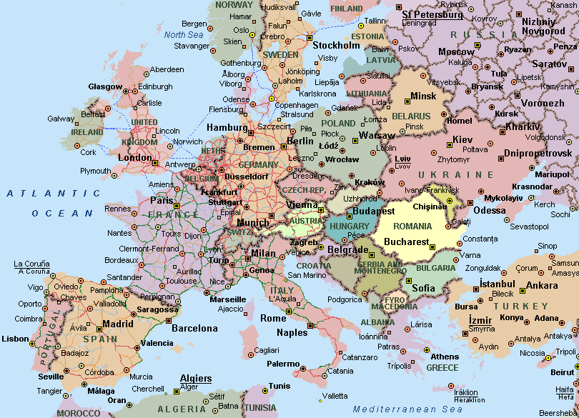
Map of Europe

Slide 4
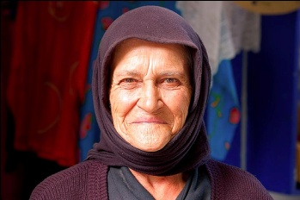
Greece's People Most Greeks wear modern clothing, although traditional clothing continues to be worn in some rural areas. Greeks are usually very friendly people who open their homes even to strangers. Socializing in outdoor cafes or restaurants is a popular activity. Many people in Greece, wear black all of the time to show respect for the dead. About 98% of the people in Greece attend a Greek Orthodox Church.
In Greece, everyone celebrates the "Name Day" of the saint that bears the same name as themselves. This usually has no relation to a person's actual birthday except by coincidence.
The naming of a baby in Greece is still usually followed quite strictly, with the result that certain names are used for many individuals in a generation. In each generation, the eldest grandson in each family will be named for the grandfather, and the eldest granddaughter will be named for the grandmother. If someone had three children, and they all produce a male grandchild, all three of those cousins will have the same name. To top it all off, all those with the same first name will celebrate the same saint's Name Day.

Slide 5
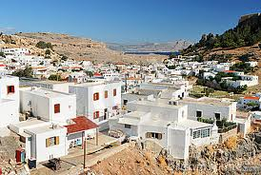
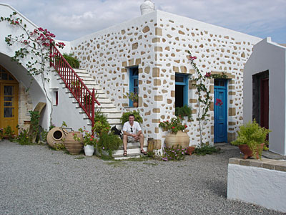
Greece's Homes
Most Greeks live in cities or coastal areas. In the cities there are apartments and modern homes. Almost every Greek apartment has a balcony. Many Greek homes are located very close to each other with little or no yard. Many homes are white with colourfully painted doors and windows. These homes are made of stone, brick, and clay. Ancient Greek homes were built around an open courtyard and some still follow this style.

Slide 6
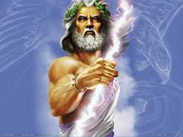
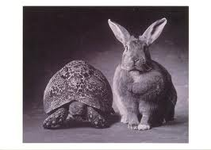
Greece's Culture
Greece is one of the oldest nations in Europe, with a history going back thousands of years. The culture of ancient Greece has had a major influence on the rest of the world in such areas as Drama , Art, Architecture, Literature, Music, Philosophy, and Mythology. Greek mythology has had a strong influence throughout the world in literature and culture.
The most important god in Greek mythology was Zeus, the god of the sky and ruler of the Olympian gods.
Aesop's fables were believed to be written by a Greek slave around 600 BC. Every story ends with a moral.

Slide 7
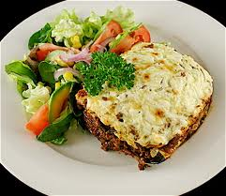
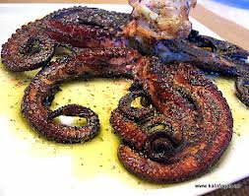
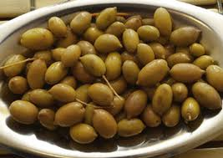
Greece's Foods Popular foods include avgolimono, which is an egg-lemon soup, moussaka (eggplant casserole) and baklava (a nut filled pastry). Greek meals may include grilled seafoods or pickled octopus, spinach and cheese pies, pita breads filled with meats, or salads made with tomato, cucumber, feta cheese, and olives. Restaurants in Greece, called tavernas, usually serve their food warm, not hot. Dinner can begin around 9:00 PM and can last until midnight.
Much of the land in Greece is mountainous, and much of the soil is poor. The most important crop is olives and Greece is the third biggest producer of olive oil after Italy and Spain. But Greece also produces grapes, wine, figs, cotton, tomatoes and tobacco.
Olives are harvested in the fall by shaking the olive trees and then gathering up the fallen olives in large nets. They are later sorted by size. Olive trees are usually quite small but they can live for hundreds of years.

Slide 8
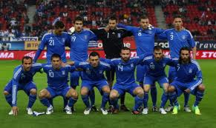
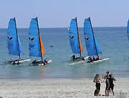
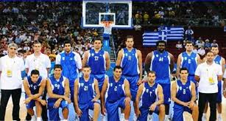
Greece's Activities
The country's favourite sports are soccer, basketball, and track and field events. Hiking and skiing are popular in the mountainous areas. Water sports are also popular. The Greeks were the first to establish the Olympic Games, thousands of years ago.
Theatre is very popular in both ancient and modern Greek culture. Plays are still held in outdoor theatres as they have been for more than 2,000 years.

Slide 9
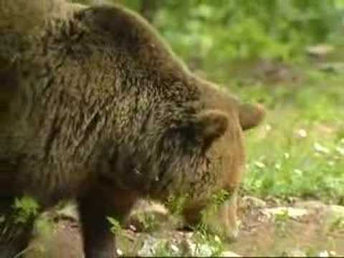
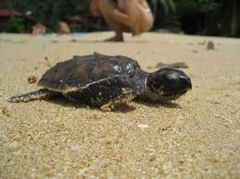
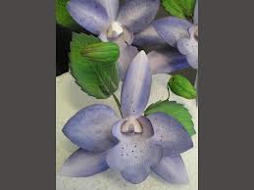
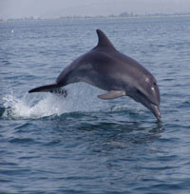
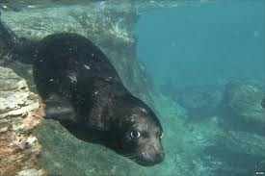
Greece's Animals
Greece is home to over 6,000 varieties of plants. Some of Greece's plants and orchids are not found anywhere else on earth. The mountains are home to wolves and bears. The warm ocean waters surrounding the islands are home to dolphins, turtles, and seal.

Slide 10
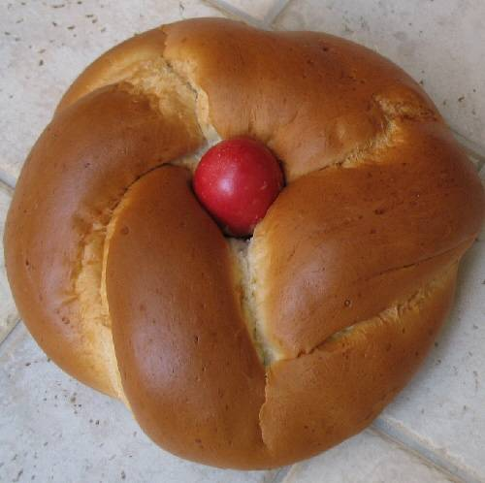
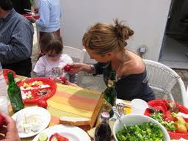
Greece's Holidays and Celebrations In Greece, most people celebrate Easter. Easter is a Christian holiday that is celebrated on a Sunday in either the end of March or the beginning of April. Easter is a bigger holiday than Christmas in Greece. Easter celebrations begin after 40 days of fasting (a time when people do not eat or drink during the day). A special Easter bread is cooked that has hard-boiled eggs in it. Easter eggs are coloured red. Children play a game with their eggs. Each child holds an egg and tries to break another child's egg. The child left with an unbroken egg is considered lucky.

Slide 11
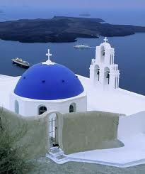
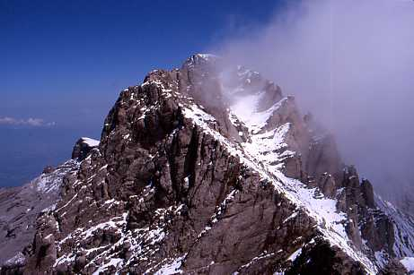
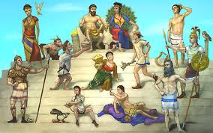
Greece's Land
Greece boasts thousands of islands - but only about 200 of them are inhabited or visited by tourists. Crete is the largest of the islands. Santorini is the most-visited Greek island. Coming in second is Crete, followed by Corfu, Rhodes and Mykonos. But Santorini is not the most popular island for local Greek travelers.
The highest peak in the Greek mountains is known as Mount Olympus. In Greek mythology, Mt. Olympus was said to be the home of the gods

Slide 12
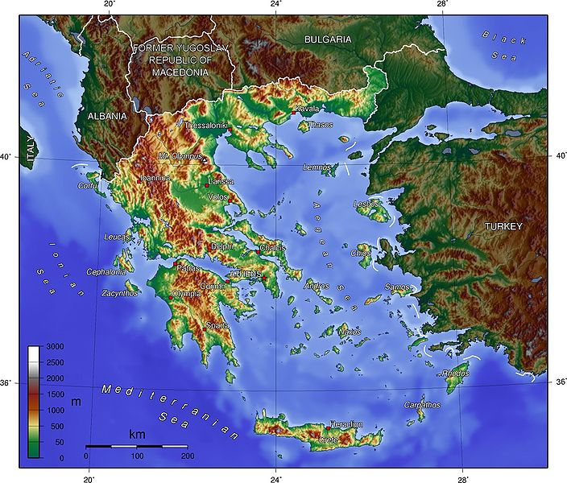
Greece is bordered by four countries, Albania, Republic of Macedonia, Bulgaria and Turkey.

Slide 13
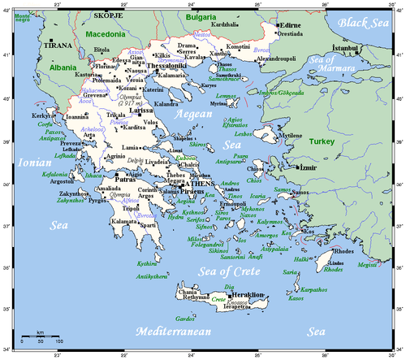
Greece’s cities, main towns and Rivers.

Slide 14
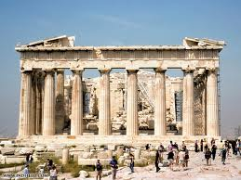
Greece's Cities and Landmarks The Parthenon was built in 438 B.C. as a temple for Athena, the goddess of war. Today it is the most popular tourist attraction in Greece.

Slide 15
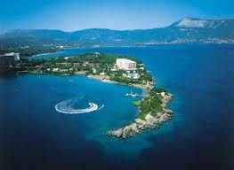
What is the weather like in Greece?
Greece has a warm, sunny climate with temperatures that peak at about 33 C in the summer months of June, July and August, lowering to between 13 C and 15 C from December to February.
Rainfall in Greece peaks at about 65mm in December and January, but lowers to only 6mm in July and August

