Slide 1
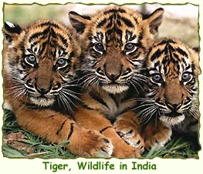
WILDLIFE IN INDIA
Let’s explore……

Slide 2
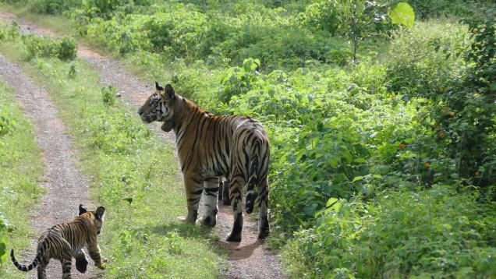
This is your task…….
Can you find out which
wild animals live in India?
Which part of India do
they live in?
What is their habitat?
Can you find out any
other information about
them?
Record any information you find in your Ideas Book and use it to help you with your next task which is writing an article about ‘Wildlife in India’ in your Topic Books.

Slide 3
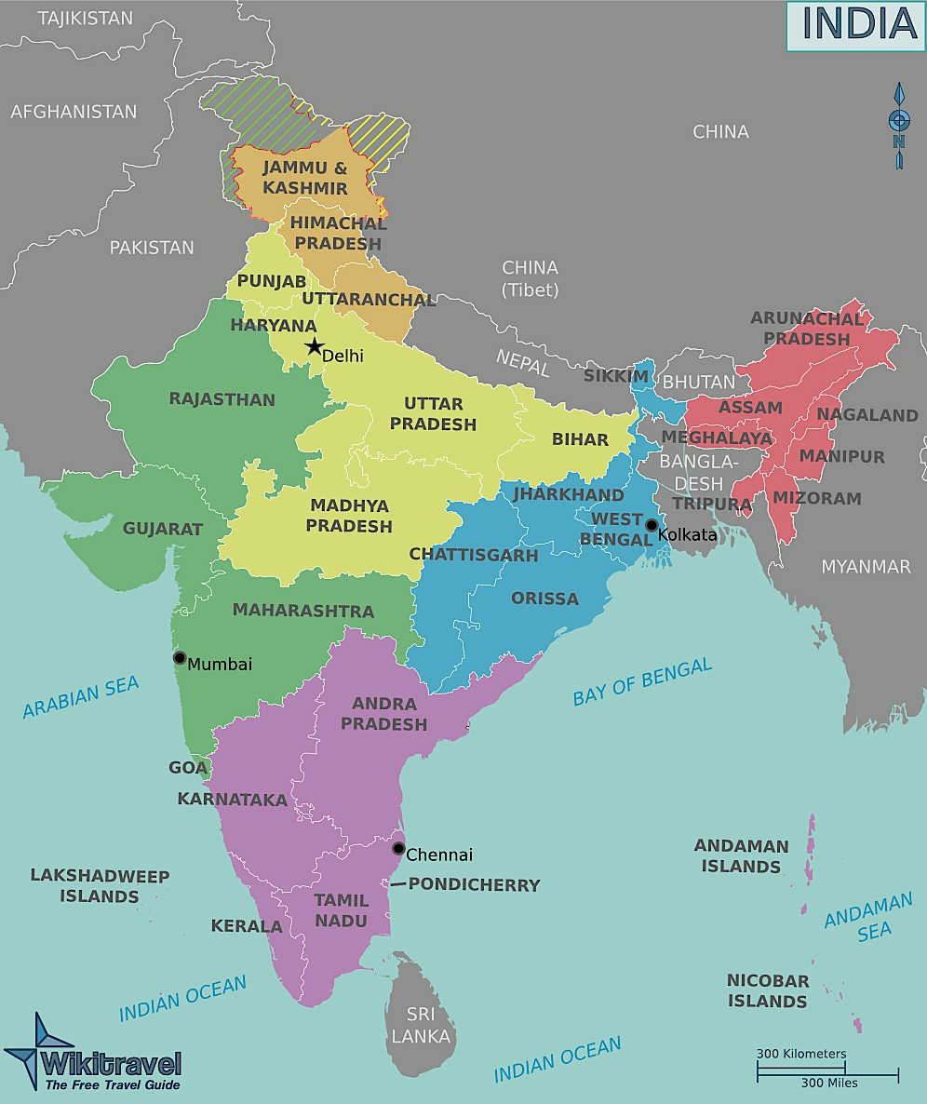
This is your HOME page.
Whenever you click
You will return
to this page.
Let’s explore!
Click on a yellow star
to start your journey…..

Slide 4
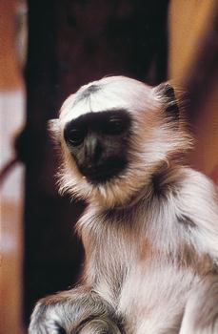
Langur Monkey
The Langur Monkey can live almost
anywhere in India as long as there
are plenty of leaves! Leaves form the
main part of its diet, although it
also enjoys fruit, nuts and flowers.
Its nickname is the ‘Leaf Monkey’.
They can do a standing jump of about 5 m – across the
width of a small river – and about 12m when coming
down from a tree.
They are grey/yellowish
in colour, with black faces
and long tails.
Click here to find
out more information

Slide 5
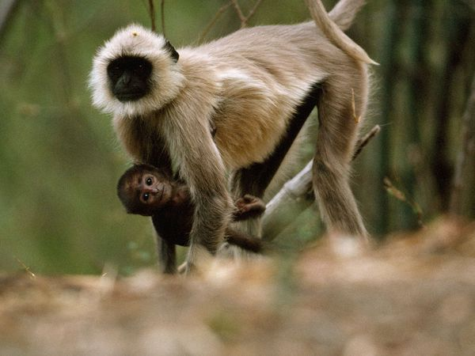
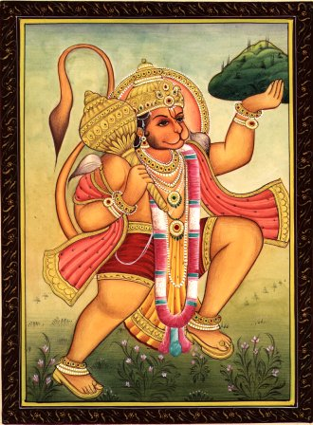
Hanuman - the
Hindu god.
The Langur Monkey….
….is considered to be a descendent of Hanuman, the
monkey god, one of the most important gods in the
Hindu religion. People in the city of Jodhpur feed
the monkeys daily as they think it brings them ‘good
luck’. Consequently, the Langur Monkeys in Jodhpur
are quite fat!

Slide 6
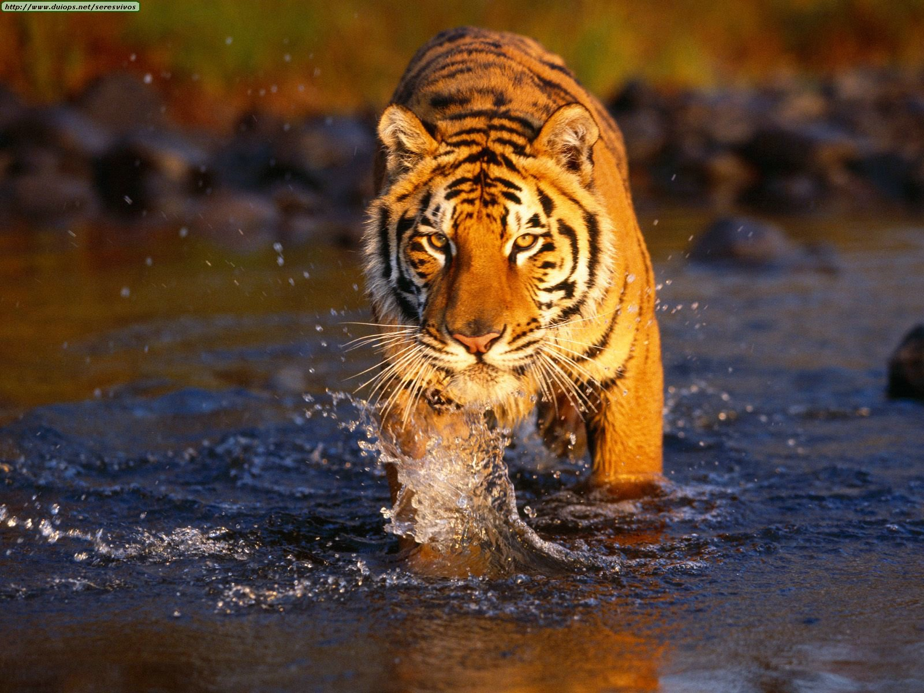
Bengal Tiger
The Bengal Tiger is a strong, powerful wild cat about 3m
in length (its long tail is almost 1m in length!). It has
orange-brown fur with black stripes over most of its body
but on its belly, the fur is white with black stripes.
It lives in forest or dense grasslands and is a carnivore
(meat eater) feeding on deer, pigs, antelopes and young
elephants.
Click here to find
out more information

Slide 7
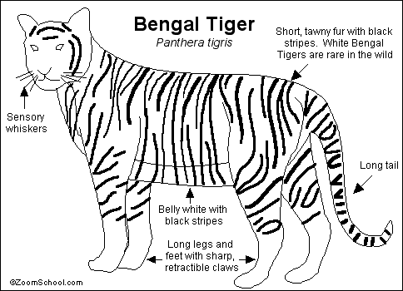
Here is a drawing of a Bengal Tiger. Can you guess what the labels are?
To check your answers, click here here.
You may draw and label your own Bengal Tiger for your Topic Book notes.
Click the green star to take you to
a web page about the Bengal Tiger.
You can actually listen to its roar!

Slide 8
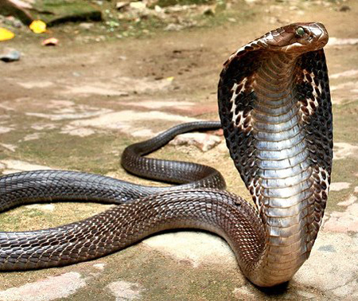
Cobra
The cobra is the world’s largest venomous snake and it is found across all
parts of India.
It has a distinctive hood behind its head which flares up when it is angry, making
it an intimidating sight.
Although it is a long snake (3 – 5m in length) it is quite thin and its brown
skin has black and white speckled pattern. The under belly is white.
Click here for
more information

Slide 9
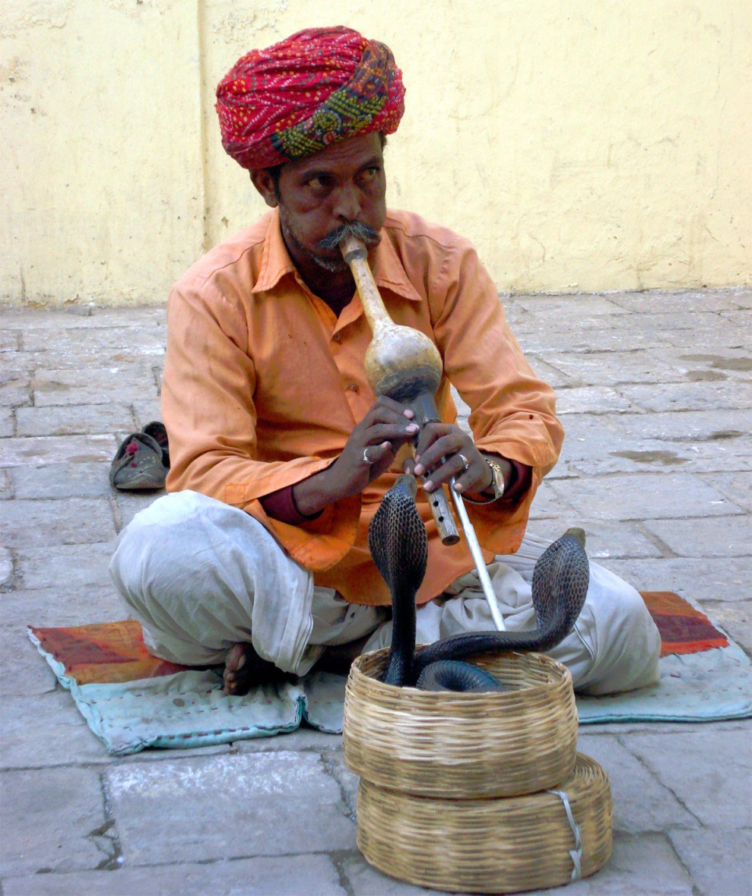
Cobras are the only snakes in the
world that build nests for their
eggs, which they guard ferociously
until the baby cobras emerge.
King cobras are found next to
snake charmers, performing a
dance for visitors to India.
Although they cannot hear the
music, they move around to
the movement and vibrations
of the pipe.
Click here to find
an amazing photograph and more information about cobras.

Slide 10
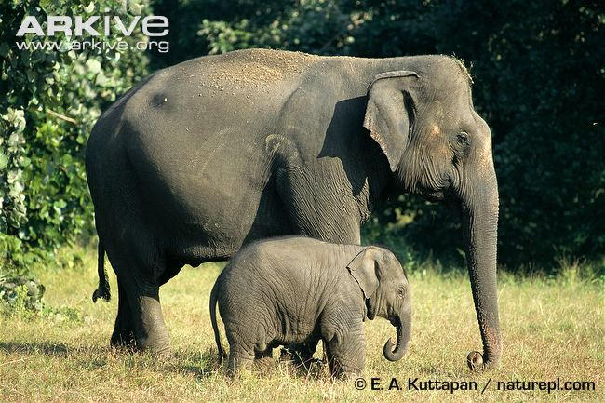
Indian Elephant
The Indian elephant is smaller than the African elephant (about 3m in height).
It is dark grey in colour with patches of pink on its forehead, ears and the base
of its trunk.
Click here to find
out more information

Slide 11
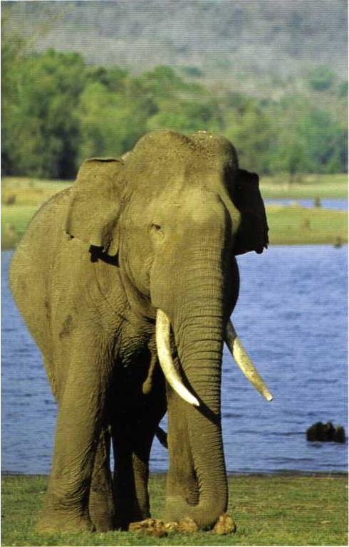
Did you know?
Did you know that an elephant does not
use its trunk to suck water up like using
a straw but it sucks water into its trunk
then squirts it into its mouth!
Elephants are hungry creatures and spend
most of the day feeding on grass, tree bark,
roots of plants and leaves. Bananas and sugar
cane are two of its favourite meals.
It is also a thirsty creature and needs a long
drink of water at least once a day.
Click click here to find out lots more about the Indian elephant. You can listen to it trumpeting and watch a video of it meeting a cobra in the river!

Slide 12
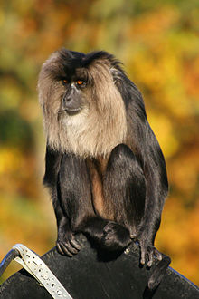
Liontail Macaque
This monkey is found in the evergreen forests of
Kerala in SW India at a height of about 3,000 feet.
It has a grey mane, like a lion, and a tufted tail like a
lion. The body is covered in sleek, black fur.
In the wild, lion-tailed macaques eat fruits, seeds, buds, leaves, insects, and small birds and mammals.
The Liontail Macaque is listed as an endangered
Species as it is only found in a small area of India.
Click here find
out more information

Slide 13
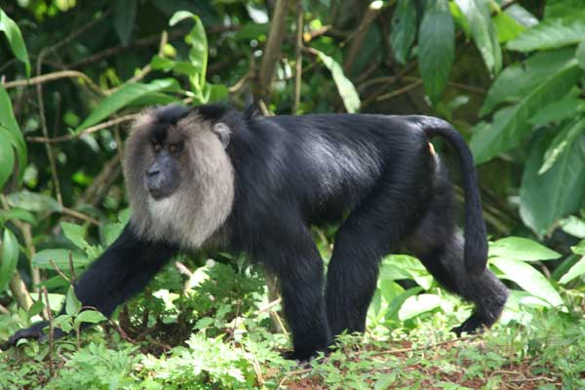
The main reason for the Macaque Monkeys becoming an endangered
species is due to their loss of habitat. They spend most of their lives
in the tree tops and rarely come to ground level. However, much
of the forest which they need as a home is being destroyed to make way
tea, coffee and teak plantations.
If you would like to see more photographs and videos of the Macaque Monkey –
click click here

Slide 14
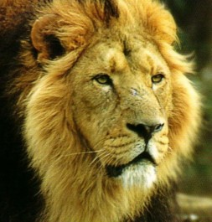
Asiatic Lion
The Asiatic Lion is an endangered species.
Only 400 exist in the forests of a small part
of India called Gujarat.
They are smaller and lighter than the African
Lions but equally aggressive.
They feed on deer, antelope and gazelle.
Click here to find
out more information

Slide 15
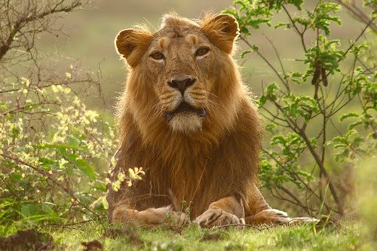
Asiatic Lions live in a group
called a pride. They move
around together looking
for food but much of the
forest which provided them
with food has been destroyed
to make way for towns and
farms. This is why they are
becoming an endangered
species.
To see more photographs,
videos and information
about this endangered
animal, click here here

