Slide 2
https://www.bbc.co.uk/bitesize/clips/z4fr87h

Slide 3
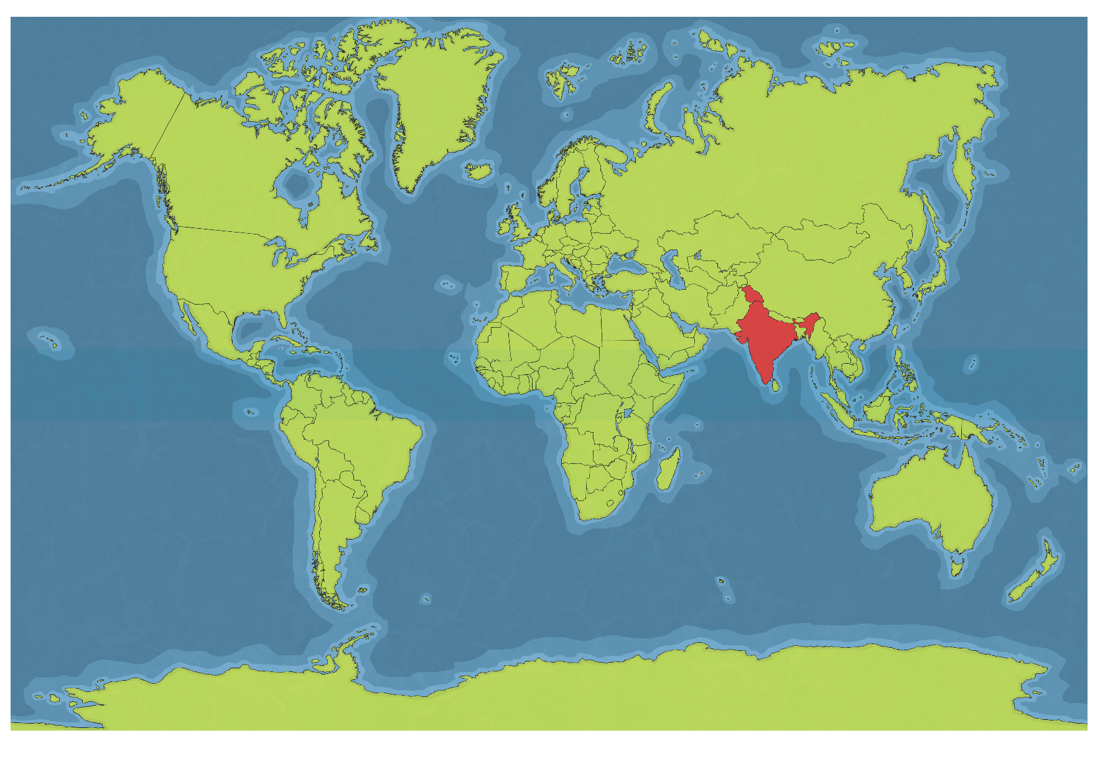
India’s Location
India is located in Asia. It is sometimes referred to as a subcontinent. It is located by the Indus River.

Slide 4
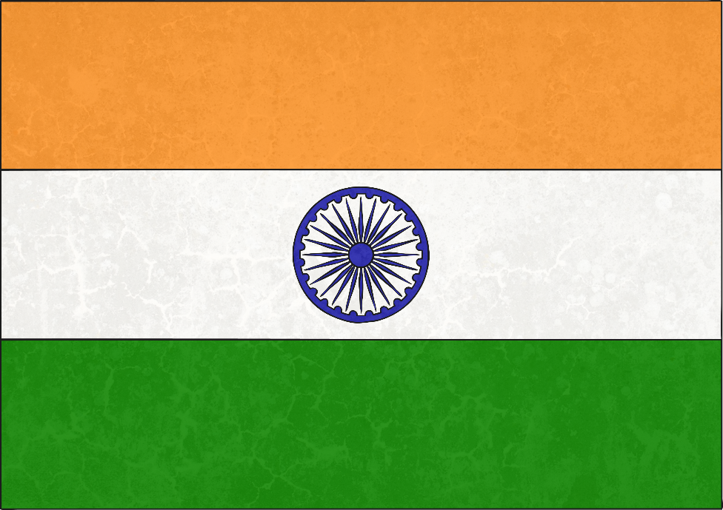
Facts About India
Official Languages: Hindi and English
Capital City: New Delhi
Landmarks: Taj Mahal, Amber Palace, Red Fort and Ellora Caves
Natural Landmarks: Ganges River, Jog Falls and Nagarhole National Park
Population: 1.35 billion
Major Religions: Hinduism, Islam, Christianity, Sikhism and Buddhism

Slide 5
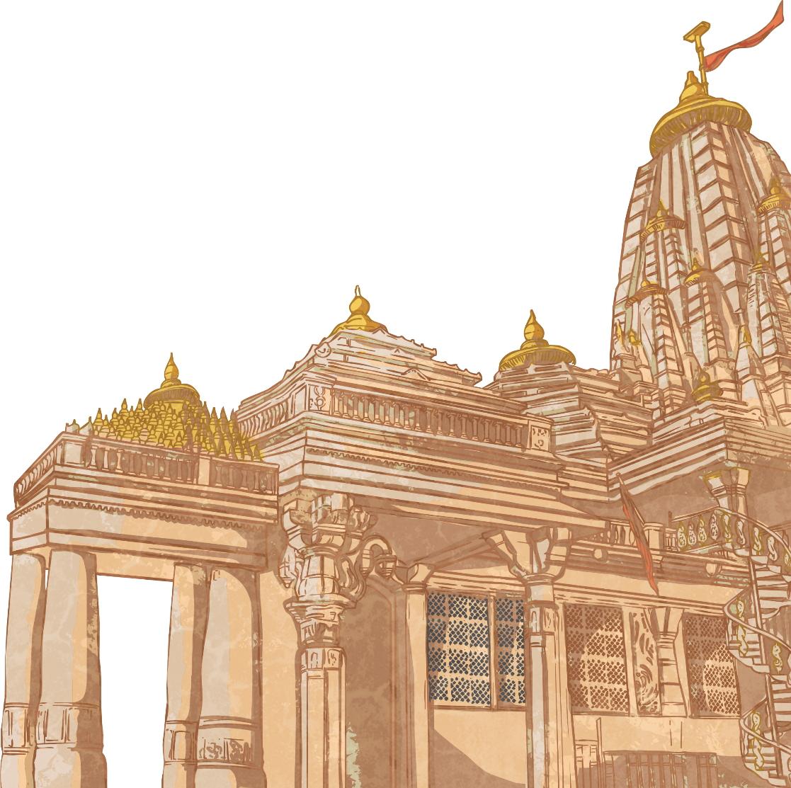
India’s Geography
India is divided into 29 states. It also has seven union territories.
India borders several countries, including China, Bhutan, Nepal, Pakistan, Bangladesh and Myanmar.
The landscape of India is very diverse, with deserts, jungles, modern cities, beaches and mountain ranges – including the Himalayas, which is the highest mountain range in the world.
There are numerous rivers in India and they all play an important role in people’s lives. The largest river is the Ganges, which is also a sacred river to Hindus.

Slide 6
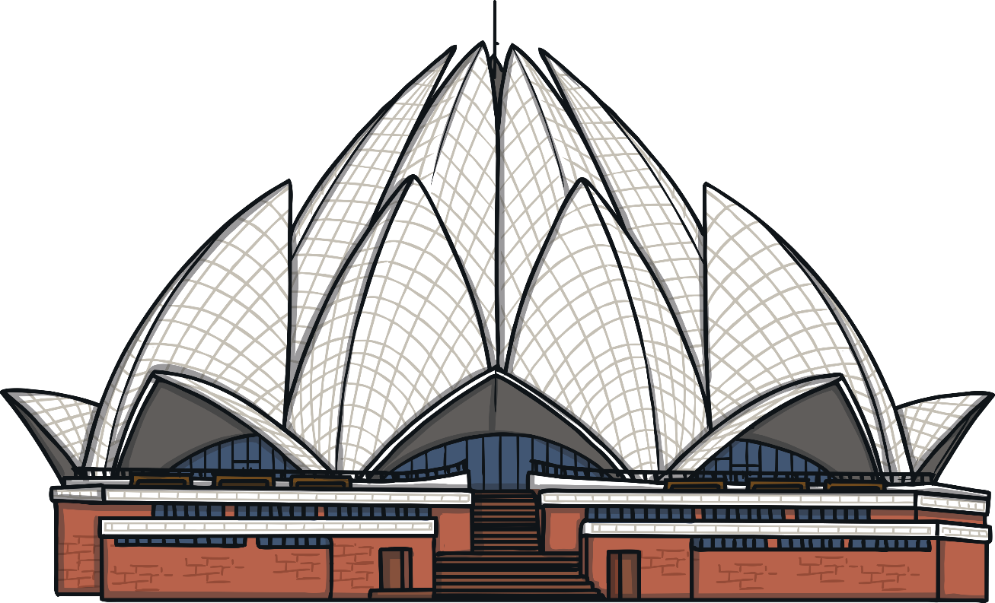
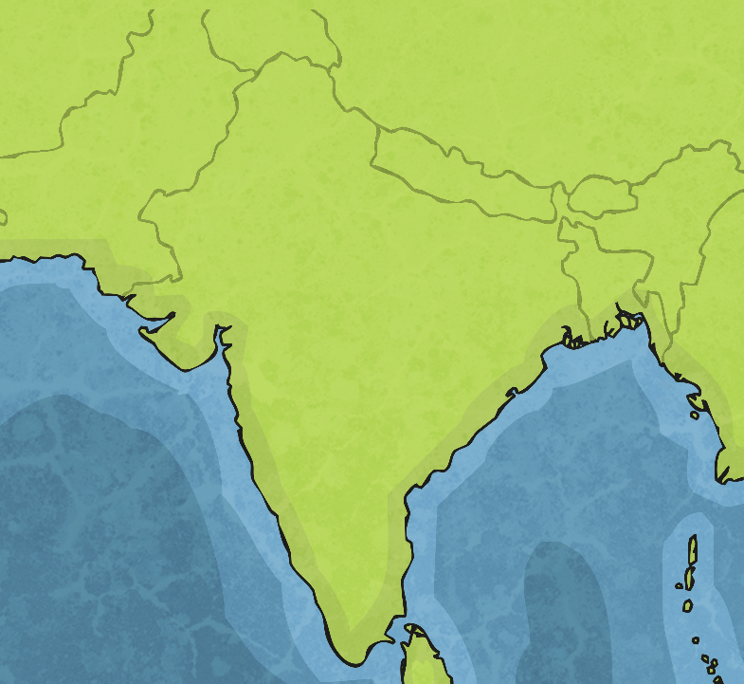
Delhi
Delhi (sometimes called ‘New Delhi’) is the capital city of India. It has a population of around 30 million people, making it the second-most populated urban area in the world.
Delhi was first settled in the 6th century BCE and has been inhabited ever since then.
Today, it is an important modern city, with a financial centre filled with business and is a popular location for tourists.
Delhi
Landmarks include the Lotus Temple, India Gate and Akshardham Temple.

Slide 7
Mumbai
Mumbai, formerly known as Bombay, is the largest city in India. It has a population of around 20 million people, making it the 7th largest city in the world.
The city is built across seven islands.
Mumbai
It is the financial, commercial and entertainment centre of India.
The city is home to many businesses and Bollywood.
Mumbai is also a popular tourist location, with historical architecture, museums and attractions, such as the Elephanta Caves.

Slide 8
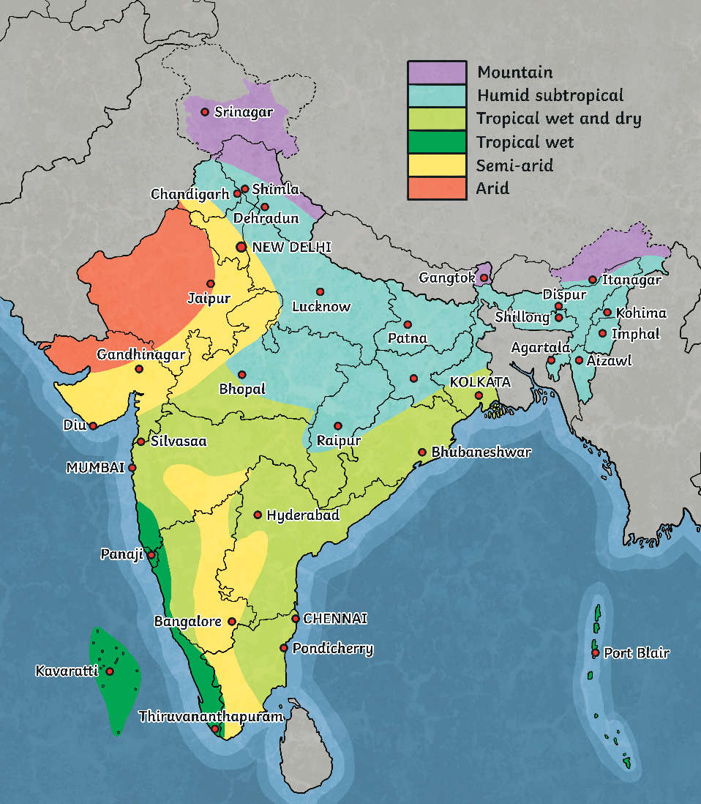
India’s Climate
India has a large range of climates across the country as it is such a large area with a variety of landscapes.
The majority of India is classified as tropical climate.
Some areas of India have an arid climate, some have a humid climate and some even have a glacial climate.

Slide 9
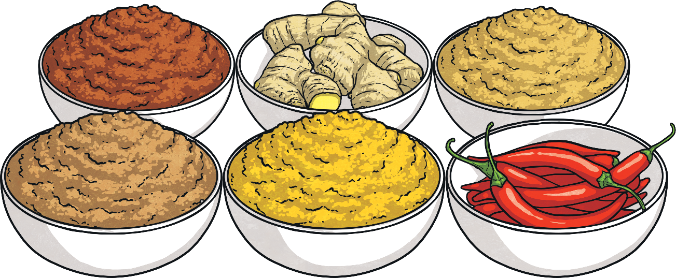
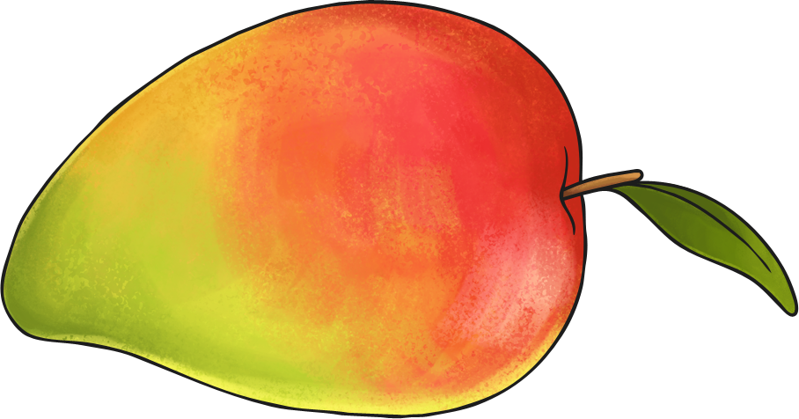
India’s Food
Since India is so diverse, its food is varied. Rice is the staple grain used in many dishes and lentils are also very popular.
India is famous for its spices and food from India usually contains a variety of them. Common spices are curry, turmeric and cinnamon. Garam masala is a popular
spice mixture.
Mangoes and other tropical fruit are also very common in India.

Slide 10
India’s Animals
India is home to a huge number of living organisms, including 8.6% of all mammals, 13.7% of all birds, 7.9% of all reptiles, 12.2% of all fish and 6% of all flowering plants.
This includes:
Amphibians
Mammals
Plants
Malabar gliding frog
Asiatic toad
Asiatic painted frog
Bengal tiger
Indian elephant
Asiatic lion
Sloth bear
Red panda
Snow leopard
Lotus flower
Orchids
Bamboo
Reptiles
King cobra
Indian star tortoise
Mugger crocodile
Marine life
Birds
Walking catfish
Gharial
Ganges river dolphin
Indian peacock
Great Indian hornbill

Slide 11
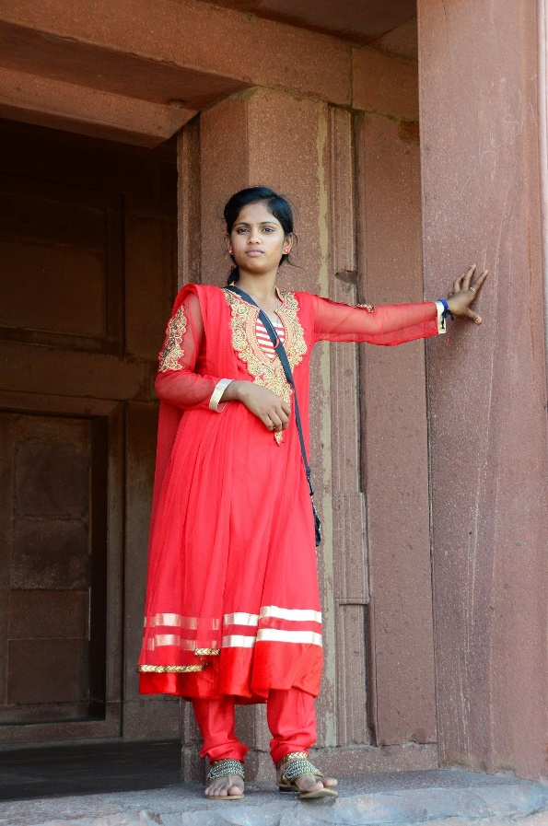
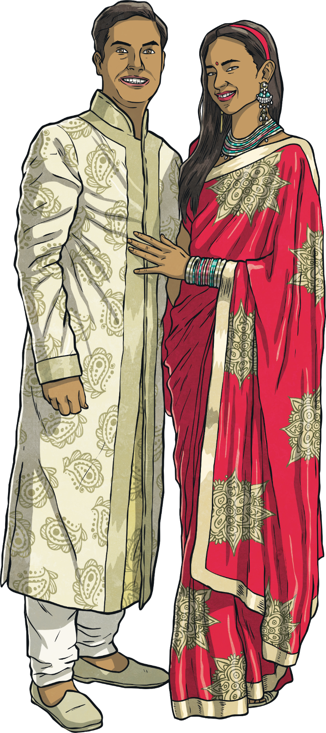
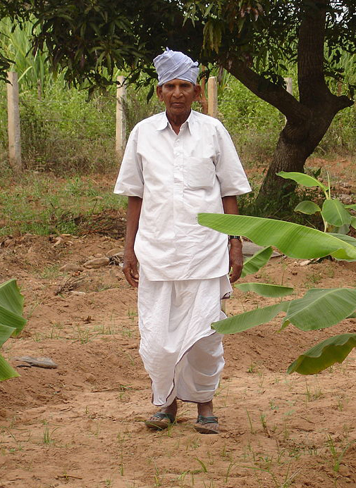
India’s Cothing
Religion impacts clothing worn by many in India.
An example of traditional clothing for women is the sari. It is a draped, robe-like dress.
Linen and silk are popular fabrics of many Indian clothes.
A dhoti is a traditionally draped cloth worn by men that resembles trousers.

Slide 12
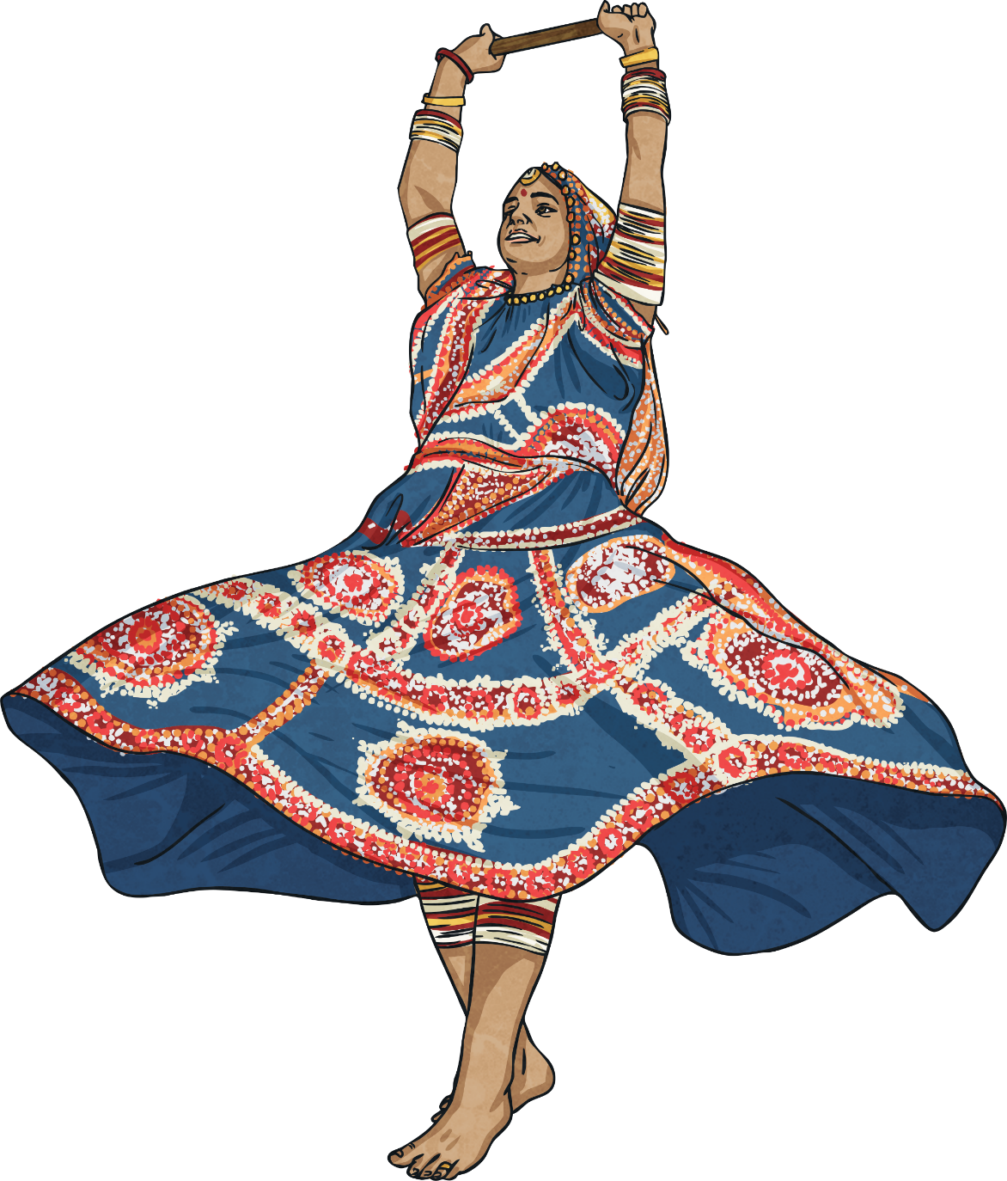
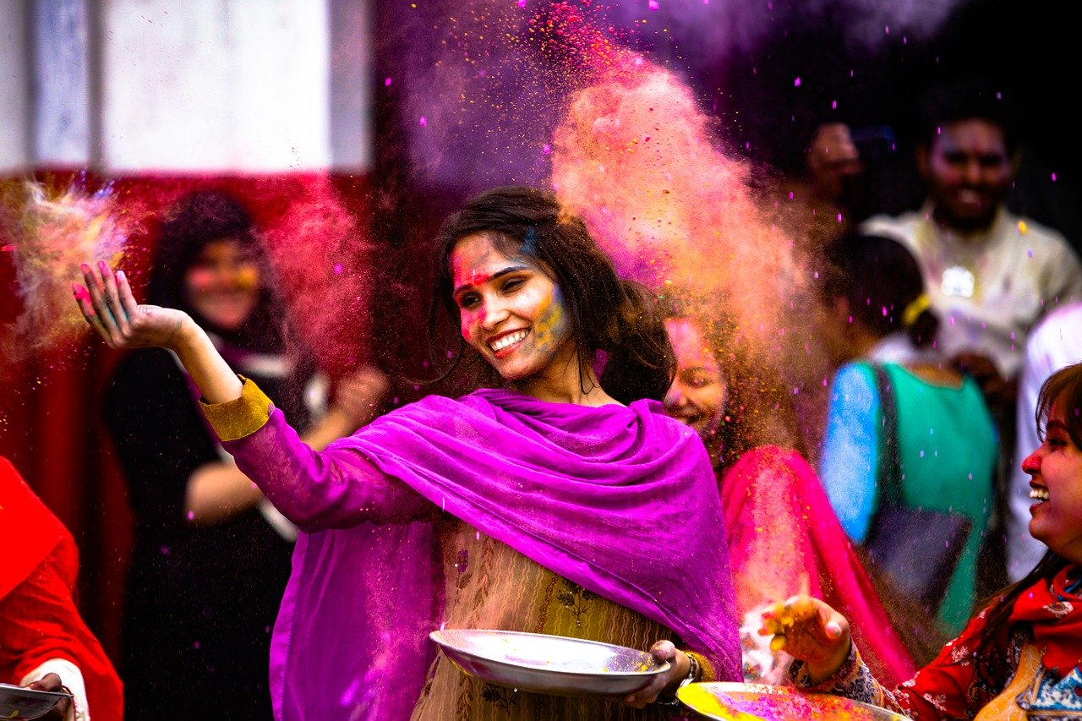
India’s Culture
India’s culture is very diverse. It includes many different people from different backgrounds.
Religions, philosophy, food, architecture, language, dance, music and even films all have influences from a range of cultures that have existed and spread throughout the country.
There are many festivals which are held throughout the year in India, including Diwali, Holi and Navratri.

Slide 13
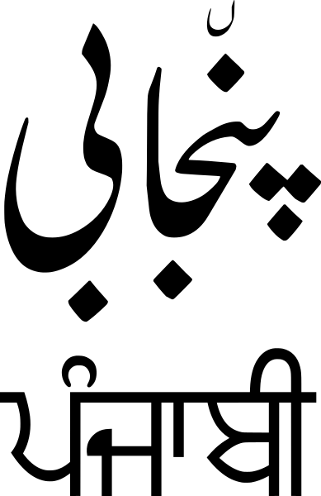
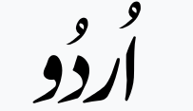
India’s Languages
The official languages of India are Hindi and English.
Despite this, there are many other languages spoken across the country, including Punjabi, Bengali, Kashmiri, Tamil, Sanskrit, Urdu and many others.
Some of these languages have very unique alphabets, such as:
Sanskrit
Hindi
Urdu
Punjabi

Slide 14
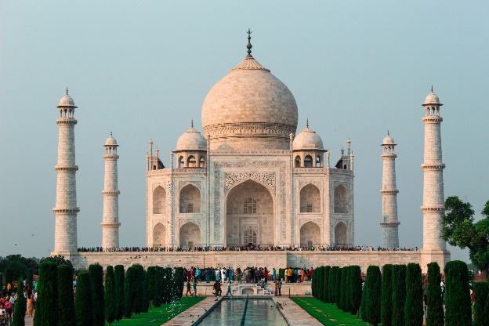
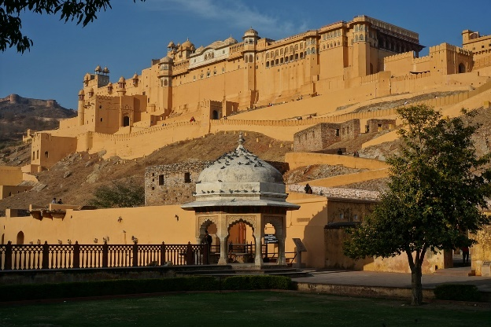
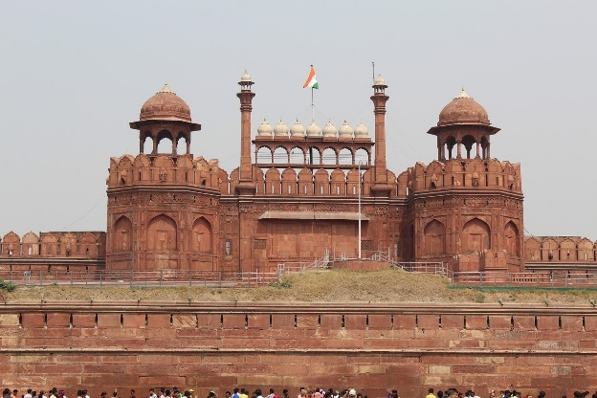
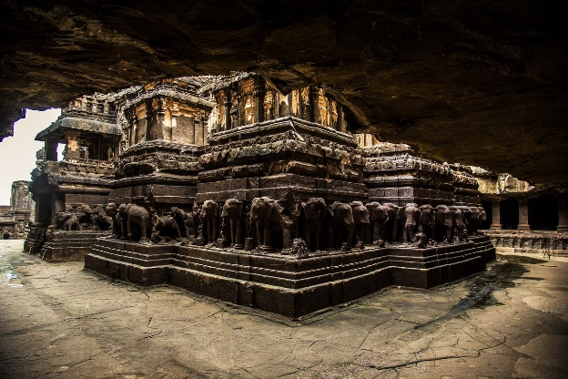
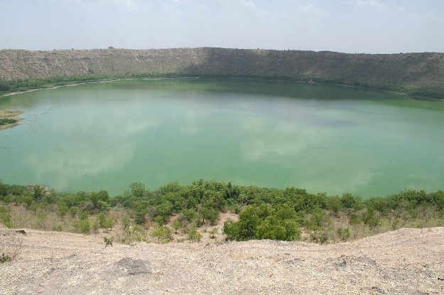
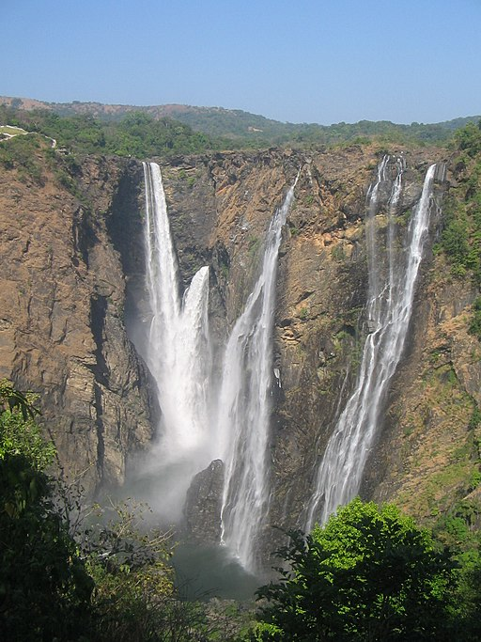
Indian Landmarks
Click on each landmark to find out more.
Taj Mahal
Amber Fort
Red Fort
Ellora Caves
Lonar Crater
Jog Falls
Next Slide

Slide 15
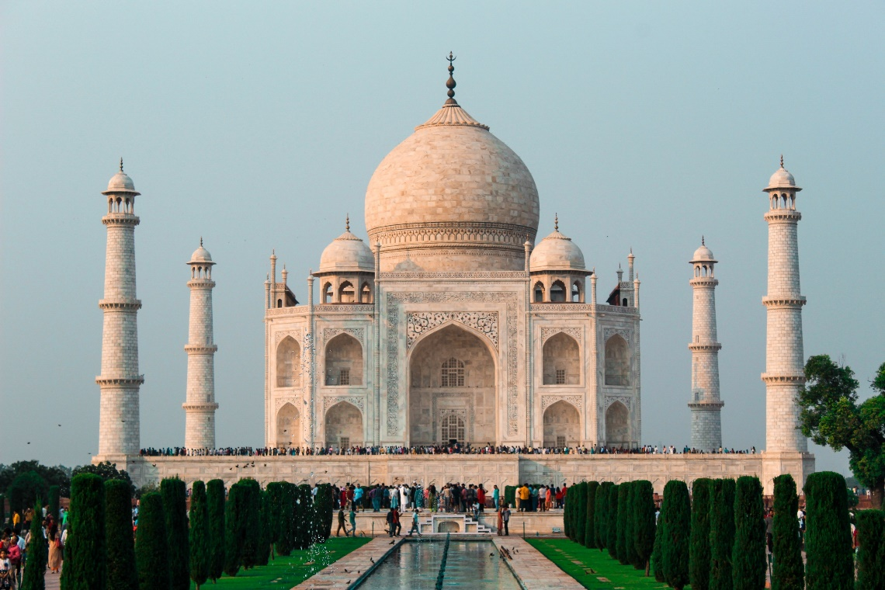
Taj Mahal
The Taj Mahal is located in Agra. It was built in 1648 by Mughal Emperor Shah Jahan as a burial chamber for his wife.
The Taj Mahal is constructed from white marble and is a mixture of Islamic, Persian and Indian architecture styles.
It is one of the new Seven Wonders of the World.
It is one of the most popular tourist sites in the world, with around 7 million visitors each year.
Back

Slide 16
Amber Fort
Amber Fort, also known as Amer Fort and Amber Palace, is a large palace complex built from pale yellow and pink sandstone. The main part of the fort dates from the 16th century, although there are remnants of much older settlements around the area.
The palace is a mix of Hindu and Mughal styles of architecture and is filled with beautifully decorated rooms.
It is located close to the city of Jaipur in the north of India.
Back

Slide 17
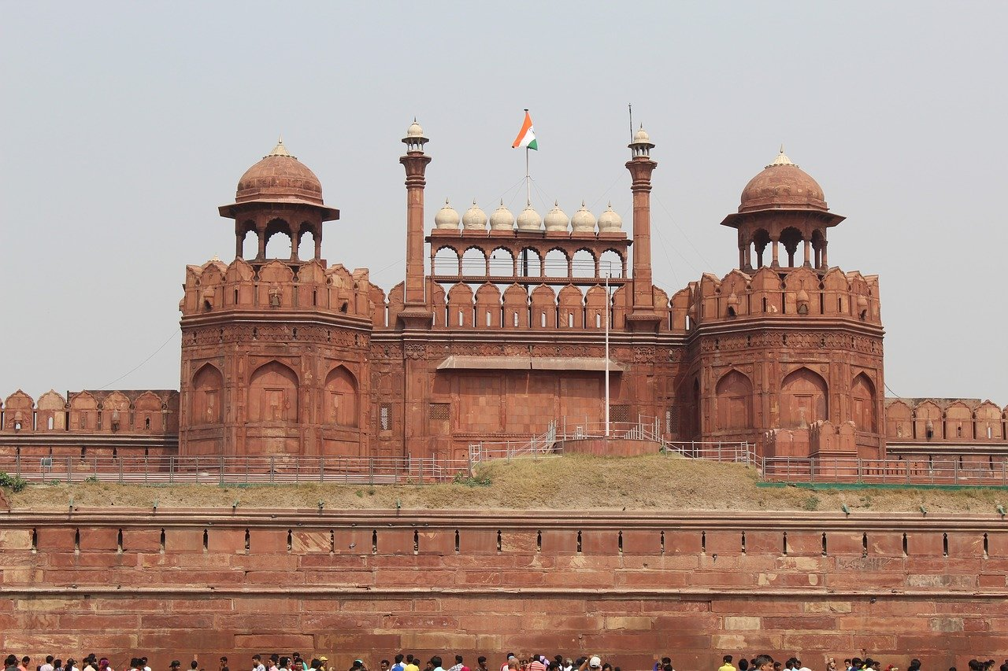
Red Fort
The Red Fort is a historical fort that served as the main home of the Mughal emperors. It was built in the 17th century when the emperor, Shah Jahan, decided to move the capital from Agra to Delhi.
The Red Fort is believed to have been designed by the same architect as the Taj Mahal.
Today, alongside being a popular tourist destination, Red Fort is used as part of India’s annual Independence Day celebrations on 15th August.
Back

Slide 18
Ellora Caves
Ellora Caves are a series of rock-cut monastery caves that are filled with Hindu, Buddhist and Jain monuments and artwork. The caves date from between AD 600 to 1000 and are one of the largest cave complexes in the world.
There are over 100 caves at the site, all of which have been excavated from basalt cliffs.
As well as acting as monasteries, temples and a rest stop for pilgrims, Ellora Caves was an important commercial area on trade routes in the region.
Back

Slide 19
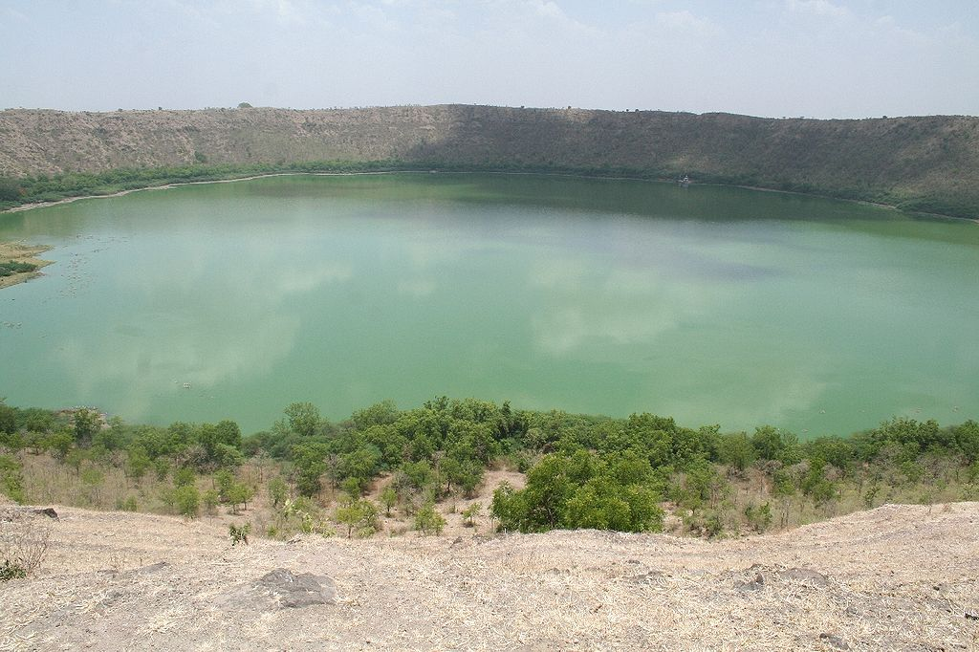
Lonar Crater
Lonar Crater, also known as Lonar Lake, is located in the west of India.
It was created around 50,000 years ago after a meteorite impacted the ground.
The crater measures around 1.8km wide and the lake is around 140 metres deep. The water within the lake contains a lot of salt, although some freshwater springs flow into the lake.
Because of the chemicals found in and around the lake, it is a haven for a wide range of plant and animal life. Monitor lizards, peafowl and parakeets can often be found in the area.
Back

Slide 20
Jog Falls
Jog Falls is located in the west of India along the Sharavati river in the middle of dense evergreen forests.
It has a drop of 253 metres and during the monsoon season, the volume of falling water greatly increases and Jog becomes one of the most spectacular waterfalls in the world.
Nearby, there is the Linganamakki Dam, which contains a hydroelectric station which is used for power generation.
Back

Slide 21
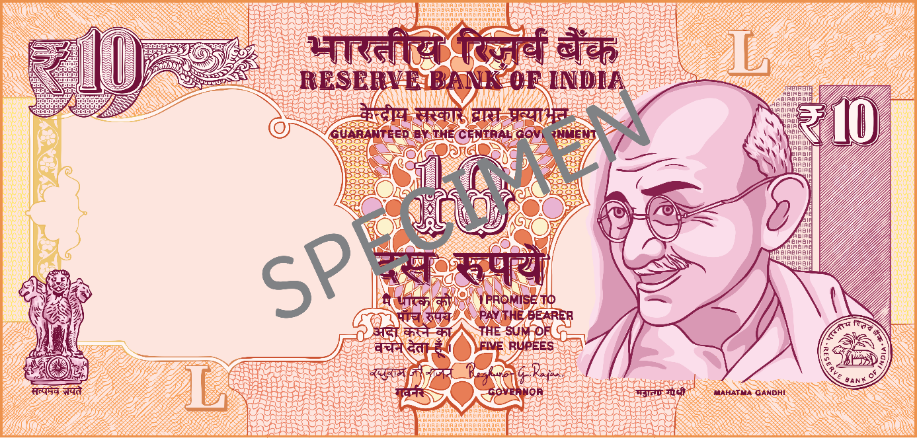
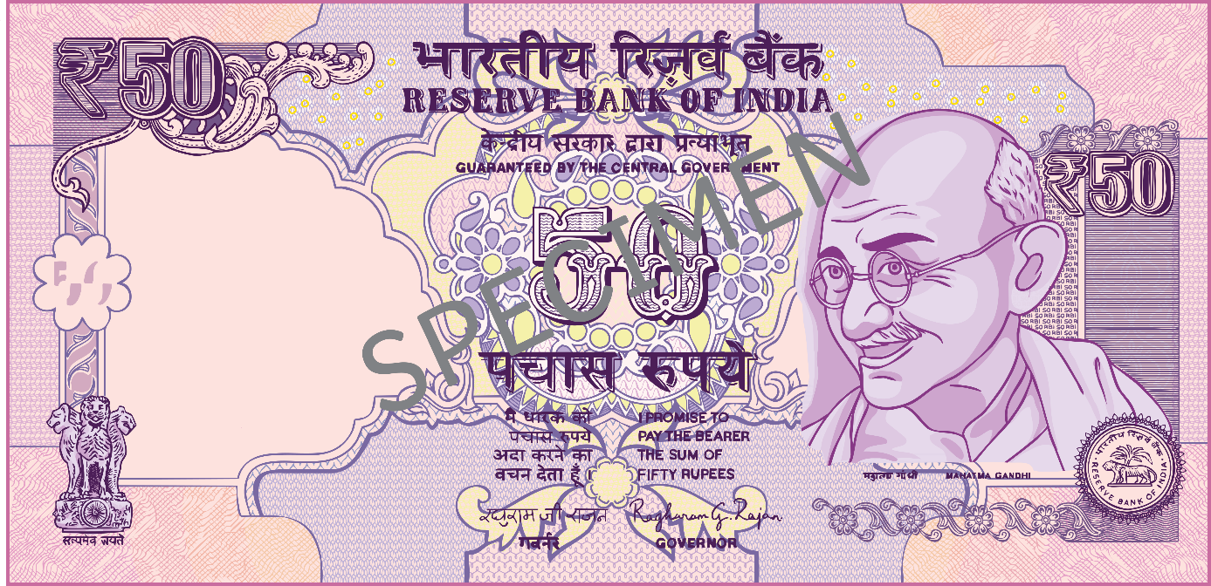
India’s Money
Rupees are the currency used in India. The symbol is ₹.
Paper notes and coins are both used.
The paper notes are very colourful and show images of Mahatma Gandhi, famous landmarks and important aspects of Indian history and culture.
x
Mahatma Gandhi was an Indian lawyer and activist who inspired millions around the world to use non-violent means of protest and campaigning.

