Slide 1
Collaborative art idea

Slide 2
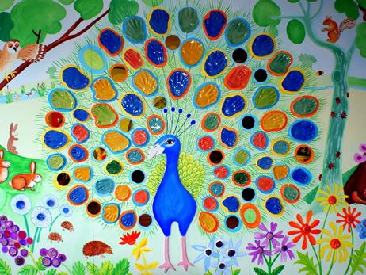

Slide 3
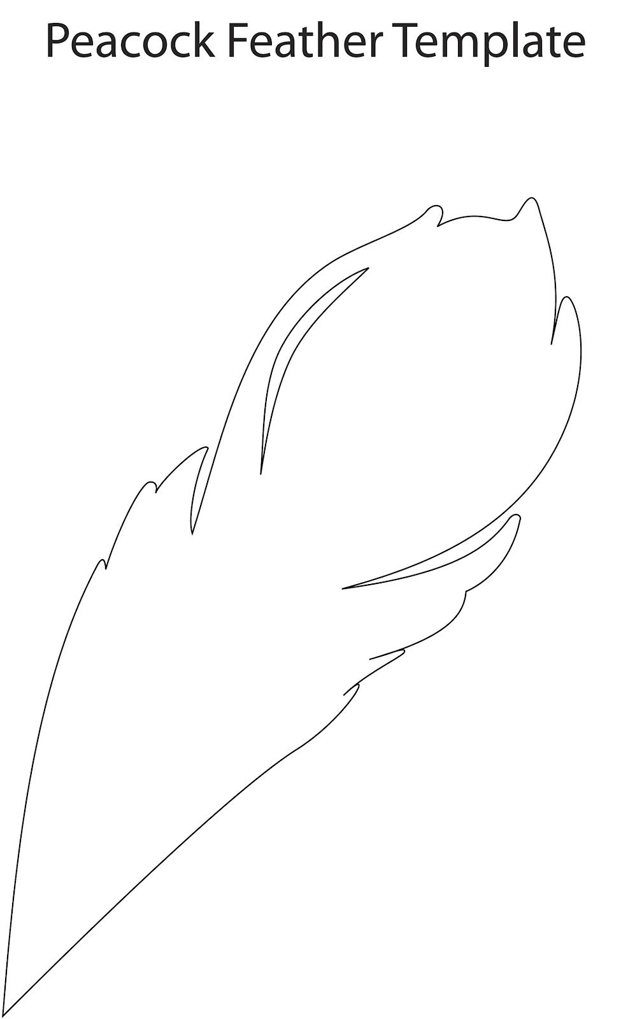

Slide 4
