Slide 2
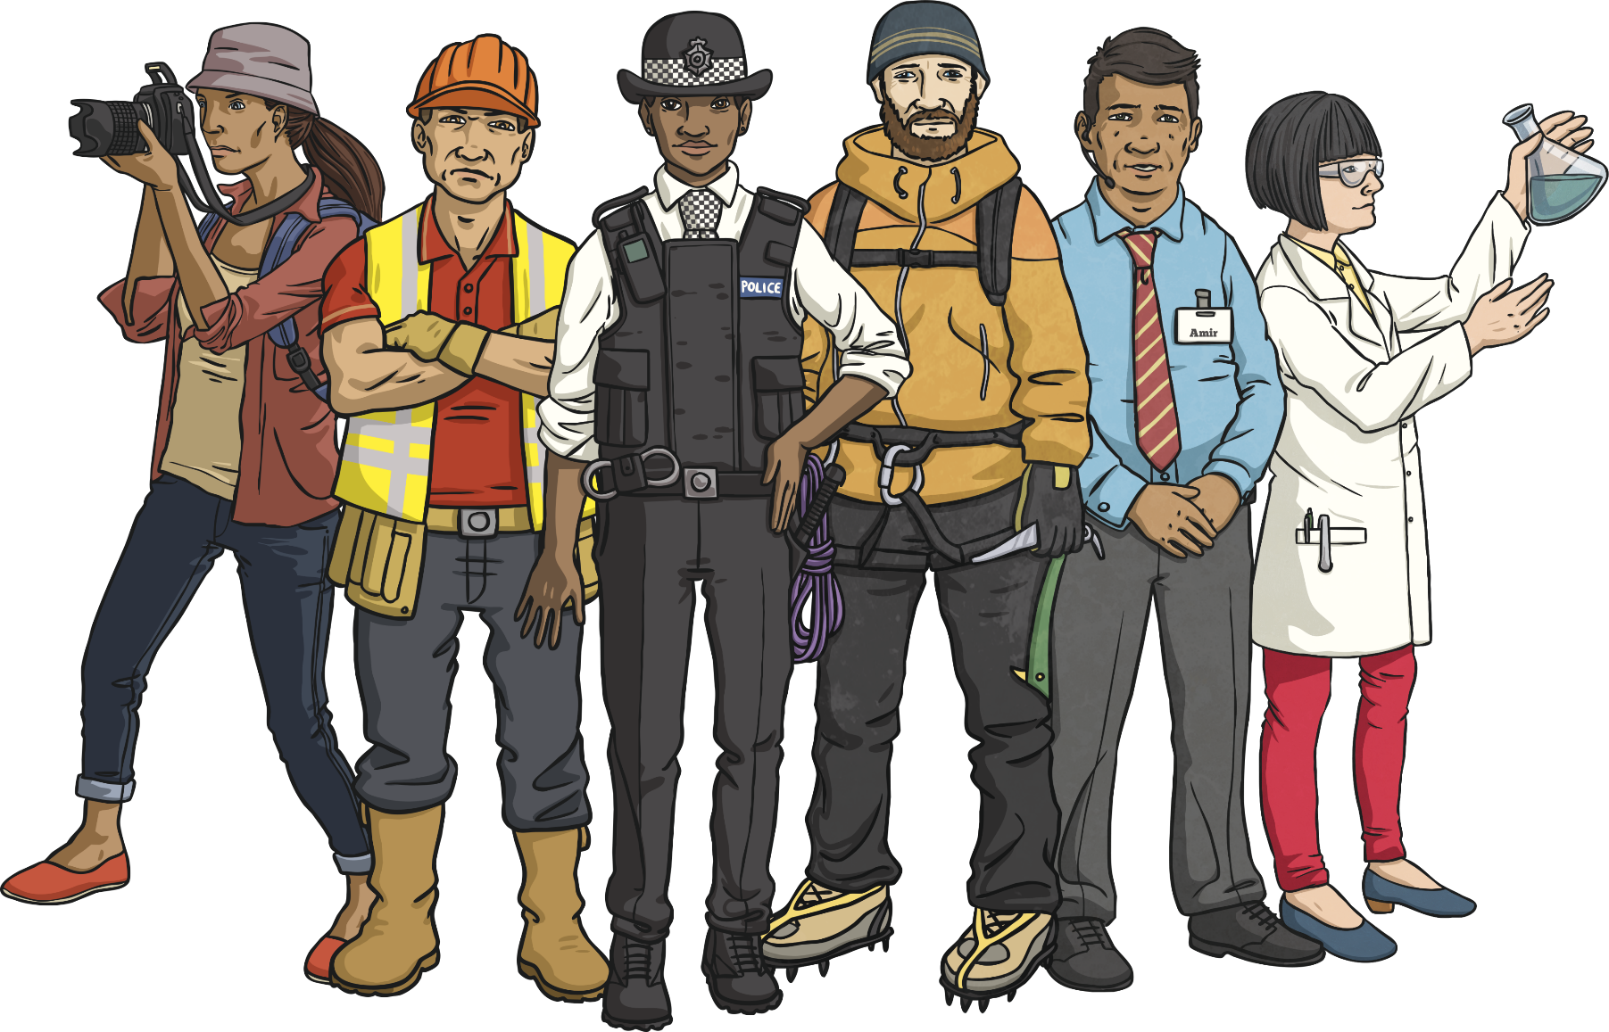
What Jobs Can You Think Of?

Slide 3
Here are the different groups that most jobs are part of:
Healthcare
Finance
Retail
Education

Slide 4
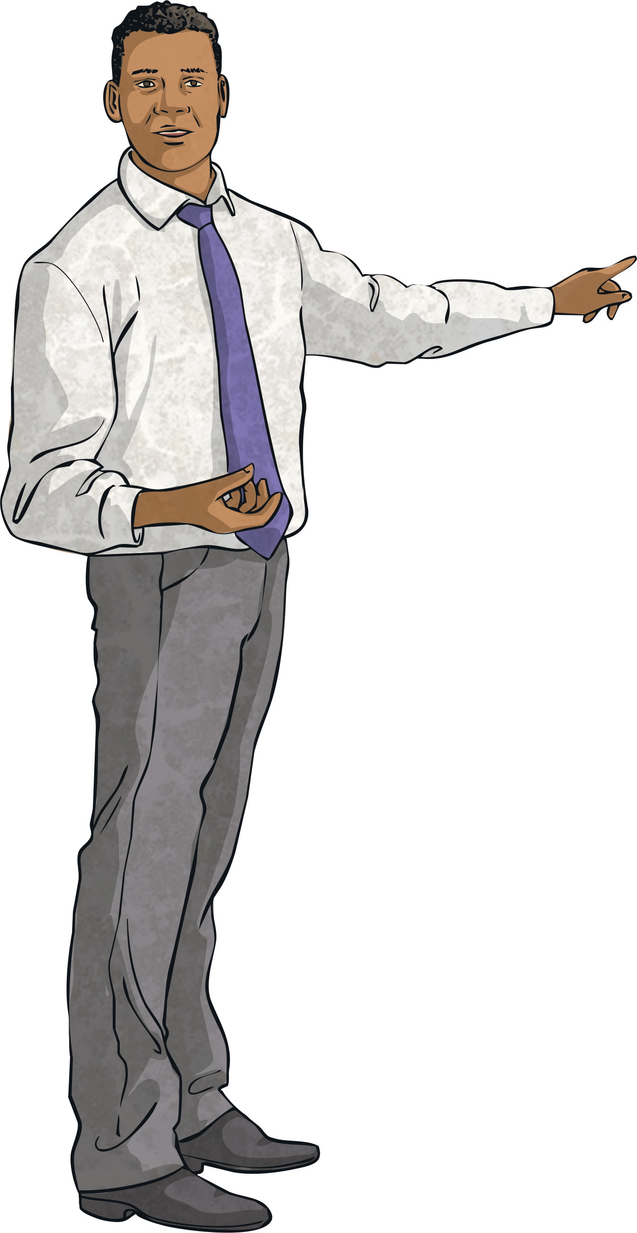
What types of skills do you think would be useful for each group of jobs?
Compassion
Helpfulness
Enthusiasm
Honesty
Organisation
Friendliness
Which of these skills do you have?

Slide 5
Imagine that you have left school with your qualifications
What job would you like to apply for? Why?

Slide 6
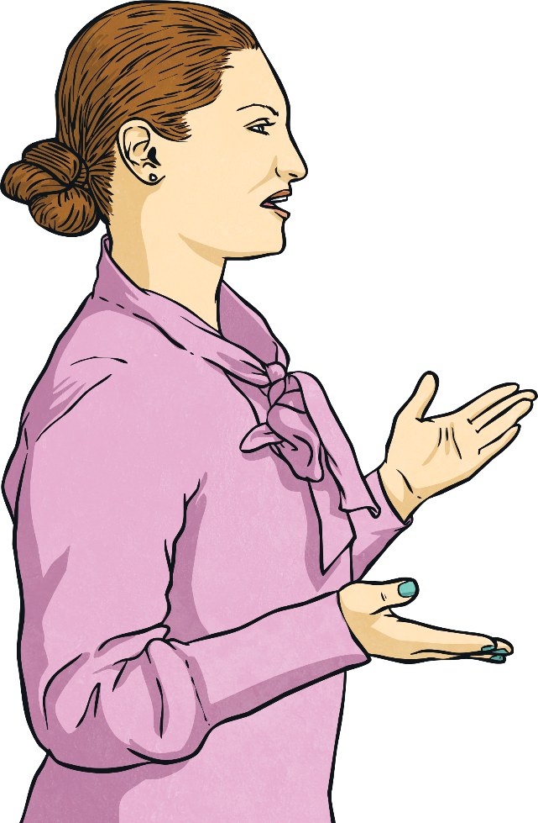
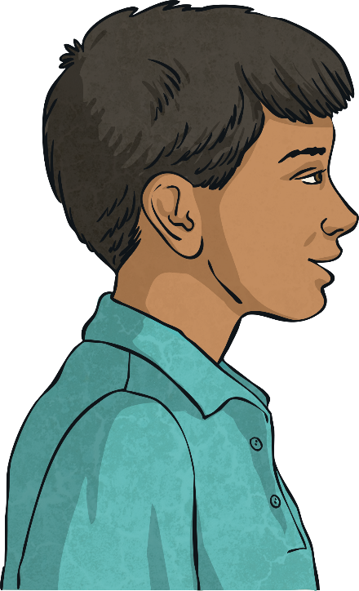
Now imagine that you are at an interview for a job.
What skills and personal qualities would you want to tell the employer about? Why?

