Slide 1
Monday
Log in to Bug Club – read a book and answer the questions

Slide 2
Tuesday
Descriptions of characters
Character descriptions create an image in the mind of the reader. A character description usually contains information about appearance (what a character looks like) and personality (how they behave).
The repeated use of the character’s name or pronouns can make character descriptions less interesting.
Example
Spiderman is a brave super hero. He became Spiderman after being bitten by a spider in a science laboratory. Spiderman’s real name is Peter Parker. He lives with his Aunt. Spiderman is a student who is also part of the Avengers. He is courageous and funny. Spiderman is medium height and wears a red costume.
This description is not very interesting to read as the sentence openers are very repetitive.

Slide 3
By varying the sentence openers the same information (below) becomes more interesting to read.
Spiderman is a brave super hero. The young man became Spiderman after being bitten by a spider in a science laboratory. In real life called Peter Parke, he lives with his Aunt. The youthful champion is a student who is also part of the Avengers. Courageous and funny, Spiderman is medium height and wears a red costume.

Slide 4
Have a look at the description of Boone (below).
Underline all the different ways of naming/introducing him that are not ‘Boone’ or ‘he’.
Boone
Boone is a cowboy who was a plastic toy, but has been brought to life by Omri’s magic cupboard. Tall and skinny, he has ginger, scruffy hair and wears a large cowboy hat. The tiny figure also wears a plaid (checked) shirt and buckskin (deer leather) trousers. His height is improved by his high heeled leather boots.
An unenthusiastic bather, Boone is dirty and smelly and believes that sweat makes him more manly. Frightened by lots of things around him and often crying, he tries to look braver than he really is. The small cowboy believes that Omri is a hallucination. At first, the pale, grubby little man is an enemy of Little Bull and wants to harm him, but eventually they become friends.

Slide 5
Task 1
Write a list of different sentence openers that you could use in a description of Little Bull.
Make sure you think about his appearance and personality.
Task 2
Write a sentence/ sentences to describe Little Bull which include an
embedded clause (a clause in the middle of the sentence which adds detail, but which you could remove and the sentence would still make sense).
See the next slide for examples.

Slide 6
The coloured clause in each sentence is the ‘embedded clause’.
It adds description/detail but the sentence still makes sense if it is removed.
Spiderman, whose real name is Peter Parker, is a courageous and athletic superhero.
Living in a hidden country, a place called Wakanda, the Black Panther is an unknown superhero until he leaves his home.
Once a test pilot, now a powerful superhero, Carol Danvers is better known as Captain Marvel.
Now write your own sentence, with an embedded clause, about Little Bull.

Slide 7
Wednesday
Plan a character profile for Little Bull
Paragraph 1
Talk about his physical appearance – try to
use paired adjectives and similes.
Paragraph 2
Talk about his personality – explain through his actions in the story so far. Example. The small warrior is very brave, he never runs from Omri despite Omri being huge in size compared to him.
Use a thesaurus to find interesting adjectives.

Slide 8
Appearance and Personality
4-5 sentences for each
Embedded clauses
A miniature powerful man, who killed
twenty four cowboys, is a very successful fighter.
This tiny man, who has a sharp knife, is
very fierce.
The argumentative warrior, who likes to
have fights, wears a knife around his waist.
Sentence openers
The brave native…
The fateful warrior…
An Indian warrior, who…
This success scalper…
Paired adjectives
Bossy and fierce…
Young yet strong…
Fierce and brave…
Mighty and threatening…
Similes
…as fierce as a rhino…
…as tall as a thumb…
…as brave as a knight…

Slide 9
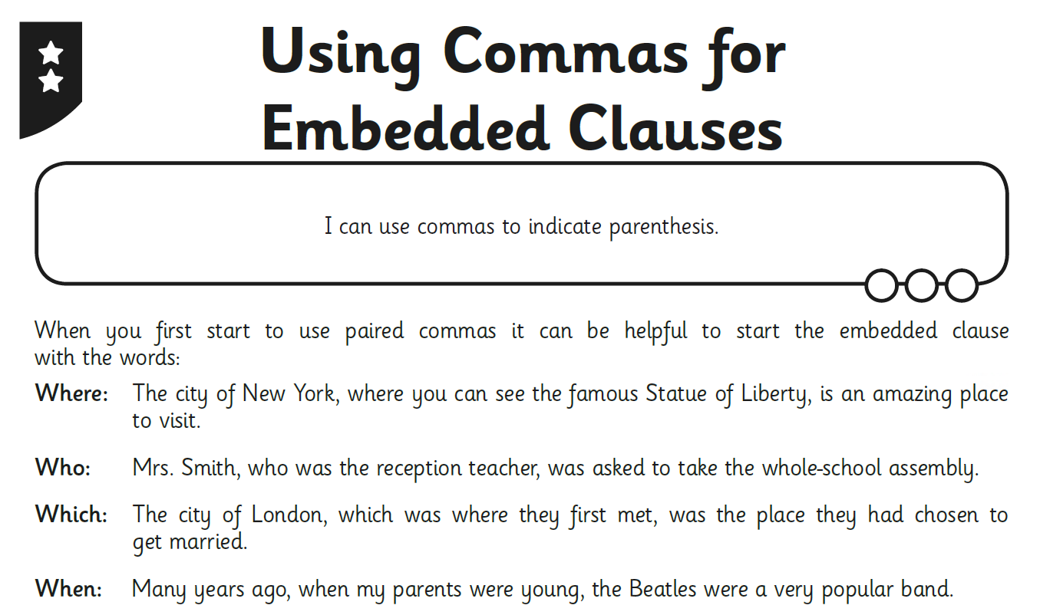
Thursday

Slide 10
Once you have worked out which embedded clause fits into which sentence, write them out in your best neat handwriting.

Slide 11
Friday – Reading Comprehension

