Slide 1
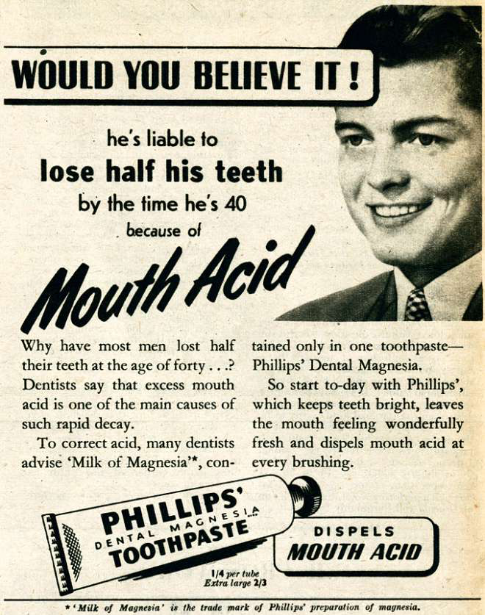

Slide 2
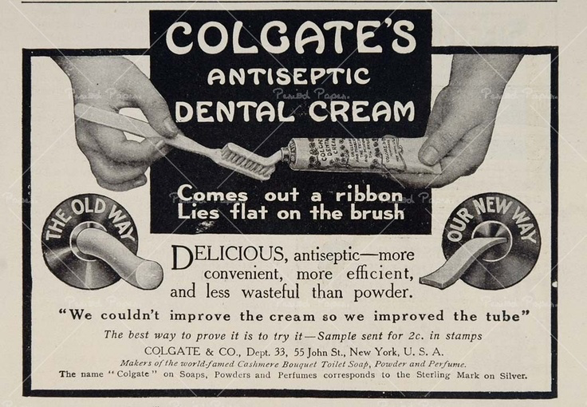

Slide 3
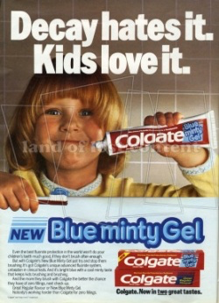

Slide 4
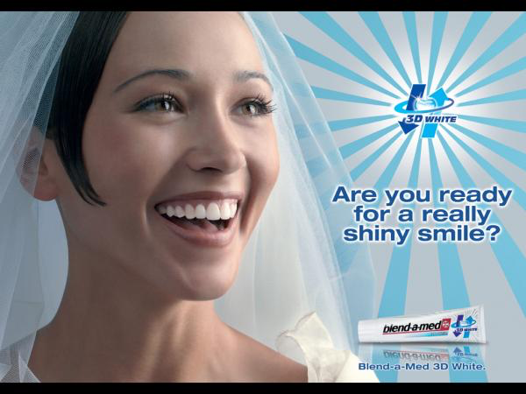

Slide 5
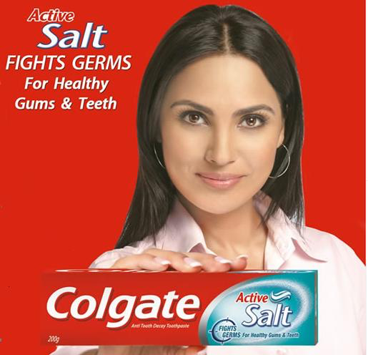

Slide 7
Colgate Max White Aquafresh Gibbs Toothpaste 1955 Homemade advert!!!!

Slide 8
Colgayne Colgayne Colgayne Colgayne
The best ever toothpaste!
Whitest, shiniest teeth
Tastes fantastic!
Cleans like no other!

Slide 9
Persuasive Language
Secondly,
Therefore,
Clearly Simply, Easily, Surely…
If you use…
There is no doubt…
You will need…
You must…
Surely you would agree…
However,
You must...
Obviously….
‘Colgayne’ advert
Slogan- The paste that…! Brush bacteria…! Say bye…..
Rhetorical Questions x2 and a Then….
Are you worried…Do you have…Is your mouth…Are your teeth….Do your friends…
(adjectives, superlatives- worst, dirtiest, smelliest…..)
3 bads – do these words…..(alliteration)
Then/Therefore you need/must…. (superlatives- newest, greatest, best….)
What does it do that is better? x3 sentences- conjunctions
plaque, decay, breath, gums, bacteria, germs, stronger
Colgayne easily/clearly can…. Secondly, it….No other toothpaste….After using….
Everybody knows…..When you….Colgayne is better than…
The benefits of that toothpaste- what do you gain? x2-
whiter, fresher, stronger, faster, tastes, fewer trips to….
Colgayne is the best because…After using….Obviously,….You must….
When you have….While brushing…..If you use…..All your friends…..Your life will….
(comparatives and EXAGGERATION…..)
How and where you can buy it
Colgayne is sold….Get down to…..Buys yours…..

Slide 10
‘Colgayne’
Brushes bad bacteria down the drain!
Are you worried that your teeth are not the strongest, healthiest and whitest on the block? Do you have bleeding, bulging, blackened gums? Foul, potent, stale- do these describe your BAD breath?
Therefore you must try the greatest…the newest…the revolutionary new COLGAYNE toothpaste! NOW!
Colgayne easily and simply fights plaque which is buried deep in your mouth. Secondly, it obviously soothes damaged gums while kicking bad breath and grubby germs to the curb. Everybody, who has ever used Colgayne, knows that when you have been using it for a few weeks, your mouth has NO DECAY…that’s right, NO decay!
Colgayne is dramatically better than all other brands because it makes your teeth whiter and your breath fresher! Without doubt, all your friends will be impressed with your new bright, fluorescent smile which brightens the darkest of rooms. Your life will be turned around when you realise that dentist trips are a thing of the past!
Colgayne is sold at all good supermarkets. Get down to yours today- don’t delay!

