Slide 1
Why should I be good?

Slide 2
What does the word ‘good’ mean?
Do not use the words ‘good’ or ‘goodness’ in your answer.

Slide 3
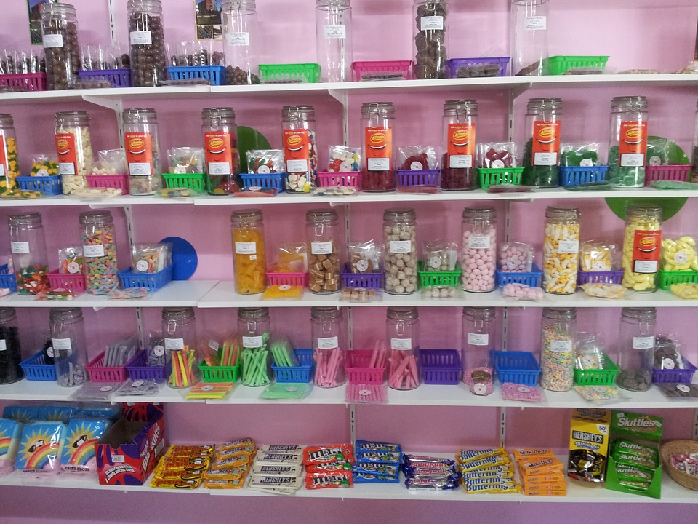
The sweet shop
You are in a sweet shop with some friends. The owner of the shop is not looking. One of your friends tells you to steal some sweets.
What should you do?
Why?

Slide 4
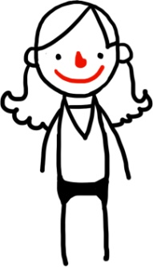
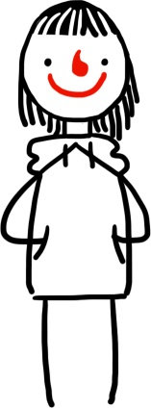
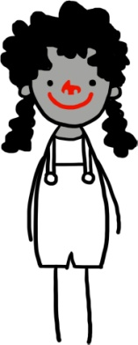
Why wouldn’t you steal the sweets?
I might get caught and get in trouble.
The shopkeeper will be unhappy.
It’s against the law.
I wouldn’t like it if someone stole from me.
I would feel like a bad person.
If everyone did it, then the sweet shop would have to close down.

Slide 5
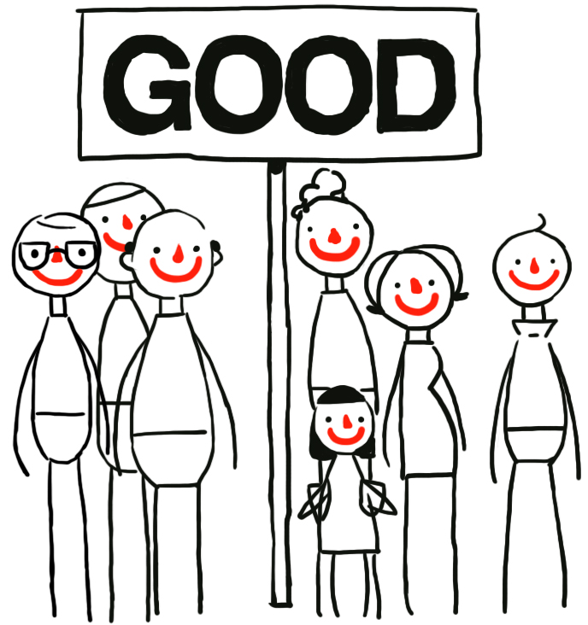
Motivations
Reasons to do good things | Reasons not to do bad things
Rewards Following rules and laws It makes you feel good Making other people happy Would like it if others did the same to me The world would be a better place if everyone did the same | Fear of punishment Breaking rules and laws It makes you feel bad / guilty Hurting other people Wouldn’t like it if someone did the same to me The world would be a worse place if everyone did the same

Slide 6
Key beliefs of humanists
Humanists believe human beings are special and human life is valuable
Humanists don’t believe in a god, or believe we can never know if there is a god
Humanists don’t believe there is any evidence for an afterlife: we should therefore make the most of this life
Humanists believe human beings should try to live full and happy lives and help others do the same

Slide 7
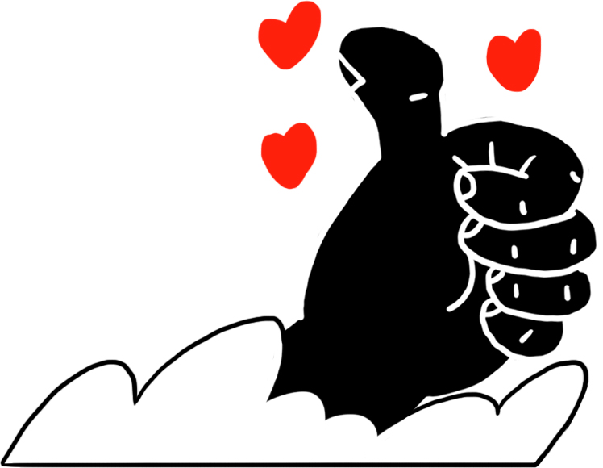
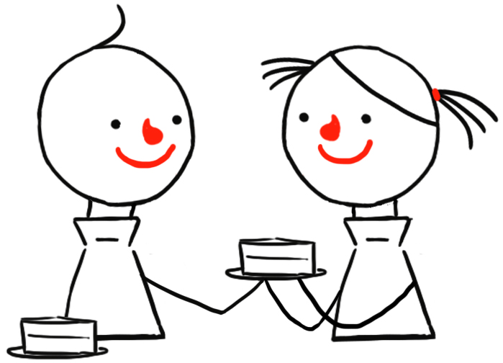
Why do humanists believe we should be good?
Humanists don’t believe we will be rewarded or punished for our behavior after we die.
Humanists, like many people, think we should not just think about rewards and punishment when deciding what to do. If this were the only reason to be good, then we might not do the right thing if we saw no opportunity for reward, or danger of punishment.
They believe we should be motivated to do good things because:
We should treat others the way we would like to be treated
If everyone tries to do the right thing, we can make the world a better place; if everyone does the wrong thing, then everyone will be worse off
Making other people happy can make us happy

Slide 8
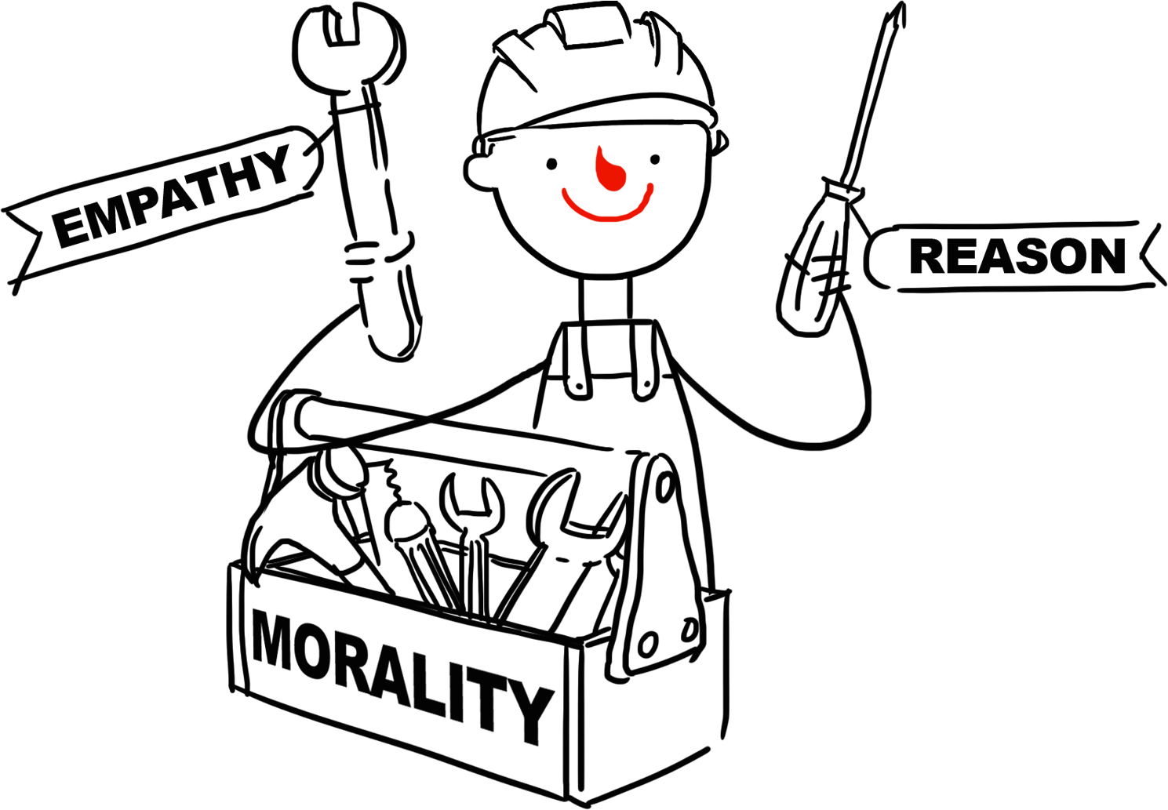
Reason and Empathy
Reason: thinking about the consequences of our actions.
Empathy: considering how others will feel.
Reason and Empathy can help us understand why we should be good.
Humanists believe we don’t need to believe in a god to be good.

Slide 9
Quotes on being good
‘A humanist is someone who does the right thing even though she knows that no one is watching.’
Dick McMahon
‘Being a Humanist means trying to behave decently without expectation of rewards or punishment after you are dead.’
Kurt Vonnegut

Slide 10
understandinghumanism.org.uk
Understanding Humanism
39 Moreland Street
London
EC1V 8BB
British Humanist Association (registered charity 285987) ©2015

