Slide 1
What is Humanism?
To ask thoughtful questions about religious and non-religious ways of life, make links and compare these different ways of life.
I can understand that not all people are religious, that non-religious people can have codes for living that don’t refer to god, and that a person can be “good without god”

Slide 2
Is everyone part of a religion?
https://www.youtube.com/watch?v=P74SNn2f4eE

Slide 3
4 rules/principles of humanism:
Be Honest
Use your mind
Tell the truth
Do to other people what you would like them to do to you.
ON WHITEBOARDS
Write down other words that link to Humanism and how people may act and treat others.

Slide 4
Key beliefs of humanists
Humanists believe human beings are special and human life is valuable
Humanists don’t believe in a god, or believe we can never know if there is a god
Humanists don’t believe there is any evidence for an afterlife: we should therefore make the most of this life
Humanists believe human beings should try to live full and happy lives and help others do the same

Slide 5
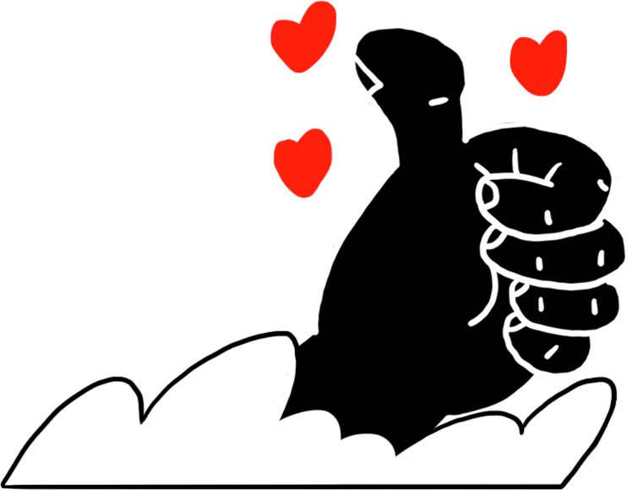
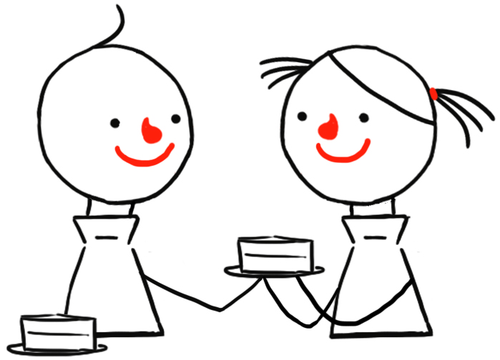
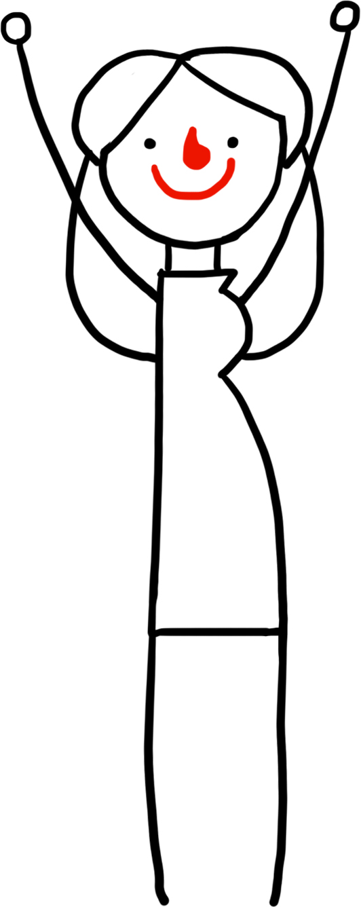
Why do humanists believe we should be good?
Humanists don’t believe we will be rewarded or punished for our behavior after we die.
Humanists, like many people, think we should not just think about rewards and punishment when deciding what to do. If this were the only reason to be good, then we might not do the right thing if we saw no opportunity for reward, or danger of punishment.
They believe we should be motivated to do good things because:
We should treat others the way we would like to be treated
If everyone tries to do the right thing, we can make the world a better place; if everyone does the wrong thing, then everyone will be worse off
Making other people happy can make us happy

Slide 6
Quotes on being good
‘A humanist is someone who does the right thing even though she knows that no one is watching.’
Dick McMahon
‘Being a Humanist means trying to behave decently without expectation of rewards or punishment after you are dead.’
Kurt Vonnegut

Slide 7
Happy Humanist
What do you think this shows?
Why would Humanists choose this symbol?

Slide 8
Your task
Design your own Humanist symbol
Write down words that link to Humanism around your design. E.g. honesty thoughtful
September 2021
My Humanist Symbol

