Slide 1
Monday

Slide 2
Word Classes

Slide 3
Noun (+ Proper noun)
Adjective
Verb
Adverb

Slide 4
They can be SINGULAR and PLURAL

Slide 5
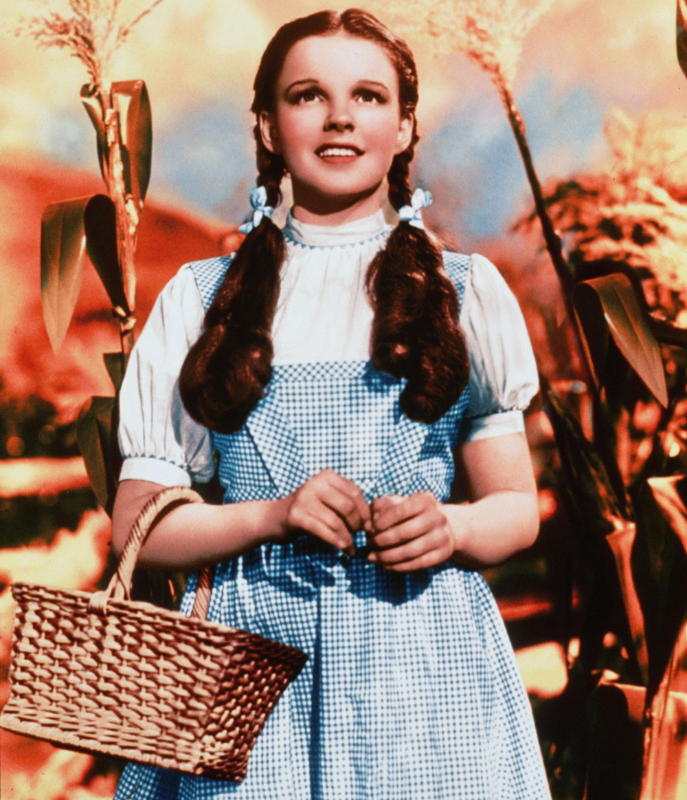
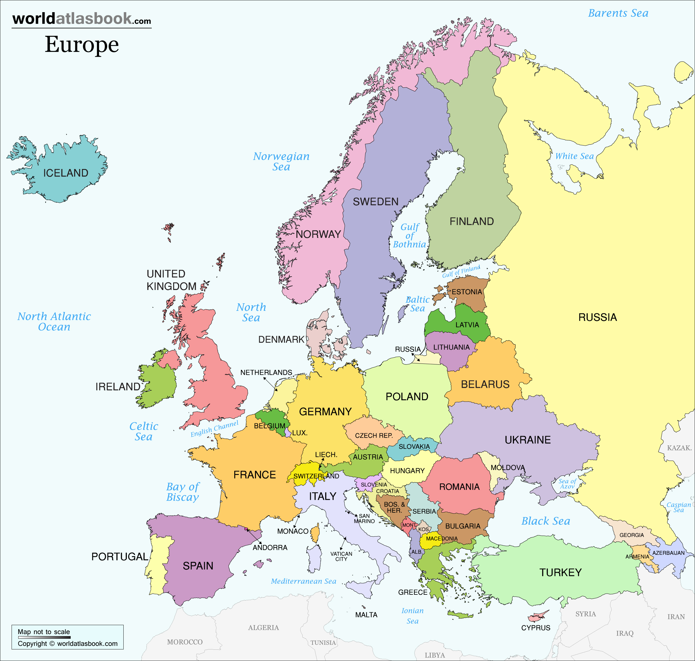
Proper nouns
Proper nouns name a special
person, place or thing. They
begin with a capital letter.

Slide 7
They can be in different TENSES- what do I mean?

Slide 8
Most ADVERBS end with ly. However these can also be sued as adverbs:
fast, too, very, quite, rather, so

Slide 9
Activity
Sort the words on the next slide into the 5 different word classes…
Noun
Proper noun
Adjective
Verb
Adverb

Slide 10
babies bird cakes Julie ocean September
quickly boy cat run women black
hopping eat jump noisily swim glasses
skipping red skid swam slowly fast
large wet naughty angry old sadly
angrily lucky Monday piano

Slide 11
Challenge activity
In your English book, write the sentences given and show the…noun, proper noun, adjective, verb and adverb
e.g. The tuneful Katy Perry spoke very nicely in the school assembly today.
(Underline the words using the correct colours)

Slide 12
The childish girl angrily kicked the can over the wooden fence while playing football.
Sadly, Bob damaged his expensive bike when he
rode through the dark, dense forest.
Running beside the River Thames, James saw a magnificent fish jumping madly in the water.

Slide 13
Tuesday

Slide 14
Read up to page ….. of Varjak Paw.
Notice descriptions of Varjak and his actions so far
Create a clss mind map with aspects of Varjak’s personality labelled and brief note style evidence underneath.

Slide 15
Wednesday

Slide 16
Use the mind map you created yesterday.
Write a study of Varjak’s character using descriptive sentences and clear explanations of viewpoint.
Remember to describe to Varjak’s feelings.

Slide 17
Thursday

Slide 18
Today you will edit and improve your work from yesterday. See if you can add any more description, can you vary your sentence openers? add conjunctions?
Use a dictionary to check your spelling.
If you have time, copy your edited work out neatly

Slide 19
Friday

Slide 20
Varjak Paw comprehension
Read up to Chapter Three.
Answer these questions, referring to the text Where do the Paw’s Live?
What did the cats think had happened to the Contessa to explain why they hadn’t seen her lately?
2. Who arrived that caused Varjak concern?
3. Where did they go?
4. How did the others react when he told them?
5. What did the gentleman do that made the others not
believe Varjak?
Remember that a meeting was called led by the elder Paw because this was an EMERGENCY- he believed the Contessa was dead and remembered this man (who had an argument with the Contessa) from the past.

