Slide 1
English

Slide 2
Monday
You are going to plan a story about 4 characters.
You can choose from: A fairy
A dragon
A squirrel
A crow
A knight
A princess
A wizard/old man
A witch/ old woman

Slide 3
Use the storyboard sheet to plan what happens to the characters. Can you change your characters to avoid stereotypes (this is when we assume a character will behave in a particular way because of their appearance. For example, you could have a brave and very clever princess who needs to rescue the knight, or a kind witch and an evil fairy.

Slide 4
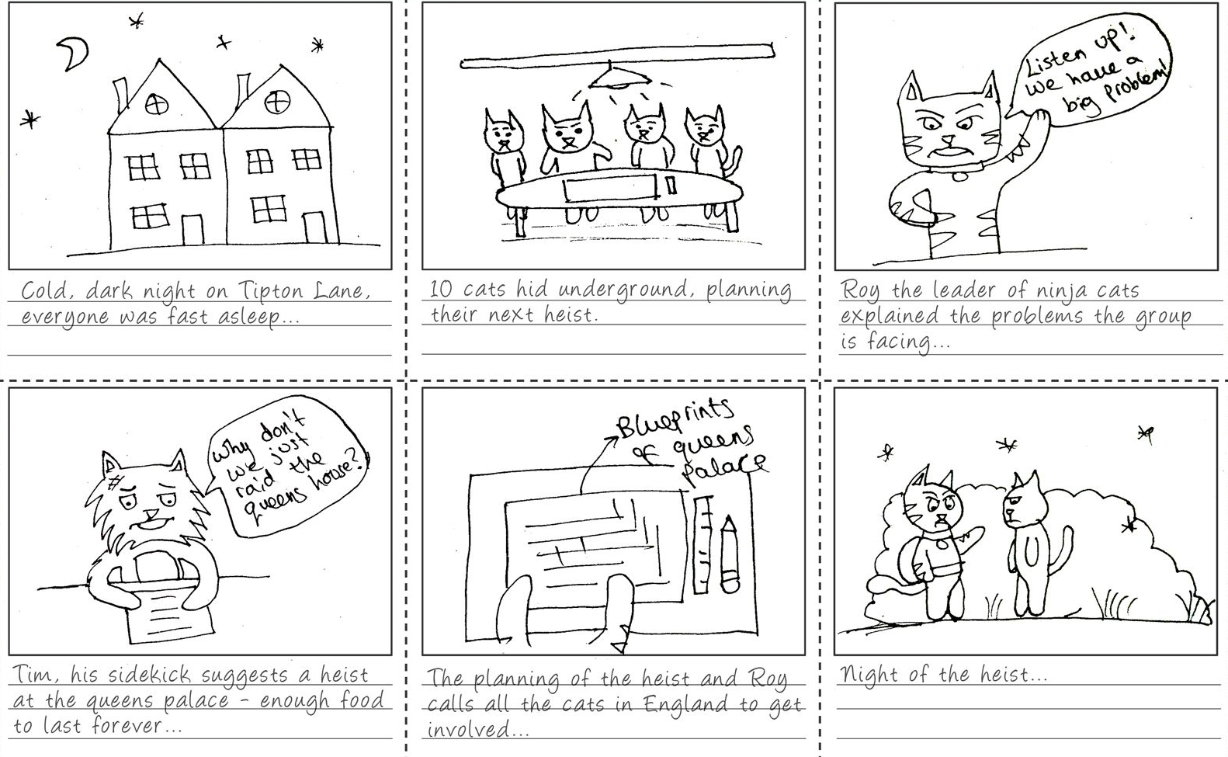
An example of a storyboard – this is just an example and is not finished. Yours will need to feature 4 characters at most from the list on slide 2.

Slide 5
Tuesday
Today you will write a playscript to tell the story that you planned yesterday (tomorrow you will record the story).
Write the character who is speaking’s name in the margin and follow with a semi colon.
You do not need to use said/shouted/replied etc. but you should use adverbs in brackets (stage directions) to show how the character speaks.
See the next slide for an example.

Slide 6
Mum : (shouting) JACK! Get out of bed and take the cow to market to
sell her. We have no money for food.
Jack : (tiredly) Ok Mum. I’ll go now.
Mum : (full of worry) Make sure you get the best price Jack, we really
need this money.
Jack : (cheerfully) Don’t worry! I will, it will be fine!
Narrator : So Jack happily set off to market to sell the weary old cow. However, on the way he met a strange old man in a dark cloak who was carrying a small velvet bag.
Use a narrator to tell some of the story and add description so that there is not TOO much talking.

Slide 7
Wednesday
Today, finish your play script. Once you have finished, use the Puppet Pals App to record your story.
If you do not have this App don’t worry. Draw and cut out pictures of your characters. Now move them around on a table top or other flat surface while you record yourself using them to tell the story you have scripted.

Slide 8
Thursday
Today you can begin (or continue) recording your story.
Once you have finished, watch your final version.
Give yourself a star for something you did well.
Can you think of one or two areas which you could improve next time?

Slide 9
Friday
Have a look at the ‘Celebrating the NHS’ document.
There are 3 different but similar versions of the comprehension text and task. Your grown up can help you to choose which version to complete.

