Slide 1
WHO IS MC ESCHER?
Maurits Cornelis Escher was a Dutch graphic artist born in 1898 who made mathematically inspired woodcuts, lithographs, and mezzotints. He was a draftsman, book illustrator, tapestry designer, and muralist, but his main work was as a printmaker. He became known for his detailed realistic prints that achieved bizarre optical and conceptual effects.

Slide 2
ESCHER TESSELLATIONS
Tessellations are connected patterns made of repeating shapes that cover a surface completely without overlapping or leaving any holes. For example, a checkerboard is a tessellation comprised of alternating colored squares. The squares meet with no overlapping and can be extended on a surface forever.
Tessellations have been used for thousands of years in architectural designs and structures. MC Escher is known as a master of tessellation artwork. Escher portrayed realistic objects like fish, birds, and other animals, in his drawings and prints.

Slide 3
Have a look at some of Escher’s Art work…

Slide 4
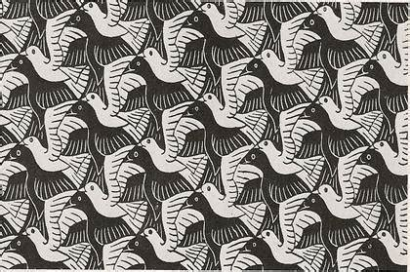

Slide 5
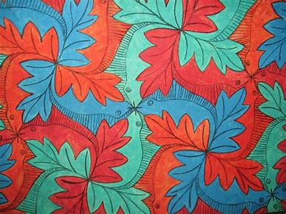

Slide 6
