Slide 1
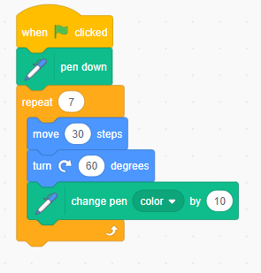
Let’s learn
In this session, you will create and program a repeating pattern in Scratch.
Let’s do
Experiment with drawing a base shape in Scratch. This could be an equilateral triangle or square, or a more complex shape. You could try this one first. Add the following blocks:
a when green flag clicked block
an erase all block.
a pen down block.
a repeat 7 block
a move 30 steps block
a turn 60 degrees block
a change pen color by 10 block.

Slide 2
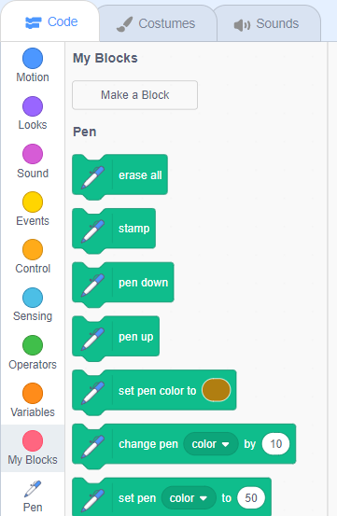
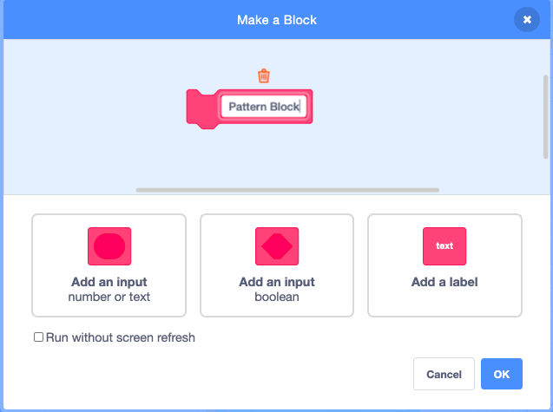
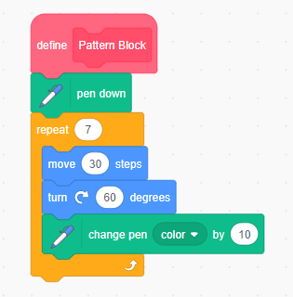
Let’s do
Remember to make your own block to group drawing instructions for a shape or pattern together.
Click ‘My Blocks’, then ‘Make a Block’. Name the block ‘Pattern Block’ and click ‘OK’.
Replace the when green flag clicked block with the define Pattern Block block.
This is an example of abstraction, as the instructions are ‘hidden’ inside the custom block.
1
2
Abstraction: a process of managing complexity by setting to the side irrelevant detail and concentrating on function rather than form
Do you know what abstraction is?
Click on this box to see the definition.

Slide 3
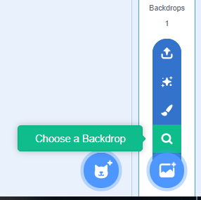
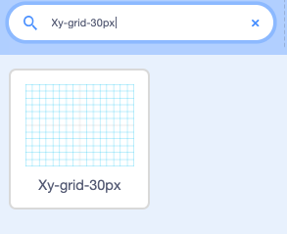
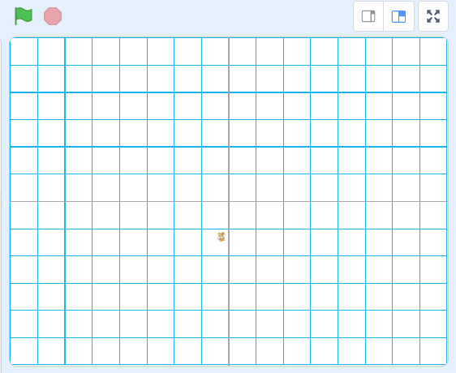
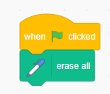
1
2
Let’s do
Select the grid background for your Scratch project.
Select ‘Choose a backdrop’.
Scroll to find ‘Xy-grid-30px’ and select it.
This will now appear on the stage. You can clear the screen by using the when green flag clicked and erase all blocks.
You will change this to a blank background later. Having the grid makes the program easier to create.
3

Slide 4
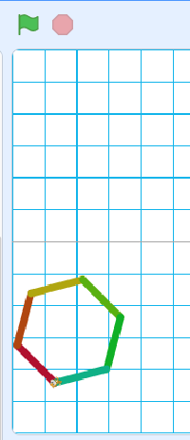
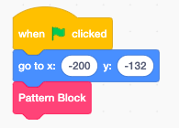
1
Let’s do
Position your sprite towards the bottom-left of the screen before drawing the shape you have programmed.
Use the go to block to position the sprite there as part of the program. Do this by:
Moving the sprite to the bottom-left of the stage. This will set its coordinates in the go to x: y: block.
Connect a when green flag clicked block, the go to x: y: block and your pattern block.
Try it out by clicking the green flag.
2
3

Slide 5
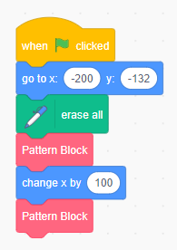
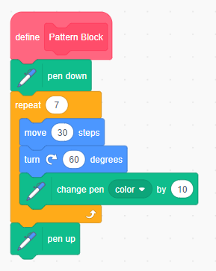
Let’s discuss
How far would the sprite have to move to create a copy of the shape to the right? Use the grid to help.
Let’s do
Move the erase all block to before the Pattern Block.
Add a change x by 100 block, then add another Pattern Block.
Add a pen up block at the end of the ‘define Pattern Block’. This means it won’t draw a line to the new position before it starts drawing the repeat pattern.
1
2
3

Slide 6
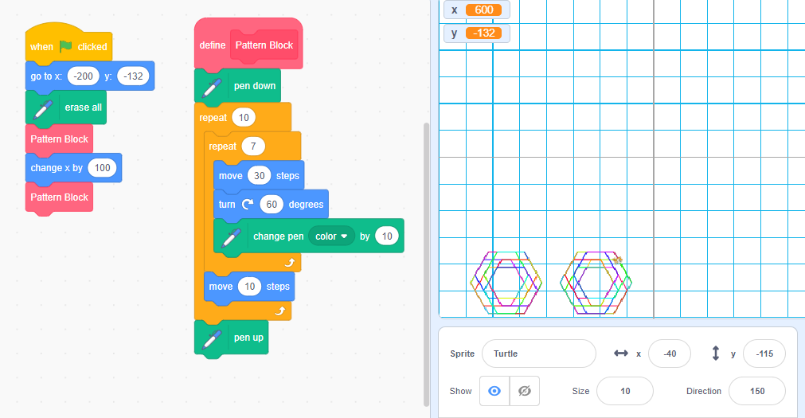
Let’s do
You can create a repeating sequence of patterns by using another repeat block.
Add a move 10 steps block after the repeat loop in the ‘define Pattern Block’ code.
Then add another repeat loop around the first repeat loop and the move 10 steps block.
This creates a repeating pattern.
2
3
1

Slide 7
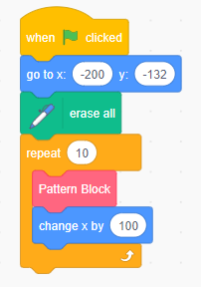
Let’s learn
You can also use a repeat loop, instead of two Pattern Blocks in the code. Set the loop to repeat 10 times.
Let’s discuss
Do you remember using repetition in Scratch in the past?
What does it mean and how did you use it?
Repetition: programming construct which allows a group of instructions to be repeated a number of times, or until a certain condition is met
Do you know what repetition is?
Click on this box to see the definition.

Slide 8
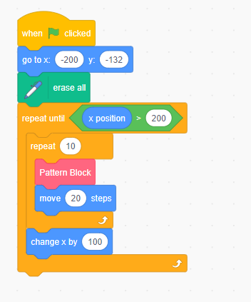
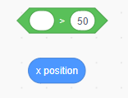
Let’s do
To make the shape repeat and create a symmetrical pattern:
Add a repeat until loop around the other repeat block.
Add a > block (Operators). Insert an x position block and set the coordinate to 200.
Move the change x by 100 block under the repeat loop and add a move 20 steps block.
The shape should repeat and create a vertical symmetrical pattern.
1
2
3
4

Slide 9
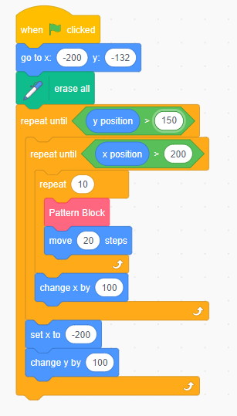
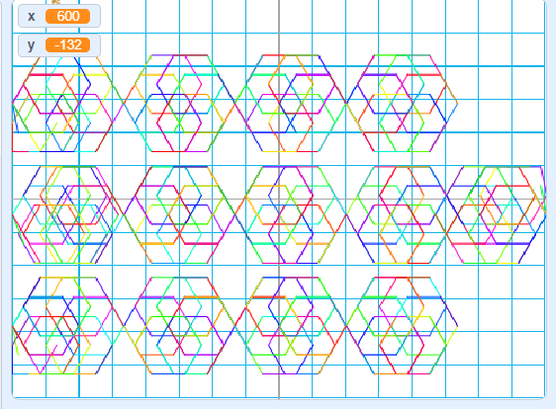
Let’s do
You can put similar instructions inside another repeat loop to change the y co-ordinate, so the pattern creates columns as well as rows.
Add a repeat until y position > 150 block around the repeat until x position > 200 repeat loop.
Add two motion blocks: set x to -200 to take the sprite back to its x starting position, and change y by 100 to start it higher up the y axis.
Your pattern should now have columns as well as rows.
1
3
2

Slide 10
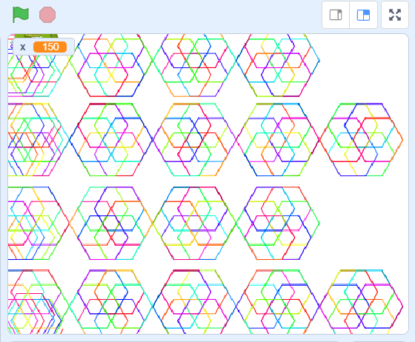
Let’s do
Experiment with creating different base shapes and different spacing between rows and columns, until you have a pattern that you are pleased with.
Now, change the background back to blank to complete your design. You do this by deleting the grid backdrop.
If you notice any bugs, you can go back and debug them.
Click on the image to open the Scratch project!

Slide 11
Let’s review
Share your patterns with other members of the class and discuss:
How did you create your pattern?
Which base shape did you use?
What spacing did you use?
Did you find this easy or difficult to program?
How might you improve your pattern?
How does Scratch compare to Inkscape to create digital art?

