Slide 1
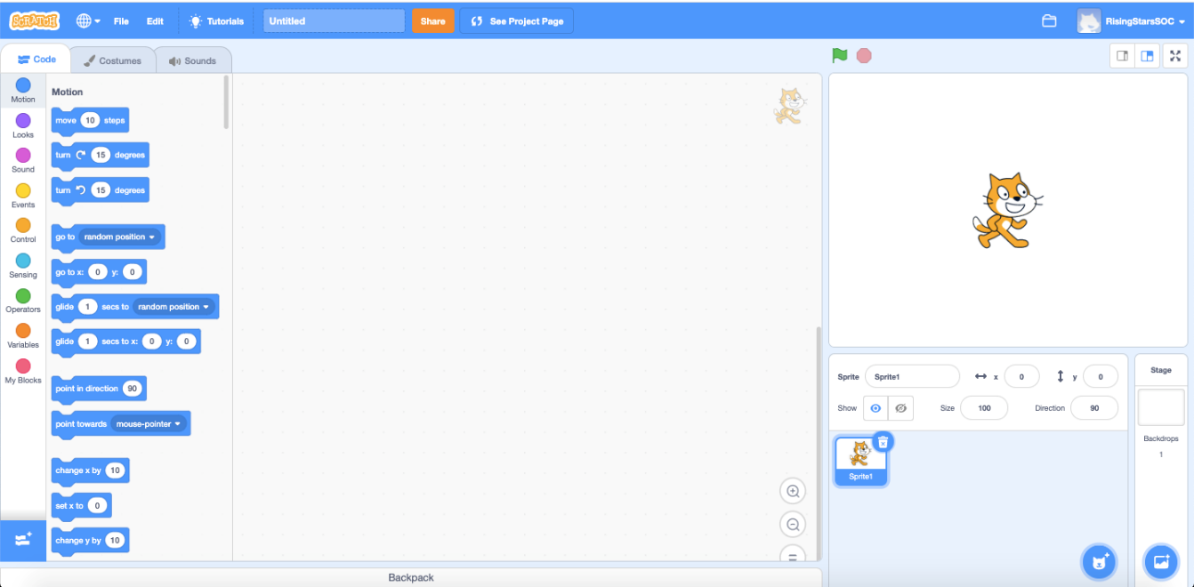
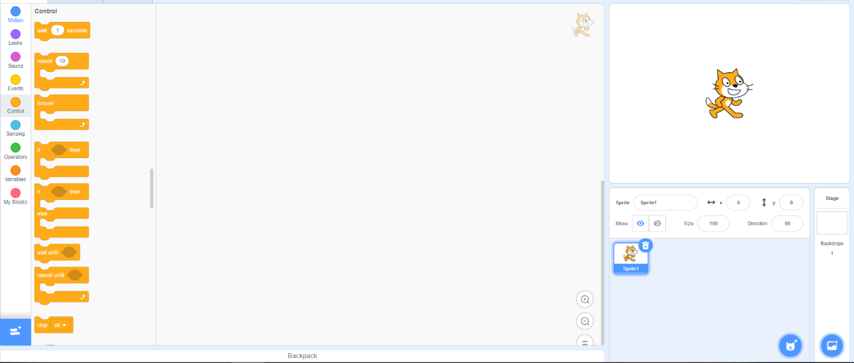
Let’s review
What do you remember about using Scratch?
In particular, what do you remember about the Motion and Control palettes?
Take some time to review how to use Scratch.
Notes:
Remind pupils here of the work they did in Unit 4.1: We are software developers.

Slide 2
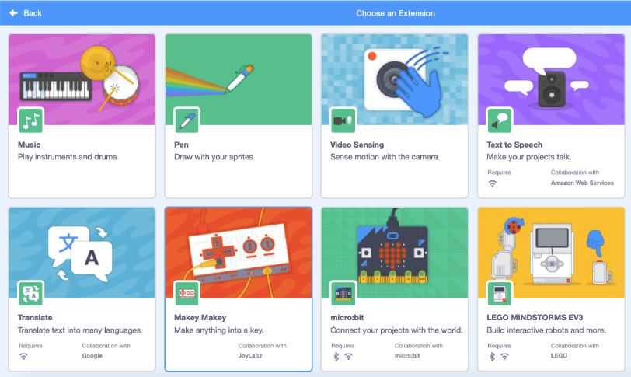
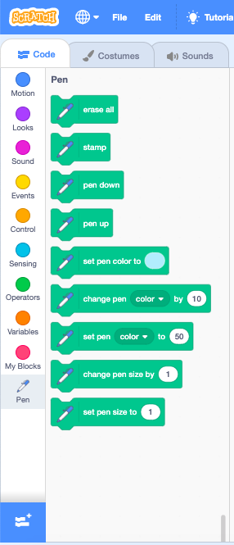
Let’s do
You will need the pen extension blocks in Scratch to draw your pattern.
Click the ‘Add extensions’ button.
Choose the pen extension.
Experiment with the pen tools such as erase all, pen up and pen down. These will be useful when creating art.
1
2
3

Slide 3
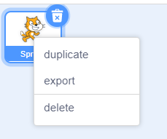
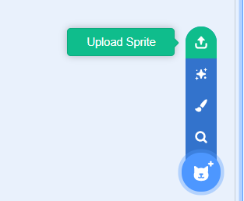
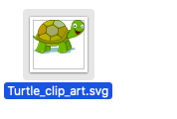
Let’s learn
Before starting, you may wish to replace the cat sprite with a turtle. This represents a turtle small floor robot which that draws by moving forward and turning, under the control of a program. You will need to find and save an image of a turtle (checking its terms of use) as the Sprite library doesn’t include one. Alternatively, you could draw a turtle in Scratch.
Delete the cat sprite.
Select ‘Upload Sprite’.
Choose the file to upload.
Shrink the sprite by reducing its size, for example to 10%.
1
2
3
4
Sprite: a graphical character in a program that can be given its own sequence of instructions
Do you know what a sprite is?
Click on this box to see the definition.

Slide 4
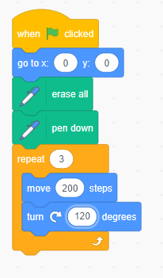
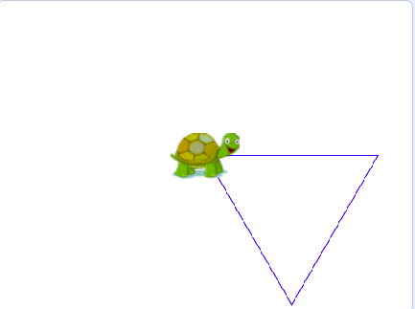
Let’s do
Explore creating simple shapes in Scratch, such as an equilateral triangle or a square.
Start with a when green flag clicked block from the Events palette.
Instruct the sprite to start at the same place every time by adding a go to x: y: block (Motion). Set both coordinates to 0.
Then add an erase all block (Pen). This will mean everything is cleared at the start.
Add a pen down block. This instructs the sprite to draw.
Then instruct the sprite to move 200 steps and turn 120 degrees, using Motion blocks.
Add the repeat block (Control) around the Motion blocks. This will mean three lines are drawn, creating a triangle.
Let’s discuss
What would you need to change for the sprite to draw a square?

Slide 5
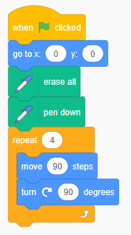
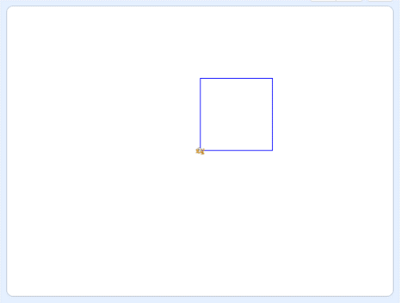
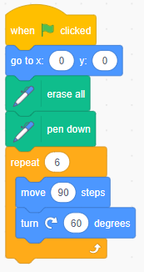
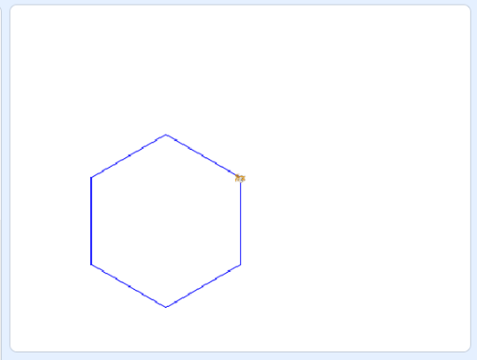
Let’s learn
To create a square, change the angle to turn 90 degrees then repeat the move and turn instructions four times. You could reduce the number of steps, for a good fit on the stage.
There is a relationship between the angle of turn and the number in a repeating loop to complete a whole turn. The number of times it repeats multiplied by the angle must equal 360 degrees.
For example, if the angle of turn was 60 degrees, this would need to repeat six times to complete the whole turn.
Repetition: programming construct which allows a group of instructions to be repeated a number of times, or until a certain condition is met
Do you know what repetition is?
Click on this box to see the definition.

Slide 6
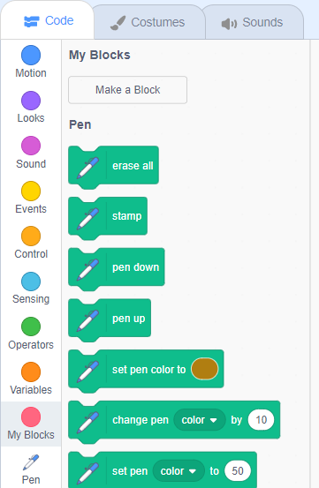
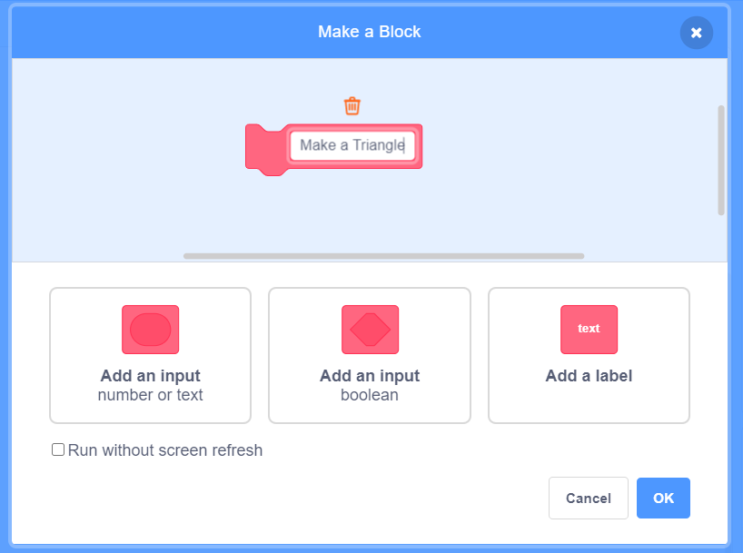
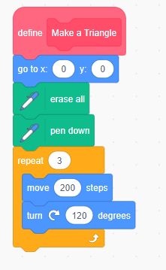
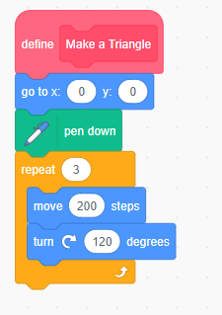
1
Let’s do
You can create your own blocks in Scratch. For example, you could create a ‘Make a Triangle’ block.
Click ‘My blocks’, then ‘Make a Block’. Name the block ‘Make a Triangle’ then click ‘OK’.
Add the script for drawing the triangle to the define Make a Triangle block.
Take out the erase all block from the script.
This means that the Make a Triangle block will now draw a triangle when used in another script.
2
3

Slide 7
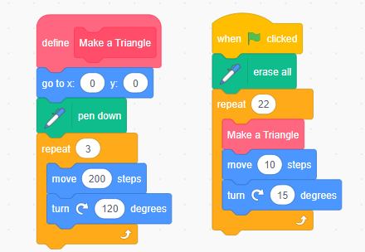
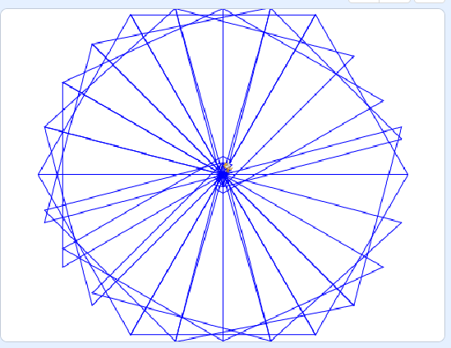
Let’s do
Create complex geometric figures by drawing a simple shape then turning it through a set angle and moving it forward.
Start with a when green flag clicked block.
Add an erase all block to start fresh each time.
Add the Make a Triangle block.
Then add a move 10 steps and a turn right 15 degrees block from the Motion palette.
Add a repeat block. If it turns 15 degrees each time, it will need to turn 24 times to create a circular pattern.

Slide 8
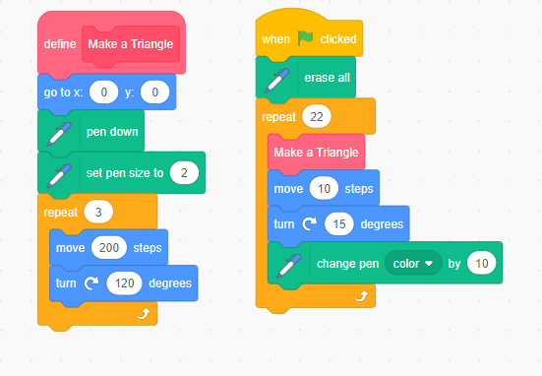
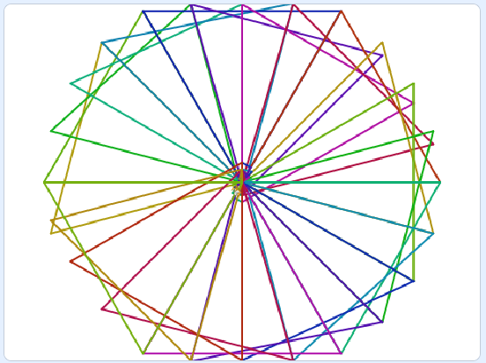
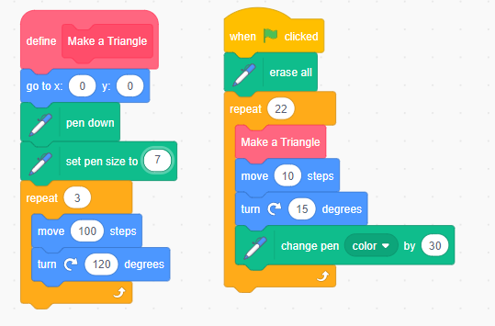
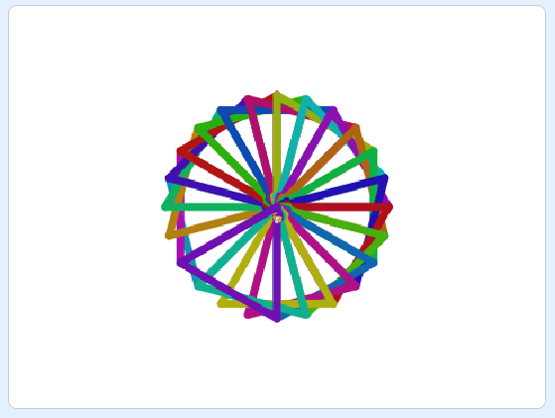
Let’s do
Add colour to your geometric repeated pattern to create a design inspired by the Islamic art you saw at the beginning of the session.
Do this by experimenting with change pen colour and set pen size blocks. You could also change the number of steps to create different effects.

