Slide 1
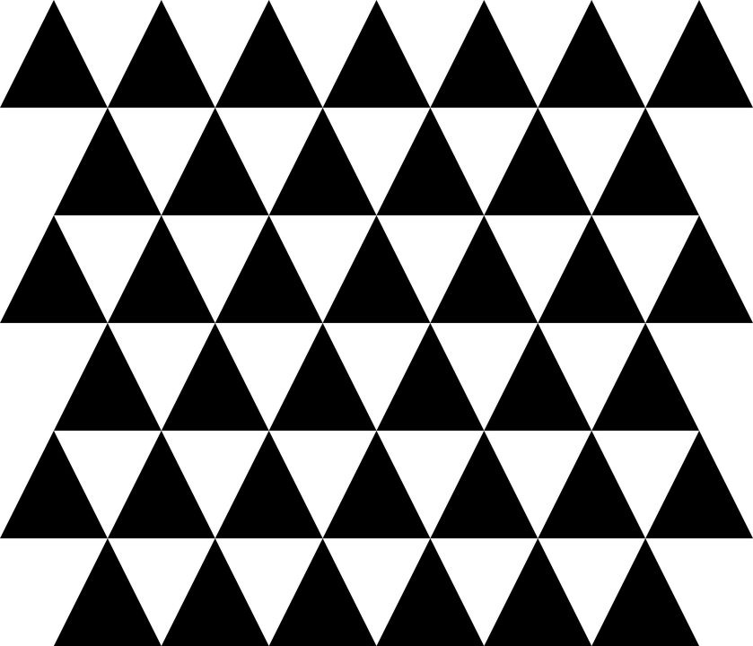
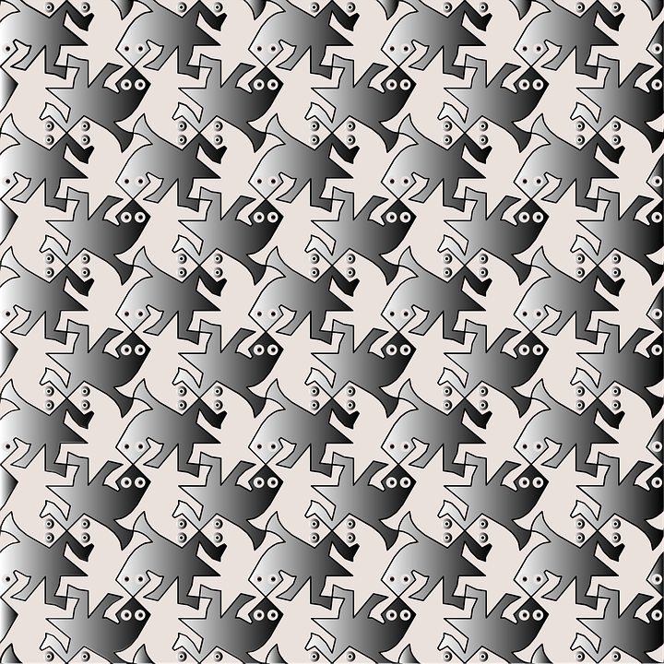
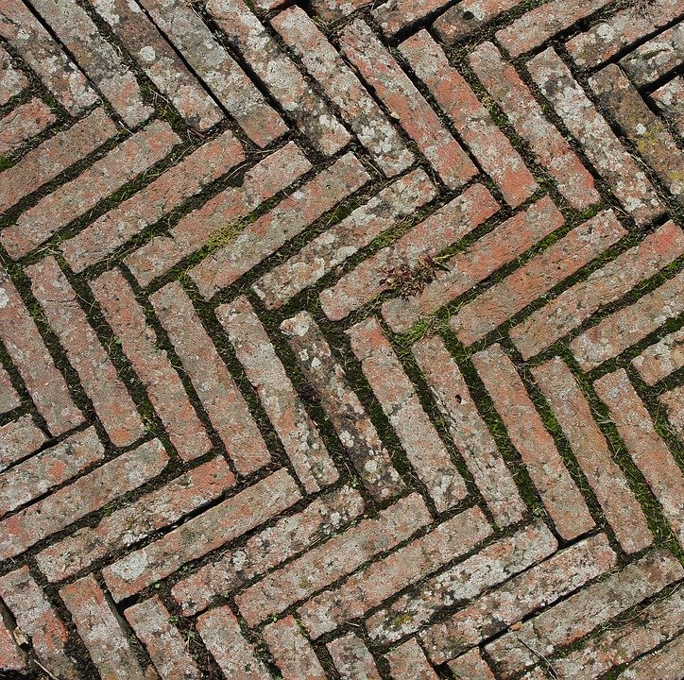
Let’s learn
In this session, you will learn about tessellations. Then you will be introduced to Inkscape and create your own.
Here are some examples of simple tessellations.
Let’s discuss
What do you notice about the tessellations?
Which one do you like best and why?
Does this give you any ideas for creating your own tessellations?

Slide 2
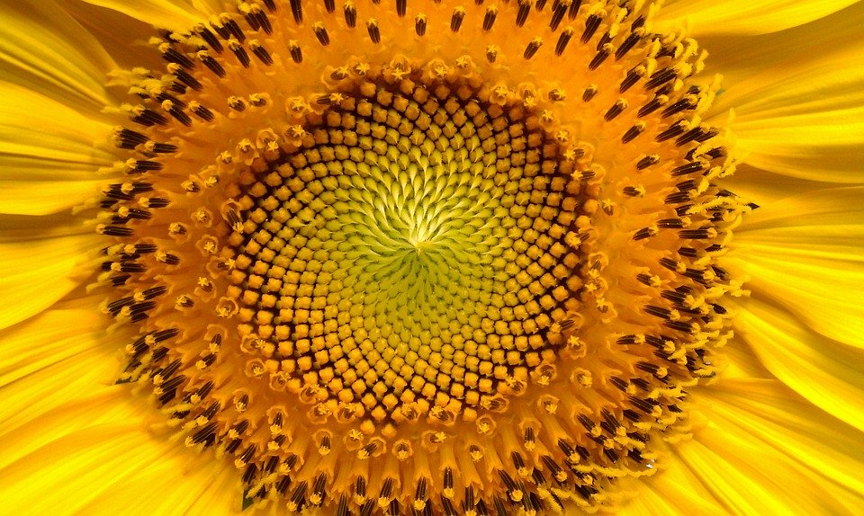
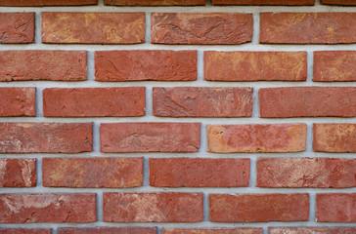
Let’s review
Remember, a tessellation is a repeating pattern of shapes that fit perfectly together.
Let’s do
In pairs, find examples of tessellations in the environment. Record any you find on a digital camera.
Let’s discuss
Discuss what you find with the class.
What tessellations did you find?
Where did you find them?
What was the most interesting/beautiful tessellation that you found?
Has this given you any ideas for when you create your own one?

Slide 3
Let’s try
Now, we will use Inkscape to create a simple tessellation of our own. Inkscape is software that enables you to create digital art.
Let’s discuss
Have you used Inkscape before?
If so, what hints or tips can you share with your classmates?
Let’s do
Open Inkscape and take some time to explore its tools.

Slide 4
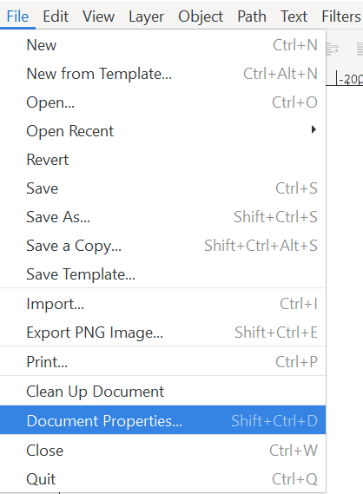
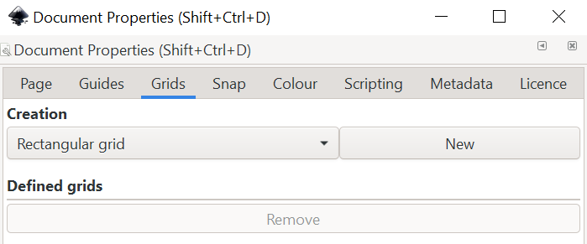
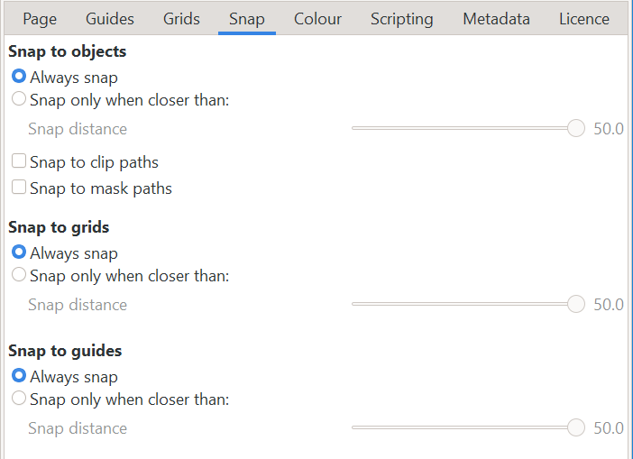
1
2
Let’s do
Set up a new document for accurate drawing by following these steps.
Open Document Properties by selecting ‘File’ then ‘Document Properties’.
In the ‘Page’ tab, set the units to ‘cm’.
In the ‘Grids’ tab, select ‘New’ to set a rectangular grid.
In the ‘Snap’ tab, choose ‘Always snap’.
3
4

Slide 5
Let’s learn
‘Snap to grid’ makes sure points on a shape are always placed on a squared grid.
‘Snap to objects’ makes sure points on a shape are lined up with points on other shapes.
‘Snap to guides’ will make sure objects line up with any ruler guides you use.

Slide 6
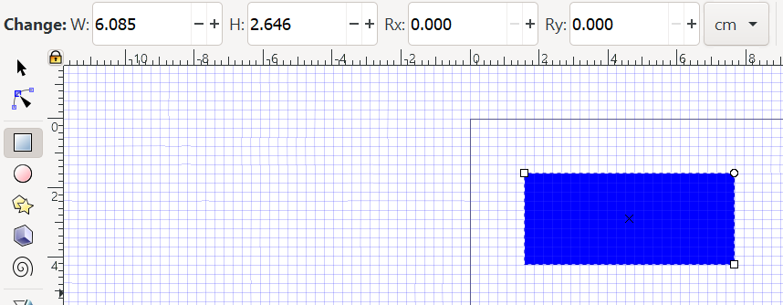
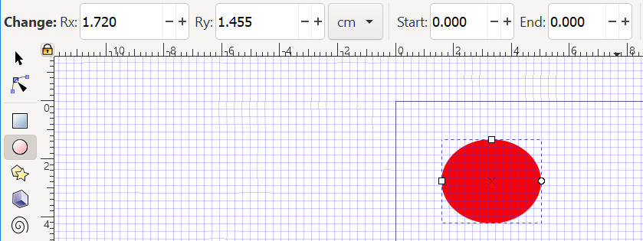
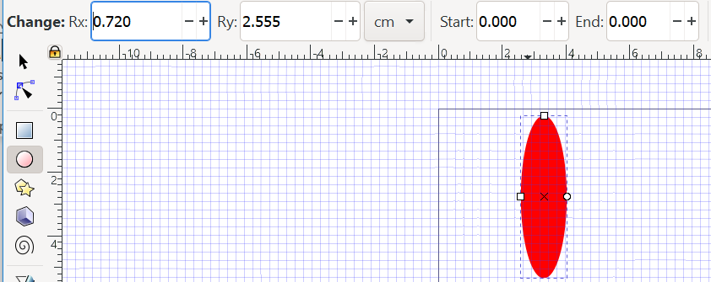
1
Let’s learn
You can create different shapes in Inkscape by using the shape tools:
Rectangles
Circles and ellipses
Stars
Use the change tool to change the appearance of the shapes.
2
3

Slide 7
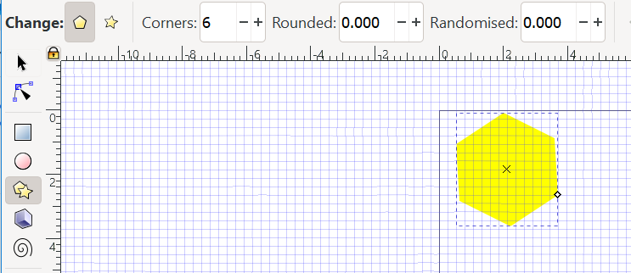
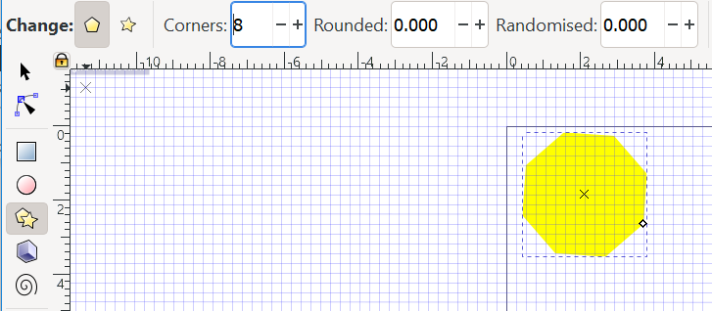
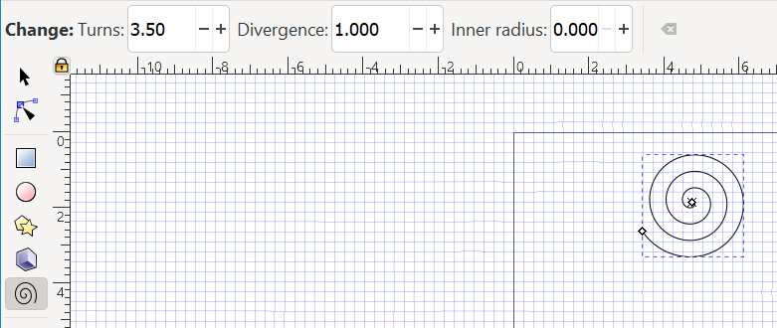
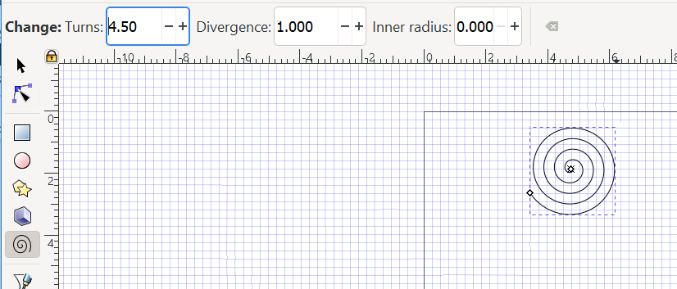
Let’s learn
You can also create polygons and spirals.

Slide 8
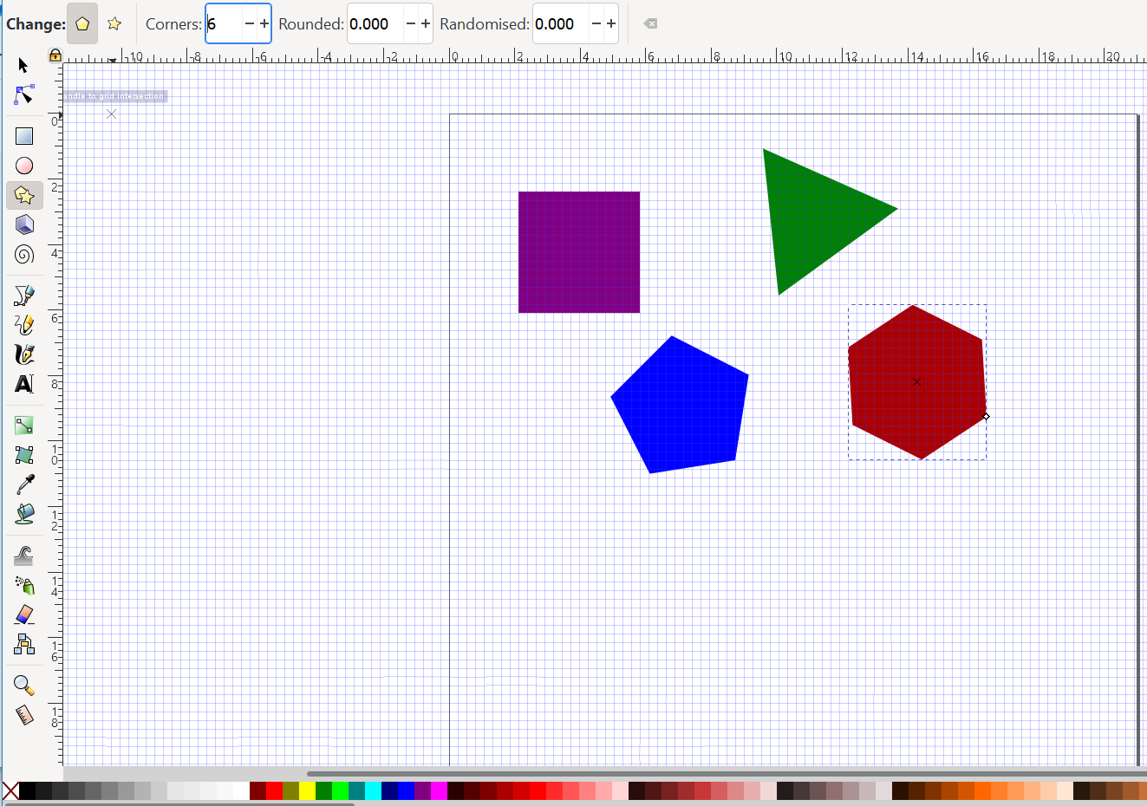
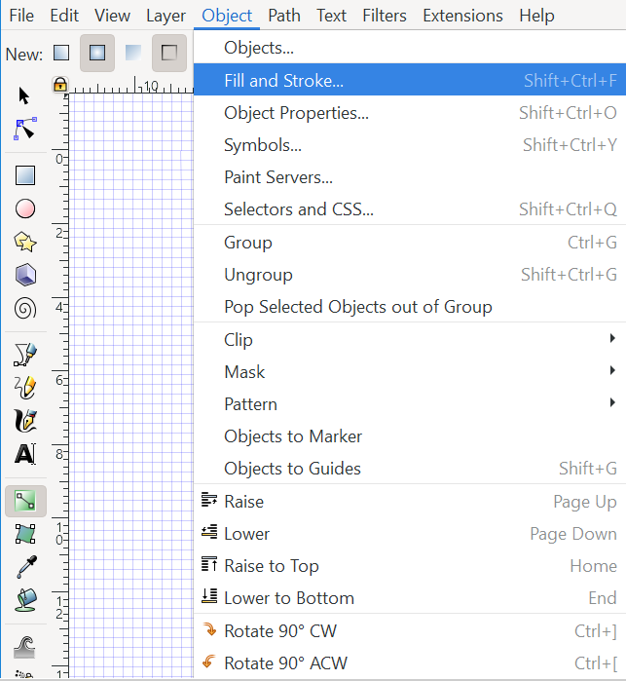
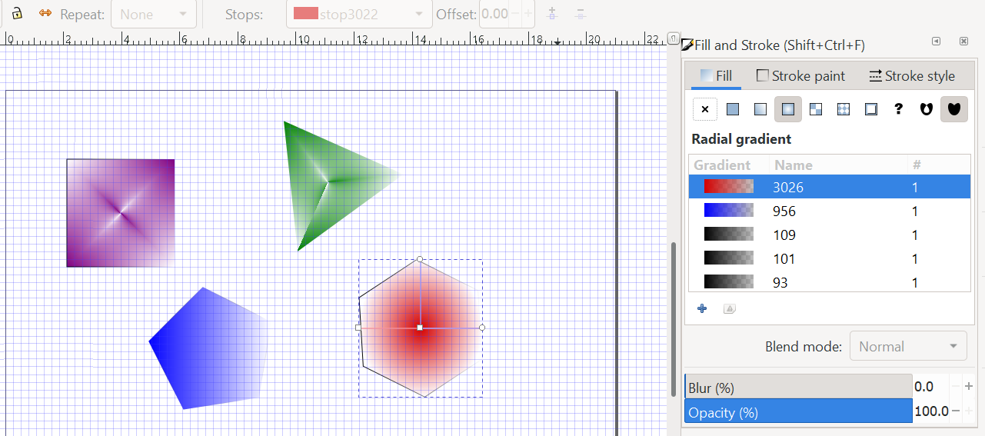
1
Let’s do
Create some polygons. You can change their colour by clicking on them then choosing a colour from the colour bar at the bottom of the screen.
You can experiment with gradient fills by:
Selecting ‘Fill and Stroke’ from the ‘Objects’ dropdown menu.
Applying some of the different gradient options.
2

Slide 9
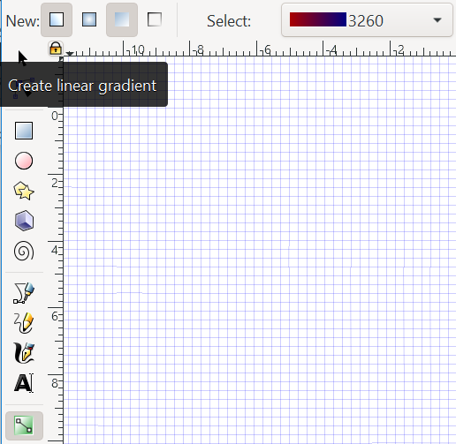
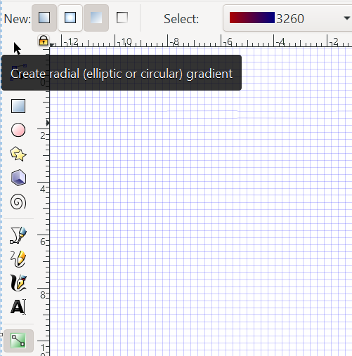
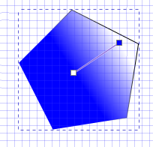
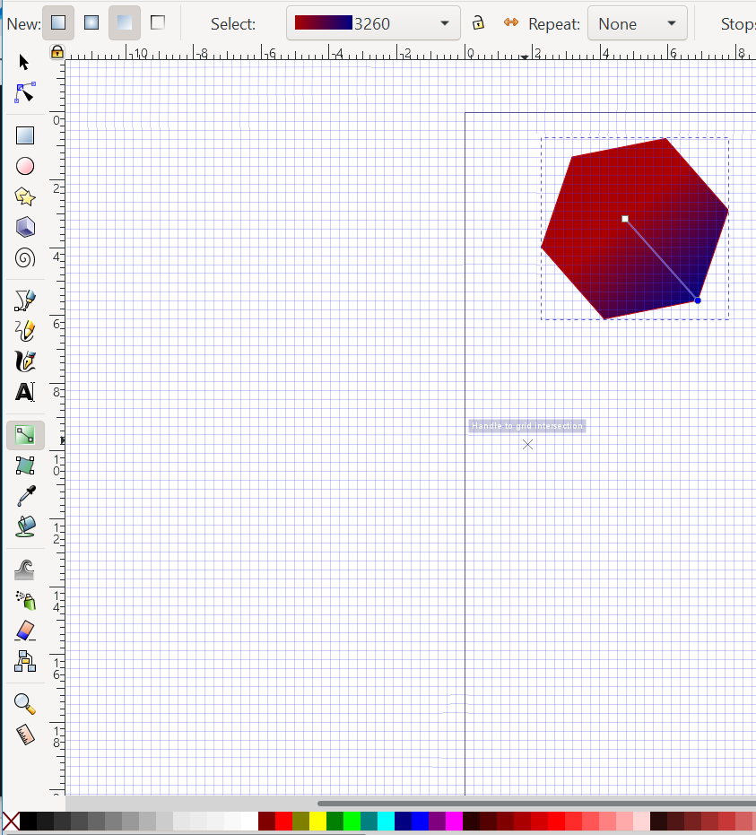
Let’s do
You can also use the gradient tool.
Select the gradient tool. Click on the object and choose ‘Create linear gradient’ or ‘Create radial gradient’ from the tool bar.
Drag the node of the gradient handle to create the gradient effect.
You can change colour in the gradient by clicking on the node and choosing a different colour from the colour tool bar, then dragging.
Let’s discuss
Which of the shapes you have created will tessellate?
1
2
3
Notes:
Triangles, quadrilaterals and hexagons will tessellate. Pentagons won’t.

Slide 10
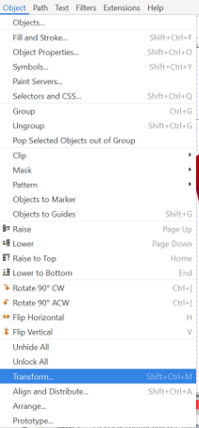
Let’s do
Choose the shape you want to tesselate. Delete the others by right-clicking on them and selecting ‘Delete’. You can use the transform tool to re-position your shape.
Click on your object. Select ‘Object’ and ‘Transform’.
Use the ‘Move’ menu. Type in the coordinates on the grid you want it to move to. Click ‘Apply’.
Use the ‘Rotate’ menu to rotate the shape. Choose the direction and click ‘Apply’.
1
3
2

Slide 11
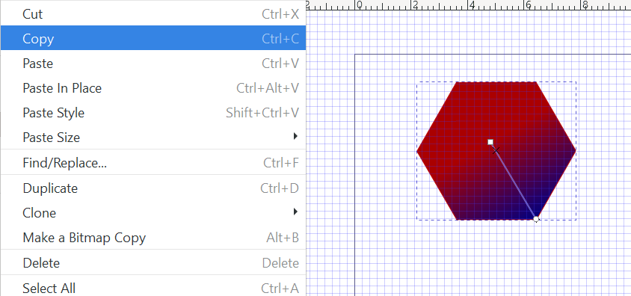
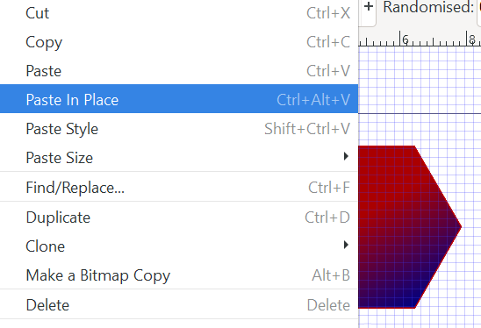
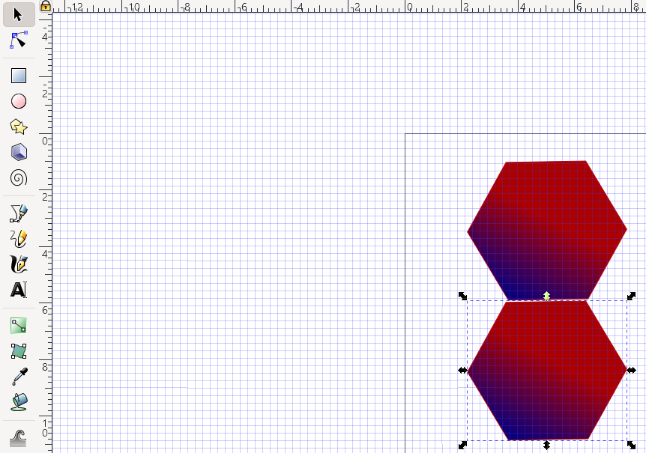
Let’s do
Now you need to make a copy of your shape in order to create a tessellation. There are different ways you can do this.
Click on your shape, select ‘Edit’, then ‘Copy’.
Select ‘Paste in place’ from the ‘Edit’ menu. This will paste a copy on top of the object.
To move the copy, select the arrow icon, click on the object and drag it into position. Or you could use the ‘Transform’ and ‘Move’ menu as before.
1
2
3
Do you know what transform means?
Click on this box to see the definition.
Transform: to change the shape of an image or part of an image

Slide 12
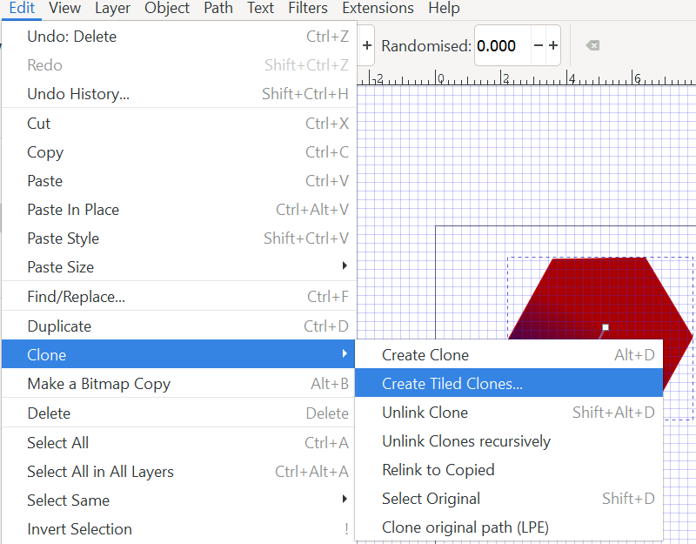
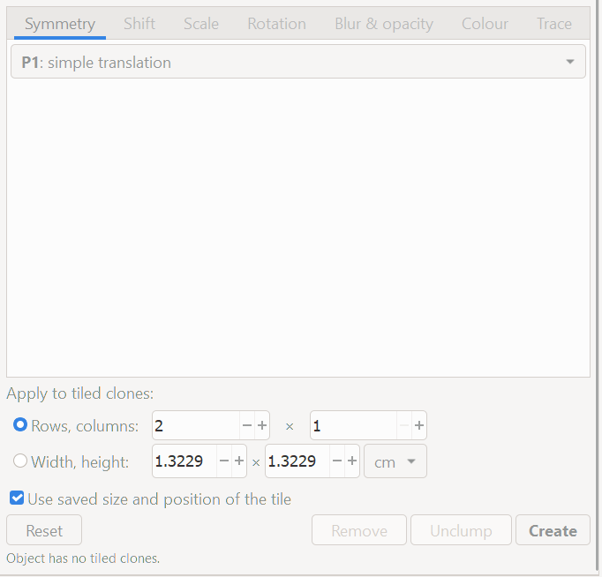
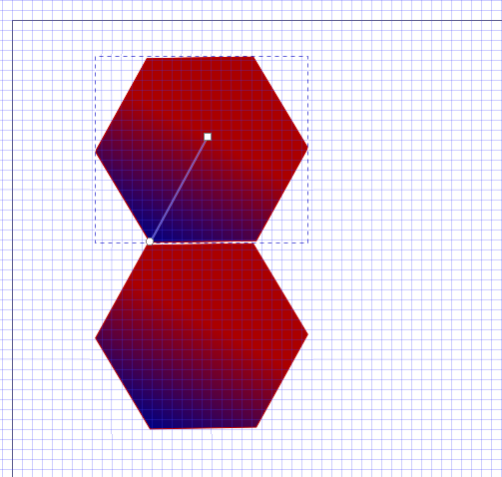
1
Let’s do
Alternatively, you can make a tiled clone to create a tessellation.
Click on your shape, select ‘Edit’, ‘Clone’, then ‘Create Tiled Clones’.
Choose how many rows or columns you want in the ‘Symmetry’ menu. Click ‘Create’.
2

Slide 13
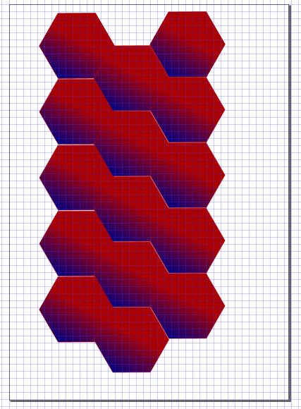
Let’s do
Repeat either copying and pasting or cloning to create a tessellation of several shapes in columns and rows.

