Slide 1
Monday

Slide 2
Read the poem
My Dad is Amazing!

Slide 3
This poem is not literal – for example Dad doesn’t really teach Granny to suck eggs it contains lots of ‘idioms’ which are phrases that have a different meaning to the literal meaning of the words.
Task 1
Do a search and find the meaning of the different idioms in the poem.
Eg. Making mountains out of molehills means behaving as if a small problem is a really big problem.
Task 2
Answer the comprehension questions on the following slide.

Slide 4
‘My Dad is Amazing’
Comprehension questions
The blue words are multiple choice answers to help you.
What adjective describes dad?
Why does he make mum’s blood boil?
He makes her hot He makes her really cross He wants to cook her
What does it mean to drive someone up the wall?
It means to crash the car It means to drive up a hill It means to keep annoying someone
Where are dad’s eyes described as being? What does this mean
What does it mean to walk around with your head in the clouds?
It means to daydream It means to keep looking upwards It means to walk on tiptoe
What is the most amazing thing about dad?
He can bite people’s heads off He can get cross with people He can tell people off really well
What adjective would describe your dad and why?

Slide 5
Tuesday
Read the poem on the following slide
Think about the rhythm of the poem
Notice how the similar/same sentence openers help to maintain a rhythm and to show that it is a list.
Notice the combination of long and (mostly) short lines.

Slide 7
Your turn!
Write your own poem, based on the poem you have just read.
Your poem will be called
Ten Things Found On A Teacher’s Desk
Have a look at the next slides if you need some inspiration.

Slide 8
Ten Things Found on a Teacher’s Desk
What might you find on there?

Slide 9
An out of date laptop used to teach the lessons

Slide 10
Piles of paper which…..

Slide 11
Half finished coffee that….

Slide 12
An unopened _______ that….

Slide 13
A really important_______ for….

Slide 14
A plastic pot of _______ so that ….

Slide 15
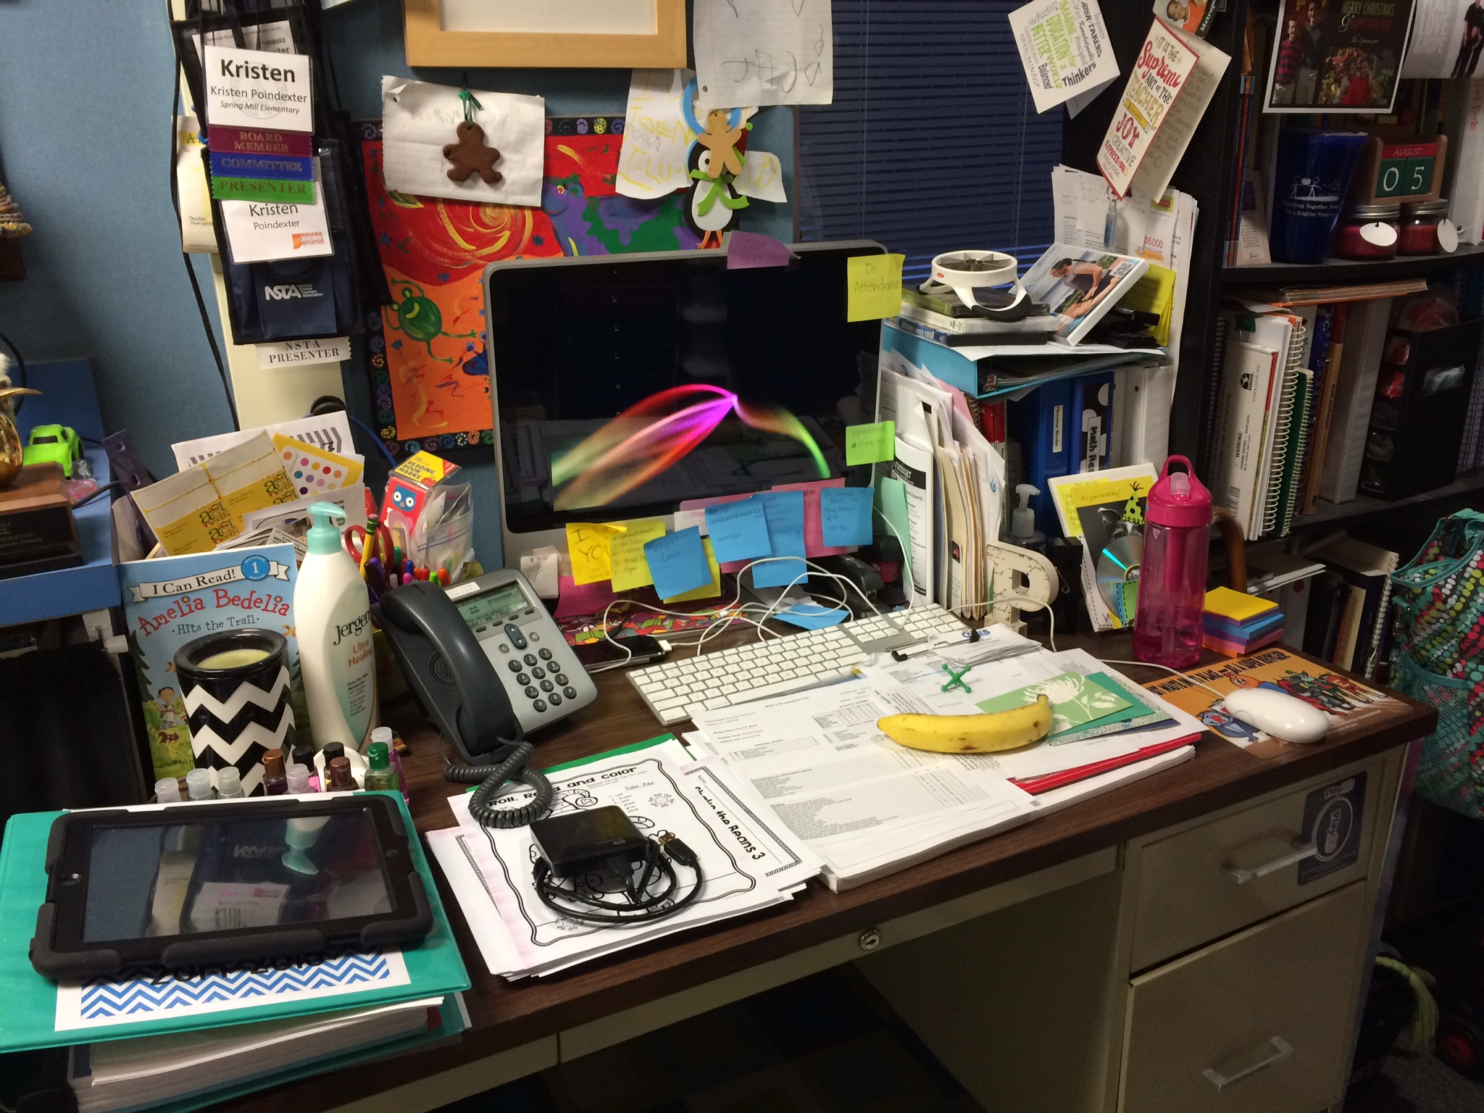
Ten Things found on a Teacher’s Desk
You could include the conjunctions….
which
that
who
so that
for

Slide 16
Ten Things found on a Teacher’s Desk
A crumpled up piece of paper.
A half finished cup of coffee which she didn’t have time to drink.
A set of keys for the playground shed.
A stripy notebook with her lesson notes for the day.
A photo of her gorgeous dog which she doesn’t stop talking about.
……

Slide 17
Wednesday

Slide 18
Ten Things Found in a Child’s Bookbag
What might you find in there?

Slide 19
A screwed up letter which was dated last year

Slide 20
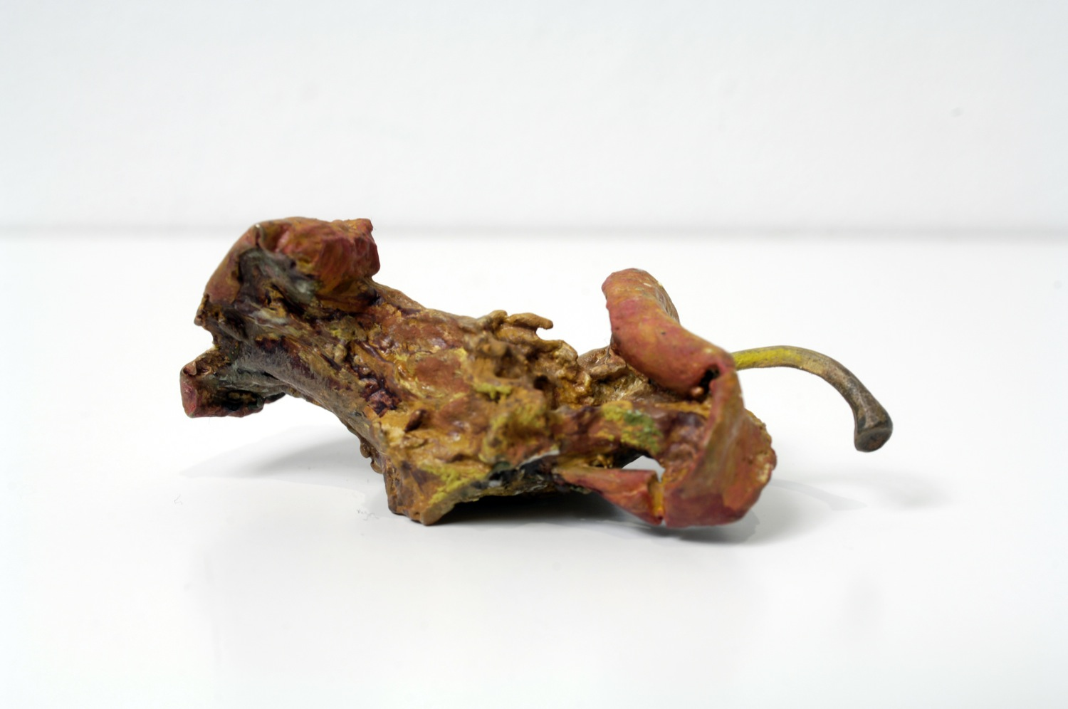
An old apple core that has been there for weeks

Slide 21
Piles of books that have never been read

Slide 22
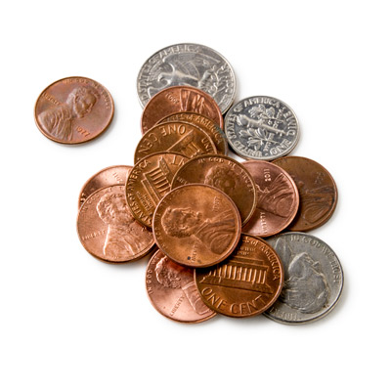
Coins for the tuckshop so that tummies don’t rumble

Slide 23
Ten Things Found in a Child’s Bookbag
Write your own poem with this title.
Try to use some of these conjunctions….
which
that
who
so that
for
although

Slide 24
Thursday

Slide 25
Think about ‘The Boy in the Dress’ by David Walliams. What is the moral/message of the story?

Slide 26
Now…
Choose one character from the story. Answer these questions.
What was the character like at the start of the story?
At the beginning ………. was…
What happened to that character in the story?
In the story, ______ etc… happened to my …………
How did they feel after (at the end) and how did they change?
_______ felt….. And he/she changed because…
Did you enjoy the book?
I enjoyed/disliked the book because…

Slide 27
Friday
Task 1
Log on to Bug Club and read a book (part of a book if it is very long one) and complete the questions.
Word challenge.
pick a letter.
Challenge 1 – think of as many words as you can which begin with that letter.
Challenge 2 – think of the longest word you can that belongs with that letter

