Slide 1
Let’s revise the story…..

Slide 2
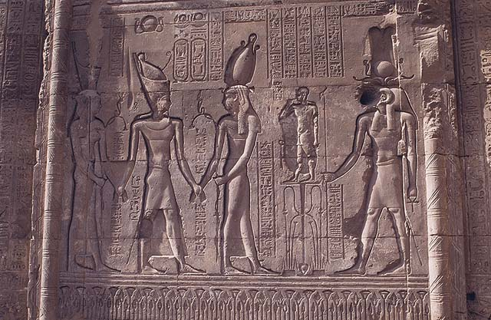
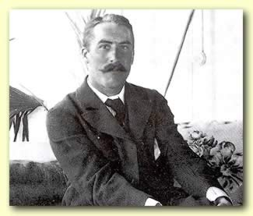
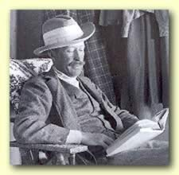
Howard Carter was a British archaeologist working in Egypt.
Howard Carter
Lord Carnarvon
Lord Carnarvan was a rich Englishman with an interest in Egypt. He paid the bills for Howard Carter’s work.

Slide 3
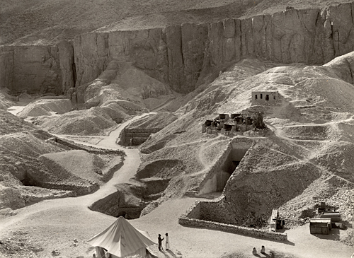
The people of Egypt buried some of their greatest pharaohs in this Valley of the Kings. By 1922 archaeologists thought they’d found them all.
Howard Carter worked out that there was still one tomb left – that of Tutankhamun!

Slide 4
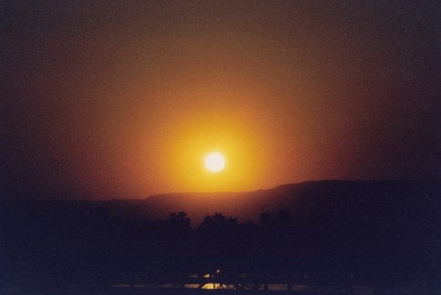
Early morning on the 3rd November 1922, in a hot and dusty valley in Egypt Egyptian workers were searching, digging away in the sand and stones.
They didn’t hold out much hope.

Slide 5
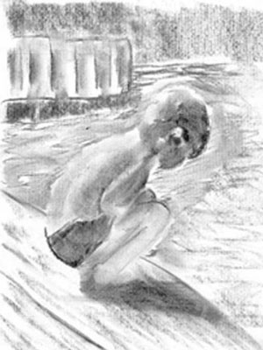
A young boy crouched a few feet away. His job was to fetch water to the workers. He sat digging in the sand with a stick. Suddenly he hit a hard surface.
He dug furiously and found a stone step.
He stared at it – then covered it over and ran to tell Howard Carter what he’d found.

Slide 6
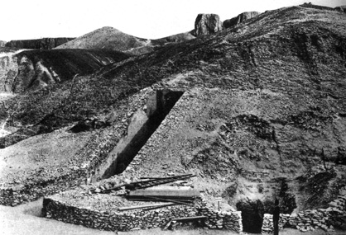
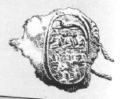
Carter ordered the workers to clear away the sand. Gradually they found 12 more steps blocked by rubble.
Then they found the top part of a door made of brick and plaster. On the door was a stamp. This meant the tomb was royal and it was intact.

Slide 7
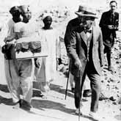
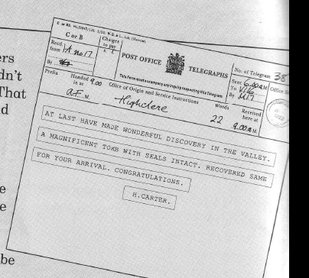
Carter ordered the workers to cover the steps over again so nobody else would find the tomb.
He sent a telegram to Lord Carnarvan in Scotland, asking him to come at once.
How long did it take Carnarvan to arrive?
Carnarvan and his daughter, Lady Evelyn arrived at the town of Luxor 2 weeks later and met Carter.

Slide 8
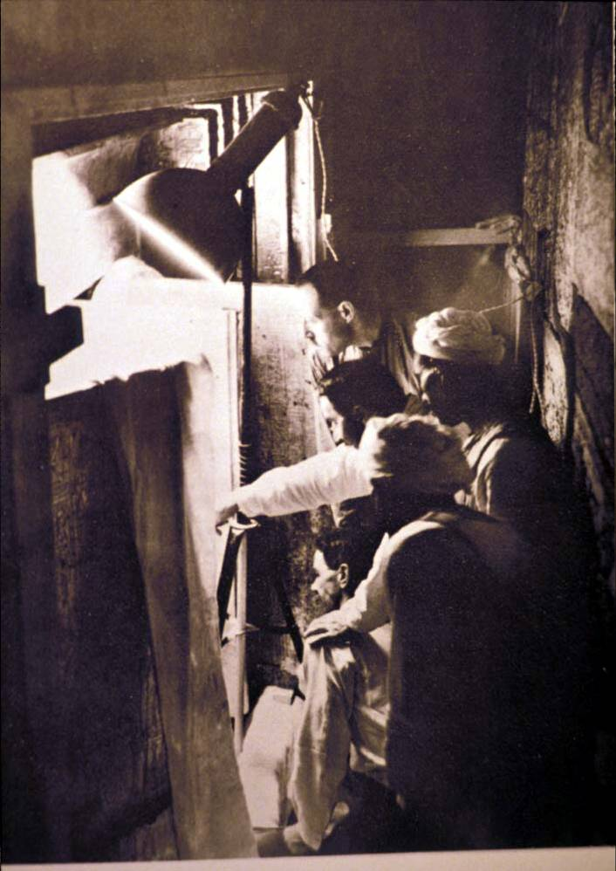
Next day, Howard Carter asked the workers to break down the door.
Carter took an iron bar and made a tiny hole in the top left hand corner. The bar passed through so the passage was clear.

Slide 9
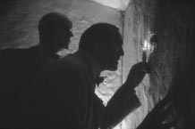
Carter took a candle and put it up to the hole to test for dangerous gas.
Then he widened the hole and looked in.
At first he saw nothing – then his eyes adjusted.
“Can you see anything,” asked Lord Carnarvan
“Yes”, replied Carter
“Wonderful things!”

Slide 10
Both Carter and Lord Carnarvan were desperate to take a closer look. But Egyptian rules said NO!
Archaeologists had to have permission to dig in Egypt. They had to have an inspector with them when they first went in.

Slide 11
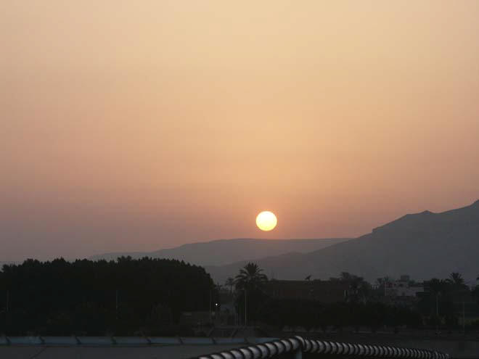
Unable to wait , later that same night Carter returned to the tomb. He made the hole bigger and they squeezed through one by one and dropped onto the floor. They found themselves in a small room.
Over 3000 years had passed since anyone had last entered. They saw a fingerprint left on the painted surface of an oil lamp. The smell of perfume still filled the air.

Slide 12
Example of a news report….

Slide 13
Tut! Tut! King Tutankhamun’s Tomb Discovered.
Last week, Howard Carter, a British Egyptologist, discovered the undetected, untouched tomb, that left for over 3000 years, of Tutankhamun, a young Pharaoh, in Luxor, which is a city in Egypt.
After weeks of searching, a small, Egyptian water boy (who was working for Carter) discovered the first step blocking the way to the secret and mysterious tomb. Eventually, after removing piles of rubbish- from previous excavations- Carter walked down a corridor of steps and was face to face with an enormous concrete slab which had a royal stamp on it: something special was inside! Moments later, Carter saw that the tomb may have been broken into by tomb robbers because there was a different coloured concrete on part of the door.
“I was devastated at seeing this, and I was worried that Lord Carnavron would be cross,” Carter told reporters. Carnavron had provided lots of money to Carter to find this lost tomb and this mission was to be the last he funded.
In the end, Carter, while being watched by Carnavron, decided to use a small pick-axe to make a hole in the concrete wall in order to see what was behind it. Following this, he took a small candle, lit it and poked it inside the whole to see what was there. Within seconds, Carter’s face was one of excitement and relief because inside he saw towering, menacing, gilt statues with intricately carved designs encrusted with precious stones; hundreds of immaculate, detailed bituminised couches that had smiling faces of glass-eyed gods and spirits on the arms and closely packed piles of exquisite alabaster vases and boxes which had golden designs studded with gems.
“I was thrilled. I was relieved. I found what I always knew was there,” Carter told the journalists.
At this moment, Carter is gathering up the treasures preparing them for museums. Back home, the British people are extremely proud of Carter and are having parties in the streets. And as for the water boy? Well he wants to carry on studying and learning about his ancient past!

Slide 14
After weeks of searching, a small, Egyptian water boy (who was working for Carter) has discovered the first step blocking the way to the secret and mysterious tomb. Eventually, after removing piles of rubbish- from previous excavations- Carter yesterday walked down a corridor of steps and was face to face with an enormous concrete slab which had a royal stamp on it: something special was inside! Moments later, Carter saw that the tomb may have been broken into by tomb robbers because there was a different coloured concrete on part of the door.
“I was devastated at seeing this, and I was worried that Lord Carnarvon would be cross,” Carter told reporters. Carnarvon had provided lots of money to Carter to find this lost tomb and this mission was to be the last he funded.

Slide 15
In the end, we are told, Carter, while being watched by Carnarvon, decided to use a small pick-axe to make a hole in the concrete wall in order to see what was behind it. Following this, he took a small candle, lit it and poked it inside the whole to see what was there. Within seconds, witnesses say, Carter’s face was one of excitement and relief because inside he saw towering, menacing, gilt statues with intricately carved designs encrusted with precious stones; hundreds of immaculate, detailed bituminised couches that had smiling faces of glass-eyed gods and spirits on the arms and closely packed piles of exquisite alabaster vases and boxes which had golden designs studded with gems.
“I was thrilled. I was relieved. I found what I always knew was there,” Carter told us.

Slide 16
Let’s write a headline…

Slide 17
Headlines- short, snappy, witty:
King Tutankhamun’s Tomb Found.
Ancient Tutankhamun Tomb Discovered.
Heroic Howard makes Wondrous Discovery.
Carter Wakes Sleeping Tomb.
Golden Treasures in Tut’s Tomb Discovered.
Carter Captures Tutankhamun’s Tomb.
Resting Pharaoh Wide Awake.
Tut! Tut! Tutankhamun’s Tomb Unearthed

Slide 18
To use the 4 ‘W’ to write an opening to a newspaper article
I can write sentences that use the 4 ‘W’ facts;
I can embed clauses using the relative pronouns ‘who’, ‘which’ and ‘that’;
I can embed phrases to add detail

Slide 19
Tut! Tut! King Tutankhamun’s Tomb Discovered.
ENGAYNE GAZETTE
When: (be careful)
Who:
What:
Where:
Late last night; Yesterday afternoon; Earlier today; On Tuesday
Howard Carter; Mr H Carter; Small Egyptian water boy
discovered the untouched tomb…; opened a 3000 year old…; unearthed the tomb of…..
Egypt; Valley of the Kings; Luxor

Slide 20
Writing the IMPORTANT opening.
When: Late last night; Yesterday afternoon; Earlier today; On Tuesday
Who: Howard Carter; Mr H Carter; small Egyptian water boy
What: discovered the …; revealed….; found….; opened a …;
unearthed the…..
Where: Egypt; Valley of the Kings; Luxor
Add some adjectives for detail for the tomb untouched; undetected; ancient; buried; well-hidden; secluded; secret; mysterious;

Slide 21
Now embed some details.
Use relative pronouns:
who (after people), which, that
Useful words for your embedding detail:
British Britain archaeologist Egyptologist searching for years been left
young Pharaoh teenage King
Egypt contained hundreds of…
Tutankhamun

Slide 22
LA sheet
______________(when)_____________(who)__
______________________________(what)____
_________________________________(where)
Now add a which at the end….

Slide 23
Tut! Tut! King Tutankhamun’s Tomb Discovered.
Last week, Howard Carter, a British Egyptologist, discovered the undetected, untouched tomb, that left for over 3000 years, of Tutankhamun, a young Pharaoh, in Luxor, which is a city in Egypt.
After weeks of searching, a small, Egyptian water boy (who was working for Carter) discovered the first step blocking the way to the secret and mysterious tomb. Eventually, after removing piles of rubbish- from previous excavations- Carter walked down a corridor of steps and was face to face with an enormous concrete slab which had a royal stamp on it: something special was inside! Moments later, Carter saw that the tomb may have been broken into by tomb robbers because there was a different coloured concrete on part of the door.
“I was devastated at seeing this, and I was worried that Lord Carnavron would be cross,” Carter told reporters. Carnavron had provided lots of money to Carter to find this lost tomb and this mission was to be the last he funded.
In the end, Carter, while being watched by Carnavron, decided to use a small pick-axe to make a hole in the concrete wall in order to see what was behind it. Following this, he took a small candle, lit it and poked it inside the whole to see what was there. Within seconds, Carter’s face was one of excitement and relief because inside he saw towering, menacing, gilt statues with intricately carved designs encrusted with precious stones; hundreds of immaculate, detailed bituminised couches that had smiling faces of glass-eyed gods and spirits on the arms and closely packed piles of exquisite alabaster vases and boxes which had golden designs studded with gems.
“I was thrilled. I was relieved. I found what I always knew was there,” Carter told the journalists.
At this moment, Carter is gathering up the treasures preparing them for museums. Back home, the British people are extremely proud of Carter and are having parties in the streets. And as for the water boy? Well he wants to carry on studying and learning about his ancient past!

Slide 24
After weeks of searching, a small, Egyptian water boy (who was working for Carter) discovered the first step blocking the way to the secret and mysterious tomb. Eventually, after removing piles of rubbish- from previous excavations- Carter walked down a corridor of steps and was face to face with an enormous concrete slab which had a royal stamp on it: something special was inside! Moments later, Carter saw that the tomb may have been broken into by tomb robbers because there was a different coloured concrete on part of the door.
“I was devastated at seeing this, and I was worried that Lord Carnavron would be cross,” Carter told reporters. Carnavron had provided lots of money to Carter to find this lost tomb and this mission was to be the last he funded.

Slide 25
LA
After weeks of searching, an Egyptian ________________ discovered the first step blocking the way to the _____ and ____ tomb. Eventually, Carter walked down a corridor and was face to face with an enormous concrete slab. Moments later, Carter saw that the tomb may have been broken into by _________ because there was a different coloured concrete on part of the door.
“I was __________________, and I was worried that Lord Carnavron would be _________,” Carter told _________.

Slide 26
In the end, Carter, while being watched by Carnavron, decided to use a small pick-axe to make a hole in the concrete wall in order to see what was behind it. Following this, he took a small candle, lit it and poked it inside the whole to see what was there. Within seconds, Carter’s face was one of excitement and relief because inside he saw towering, menacing, gilt statues with intricately carved designs encrusted with precious stones; hundreds of immaculate, detailed bituminised couches that had smiling faces of glass-eyed gods and spirits on the arms and closely packed piles of exquisite alabaster vases and boxes which had golden designs studded with gems.
“I was thrilled. I was relieved. I found what I always knew was there,” Carter told the journalists.

Slide 27
LA
In the end, Carter decided to use a _________to make a _____ in the concrete wall in order to see what was behind it. Following this, he took a small candle and _______ to see _______. Within seconds, Carter saw _______, ________, _______ statues; hundreds of _____________ and piles of ________________.
“I was thrilled. I was relieved. I found what I always________________,” _______ told the _________.

Slide 28
At this moment, Carter is gathering up the treasures preparing them for museums. Back home, the British people are extremely proud of Carter and are having parties in the streets. And as for the water boy? Well he wants to carry on studying and learning about his ancient past!

Slide 29
Part 1- the find!
Part 2- inside!
No ‘THE’ sentences
Water boy’s find - After weeks… When everyone… As the… While people… During the…
who ( ) - , embedded
Clearing rocks, Carter walking, corridor, door, stamp - When the.. Eventually all the... After… Finally…
which came/had/was… :
Tomb robbers- Annoyed….Moments later… Disappointed…Saddened…Losing hope…
because
“I felt…I was worried…,” Carter told…..
Carnarvon? Carnavron was…Carnavron had…
who ( ) - , embedded
No ‘THE’ sentences
Hole – However Carter….In the end…Wanting to….Curious….
while being/feeling… embedded so so that
Candle - Following this…Next…After that…With a match…From his pocket…Although thinking…Despite feeling…
so that in order to
Carter’s feelings, face - Within seconds…As soon as…When the candle…While the flame…
because
Treasures detail from earlier in the week
Inside he…From the shadows…All around…Everywhere he…Behind the….
“I was….I saw….I felt….,” Carter told…
Part 3- Now…
No ‘THE’ sentences
Carter? British people? Egyptians? Water boy?
At the moment, Right now, Back home, Currently, As we speak…
Some….; others, If the boy…, if…, if…, then the world/Carter….

Slide 30
Part 1- the find!
Part 2- inside!
No ‘THE’ sentences
Water boy’s find –
_______________ a water boy…..
Clearing rocks, Carter walking, corridor, door, stamp –
________________Carter walked….and came….
Tomb robbers-
____________ Carter thought it….
“I felt…I was worried…,” Carter told…..
Carnarvon
Carnavron was a……who had…..
After... When the… Also Next
because
No ‘THE’ sentences
Hole – _________ Carter used a………..
Candle - _________ he took a……….
Carter’s feelings, face - _________ Carter’s face…
Treasures detail from earlier in the week
Inside he/Every where he……
“I was….I saw….I felt….,” Carter told…
After… When the… When he… Next Moments... While he….
so that because
Part 3- Now…
No ‘THE’ sentences
Carter? British people? Egyptians? Water boy?
At the moment ……

Slide 31
No ‘THE’ sentences
-Time/place adverbials- When, As, While, After, During, Finally, At the moment, Eventually, Moments, Within, Inside, All around, Everywhere, Behind the, Back at…From the…..
- ‘ly’ ‘ed’ ‘ing’ opener
- COMMAS
‘who’ embedded - COMMAS
‘which’ and ‘because’
“…,” Carter told…..
Past tense
Present tense change
No ‘THE’ sentences
-Time/place adverbials- When, As, While, After, During, Finally, At the moment, Eventually, Moments, Within, Inside, All around, Everywhere, Behind the, Back at…From the…..
- ‘ly’ ‘ed’ ‘ing’ opener - COMMAS
‘who’ embedded - COMMAS
‘which’ and ‘because’
“…,” Carter told…..
Past tense
Present tense change
No ‘THE’ sentences
-Time/place adverbials- When, As, While, After, During, Finally, At the moment, Eventually, Moments, Within, Inside, All around, Everywhere, Behind the, Back at…From the…..
- ‘ly’ ‘ed’ ‘ing’ opener
- COMMAS
‘who’ embedded - COMMAS
‘which’ and ‘because’
“…,” Carter told…..
Past tense
Present tense change
No ‘THE’ sentences
-Time/place adverbials- When, As, While, After, During, Finally, At the moment, Eventually, Moments, Within, Inside, All around, Everywhere, Behind the, Back at…From the…..
- ‘ly’ ‘ed’ ‘ing’ opener - COMMAS
‘who’ embedded - COMMAS
‘which’ and ‘because’
“…,” Carter told…..
Past tense
Present tense change
No ‘THE’ sentences
-Time/place adverbials- When, As, While, After, During, Finally, At the moment, Eventually, Moments, Within, Inside, All around, Everywhere, Behind the, Back at…From the…..
- ‘ly’ ‘ed’ ‘ing’ opener - COMMAS
‘who’ embedded - COMMAS
‘which’ and ‘because’
“…,” Carter told…..
Past tense
Present tense change
No ‘THE’ sentences
-Time/place adverbials- When, As, While, After, During, Finally, At the moment, Eventually, Moments, Within, Inside, All around, Everywhere, Behind the, Back at…From the…..
- ‘ly’ ‘ed’ ‘ing’ opener - COMMAS
‘who’ embedded - COMMAS
‘which’ and ‘because’
“…,” Carter told…..
Past tense
Present tense change

Slide 32
No ‘THE’ sentences
-Time/place adverbials
- ‘ly’ ‘ed’ ‘ing’ opener
- Although, However, Despite
- COMMAS
‘who’ and ‘whole’ embedded – COMMAS, ( ) -
‘which’ ‘because’ ‘while’
“…,” Carter told…..
Past tense to present tense
: ; add related phrase/clause
If…, if…, if…, then.
Question
Short snappy sentence
No ‘THE’ sentences
-Time/place adverbials
- ‘ly’ ‘ed’ ‘ing’ opener
- Although, However, Despite
- COMMAS
‘who’ and ‘whole’ embedded – COMMAS, ( ) -
‘which’ ‘because’ ‘while’
“…,” Carter told…..
Past tense to present tense
: ; add related phrase/clause
If…, if…, if…, then.
Question
Short snappy sentence
No ‘THE’ sentences
-Time/place adverbials
- ‘ly’ ‘ed’ ‘ing’ opener
- Although, However, Despite
- COMMAS
‘who’ and ‘whole’ embedded – COMMAS, ( ) -
‘which’ ‘because’ ‘while’
“…,” Carter told…..
Past tense to present tense
: ; add related phrase/clause
If…, if…, if…, then.
Question
Short snappy sentence

