Slide 2
Feedback: “Should under-13s have Instagram?”
“I think that under-13s should have Instagram because it is a good place for inspiration. You should use it for appropriate stuff like baking recipes.”
Northwood College for Girls
“There's no way to verify an age even if it's to be younger than you are. How will they stop adults faking their age to join?”
Royal Alexandra & Albert School
“I think that they should because then they can join in to and also they can put it on private so no strangers can follow hen and they can also see your friends.”
Homerswood Primary & Nursery School
“It shouldn't be available to kids as you can't make it 100% safe as there will always be a way for bad people to access it.”
Lower Farm Primary School
Yes
No
38.9%
61.1%
“Yes, for over-10s only. As it can be constructive to entertain ourselves.”
Adderley Primary School

Slide 3
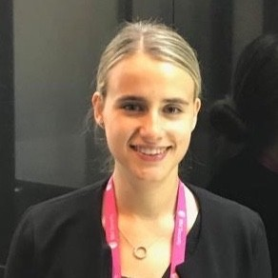
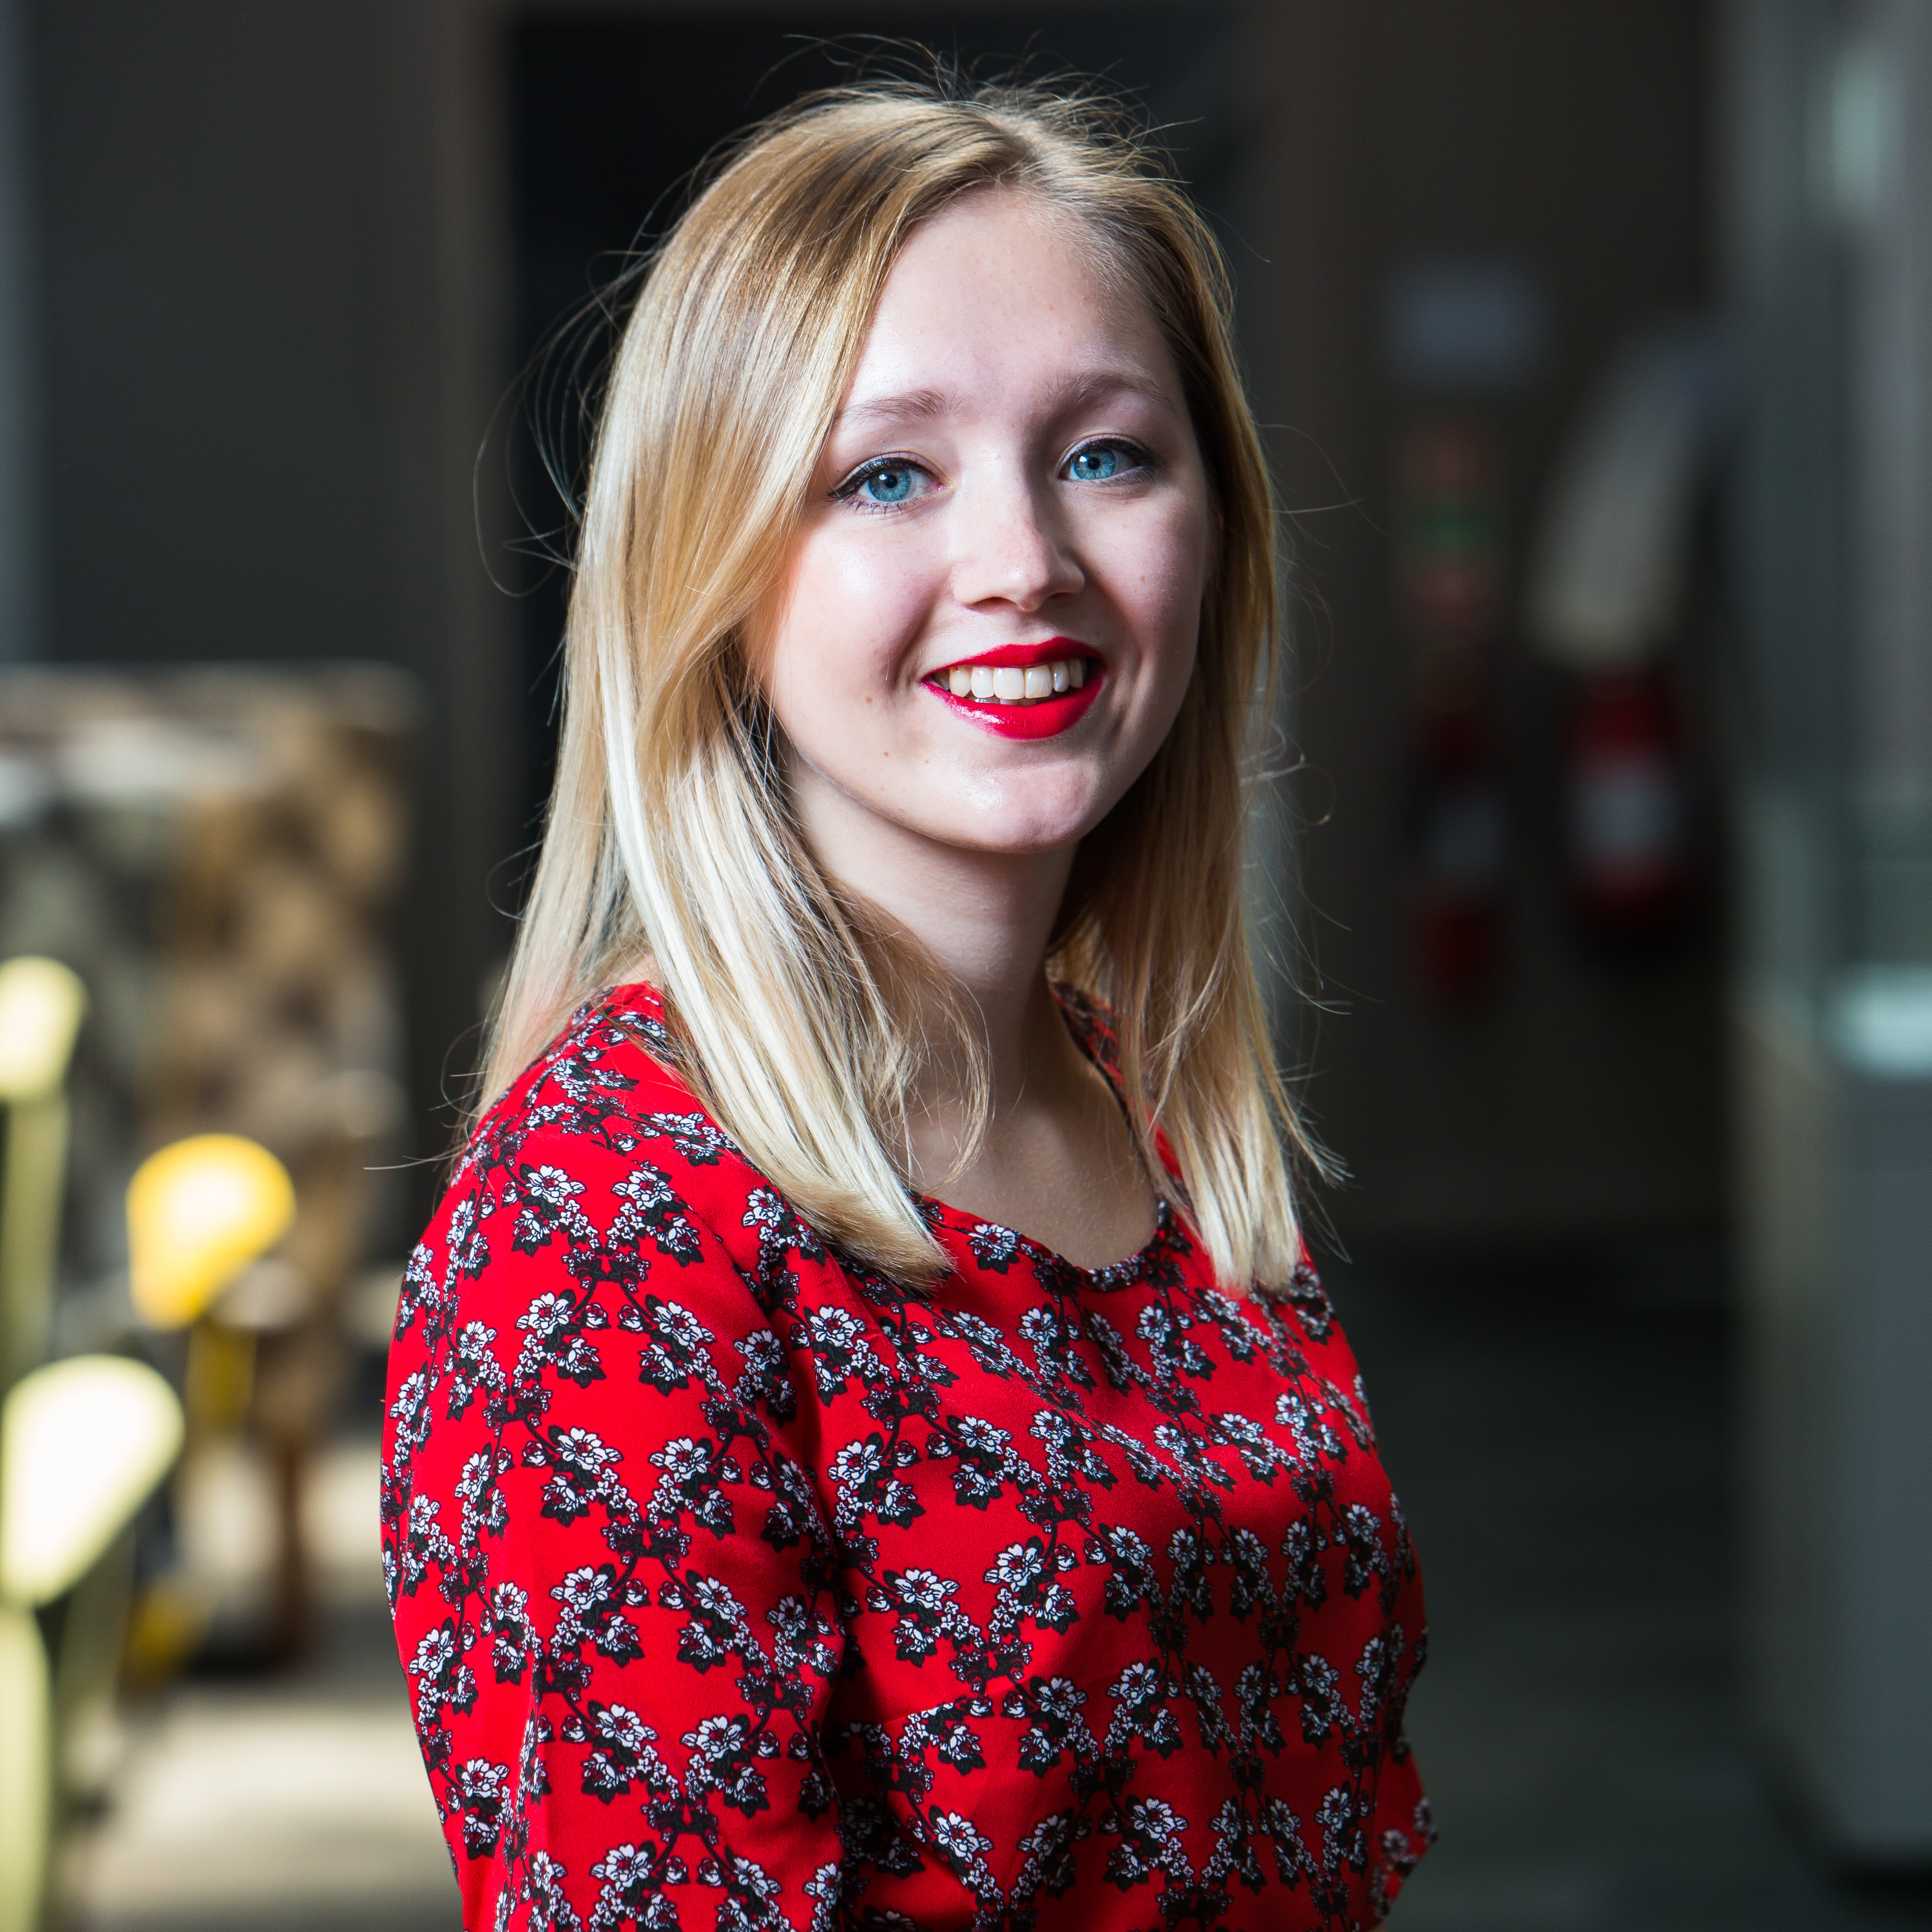
Feedback: “Should under-13s have Instagram?”
Check out what Aleksandra Trzeciak from IBM had to say about the results of this topic, or click the image for more information!
0:00-3:15
“Age restrictions around the use of social media are a complex issue. Despite Instagram's age policy, it's difficult to prevent users from [making up] their age to access the platform - pretending to be both older, but in some cases younger!”
(Full quote in Notes)
Becca Cawthorne, Senior Communications Officer at Childnet, also shared her thoughts on the topic with us:
“It was really inspiring to see how much you all put the safety of young people first, which is definitely the key thing to consider when new social media sites are thought of and proposed. When sites ask for your age, this is truly done to ensure the settings are at a level to protect you as a user, which is why it is always key to give a correct age when signing up for an account, whether that is on the possible Instagram for under-13s or any other site.”
https://safeshare.tv/x/ss60916e7b13bec
Notes:
Full Quote: “Age restrictions around the use of social media are a complex issue. Despite Instagram's age policy, it's difficult to prevent users from falsifying their age to access the platform - pretending to be both older, but in some cases younger! Therefore, it is crucial to stay vigilant and practice Internet Safety with all online activities. This includes not revealing your personal information, location details or anything else that can make you vulnerable. I always think of it as - don't do anything online that you wouldn't do in person. The attached video illustrates how some of the things we do online would seem strange if we did them in real life. One more thing to remember: everything you put online has a permanent trail. Stay safe!”
Alternative Video Link: https://www.youtube.com/watch?v=aDycZH0CA4I
Images
https://www.linkedin.com/in/aleksandratrzeciak/?originalSubdomain=uk
https://www.childnet.com/what-we-do/staff-and-trustees/staff/becca-cawthorne-1

Slide 4
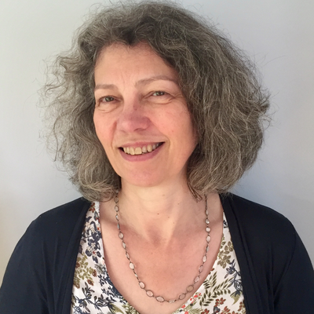
Feedback: “Should under-13s have Instagram?”
Click the image to find out what Professor Sonia Livingstone from the Department of Media & Communications at the London School of Economics (LSE) had to say about the results of this topic, or check out a snippet below!
0:00-1:02
“Having researched the risks of social media, I don’t think Instagram should provide such a service. But a more responsive and responsible company could, perhaps. After all, especially during the pandemic, children have really needed a way to be in touch, and it’s for society to provide this in a way that both children and parents can trust.”
The VoteTopic results were shared with…
Common Sense Media
UK Safer Internet Centre
Childnet International
5Rights Foundation
Digital Life Skills
https://safeshare.tv/x/KvS5d2fqmIA
Notes:
Alternative Video Link: https://youtu.be/KvS5d2fqmIA
Images
https://www.thebritishacademy.ac.uk/fellows/sonia-livingstone-FBA/
https://www.digitallifeskills.org.uk/
https://www.commonsensemedia.org/
https://seeklogo.com/vector-logo/302534/uk-safer-internet-centre
https://en.wikipedia.org/wiki/Childnet
https://twitter.com/5rightsfound

Slide 5
Starter: During lockdown…
Individual activity (2-3 mins)
First, think back to when you were in lockdown. Then, take a look at these different activities. Can you order them from the thing you did the most to the thing you did the least?
Watched TV
Went for a walk outside
Played on a device
Spent time with family
Called friends or family
Challenge:
If you were feeling sad or down, which of these things would cheer you up the most and why?
Notes:
Images
Icons8
iStock

Slide 6
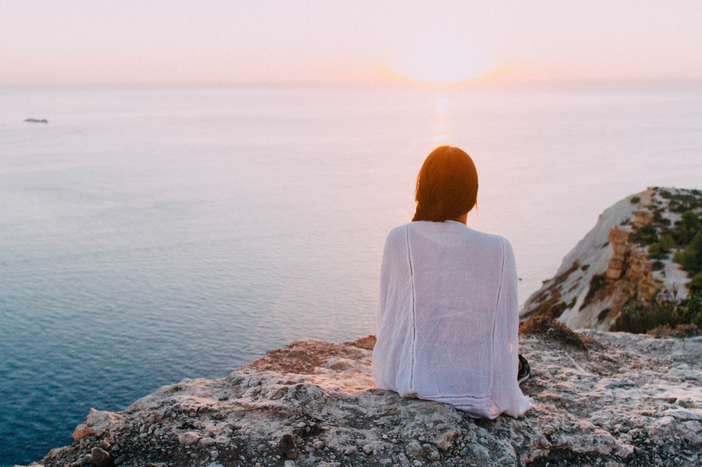
Do we take the benefits of nature for granted?
Notes:
Images
Pexels

Slide 7
Starter: During lockdown…
Why are we talking about this?
Would you rather?
The power of nature…
What’s your opinion?
Ext: Appreciation poster
Vote!
Notes:
Images
Icons8

Slide 8
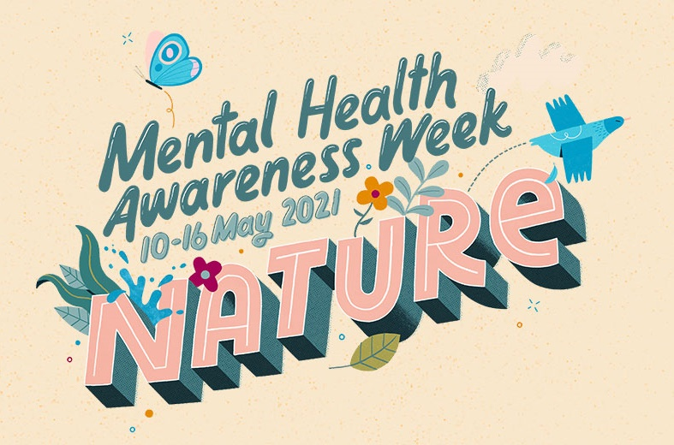
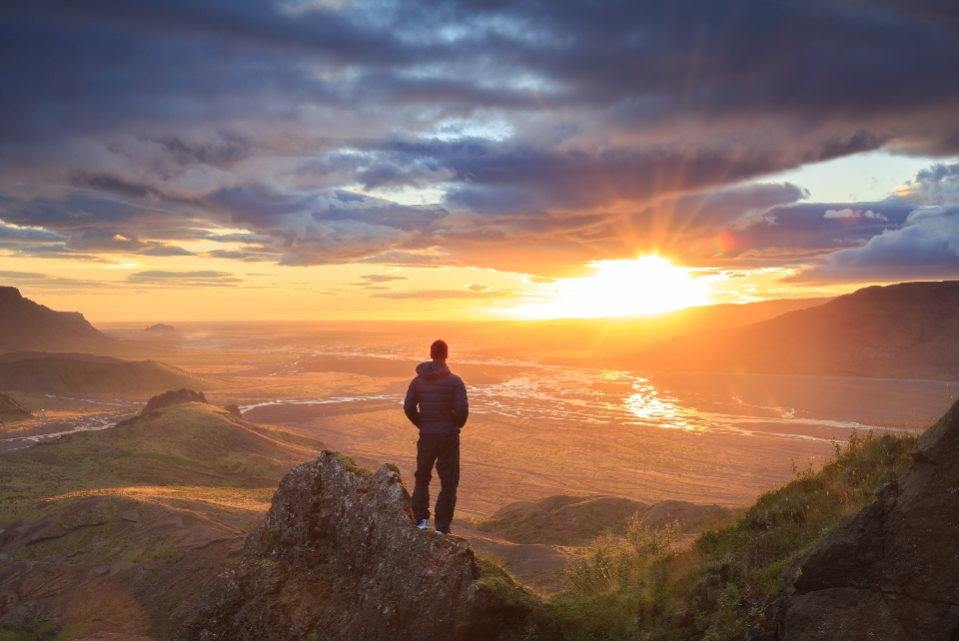
Why are we talking about this?
This week is Mental Health Awareness Week! The theme this year is nature.
One of the reasons the team behind Mental Health Awareness Week chose nature as their theme was because, during lockdown, 45% of people said that going for a walk in green spaces had helped improve their mental health.
But can nature really improve our mental health? And, if it can, do we make the most of it, or do we take it for granted? This is what you will be talking about today.
Taking something for granted means that you do not appreciate it fully.
Notes:
Images:
Icons8
iStock
https://www.mentalhealth.org.uk/campaigns/mental-health-awareness-week
References:
https://www.mentalhealth.org.uk/campaigns/mental-health-awareness-week

Slide 9
Starter: During lockdown…
Why are we talking about this?
Would you rather?
The power of nature…
What’s your opinion?
Ext: Appreciation poster
Vote!
Notes:
Images
Icons8

Slide 10
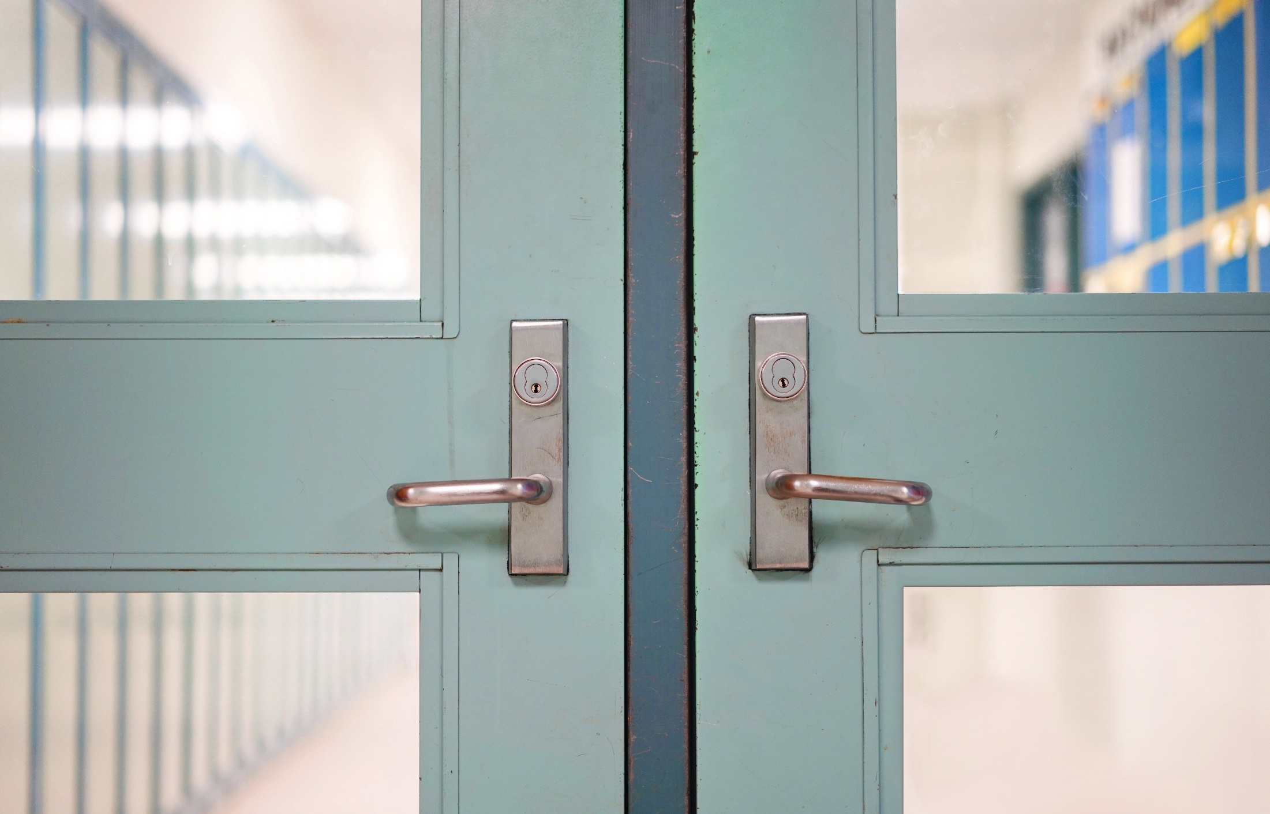
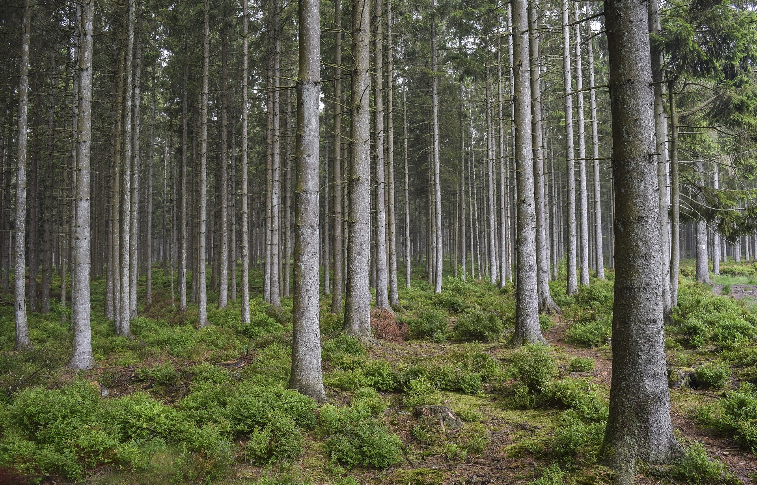
Would you rather?
Vote with your feet! (3-4 mins)
On the next few slides, you are going to see some different activities. Your task: move to the side of the room that shows the activity that you would rather do!
Outdoors!
Indoors!
Notes:
Images:
1) iStock

Slide 11
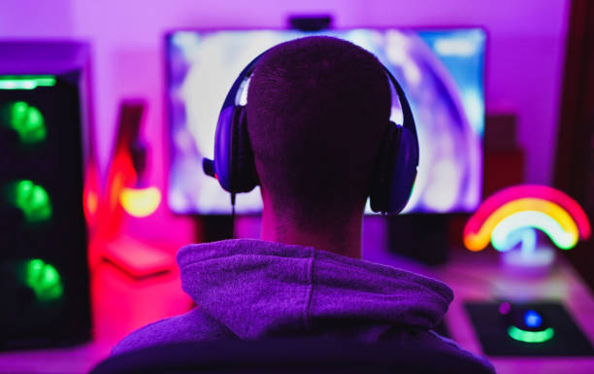
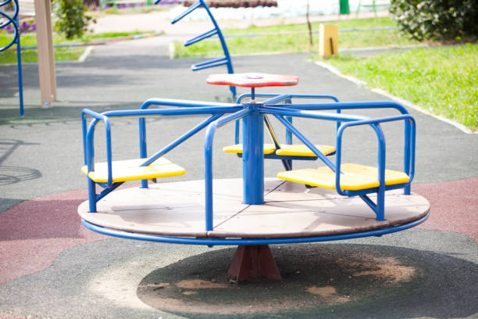
Would you rather?
Play in the park
Play on a computer game
Outdoors!
Indoors!
Notes:
Images:
1) iStock

Slide 12
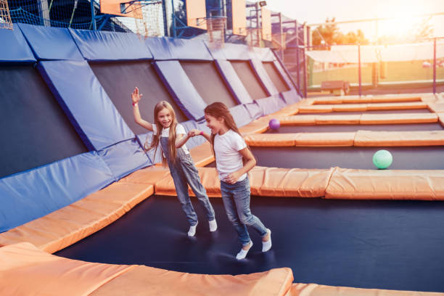
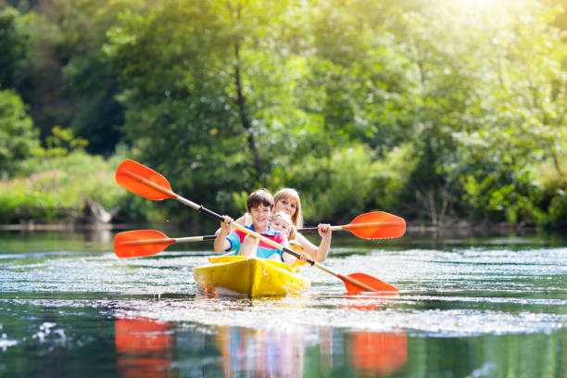
Would you rather?
Paddle in a canoe
Visit a trampoline park
Outdoors!
Indoors!
Notes:
Images:
1) iStock

Slide 13
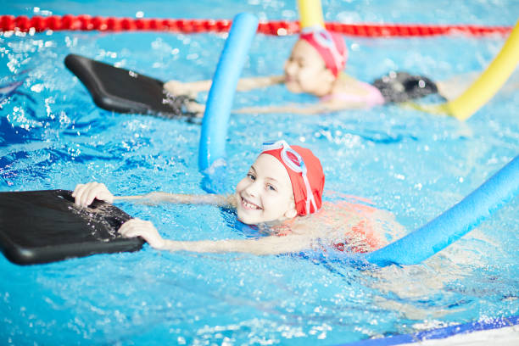
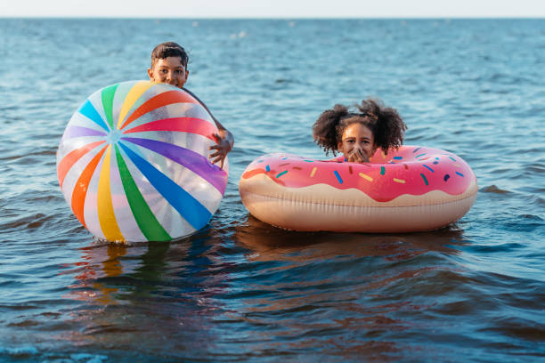
Would you rather?
Swim in the sea
Swim in an indoor pool
Outdoors!
Indoors!
Notes:
Images:
1) iStock

Slide 14
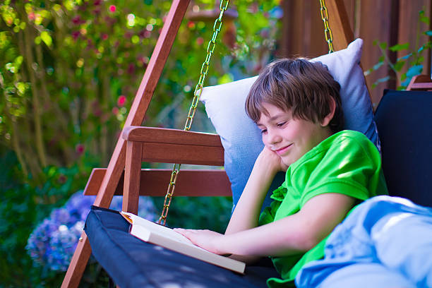
Would you rather?
Read a book in the garden
Read a book in your room
Outdoors!
Indoors!
Notes:
Images:
1) iStock

Slide 15
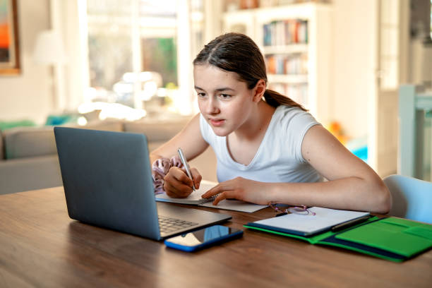
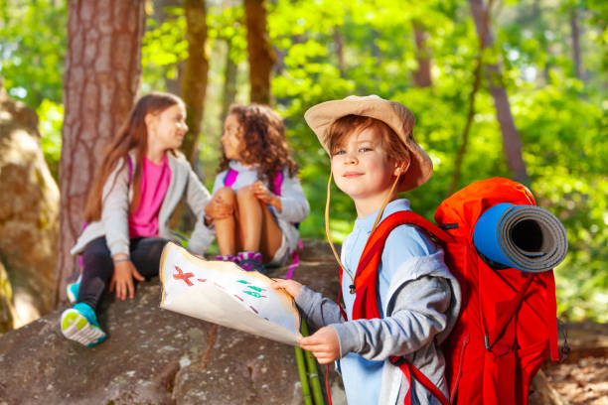
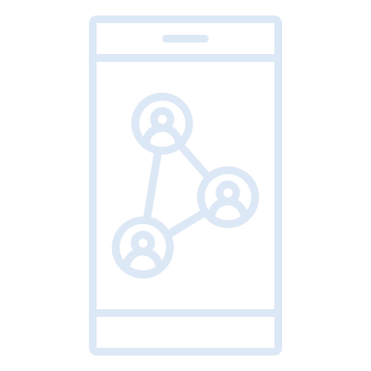
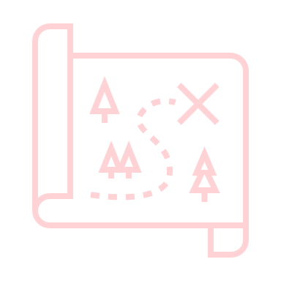
Would you rather?
Go on a treasure hunt
Take an online quiz
Outdoors!
Indoors!
Notes:
Images:
1) iStock

Slide 16
Would you rather?
Challenge:
Overall, do you think you’re more of an “indoors person” or more of an “outdoors person”? Why?
Overall, I prefer to do things outdoors!
In general, I like doing activities indoors.
Outdoors!
Indoors!
Notes:
Images:
1) iStock

Slide 17
Starter: During lockdown…
Why are we talking about this?
Would you rather?
The power of nature…
What’s your opinion?
Ext: Appreciation poster
Vote!
Notes:
Images
Icons8

Slide 18
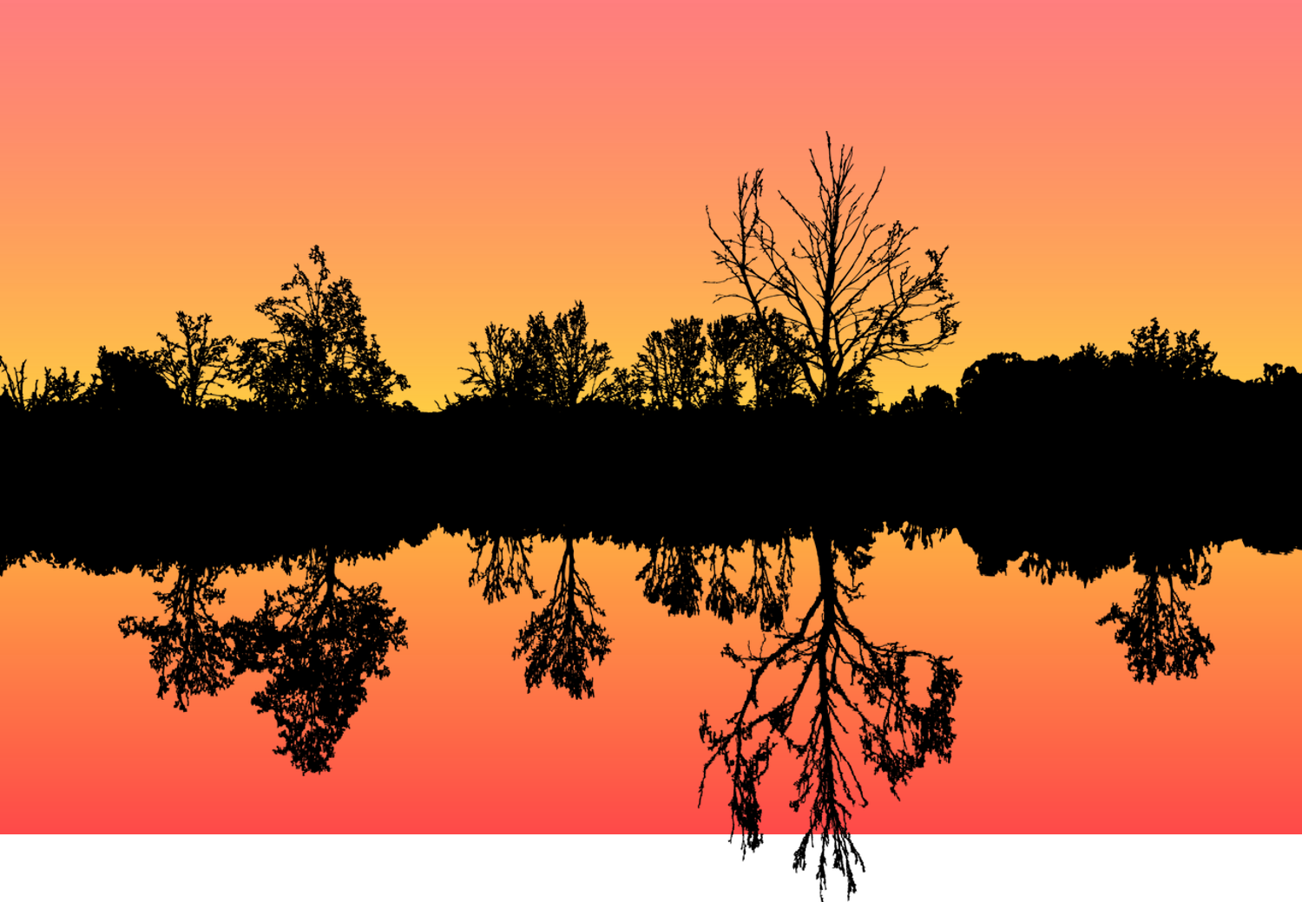
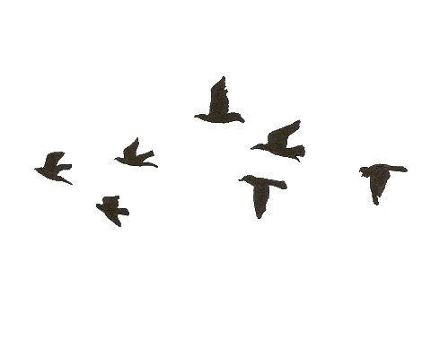
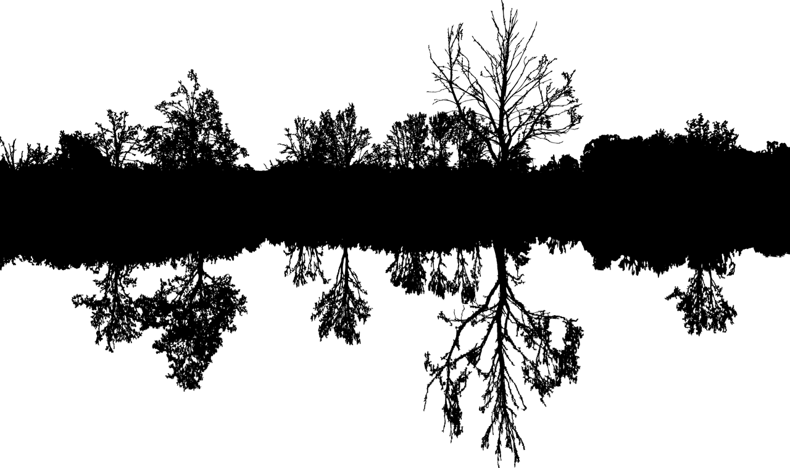
The power of nature…
Human beings have always relied on nature to survive. For example, we have grown food to eat or looked for water to drink in order to fuel our bodies!
But, over the past 20 years scientists have found that nature doesn’t just give us food and water – it’s also important for keeping us mentally well.

Slide 19
The power of nature…
As humans have evolved, we’ve constructed many more buildings and developed new technologies. This means that it can be harder to find nature than it used to be.
True or false? (5-10 mins)
On the next slide, you will see five statements about how nature can affect our mental health. For each one, decide if you think it is true or false.
Mental health:
The condition of the mind that shows whether someone is feeling happy.
Notes:
References
https://dictionary.cambridge.org/dictionary/english/mental-health

Slide 20
The power of nature…
Taking a break from a test to look out of a window or listen to the sounds of nature can help you get better marks.
or
Going outside for 30 minutes can make you feel more positive and happy.
or
You have to go outside to get the benefits - watching nature programmes or listening to nature sounds doesn’t work.
or
Everyone has a garden or a park close to them, so they can always find green spaces to help them feel better.
or
People who walked often during lockdown had better mental health than those who watched lots of TV.
or
Answers ready?
Head to the next slide to see if you were right!
Notes:
References:
https://www.apa.org/monitor/2020/04/nurtured-nature
https://www.bbc.co.uk/news/science-environment-48398033
https://metro.co.uk/2021/03/31/the-incredible-mental-health-benefits-of-walking-and-hiking-14334062/#:~:text=Over%20lockdown%20many%20of%20us,ways%20to%20fill%20the%20time.&text=Walking%20is%20an%20amazing%20tool,about%20the%20world%20around%20you.

Slide 21
The power of nature…
This is true! Studies showed that children who looked out of the window for 40 seconds scored more on their tests!
Taking a break from a test to look out of a window or listen to the sounds of nature can help you get better marks.
or
This is true! Scientists think you should spend at least 2 hours every week in green spaces to keep your mood high.
Going outside for 30 minutes can make you feel more positive and happy.
or
This is false! If you can’t get outside, listening to or watching nature programmes or sounds can make you feel better!
You have to go outside to get the benefits - watching nature programmes or listening to nature sounds doesn’t work.
or
This is false! One in eight homes do not have a garden, and 2.6 million people don’t have a park near their house.
Everyone has a garden or a park close to them, so they can always find green spaces to help them feel better.
or
This is true! Going for a walk improves your mood, gives you more energy and helps people feel more positive.
People who walked often during lockdown had better mental health than those who watched lots of TV.
or
Challenge:
Did any of these answers surprise you? Share your thoughts with the class.
Notes:
References:
https://www.apa.org/monitor/2020/04/nurtured-nature
https://www.bbc.co.uk/news/science-environment-48398033
https://metro.co.uk/2021/03/31/the-incredible-mental-health-benefits-of-walking-and-hiking-14334062/#:~:text=Over%20lockdown%20many%20of%20us,ways%20to%20fill%20the%20time.&text=Walking%20is%20an%20amazing%20tool,about%20the%20world%20around%20you.

Slide 22
Starter: During lockdown…
Why are we talking about this?
Would you rather?
The power of nature…
What’s your opinion?
Ext: Appreciation poster
Vote!
Notes:
Images
Icons8

Slide 23
What’s your opinion?
Now that you know how nature can help to improve your mental health, it’s time to think about this week’s question!
Do we take the benefits of nature for granted?
A 2-minute speech (10-20 mins)
For this activity, you will need to be in groups of 4. Your group is going to give a 2-minute speech to the class on this week’s question, explaining the benefits of nature and whether you think we take it for granted or not. Use the sentence starters on the next slide to help you plan your speech!
Top tip!
Speaking for 2 whole minutes can be quite tricky… To help you, ask your teacher to show a 2-minute timer on the board while you practise, and try to plan what each person is going to say.

Slide 24
What’s your opinion?
We believe that we do take nature for granted because…
We believe that we do not take nature for granted because…
The benefits of a garden or park are … and it is possible to…
If you do not have access to a garden or park, you can still…
If you were to go outside, you would notice …
Evidence shows that when we spend time in nature…
Notes:
Images
Icons8

Slide 25
Starter: During lockdown…
Why are we talking about this?
Would you rather?
The power of nature…
What’s your opinion?
Ext: Appreciation poster
Vote!
Notes:
Images
Icons8

Slide 26
Ext: Appreciation poster
Individual/Pair activity (5+ mins)
Now that you know how nature can help improve our mental health, why not create a poster for your school or local area, encouraging people to get outside! Use the prompts to help you, and make sure to include what you’ve learned today.
Is there a local park or area that you think people should know about?
Are there any local outdoor groups or clubs people could join?
What activities could people do outdoors to improve their mental health?
Notes:
Images
iStock
Icons8

Slide 27
Starter: During lockdown…
Why are we talking about this?
Would you rather?
The power of nature…
What’s your opinion?
Ext: Appreciation poster
Vote!
Notes:
Images
Icons8

Slide 28
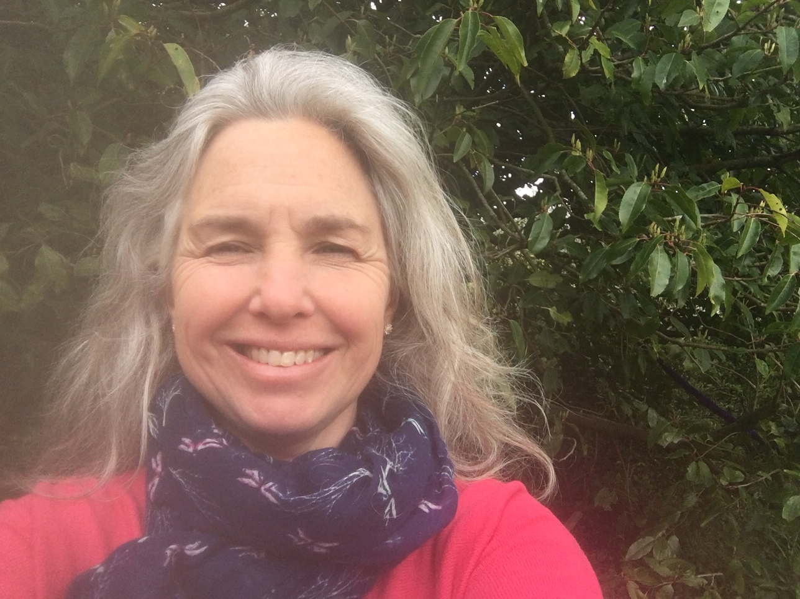
Learn more: An ode to nature!
0:00-3:35
Children’s author Sir Michael Morpurgo wrote a poem in lockdown all about nature. Click the image to hear the poem. Then, why not try writing your own? Email it to us at: primary@votesforschools.com!
Please Note:
This will take you to the BBC’s website.
0:00-5:42
Career Spotlight:
This is Jo. She has had a long and exciting career focused around the environment, and is now training to be a Forest School leader! Click the image to hear more about her love of nature, her career journey, and the advice she would give anyone wanting to work in this area in the future.
https://safeshare.tv/x/KA2ckH0Y_xU
Notes:
Alternative Video Link: https://youtu.be/KA2ckH0Y_xU
Images
Pixabay
Courtesy of Jo
References
https://www.bbc.co.uk/bitesize/articles/z7f7xyc

Slide 29
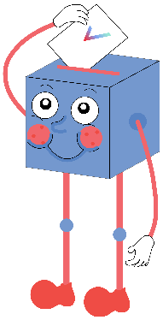
Do we take the benefits of nature for granted?
There are lots of benefits to being outside, but we spend most of the day inside…
The fact we only realised how important nature is during lockdown shows we have been taking it for granted for a long time.
I didn’t know about a lot of the benefits in this lesson, so this shows we have been overlooking nature.
…
Children definitely spend more time outdoors than adults – like at break or lunchtime! We appreciate it more.
Lockdown has highlighted how important nature is and all the benefits it can provide. We have a new appreciation for it now.
I knew about the benefits of nature before this lesson, and have been making use of them!
…
We will be sharing your thoughts on this topic with the Mental Health Foundation, YoungMinds, Rethink Mental Illness, The Outward Bound Trust and the Wildlife Trusts.

Slide 30
Visit our website to have your voices heard!
Teachers: For a refresher on how to log your votes, please click here. And for any other issues, feedback or comments, email primary@votesforschools.com.
Notes:
Alternative Video Link: https://www.youtube.com/watch?v=N0-AjP3cFjg&feature=youtu.be

