Slide 1
Dear Year 2…

Slide 2
We have really enjoyed our zoom meetings and we are so proud of all your efforts and amazing hard work. Thank you for being super stars.

Slide 3
Our messages to all our wonderful children. And for your grown ups too, we truly appreciate and thank you for your dedication in your child’s Year 2 journey.

Slide 4
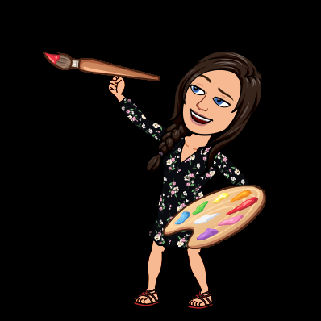
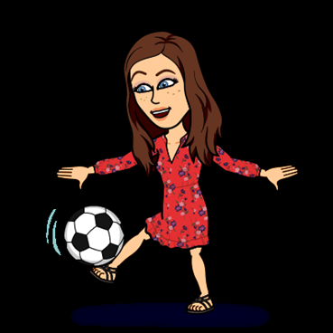
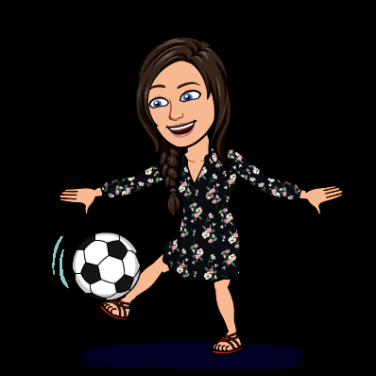
We are really looking forward to sharing more experiences, learning, working, having fun and seeing you all playing together again.

Slide 5
We are a year group who
Enjoys working together
Learning together
Cares for
One another and always
Makes sure
Everyone feel important
Being superstars at home
Amazing us with how
Clever you are and just
Keep being your excellent selves

